Slide 1
Code Generation

Slide 2
Roadmap
Last time, we learned about variable access
Local vs global variables
Static vs dynamic scopes
Today
We’ll start getting into the details of MIPS
Code generation

Slide 3
Roadmap
Scanner
Scanner
Tokens
Parser
Parser
Parse Tree
AST
Semantic Anlaysis
Annotated AST
Symbol Table
IR Codegen
Backend
Optimizer
MC Codegen

Slide 4
The Compiler Back-end
Unlike front-end, we can skip phases without sacrificing correctness
Actually have a couple of options
What phases do we do
How do we order our phases

Slide 5
Outline
Possible compiler designs
Generate IR code or MC code directly?
Generate during SDT or as another phase?
Frontend
or
IR
Codegen
MC
Codegen
Optimizer
MC
Codegen

Slide 6
How many passes do we want?
Fewer passes
Faster compiling
Less storage requirements
May increase burden on programmer
More passes
Heavyweight
Can lead to better modularity
We’ll go with this approach for our language

Slide 7
To Generate IR Code or Not?
Generate Intermediate Representation:
More amenable to optimization
More flexible output options
Can reduce the complexity of code generation
Go straight to machine code:
Much faster to generate code (skip 1 pass, at least)
Less engineering in the compiler

Slide 8
What might the IR Do?
Provide illusion of infinitely many registers
“Flatten out” expressions
Does not allow build-up of complex expressions
3AC (Three-Address Code)
Pseudocode-machine style instruction set
Every operator has at most 3 operands

Slide 9
3AC Example
tmp1 = y * z
tmp2 = x+tmp1
tmp3 = x*y
tmp4 = tmp3+z
if (tmp2 <= tmp4) goto L
a = 0
L: b = 2
if (x + y * z > x * y + z)
a = 0;
b = 2;

Slide 10
3AC Instruction Set
Assignment
x = y op z
x = op y
x = y
Jumps
if ( x op y) goto L
Indirection
x = y[z]
y[z] = x
x = &y
x = *y
*y = x
Call/Return
param x,k
retval x
call p
enter p
leave p
return
retrieve x
Type Conversion
x = AtoB y
Labeling
label L
Basic Math
times, plus, etc.

Slide 11
3AC Representation
Each instruction represented using a structure called a “quad”
Space for the operator
Space for each operand
Pointer to auxilary info
Label, succesor quad, etc.
Chain of quads sent to an architecture specific machine code generation phase

Slide 12
3AC LLVM Example
Demo

Slide 13
Direct machine code generation
Option 1
Have a chain of quad-like structures where each element is a machine-code instruction
Pass the chain to a phase that writes to file
Option 2
Write code directly to the file
Greatly aided by assembly conventions here
Assembler allows us to use function names, labels in output

Slide 14
Our language: skip the IR
Traverse AST
Add codeGen methods to the AST nodes
Directly write corresponding code into file

Slide 15
Correctness/Efficiency Tradeoffs
Two high-level goals
Generate correct code
Generate efficient code
It can be difficult to achieve both of these at the same time
Why?

Slide 16
Simplifying assumptions
Make sure we don’t have to worry about running out of registers
We’ll put all function arguments on the stack
We’ll make liberal use of the stack for computation
Only use $t1 and $t0 for computation

Slide 17
The CodeGen Pass
We’ll now go through a high-level idea of how the topmost nodes in the program are generated

Slide 18
The Effect of Different Nodes
Many nodes simply structure their results
ProgramNode.codeGen
call codeGen on the child
List node types (e.g., StmtList)
call codeGen on each element in turn
DeclNode
StructDeclNode – no code to generate!
FnDeclNode – generate function body
VarDeclNode – varies on context! Globals v locals

Slide 19
Global Variable Declarations
Source code:
int name;
struct MyStruct instance;
In varDeclNode
Generate:
.data
.align 4 #Align on word boundaries
_name: .space N #(N is the size of variable)

Slide 20
Generating Global Variable Declaration
.data
.align 4 #Align on word boundaries
_name: .space N #(N is the size of variable)
How do we know the size?
For scalars, well defined: int, bool (4 bytes)
structs, 4 * size of the struct
We can calculate this during name analysis

Slide 21
Generating Function Definitions
Need to generate
Preamble
Sort of like the function signature
Prologue
Set up the function
Body
Perform the computation
Epilogue
Tear down the function

Slide 22
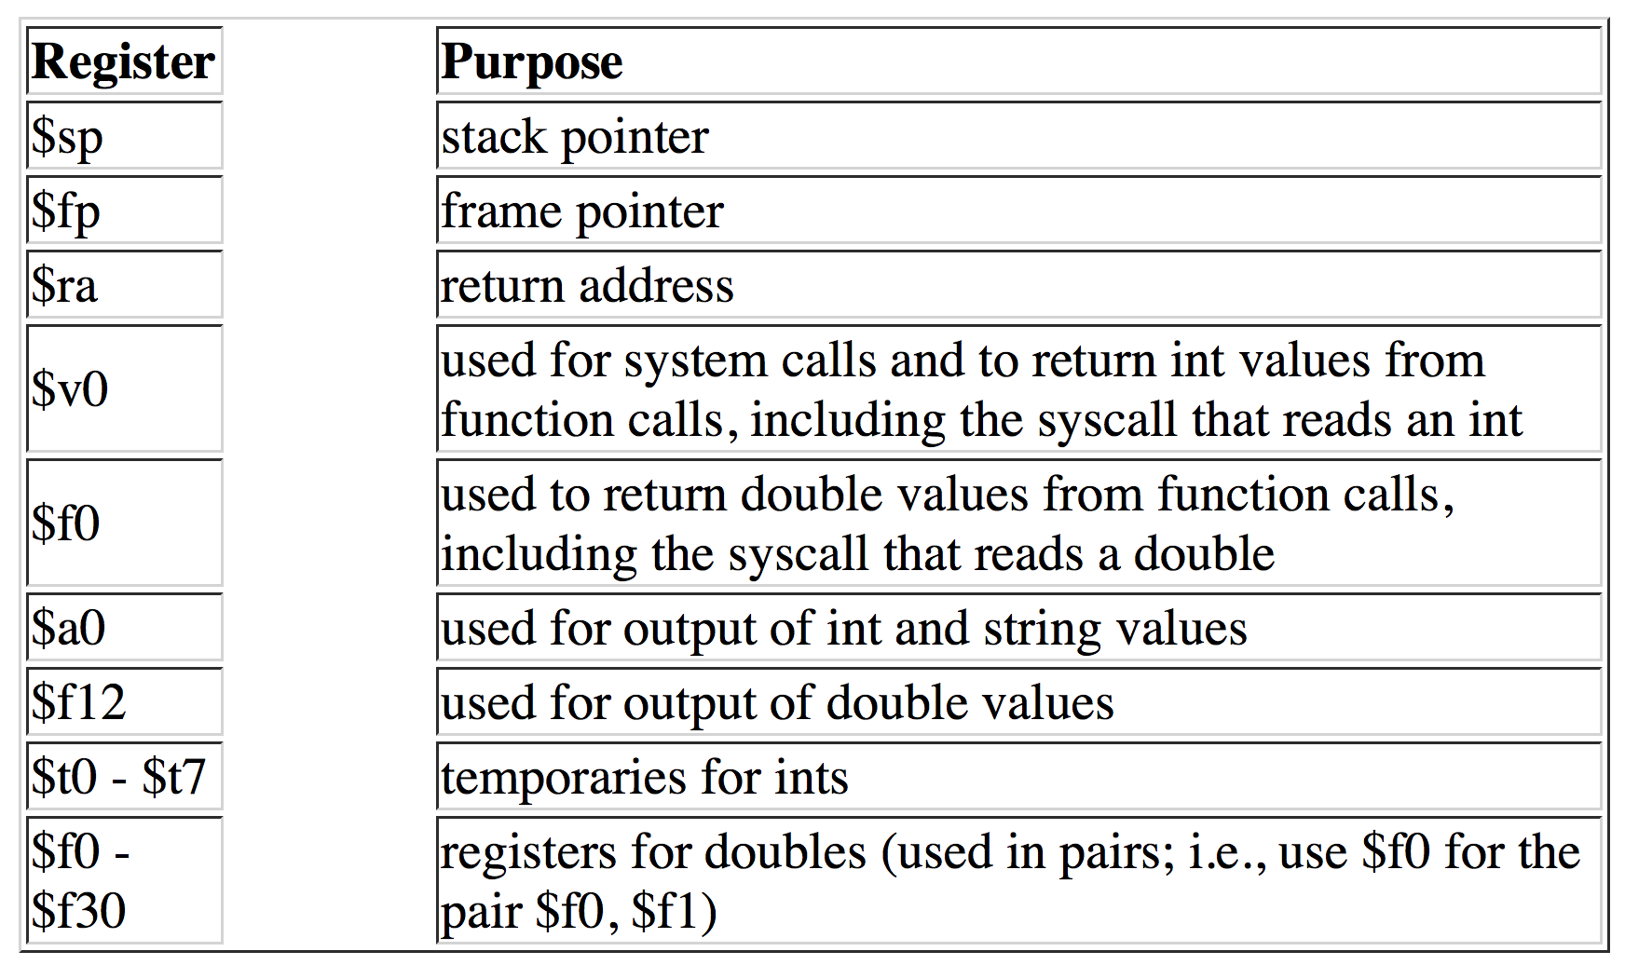
MIPS crash course
Registers

Slide 23
Program structure
Data
Label: .data
Variable names & size; heap storage
Code
Label: .text
Program instructions
Starting location: main
Ending location

Slide 24
Data
name: type value(s)
E.g.
v1: .word 10
a1: .byte ‘a’ , ’b’
a2: .space 40
40 here is allocated space – no value is initialized

Slide 25
Mem Instructions
lw register_destination, RAM_source
copy word (4 bytes) at source RAM location to destination register.
lb register_destination, RAM_source
copy byte at source RAM location to low-order byte of destination register
li register_destination, value
load immediate value into destination register

Slide 26
Mem instructions
sw register_source, RAM_dest
store word in source register into RAM destination
sb register_source, RAM_dest
store byte in source register into RAM destination

Slide 27
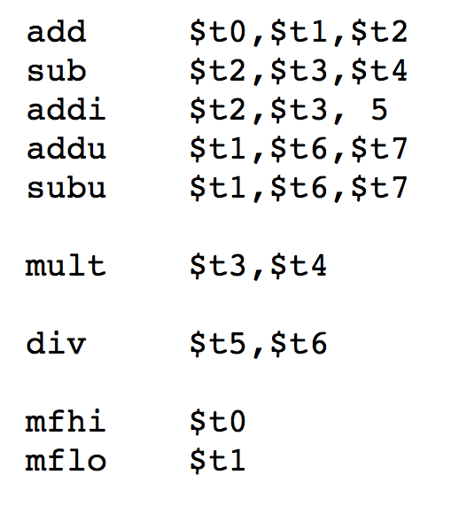
Arithmetic instructions
Stores result in $lo
Stores result in $lo and
Remainder in $hi

Slide 28
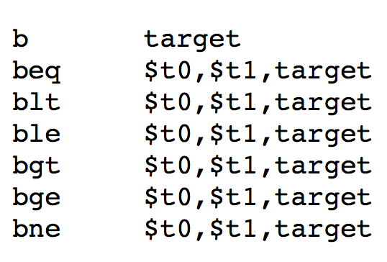

Control instructions
Jump and store return address in $31

Slide 29
TODO
Watch ALL MIPS and SPIM tutorials online
pages.cs.wisc.edu/~loris/cs536s18/resources.html
MIPS tutorial
https://minnie.tuhs.org/CompArch/Resources/mips_quick_tutorial.html

Slide 30
Roadmap
Today
Talked about compiler backend design points
Decided to go with direct to machine code design for our language
Next time:
Run through what actual codegen pass will look like

