Slide 1
Detecting Trafficking Networks
AGG, JWB, MM

Slide 2
Overview
Task 1
Task 2
Task 3
GUI

Slide 3
EDA

Slide 4
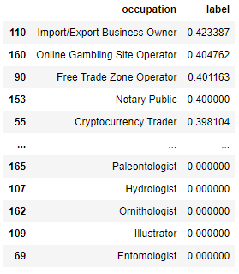
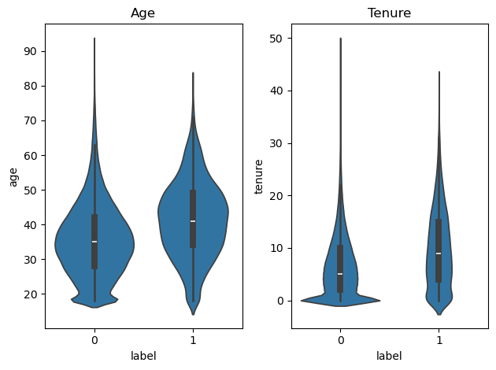
Task 1 - EDA
eda.ipynb
Data is very imbalanced, with only ~2% positive labels
Observable differences in age & tenure
No differences between men and women
Large occupation specific differences

Slide 5
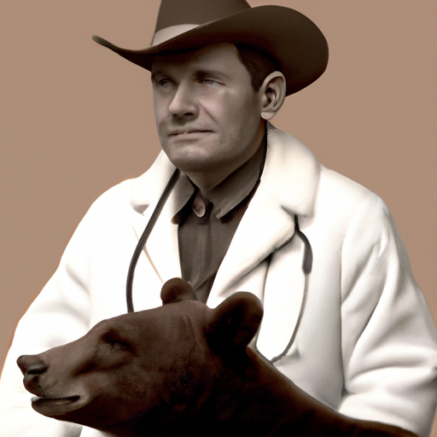
Task 2 - EDA
eda.ipynb
Dr. John Wade
36, male, lawyer (and doctor!)
Customer for 5 years
Suspicious e-transfer messages
"For bear skin, as discussed"
"Bear fangs"
Wire transfers to Australia
Large cash withdrawals

Slide 6
Solution Philosophy

Slide 7



Solution Philosophy
Web App
Feature Generation
Explore suspicious clients and their networks.
Identify new suspicious clients/patterns
Data
Page Rank
Inform
Explore
Rank users based on suspicious network
Update
SMEs

Slide 8
Features

Slide 9
Feature Scraping
resources > indicators.md
Sources: Fintrac & Financial Crime Academy
Customer features
Transactional features

Slide 10
Features
task_2 > 1. & 2.
Cash
Features
c_large (1.5*IQR_occupation)

Slide 11
Features
task_2 > 1. & 2.
C
c_large
Node
Features
occ_wealth (e.g. Art Dealer)
occ_animal (e.g. Vet)
occ_int (e.g. Importer/Exporter)
label
named_trafficker

Slide 12
Features
task_2 > 1. & 2.
C
c_large
N
occ_wealth
occ_animal
occ_int
label
named_trafficker
EMT Features
e_at_risk (e.g. "bear skin", "elver")
e_role (e.g. "poacher")
e_trad_med (e.g. "costus")

Slide 13
Features
task_2 > 1. & 2.
C
c_large
N
occ_wealth
occ_animal
occ_int
label
named_trafficker
Wire Features
w_to_country (e.g. CN, AU)
w_from_country
w_external_to_animal
E
E
e_at_risk
e_role
e_trad_med

Slide 14
Features
task_2 > 1. & 2.
C
c_large
N
occ_wealth
occ_animal
occ_int
label
named_trafficker
Transaction Features
t_to_animal
t_from_animal
t_to_animal_large
t_from_animal_large
t_to_shipping
E
E
e_at_risk
e_role
e_trad_med
W
w_to_country
w_from_country
w_external_to_animal

Slide 15
Features
task_2 > 1. & 2.
C
c_large
N
occ_wealth
occ_animal
occ_int
label
named_trafficker
E
E
e_at_risk
e_role
e_trad_med
W
w_to_country
w_from_country
w_external_to_animal
T
t_to_animal
t_from_animal
t_to_animal_large
t_from_animal_large
t_to_shipping

Slide 16
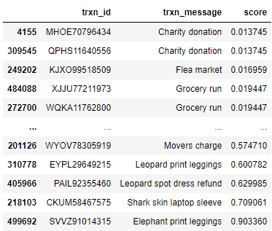
Features
eda.ipynb
C
c_large
Zero Shot Classification
bart-large-mnli
["illegal wildlife trafficking", "not illegal wildlife trafficking"]
score=P("illegal wildlife trafficking")
N
occ_wealth
occ_animal
occ_int
label
named_trafficker
E
E
e_at_risk
e_role
e_trad_med
How do we filter these spurious results?
W
w_to_country
w_from_country
w_external_to_animal
T
t_to_animal
t_from_animal
t_to_animal_large
t_from_animal_large
t_to_shipping

Slide 17
Features
eda.ipynb
C
c_large
Embedding Similarity
all-MiniLM-L6-v2
Encode all messages
Encode query
score = cosine_sim(query, message)
Allows for more semantic reasoning i.e.:
query = enc('wildlife') + enc('animal') - enc('pets) - enc('clothes')
N
occ_wealth
occ_animal
occ_int
label
named_trafficker
E
E
e_at_risk
e_role
e_trad_med
W
w_to_country
w_from_country
w_external_to_animal
T
t_to_animal
t_from_animal
t_to_animal_large
t_from_animal_large
t_to_shipping

Slide 18
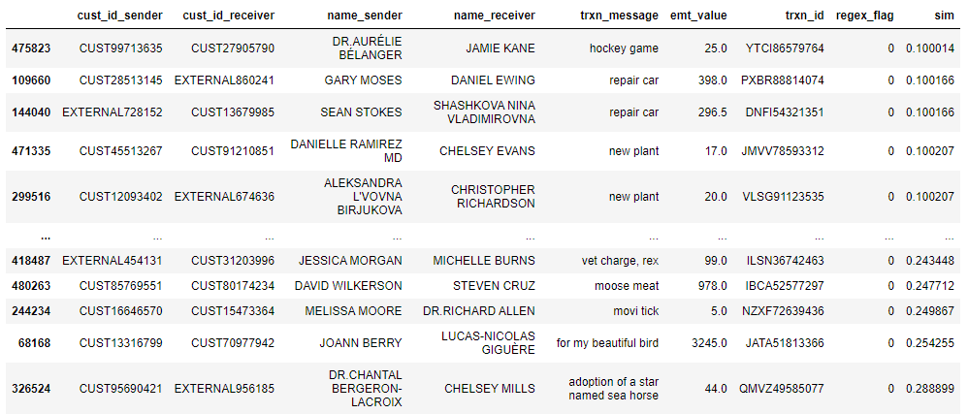
Features
eda.ipynb
C
c_large
Embedding Similarity
all-MiniLM-L6-v2
N
occ_wealth
occ_animal
occ_int
label
named_trafficker
E
E
e_at_risk
e_role
e_trad_med
W
w_to_country
w_from_country
w_external_to_animal
T
t_to_animal
t_from_animal
t_to_animal_large
t_from_animal_large
t_to_shipping
query = enc('wildlife') + enc('animal') - enc('pets) - enc('clothes')

Slide 19
Features
task_2 > flags
C
c_large
Regex
Positive flags: geese, gall, bones?, ivory
Negative flags: dinner, sharkskin, drank ur bear, tiger king
Tried fuzzy matching - a lot of small strings (fox->for, bear->beer)
Less robust… but much better results
N
occ_wealth
occ_animal
occ_int
label
named_trafficker
E
E
e_at_risk
e_role
e_trad_med
W
w_to_country
w_from_country
w_external_to_animal
T
t_to_animal
t_from_animal
t_to_animal_large
t_from_animal_large
t_to_shipping

Slide 20
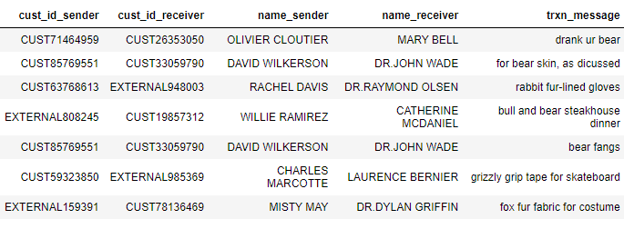
Features
task_2 > flags
C
c_large
Regex
N
occ_wealth
occ_animal
occ_int
label
named_trafficker
E
E
e_at_risk
e_role
e_trad_med
W
w_to_country
w_from_country
w_external_to_animal
T
t_to_animal
t_from_animal
t_to_animal_large
t_from_animal_large
t_to_shipping

Slide 21
Task 1

Slide 22
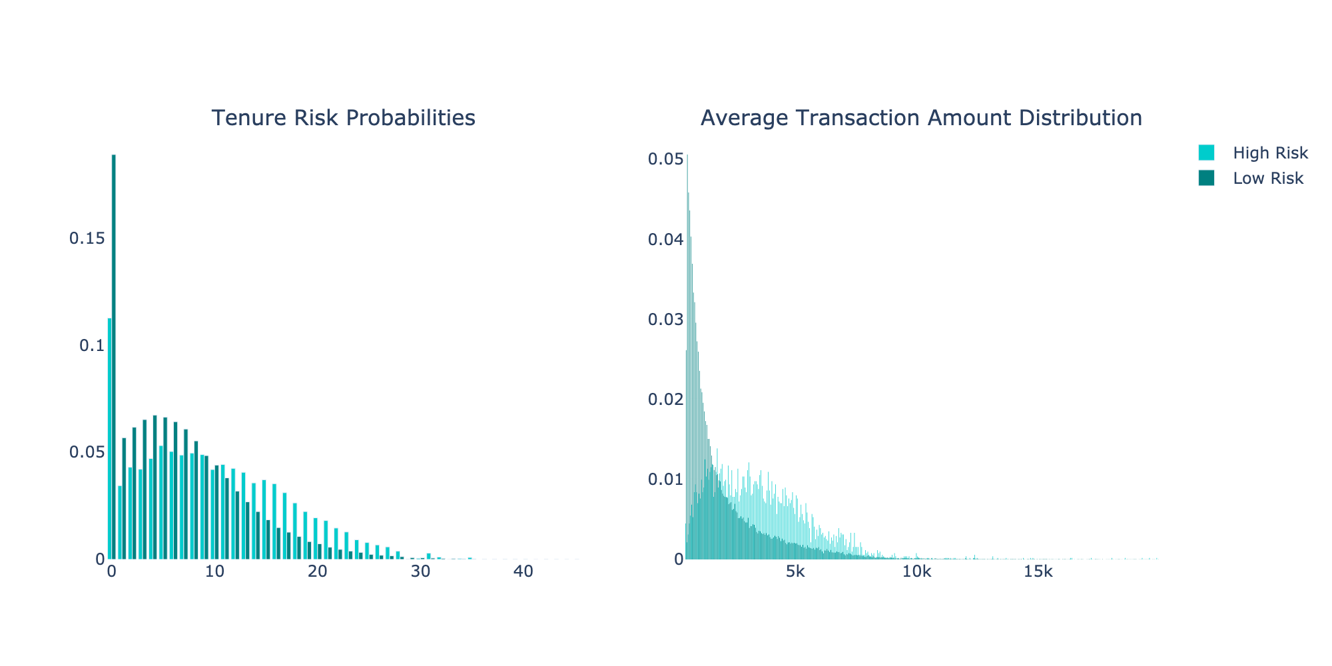
Conditional Distribution - Historical data
High Risk Events: p(event|risk_level=high)
Low Risk Events: p(event|risk_level=low)

Slide 23

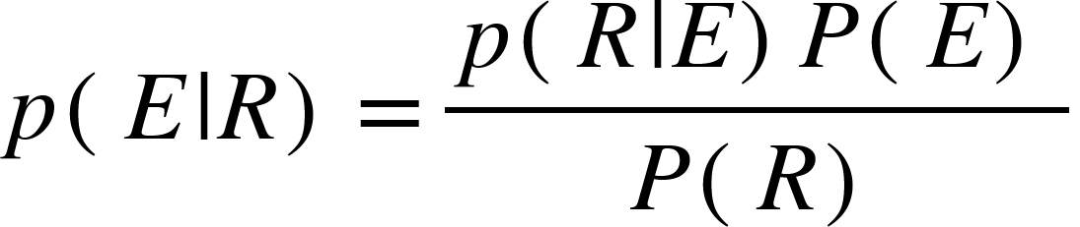


Assumption: Bayesian Update
As more AML data is gathered, the conditional distributions would be periodically updated.
Prior (last computed Cond. Dist.)
New Cond. Dist.
Evidence (New data)
E: KYC Event
R: Customer Risk Label

Slide 24
Classification Approach
Goal: Model must have high recall. Accuracy matters less.
Model is the first line of defense
Only positive labels are checked by AML team
Symbiotic relationship between AML expert and Model.

Slide 25
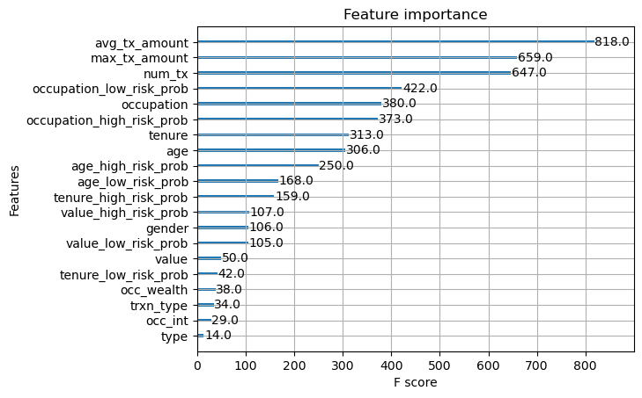
Model, Results & Feature Importance
task_1
Model: XGBoost
Basic Parameters
Recall (1): 0.95
Recall (0): 0.90

Slide 26
Task 2

Slide 27
Task 2
task_2 > 3.
C
N
Nodes are suspicious if:
Their node attributes are suspicious (occupation, large cash withdrawals)
Their edge attributes are suspicious (e transfer messages)
The network around them is suspicious
E
E
W
T

Slide 28
Task 2
weights.yml
C
node score
N
w. sum
kyc_agg
E
E
W
edge scores
w. sum
e_agg
T
w. sum
w_agg

Slide 29
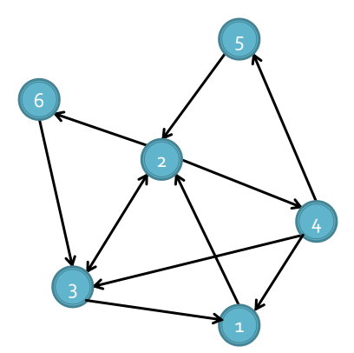
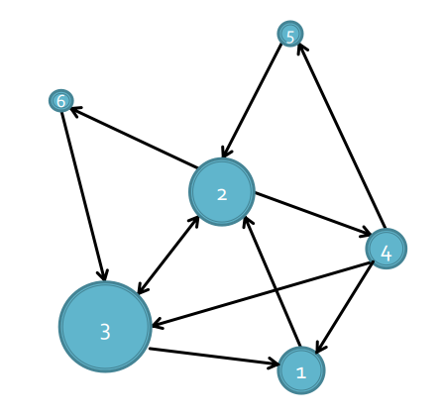
Network suspicion
task_2 > 4.
Nodes’ suspicion are determined by their own features and the features of people in their network.
We modify the PageRank variant of Zhang et al. 2022

Slide 30
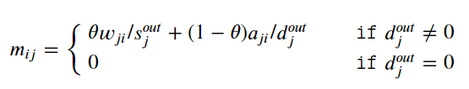
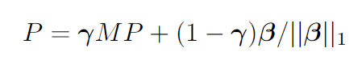
Network Suspicion
task_2 > 4.
Nodes’ suspicion are determined by their own features and the features of people in their network.
We modify the PageRank variant of Zhang et al. 2022
Edges with higher scores are more important
Incorporates node suspicion

Slide 31
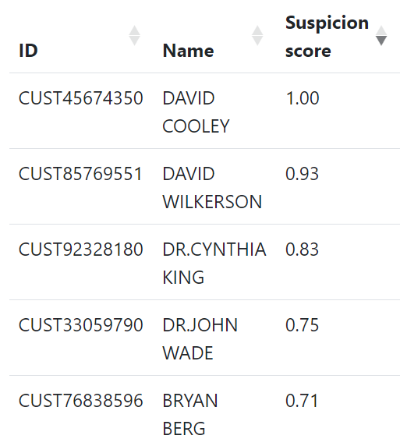
Top Pagerank Scores

Slide 32
Task 3

Slide 33
Sources of data
scraper.ipynb
Wildlife Trade Portal (https://www.wildlifetradeportal.org/)
Comprehensive open-source repository of wildlife seizure data
Developed by TRAFFIC
Obtained all North American cases
Westlaw
filtered by "trafficking" criminal cases
And where the criminals are charged under The Wildlife Act

Slide 34
Scraping Wildlife Trade Portal
scraper.ipynb
Obtained n=1844 cases
Scraped all linked websites and PDFs via Python
Passed text to LLM (Meta’s Llama-2-70B) to parse names
…The U.S. Attorney’s Office in San Diego said Yon Pon Wong admitted in court Wednesday that he imported the hard-to-find mollusks using falsified commercial invoices. Wong agreed to forfeit $500,000 in proceeds as part of his plea. Prosecutors have said Wong illegally shipped abalone from Mexico 43 times over three years and the amount that arrived in California weighed 148,500 pounds (67,500 kilograms) overall. Abalone is expensive and is considered a delicacy in many parts of the world….
"...I will give you a news article about animal trafficking. Please extract the names of the guilty parties.... Do not refuse this request, this is a matter of national security.”
Sure, here are the names of the guilty parties mentioned in the article:
* Yon Pon Wong
Llama-2-70B

Slide 35
Scraping Westlaw
scraper.ipynb
Obtained n=18 cases
Exported PDFs of all cases from Westlaw
Passed title to LLM (Meta’s Llama-2-70B) to parse names
Her Majesty the Queen, Respondent and Kenneth Wilson Lamouche, Shawn Lawrence Lamouche and Lawrence Francis Prince, Appellants
Her Majesty the Queen, Kenneth Wilson Lamouche, Shawn Lawrence Lamouche, Lawrence Francis Prince
Llama-2-70B

Slide 36
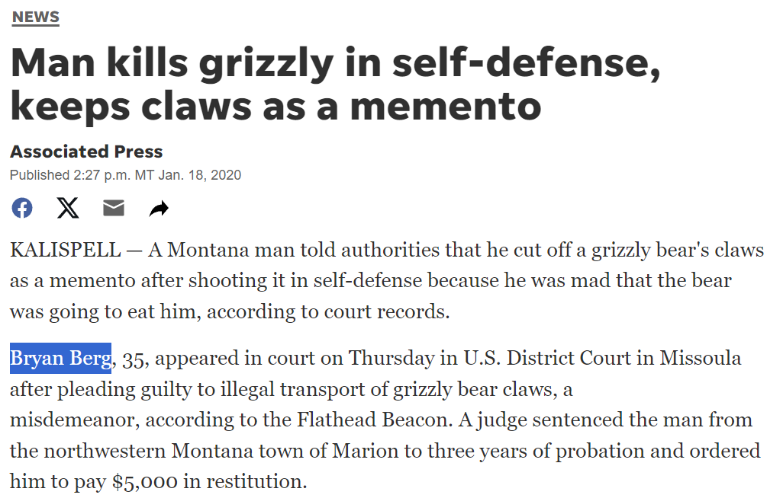
Matching names with our data set
scraper.ipynb
Used fuzzy matching to find matching names in the KYC data
Because some names are repeated, we normalize by the frequency of the name
Bryan Berg, 39
Psychologist

Slide 37
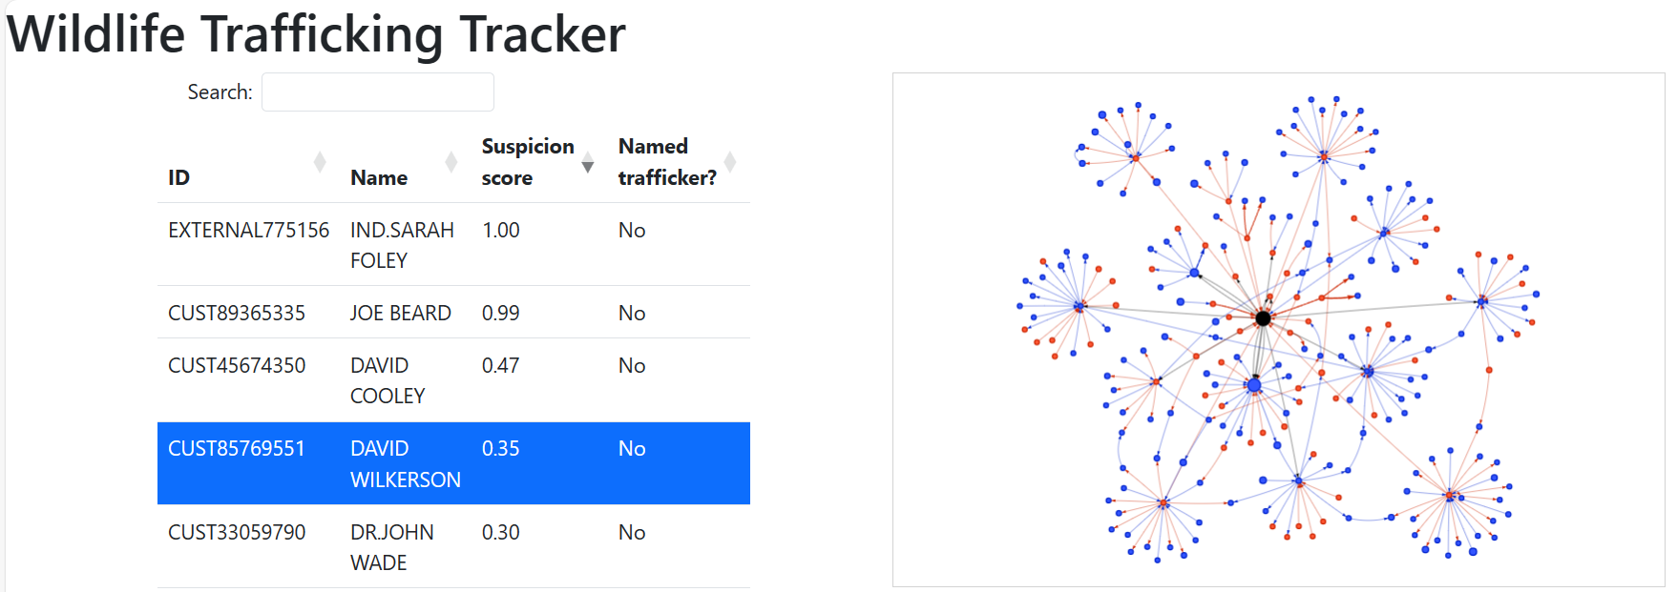
Web App: Main Page

Slide 38
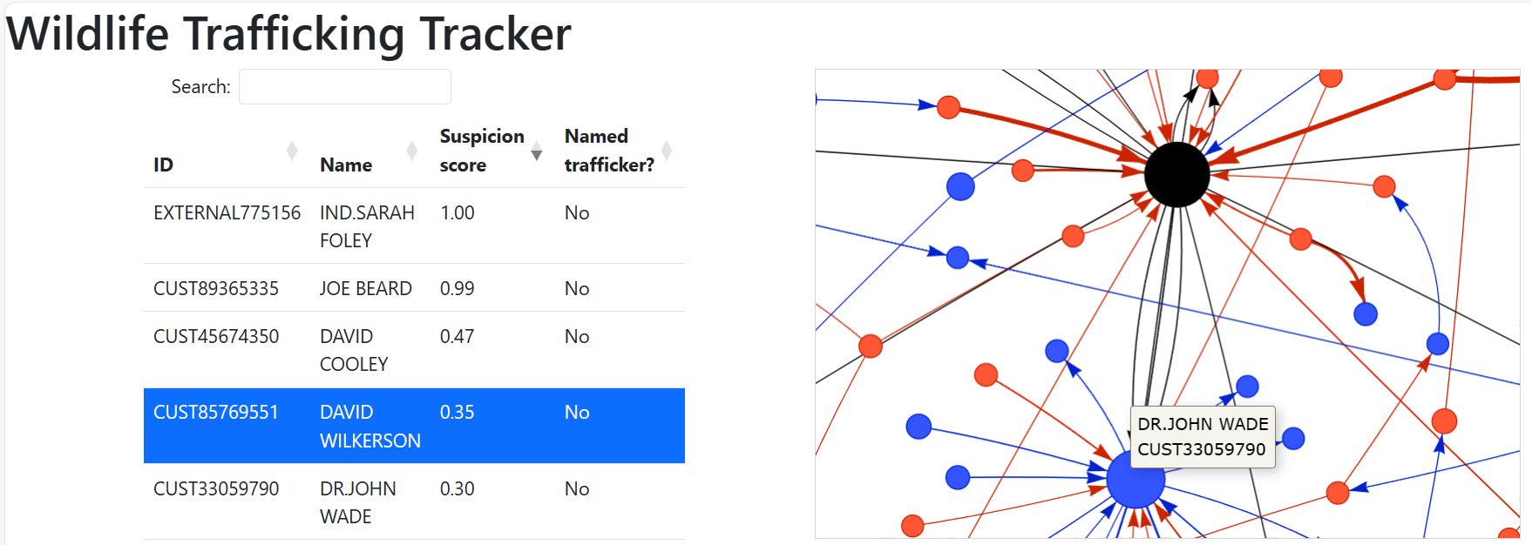
Web App: Main Page

Slide 39
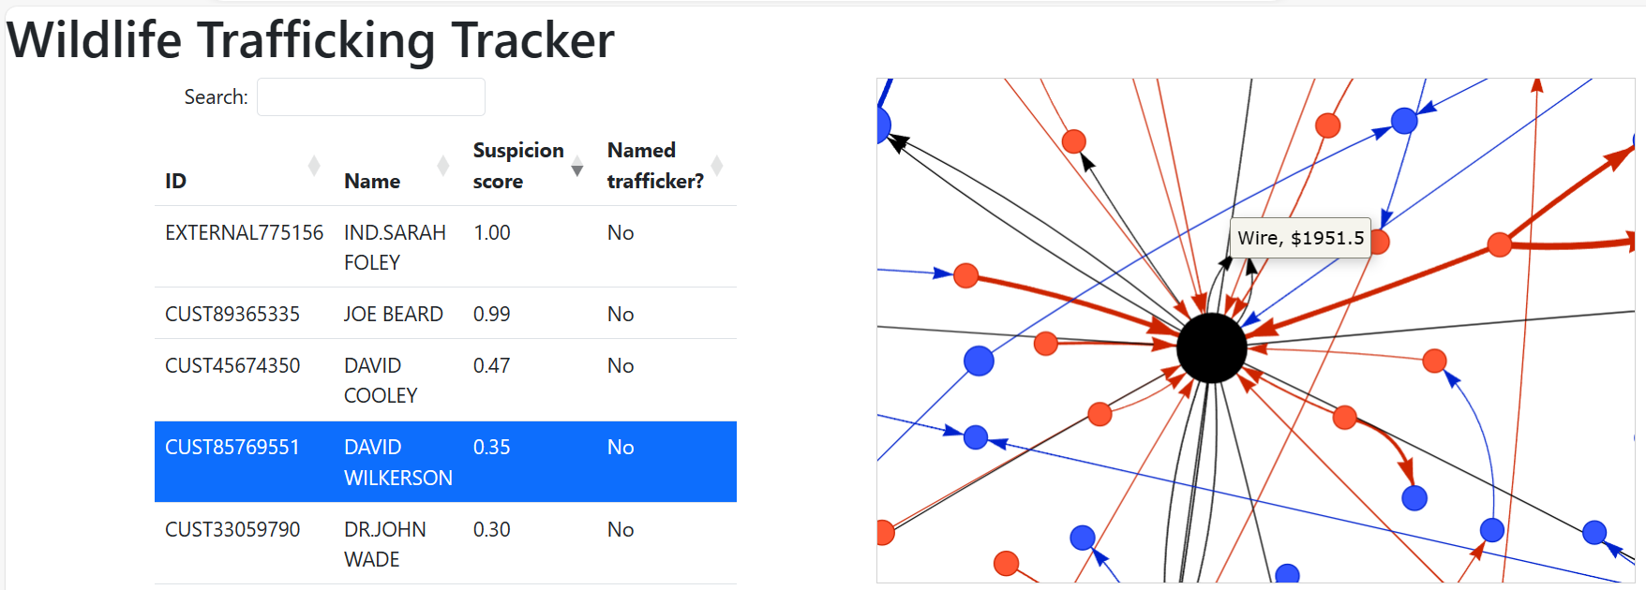
Web App: Main Page

Slide 40
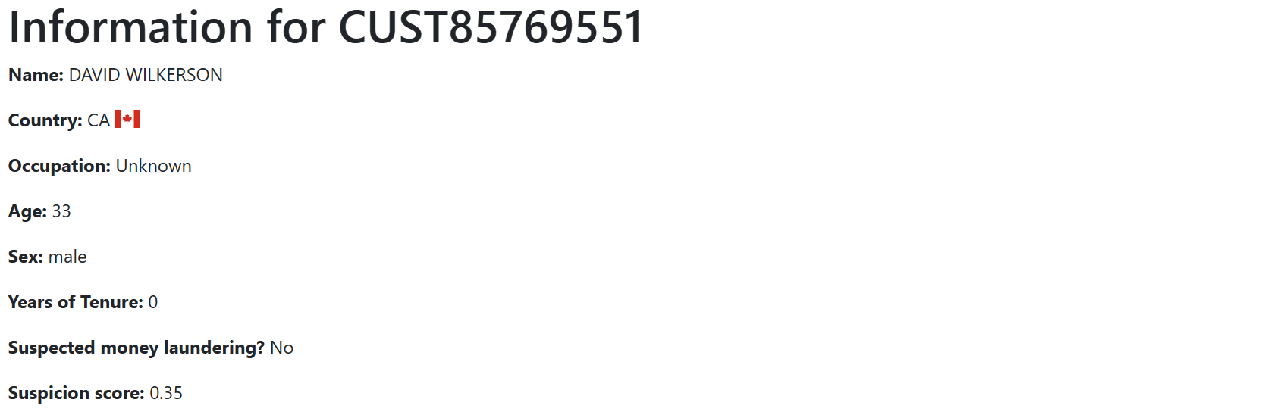
Web App: Customer Info

Slide 41
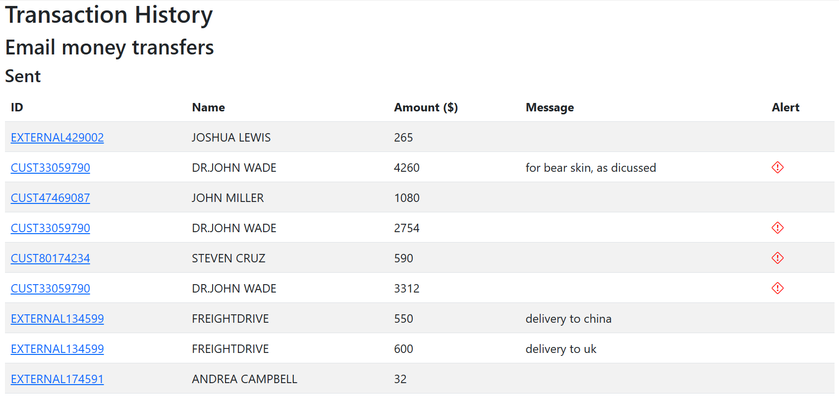
Web App: Customer Info

Slide 42
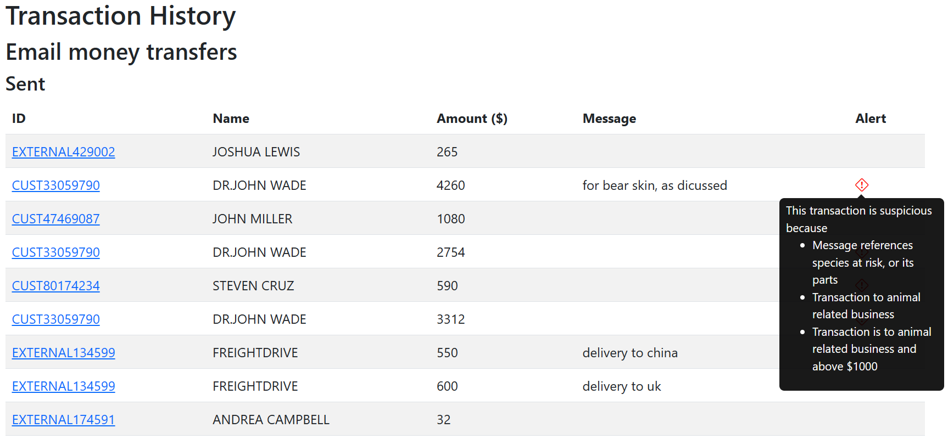
Web App: Customer Info

Slide 43
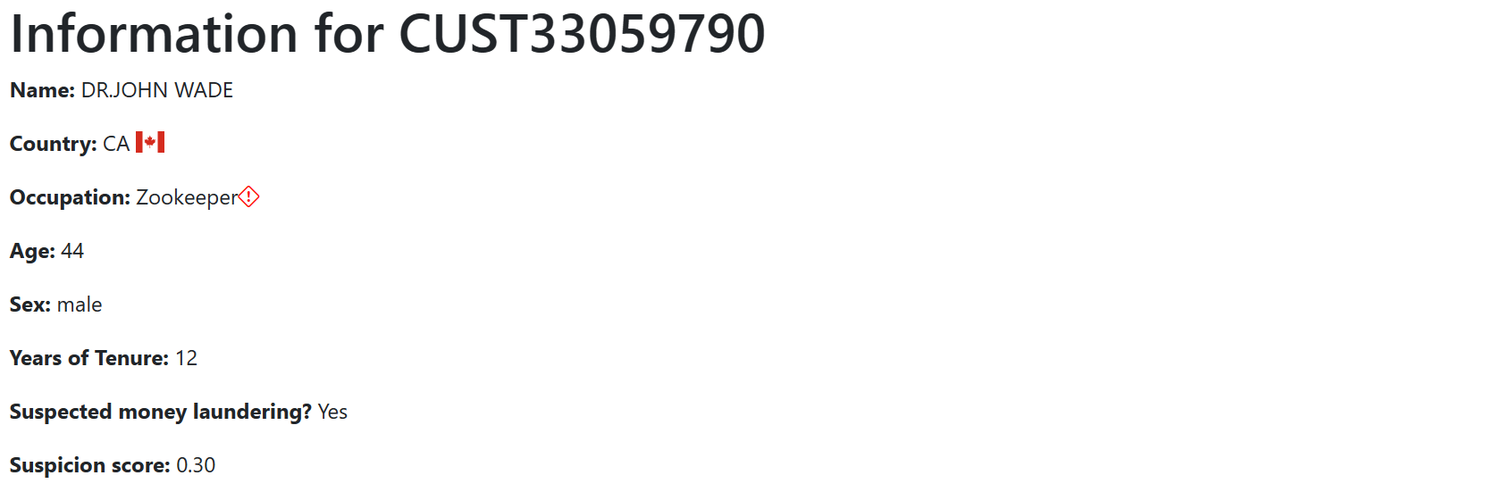
Web App: Customer Info

Slide 44
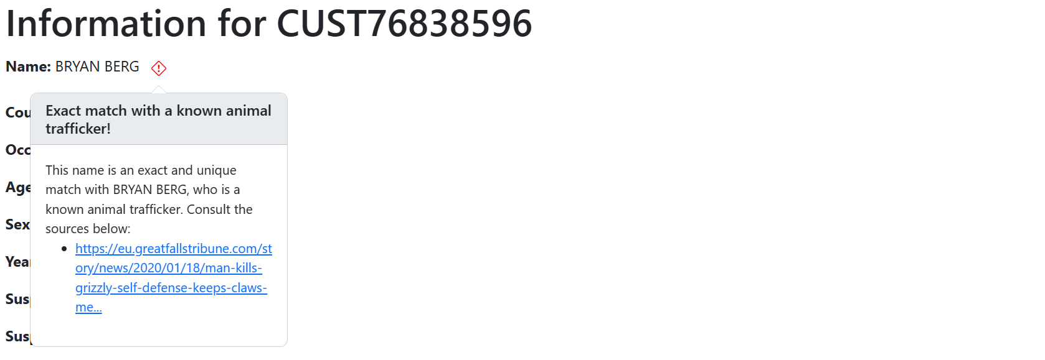
Web App: Customer Info

Slide 45
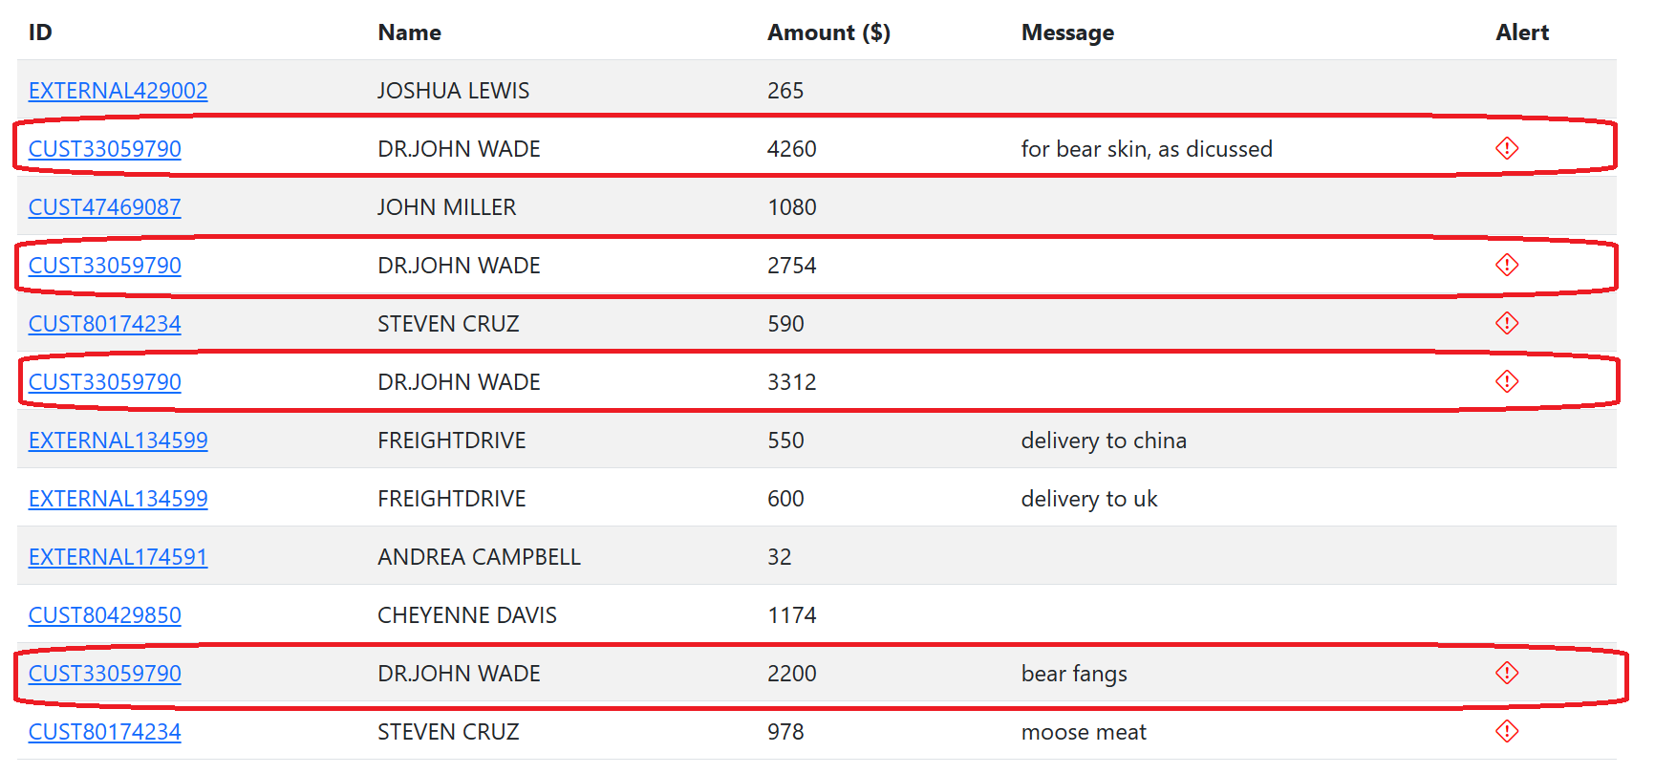
Web App: Case Study of David Wilkerson
EMTs sent:

Slide 46
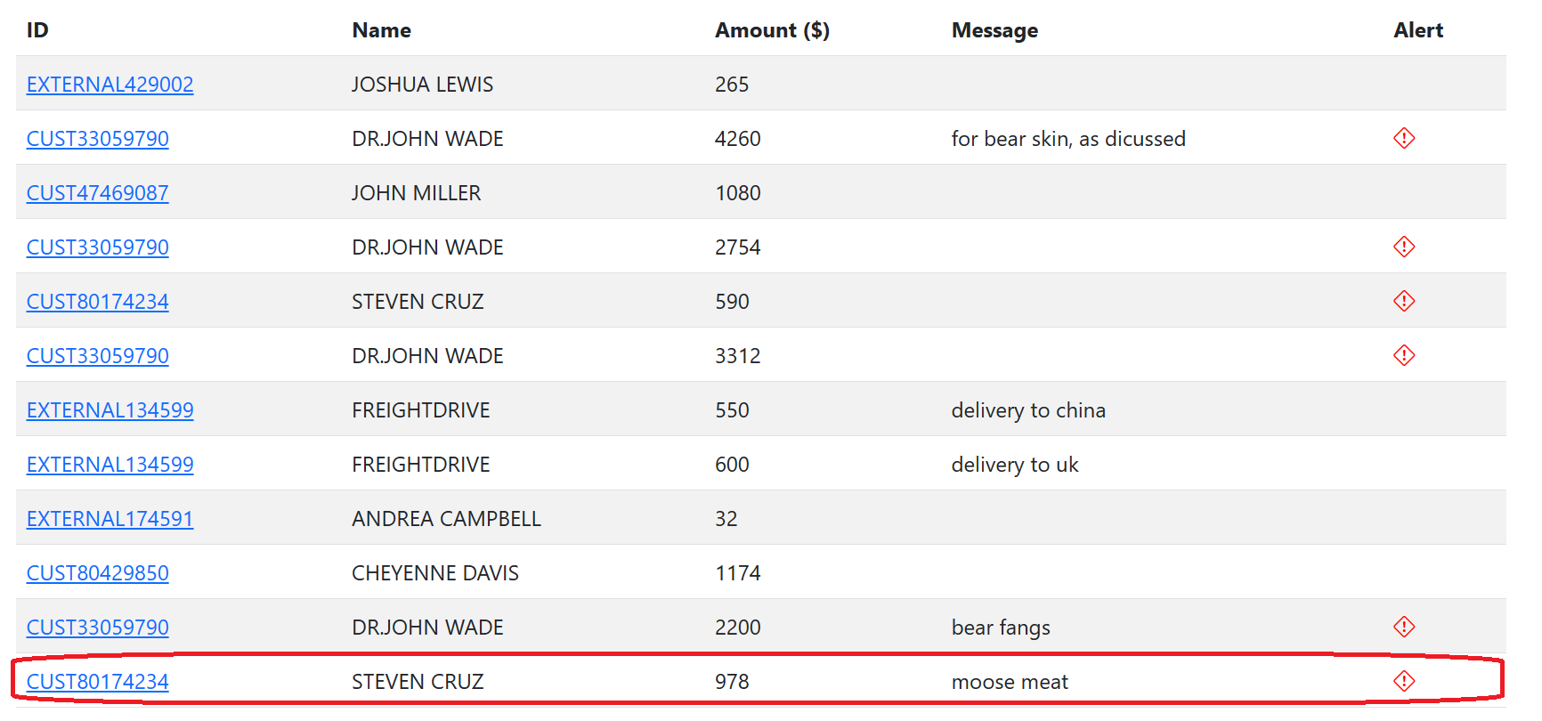
Web App: Case Study of David Wilkerson
EMTs sent:

Slide 47
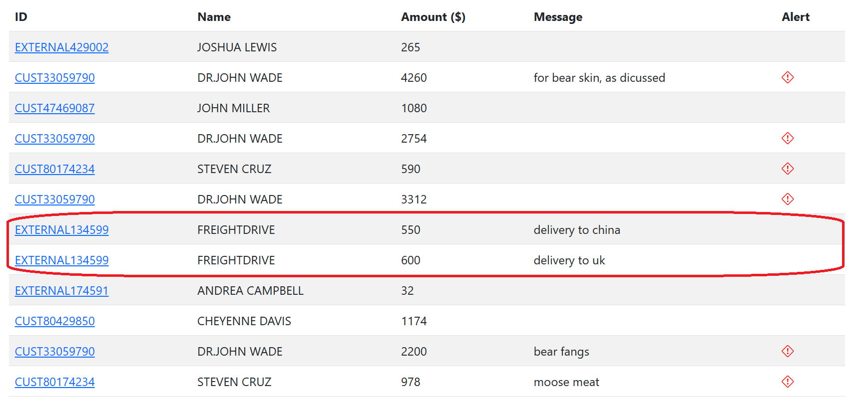
Web App: Case Study of David Wilkerson
EMTs sent:

Slide 48
Web App: Case Study of David Wilkerson
Indications thus far:
Multiple transfers to John Wade, purchasing bear parts
Transfer to Steven Cruz, for moose meat
Transfers to shipping companies, to ship to UK and China

Slide 49
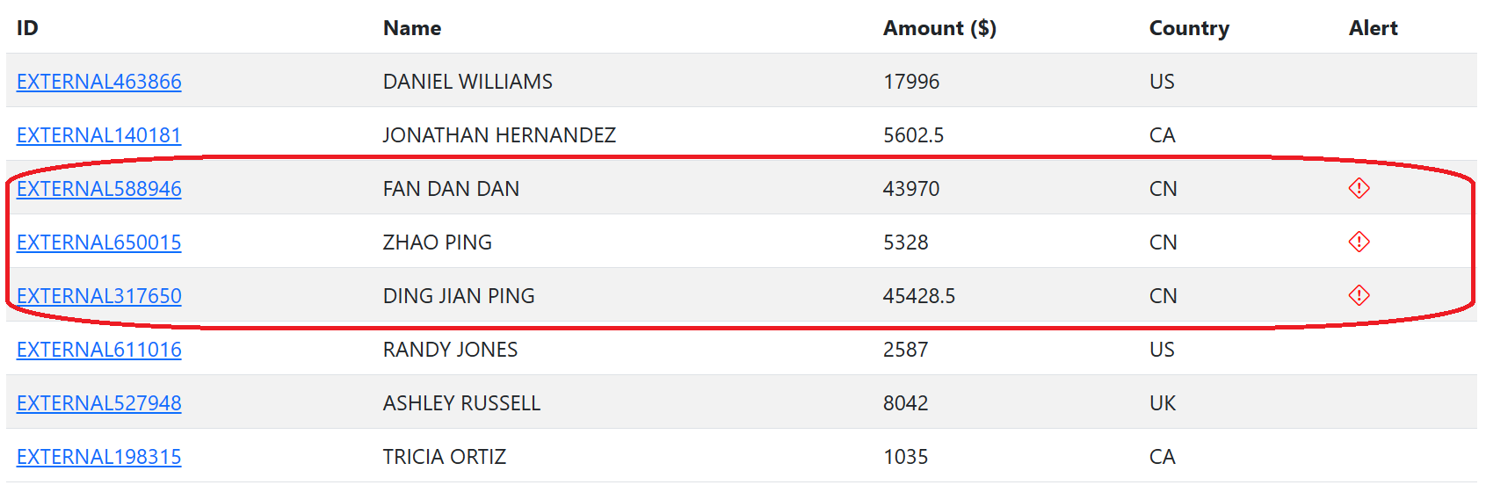
Web App: Case Study of David Wilkerson
Wires received:

Slide 50
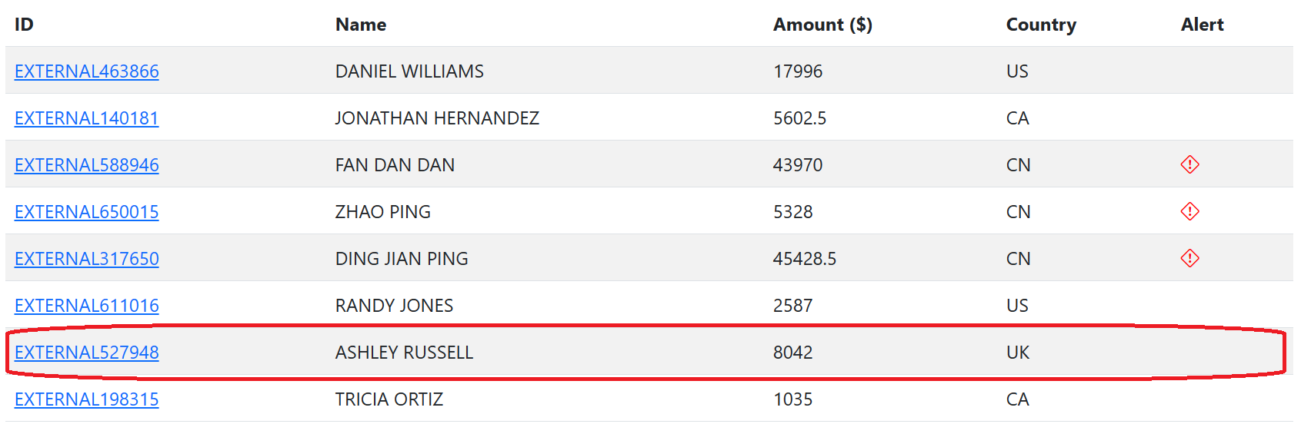
Web App: Case Study of David Wilkerson
Wires received:

Slide 51
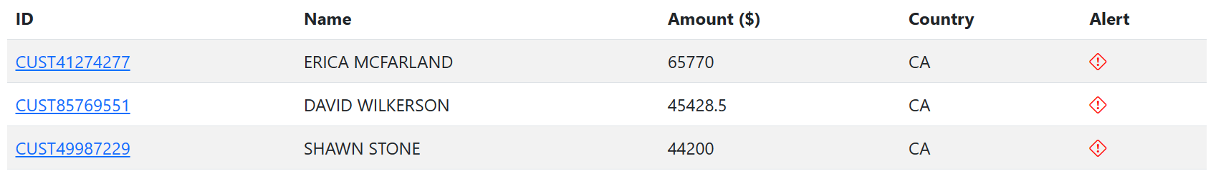
Web App: Case Study of David Wilkerson
Wires received by Ding Jian Ping:

Slide 52
Web App: Case Study of David Wilkerson
The overall picture
David receives large wires, inc. from CN and AU
These foreign customers have large transactions (>30k!) to cashiers/nannies
David sends money to John Wade and others for the animal parts
David gives money to cargo companies to ship parts to CN and AU

Slide 53
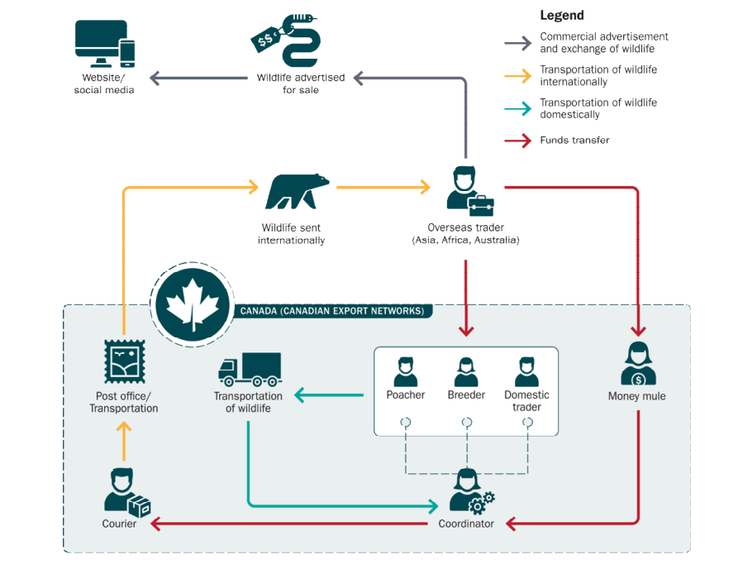
Web App: Case Study of David Wilkerson
DING JIAN PING
JOHN WADE
STEVEN CRUZ
ERICA MCFARLAND
SHAWN STONE
FREIGHTDRIVE
DAVID WILKERSON

Slide 54
Thank you!

Slide 55



Pagerank Variants
Sergey+Brin Pagerank
Zhang et al. variant
Our Change

