Slide 1
Code for Good – Chicago 2017
Team 15
Pitch In Solution
A four year digital map of a student’s accomplishment
Presented by
Anya Chopra, Emil Sorensen, Kevin Guo

Slide 2
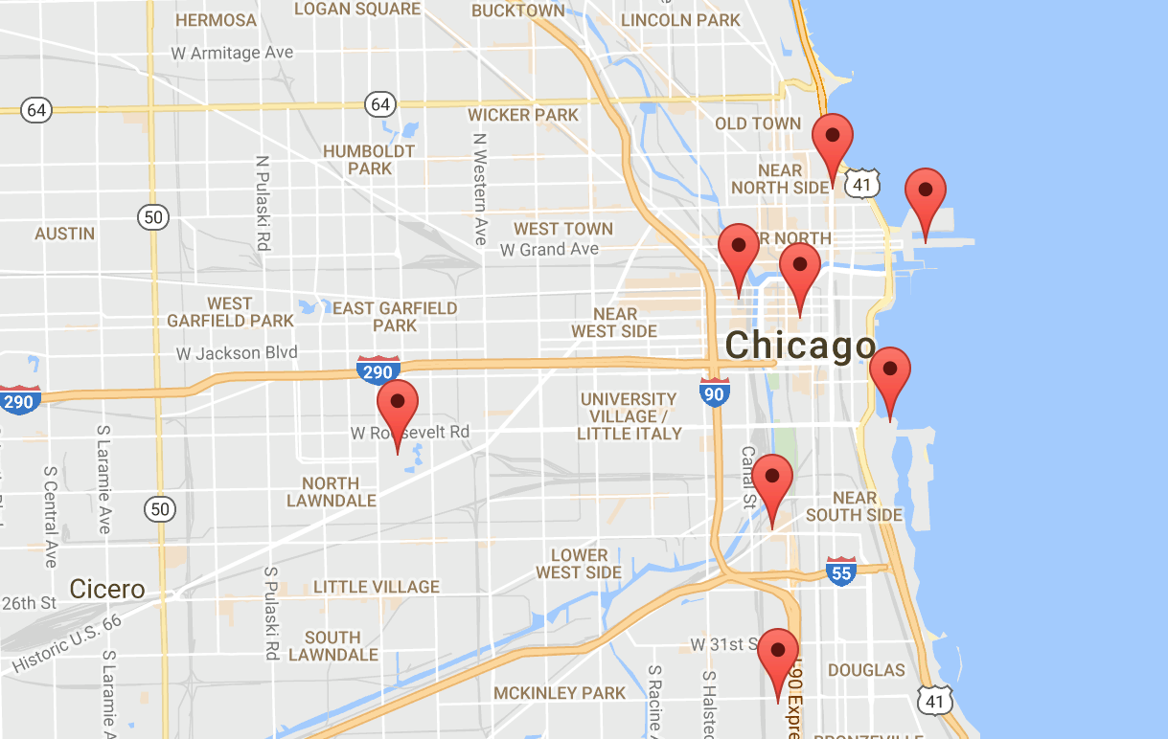


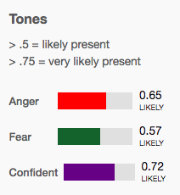



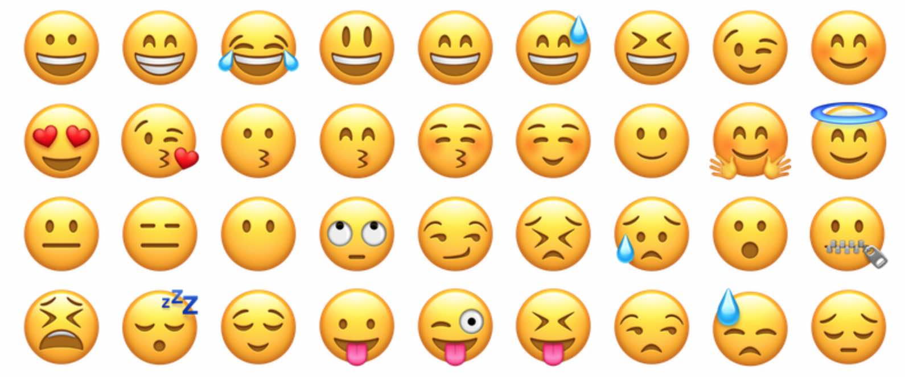
Key Features
Personalized Accounts Personalization features, digital ticket tracking, individual accomplishment mapping
Algorithmic Text Analysis Implement IBM Watson to quantify emotions from journal entry text (anger, sadness, joy, extraversion, etc.)
Wellness Surveys Consistent 3-question surveys to track student social & emotional wellness

Slide 3
Demo
HYPER LINK

Slide 4
Future Plans
Personalized Accounts Personalization features, digital ticket tracking, individual accomplishment mapping
Algorithmic Text Analysis Implement IBM Watson to quantify emotions in journal entries
Wellness Surveys Consistent 3-question surveys to track student social & emotional wellness

