Slide 1
Code for Good – Chicago 2017
Team 15
Pitch In Solution
A four year digital account of a student’s accomplishments
Presented by
Zachy Balkhy, Anya Chopra, Zach Kamran, Pablo Melana-Dayton, and Jacob Warfield

Slide 2
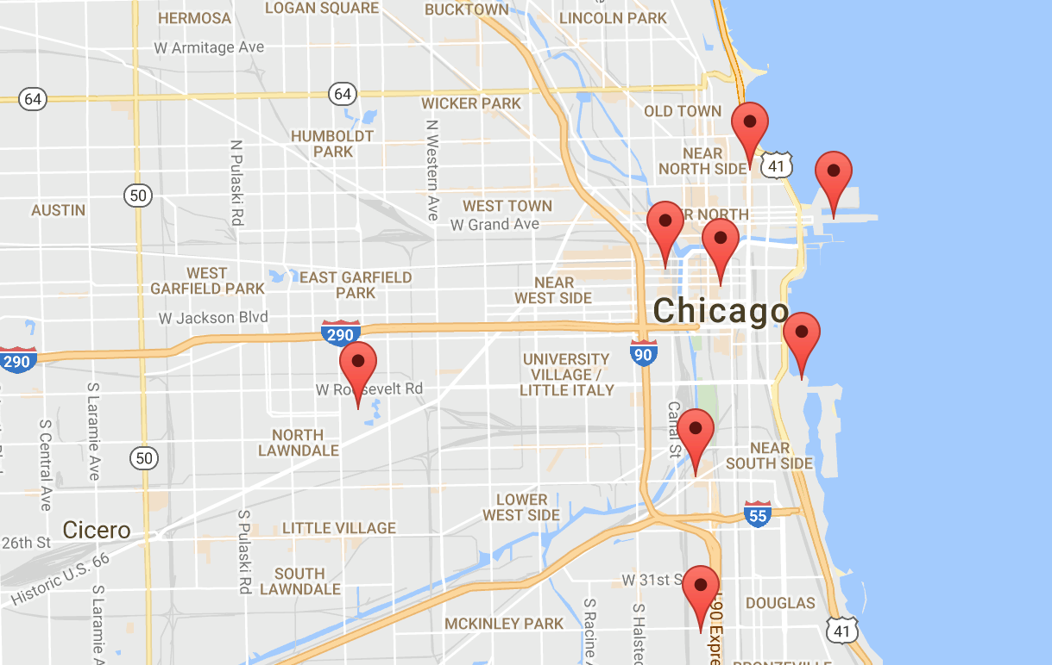


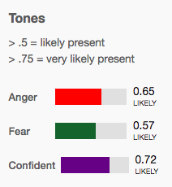


Key Features
Personalized Accounts Personalization features, digital ticket tracking, individual accomplishment mapping
Algorithmic Text Analysis Implement IBM Watson to quantify emotions from journal entry text (anger, sadness, joy, extraversion, etc.)

Slide 3
Demo
HYPER LINK

Slide 4




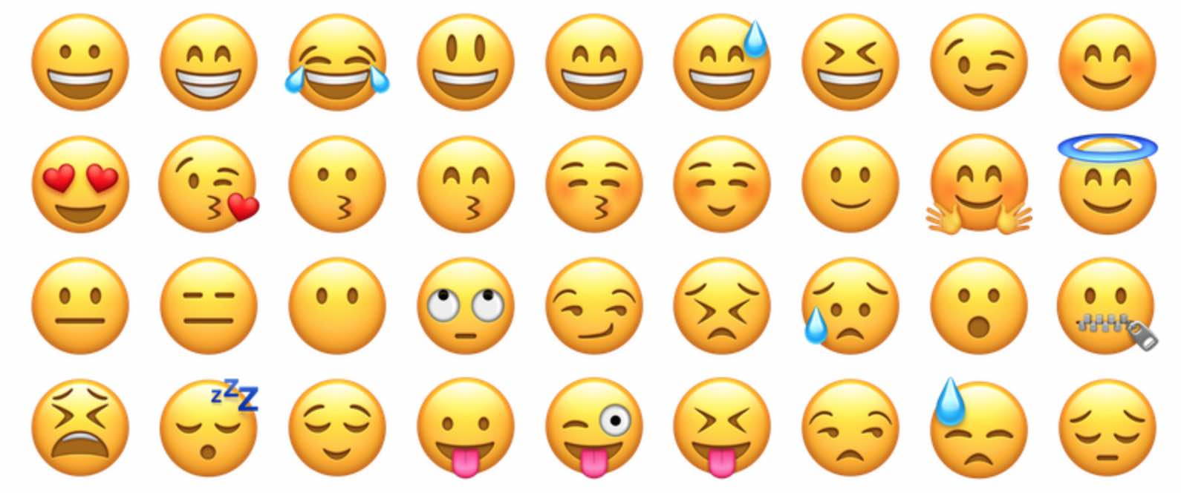
Future Plans
Automatic Syncing of Databases Connect website database to existing excel tracker, allow inputs directly to Excel
Improve milestone markers Added functionality with picture and video formats
Wellness Surveys Consistent 3-question surveys to track student social & emotional well-being

