Slide 1


Studio Pod Analytics Computing Vision: Film Type Discovery
Notes:
Joseph

Slide 2




Our Experienced Team
We have several excited practitioners here to share their analysis with you!
Josue Galindo De La Serna
Data Scientist
Deloitte Consulting LLP
Joseph Wargo
Data Cleaning SME
Deloitte Consulting LLPP
Madelyn Helson
Data Scientist
Deloitte Consulting LLP
Sheri Elsaker
Strategic Data Analyst
Deloitte Consulting LLP
Notes:
Joseph

Slide 3
Agenda
Overview of what we will be reviewing in this presentation
01
04
07
DS Process: CRISP- DM
Recommendation 1
Recommendation Summary
02
05
08
Data
Recommendation 2
Acknowledgments
03
06
09
Analysis Generation
Recommendation 3
Thank You
Notes:
Joseph

Slide 4




DS Process: CRISP - DM
Data Preparation
Cleaning, constructing, and formatting the data frames to be easily manipulated
This includes standardizing the genres, inputting Booleans to aid with qualitative comparisons, etc
Deployment
Gathered final information such as the top 3 recommendations and why.
Ensure this meets the business needs and requirements
Sharing our journey
Data Understanding
Initial examination of data
Verification that the data can assist with our plans and goals
Business Understanding
What is the current situation?
What insights will have the greatest impact?
Can we retrieve these insights and how?
Notes:
Joseph
Highlight these are not all the steps, but this slide will help us tell our story
Who is our stakeholder?
Students must explain how their projects address a real-world problem
In Semester 1 Capstone, the problem basics are provided in the project description
A real-world problem is an actual problem faced by an actual stakeholder
A stakeholder is a specific individual, group of people, or organization
A problem is a challenge faced by a stakeholder in pursuit of some goal
A real-world problem is one that exists in reality, i.e. students could present the project to an actual human being and they could actually find value in it.
Presentation describes the project goals, data, methods, and results.
Mention how in business understanding that is also where we come up with the plan. Those questions are what set us up to have a plan

Slide 5
Data
Movie Basics
Movie ID
Primary Title
Original Title
Start Year
Runtime Minutes
Genres
Persons
Person ID
Primary Name
Birth Year
Death Year
Primary Profession
Principals
Person ID
Movie ID
Ordering
Category
Job
Characters
Movie Ratings
Movie ID
Average Rating
Number of Votes
Known For
Person ID
Movie ID
Directors
Movie ID
Ordering
Title
Region
Language
Types
Attributes
Is Original Title
Directors
Person ID
Movie ID
Writers
Person ID
Movie ID
Notes:
Joseph
Include total number of movies
Madelyn
Vanya July 5

Slide 6
Analysis Generation
Three questions that drove our analysis on box office films:
Five data sets from reputable movie review websites with over 300,000 rows of data.
Question: Are any of the genres undervalued?
Value: Identifying genres with high likability and low quantity of material exposes an opening in the film industry for Computing Vision to successfully create in while facing minimal competition.
Question: Which actors and actresses are the most popular? What is the most optimal cast size?
Value: Choosing the right number of actors and actresses that are performing at the top of their industry can draw an immense amount of attention and praise from reviewers.
Question: Which directors receive the highest praise from critics?
Value: A director with a portfolio of high-quality productions can aid in establishing Computing Vision as a highly regarded movie studio.
Data Description
Genres
Actors
Directors
Notes:
Joseph
Websites: - Box Office Mojo
IMDB
Rotten Tomatoes
TMDB
The Numbers

Slide 7
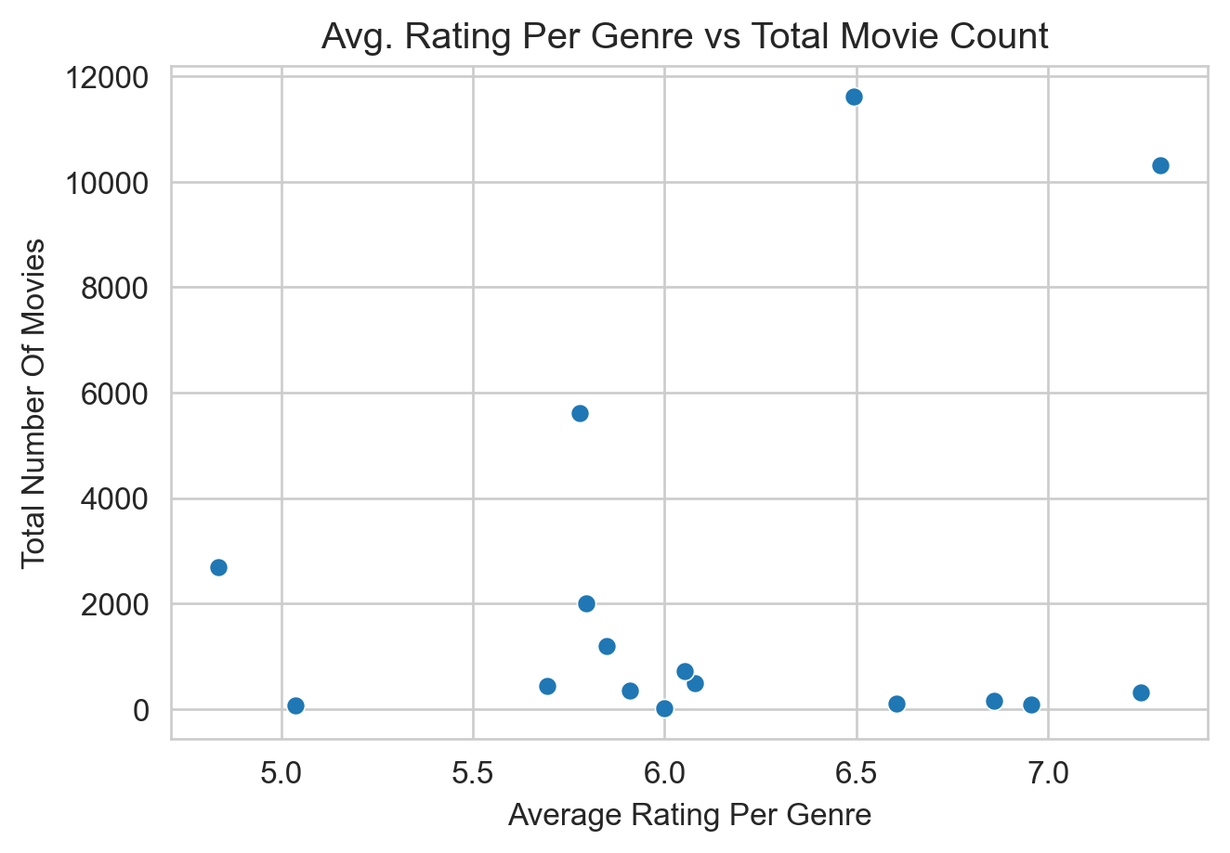
Recommendation 1 - Genre
Breakdown of movie genres across the industry according to the average rating and quantities of movies in each genre
Scatter Plot Data
Average Rating
6.1/10
Average Total Number of Movies
2262
Notes:
Madelyn
Make all visuals less blurry
Make style consistent
Joseph
We need to include method and visual results here
This slide is showing the full range of data we started with
Our goal was to identify a segment of the movie market where we could face minimal competition
and have a product that is well liked by consumers
On the graph you can see that the majority of the genres have fewer than 2000 movies but only five movies have
Above a 6.5 rating
Through theses observations we were able to identify the data we wanted to focus our analysis on (lead into next slide_

Slide 8
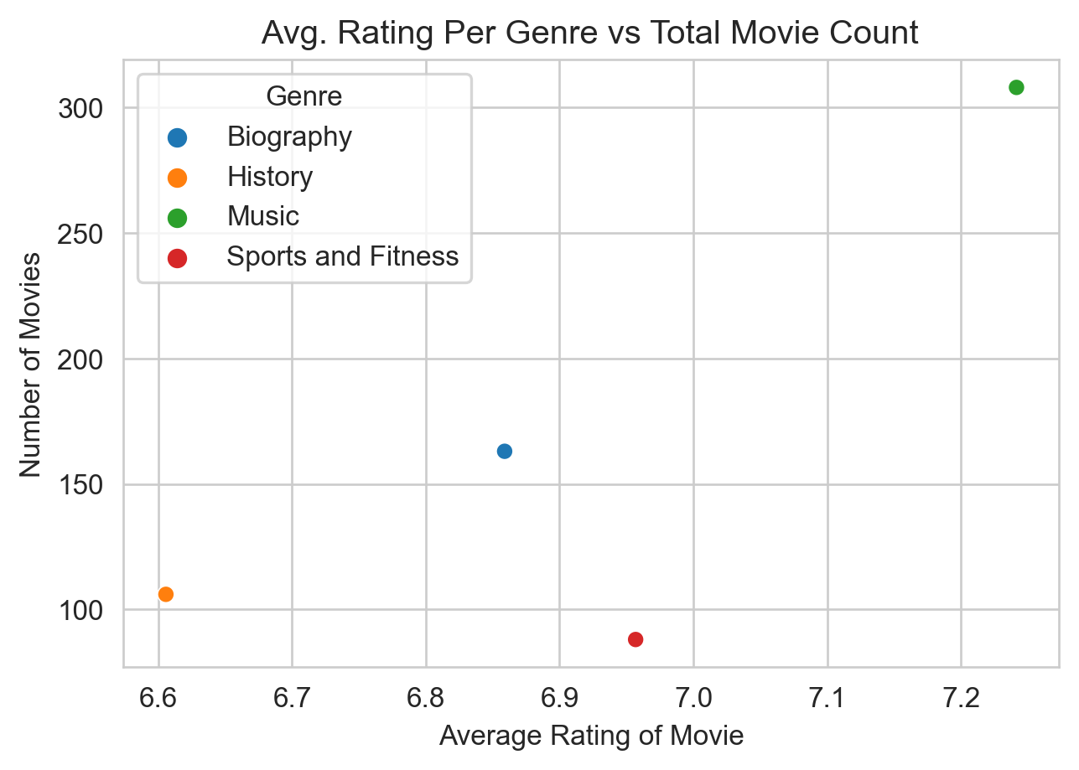
Recommendation 1 - Genre
The music genre is the most lucrative genre due to its above average ratings and market size.
Music
Scatter Plot Data
Average Rating
6.9/10
Music Genre Rating
7.2/10
Average Total Number of Movies
166
Music Genre Number of Movies
308
Music
Statistical Test
Hypothesis Test
Passed
Notes:
Madelyn
Make style consistent
This slide is showing the data we want to focus our analysis on
Here we are able to take a closer look at the data that fits our criteria
Our team has identified the music genre as the most lucrative movie genre to produce in since it does not face intense direct competition
and receives above average reviews

Slide 9
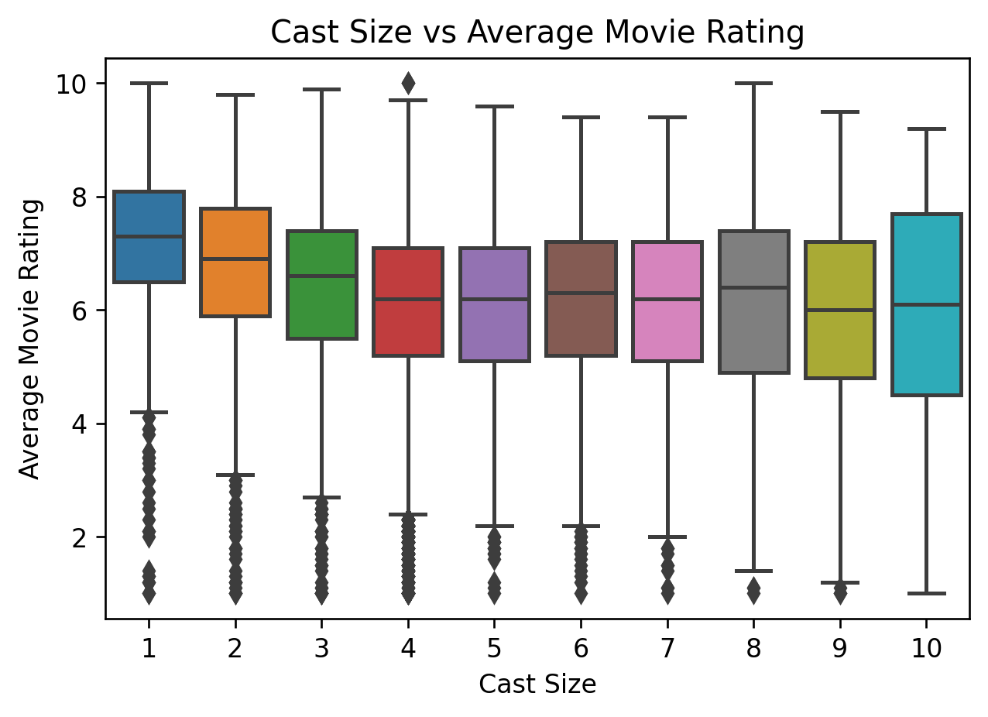
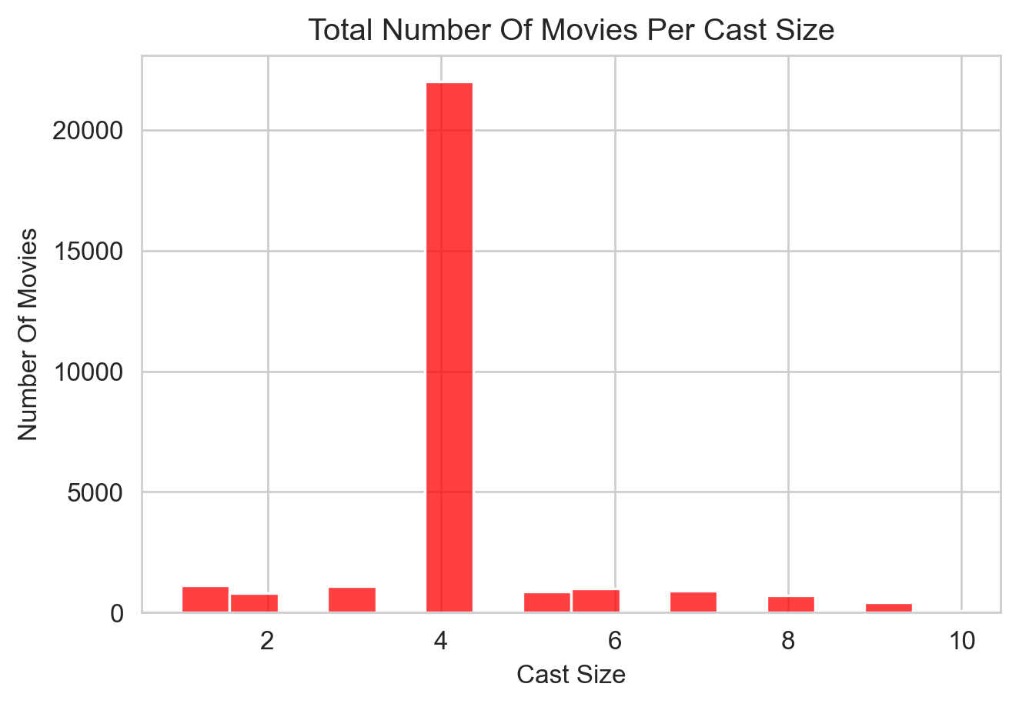
Recommendation 2 - Cast
Correlation between movie cast size and average moving rating
Cast size does not affect movie overall rating
The most popular cast features four main characters
Notes:
Josue
Make all visuals less blurry
Joseph
We need to include method and visual results here
Top actors with most reviews, but ordered by rating

Slide 10
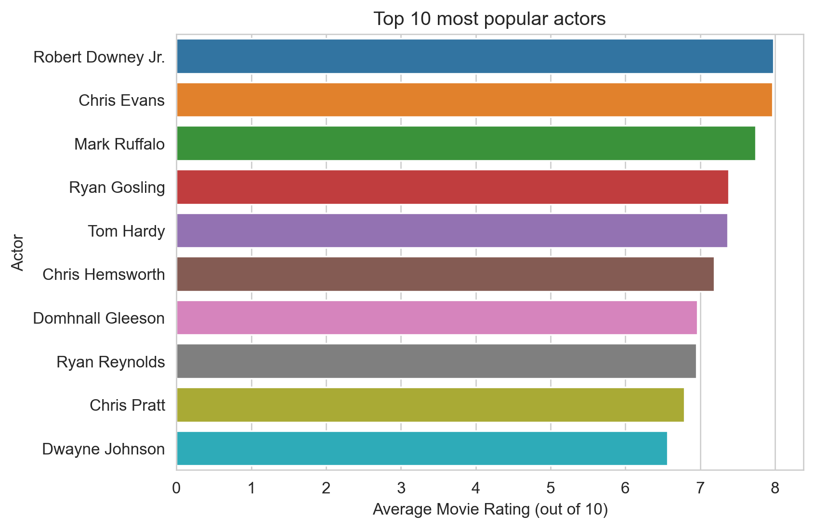
Recommendation 2 - Cast
Top 10 most popular actors with most reviews ordered by rating in descending order from 2015 onwards
The Top 10 Most Popular Movie Actors
Notes:
Josue
Make all visuals less blurry
Joseph
We need to include method and visual results here
Top actors with most reviews, but ordered by rating

Slide 11
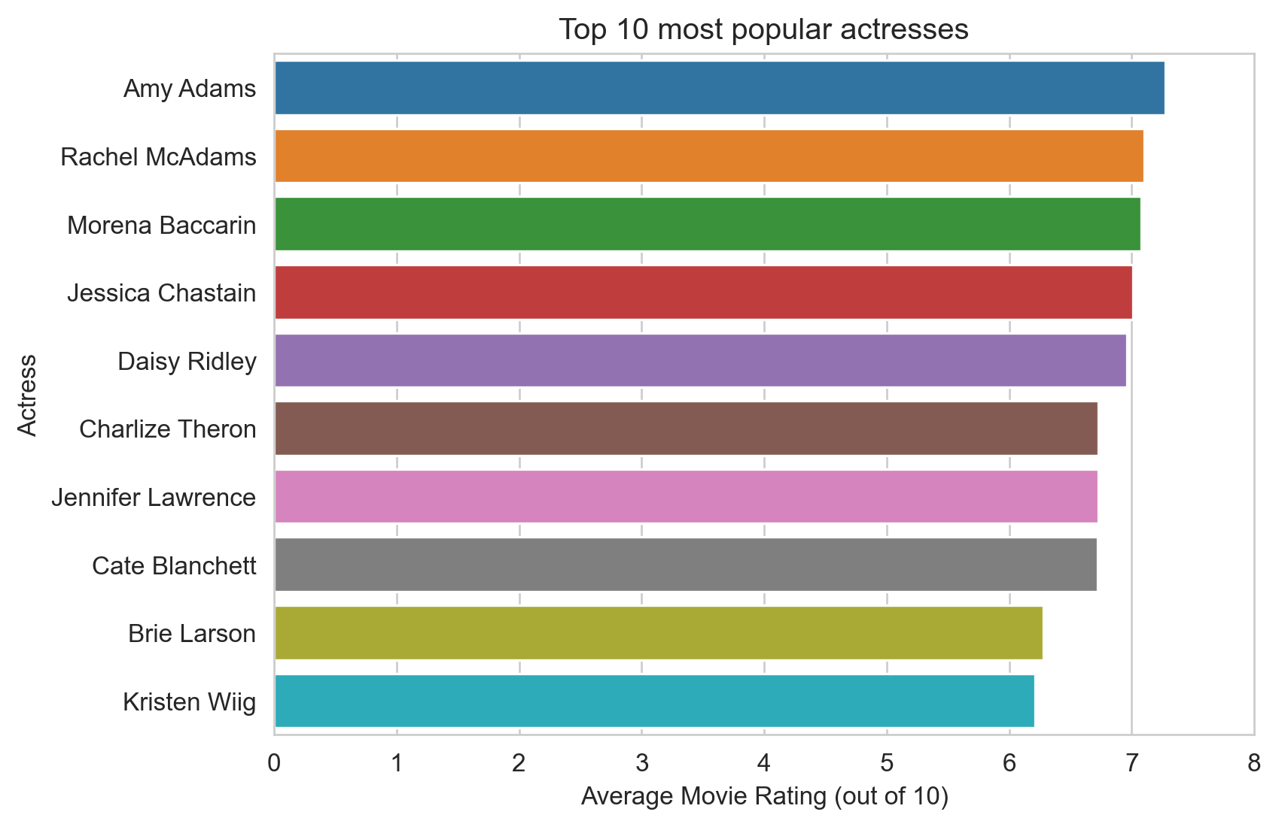
Recommendation 2 - Cast
Top 10 most popular actresses with most reviews ordered by rating in descending order from 2015 onwards
The Top 10 Most Popular Movie Actresses
Notes:
Josue
Make all visuals less blurry
Joseph
We need to include method and visual results here
Top actors with most reviews, but ordered by rating

Slide 12
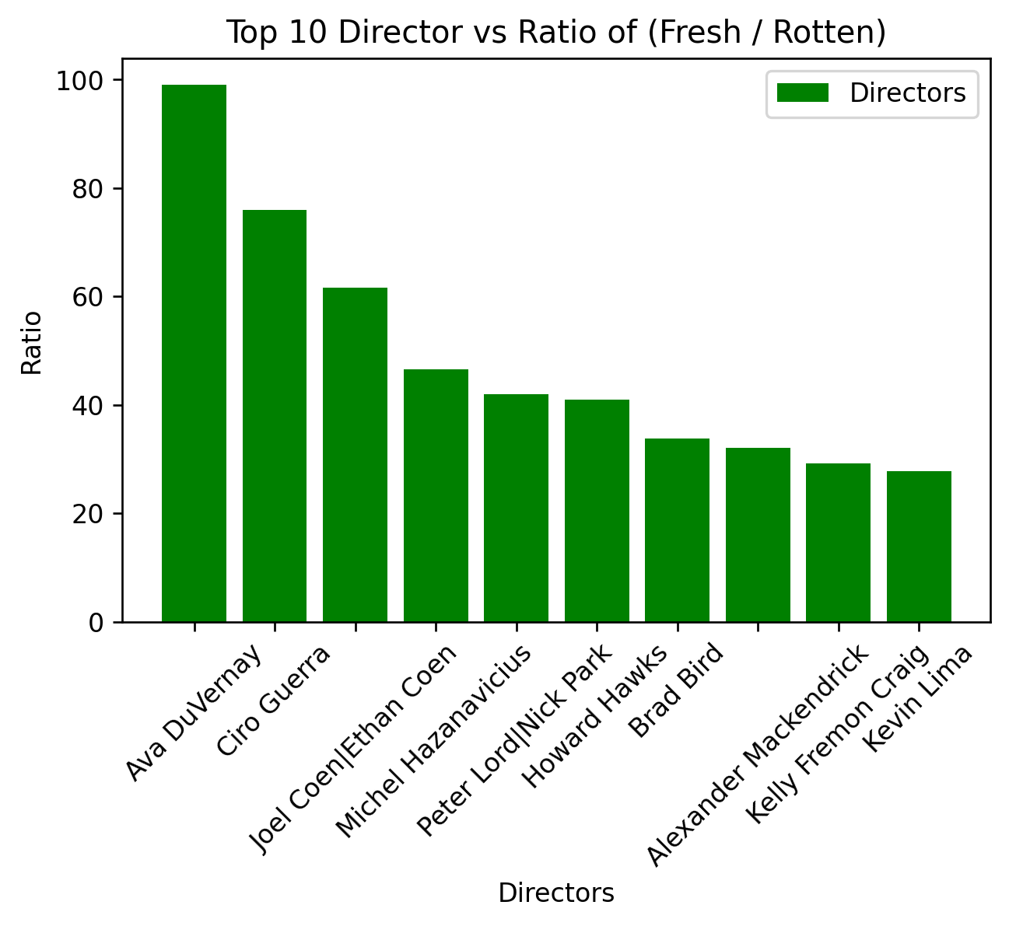
Recommendation 3 - Directors
The bar plot below shows the directors verses their ratio of rotten reviews to rotten reviews
Ava has the highest ratio with means she is most balanced and highly regarded positively
Notes:
Sheri
Make all visuals less blurry
Remove legends
Sheri
We need to include method and visual results here

Slide 13
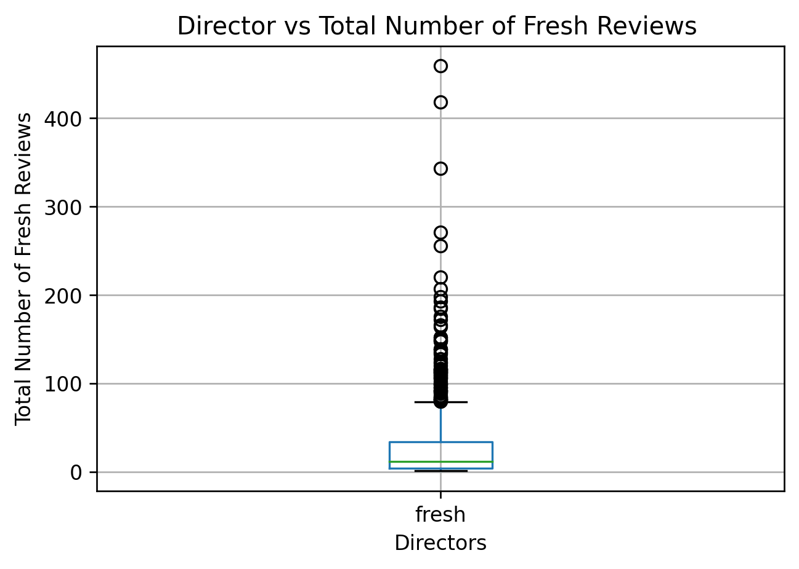
Recommendation 3 - Directors
Ava Duvernay is the director we recommend due to her favorable reviews and ratings
Ava DuVernay
Notes:
Sheri
Make all visuals less blurry
Sheri
We need to include method and visual results here
45 is the average and std dev 29 – top 1.2%

Slide 14
Recommendation Summary
3 recommendations based on statistical analysis
1
2
3
Genre Recommendation
Cast Recommendation
Director Recommendation
Create a movie that falls into the music genre
Cast four main actors and actresses from the lists of top performers
Hire Ava DuVernay as the movie director
Notes:
Sheri
Cut down on text
Sheri
Ava was 8/829 of fresh

Slide 15
Acknowledgments
Special Thank You!
Flatiron Instructor
William Wang
Flatiron Instructor
Nesli Bisgin
Deloitte
Program Coordinator
Tina Lhotak
Deloitte
Program
Coordinator
Amy Huttenhoff
Deloitte
Program Coordinator
Laura Tolliver
Mentor
Lionel Medal
Flatiron Program Coordinator
Jordan Schraeder
AI Cohort 4
Guest Speakers
Notes:
Sheri

Slide 16
THANK YOU!
QUESTIONS
Notes:
Sheri

Slide 17
Re
Here are the top 3 recommendations we have found after doing thorough research
1
2
3
Recommendation 1
Recommendation 2
Recommendation 3
Our team recommends to centralize production focus in the Music genre. Movies in the music genre have above average ratings and face less competition within the specific genre
Movies in the music genre have an average rating of 7.2/10 while all other genres have an average rating of 6.4/10
There are currently 308 movies that fall into the music genre while other genres have 2262 movies in them on average
We came out with list of candidates for actors and actresses from the most popular ones in the latest years to include in the movie as part of the main cast
Based on the total number of reviews they have; we have selected 10 actors and 10 actresses to choose from.
We have ordered them based on the average ratings of the movies they have participated in in since 2015
We also recommend to choose around 4 main actors or actresses
Ava Duvernay is director that we recommend for any upcoming movies
When comparing ratio of fresh to rotten, her ratio was the highest (198 fresh/2 rotten) of the total 829 directors.
The average number of fresh given for these directors was 45 and the standard deviation was 29. Ava had 198, which makes her a huge outlier to the right. Specifically, she was in the top 1.2% of positive feedback
When looking at the average rating of all the movies each of the directors have directed, Ava was in the top 6.7%.
Notes:
Sheri
Cut down on text
Sheri
Ava was 8/829 of fresh

Slide 18



Hypothesis Test
Null Hypothesis: Movies that fall in the music genre do not have higher average ratings than movies in other genres.
Alternative Hypothesis: Movies that fall in the music genre have significantly higher average ratings compared to movies in other genres.
Question at hand: Do movies in the music genre have significantly higher average ratings than movies in other genres?
Test type: Z score
Significance level: 5%
Probability level: 0.0 %
Conclusion: Since our probability level is lower than our significance level, we can reject our null hypothesis and assume movies in the music genre have higher average ratings than movies in other genres.
Notes:
Madelyn
Don’t explain what a hypothesis test is, just do the human interpretation
Independent variable
Dependant variables
Equation
Sample
Mean
Alpha
Std dev
T test or z test

