Slide 1
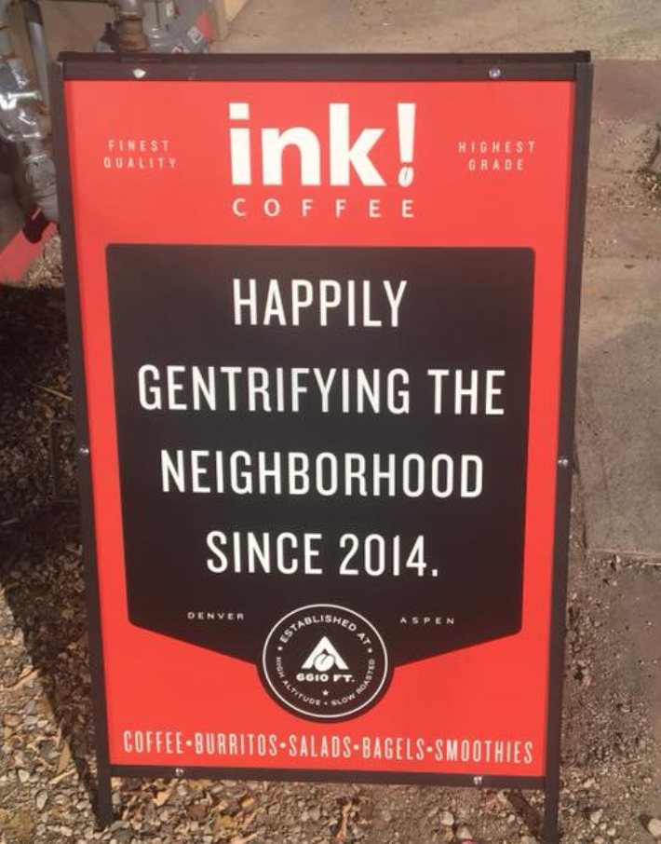
Coffee Shops
&
Gentrification

Slide 2
Team Members
Kevin Taylor - Data Munging
Gary Frankhauser - Leaflet and Mapping Landing Page
John Warlop - Flask and Heroku Integration

Slide 3
Project Objectives
Does the introduction of coffee shops foretell the gentrification of the surrounding neighborhood?
If so,could knowing this be used as a way to figure out which neighborhoods would be the best to invest in

Slide 4
Data Munging/Collection/Cleaning (Kevin)
Collected data from RedFin spanning 2012-2018
Foursquare API to gather information on coffee shops
GeoJSON data for San Diego neighborhoods
Merge data sets

Slide 5
Mapping page w/Leaflet (Gary)
Mapbox to create map of project area
Leaflet and JQuery to create Time Slider for coffee shops data points
D3 to create choropleth of Median Housing Prices

Slide 6
Landing page and server side integration (John)
Landing page
Flask integration of team member files
Heroku integration

Slide 7
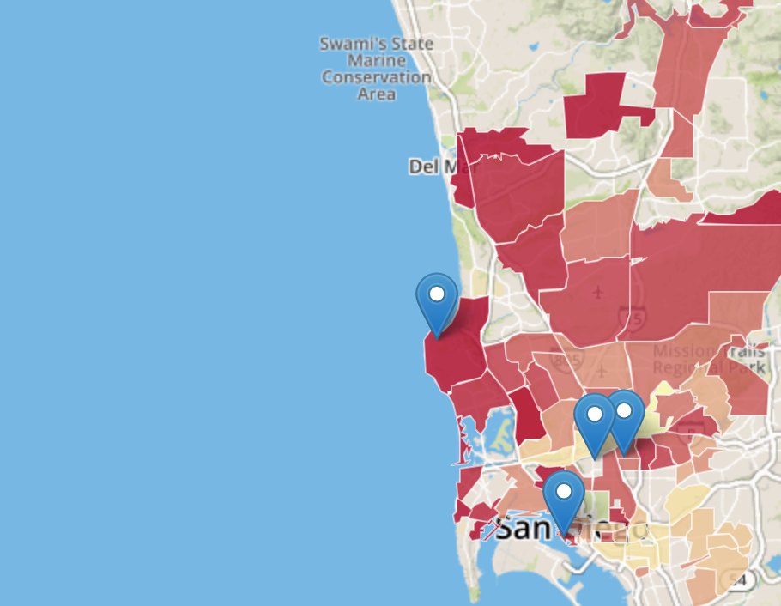
Site Demonstration(Gary)

Slide 8
Project Challenges
Housing data difficult to attain
Cleaning data from multiple sources
Accessing as much data as we needed proved to be too much to handle
Integrating JQuery time sliders w/choropleth

