Slide 1
Doing Data Science
Unit 12
Dr. Jacquie Cheun
Data Science @ SMU

Slide 2
Admin notes
Live Session Unit 12 assignment due 1 hr before Live Session 14
Unit 13: Case Study Work
Unit 14: Ethics
Unit 15: Case Study 2 presentations

Slide 3
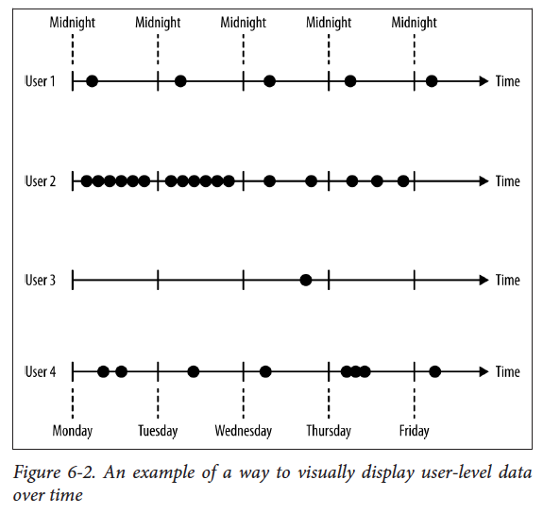
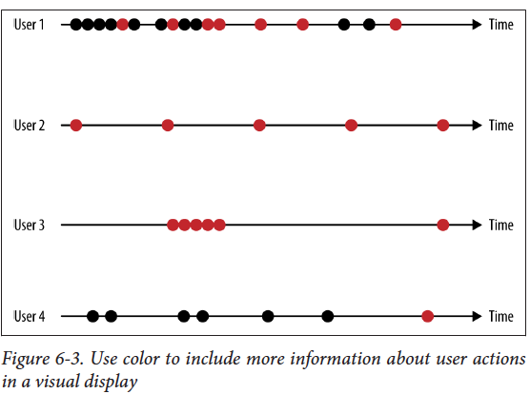
Time series modeling
Timestamps: data time logged with data points. The effect of Big Data.

Slide 4
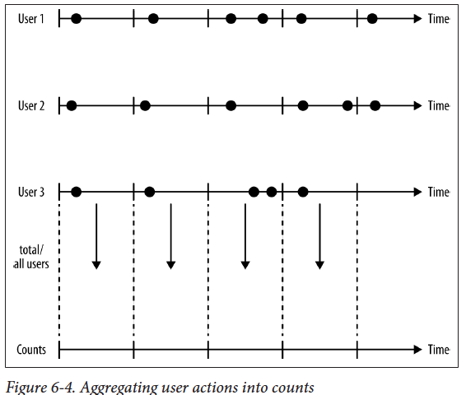
Aggregating user actions into counts.
Are we counting unique users or overall number of user logins? Number of actions or the numbers of users who performed a given action atleast once in a time segment?
What is the time horizon? Seconds, minute, hour, day, week? Why? Do timezones matter?

Slide 5
Trends and seasonality - applicable in many markets (fashion, retail, e-commerce)
Very important for financial data (signals are small)
In-sample data: training and test data for model tuning.
Out-of-sample data: separate test data to gauge performance in production.
Causal modeling: only use information from past up to present to predict future.
Once in production, a model may need to be updated based on observations from new data.

Slide 6
Transforming your data to make it “behave better”
Normalize/scale: divide by maximum value, or subtract the mean and divide by the standard deviation
Take log of data
Segment or create a categorical variable (e.g, likelihood to look for a new job (low-med-high) based on threshold score segments)
Threshold, e.g.,transform to a binary variable based on a preset threshold (e.g., spam or not spam)

Slide 7
For normalizing values,
Use a running estimate of the mean (or a real time mean) instead of the mean calculated over the training set! Why?
In finance, returns are considered on a daily basis.
Use log returns instead of percent returns ...why?
Log returns are additive: a 5-day log return is a sum of five 1-day log returns. Computationally handy.
Log returns are symmetric with respect to gains and losses, percent returns are biased in favor of gains.

Slide 8

For short-time horizons (daily or shorter), both are acceptable.
x = Ft / F(t-1)
Scaled percent return is: x - 1
Log return is: log (x) which has the following Taylor expansion:
The first term is the same as the scaled percent return.
The second term is small compared to first (for daily returns) ..hence a good approximation of percent returns using log returns.

Slide 9
Volatility measurement: how much has the data changed recently
Decide on a lookback window (length of time in the past to take info from)
How does the size of the lookback window affect volatility estimates?
How to use the lookback window data?
Strict rolling window: equally weight all previous n days..drawbacks?
Continuous lookback window: “exponentially downweight” older data, “half-life”, “Information gradually fades away from people’s memories”

Slide 10
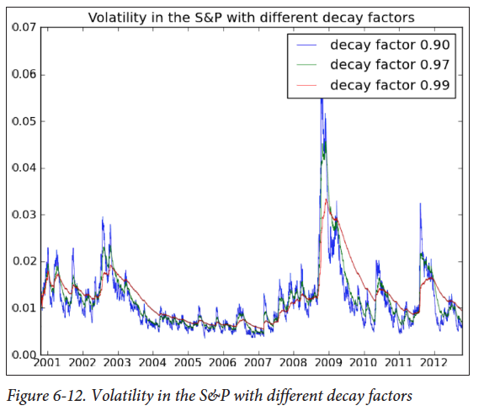
Decay factor:
e.g., if it's 0.97, then for a return from 5 days ago, we multiply it by 0.97^5.
You can ignore the mean for daily volatility measurements. (its small)
Weigh recent data more than older data.

Slide 11
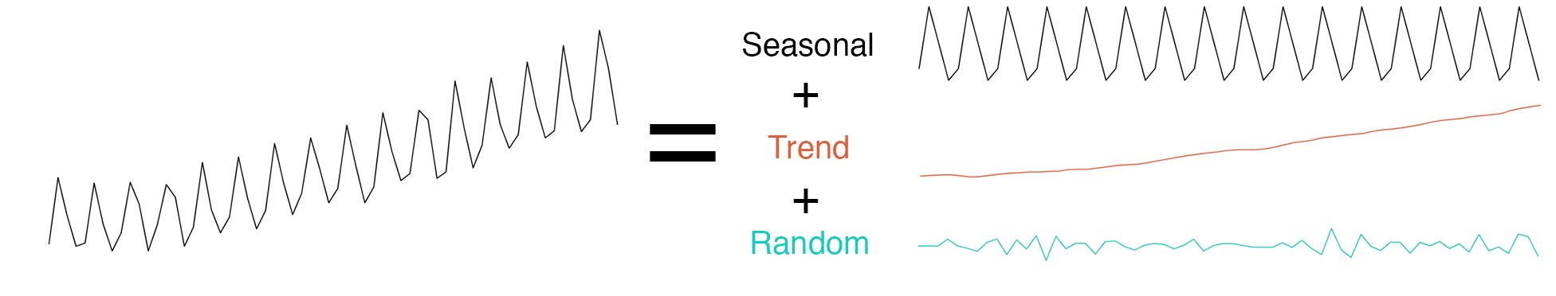
Components of a Time Series ref anomaly
Seasonality: how things change within a specific period, e.g., year, month, week, day. Example: US unemployment tends to decrease during end of the year holiday season (should adjust for this to detect overall trend). Can be detected using Fourier transforms
Trend: how things are changing overall, e.g., a website gaining in popularity should have a general trend of increasing number of visitors per month.
Random/residuals/noise/remainder: activity not explained by trends or seasonality

Slide 12
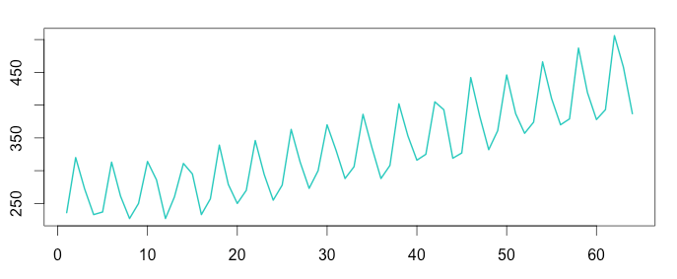
Additive and Multiplicative decompositions
E.g., Australian beer production. Constant seasonal variation. Doesn’t change when trend/time series increases.
Additive model:
Time Series = Seasonal + Trend + Random

Slide 13
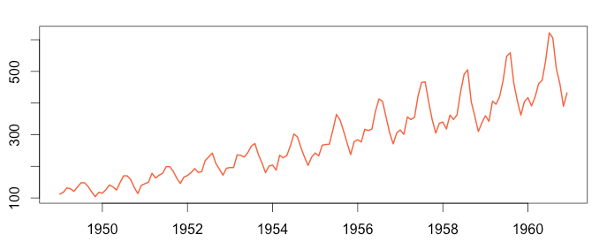
E.g., Airline passenger number. Seasonal variation increases with time series increase.
Multiplicative model:
Time Series = Seasonal * Trend * Random

Slide 14
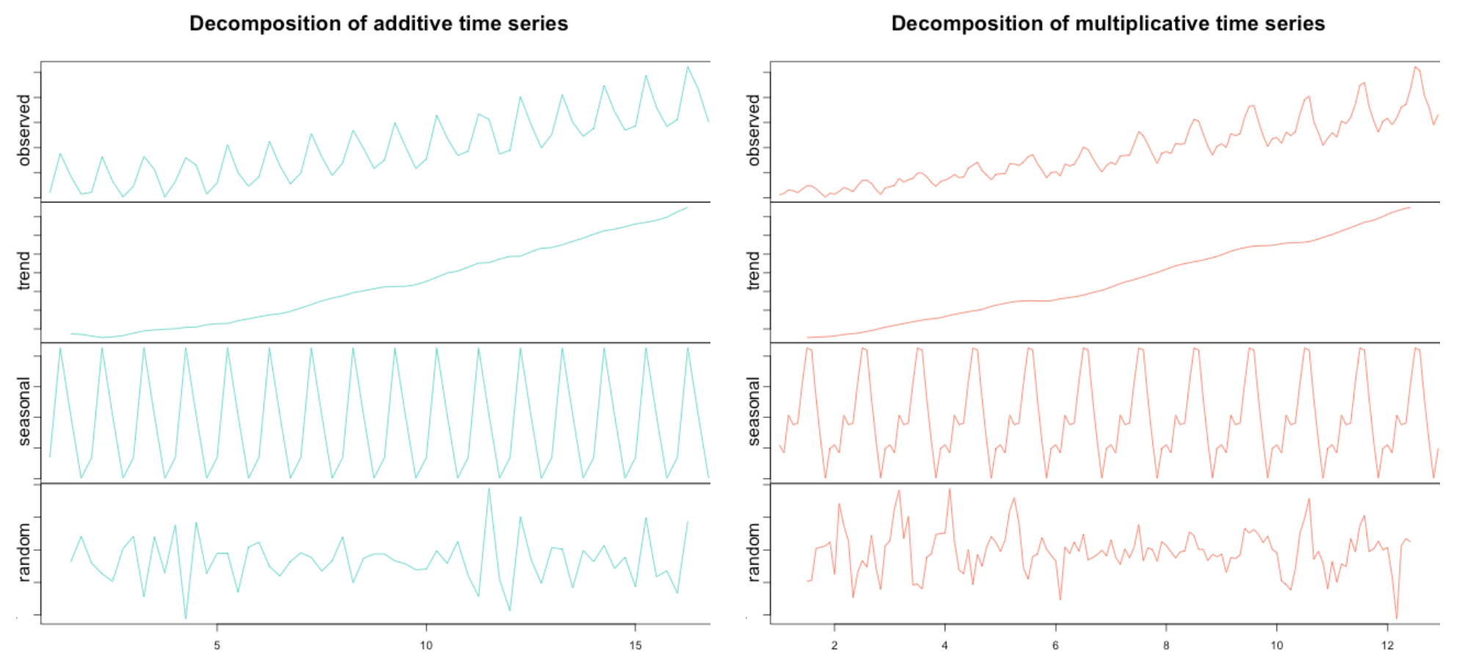
Decompose time series in R
Use the Decompose(..) function or the STL(...) function.
Decompose(..) assumes that seasonality component repeats from year to year.
STL might be more robust, while Decompose is easier to use.

Slide 15
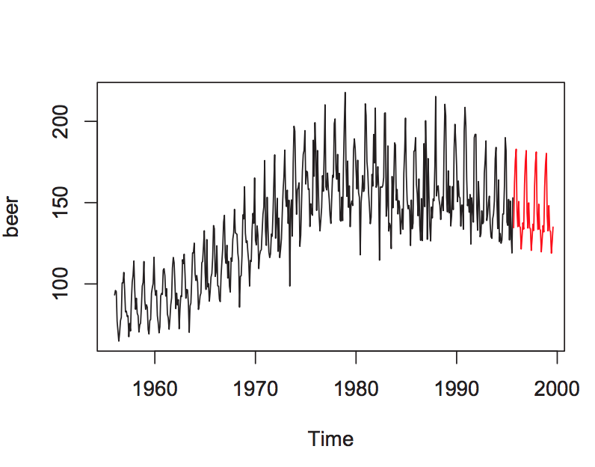
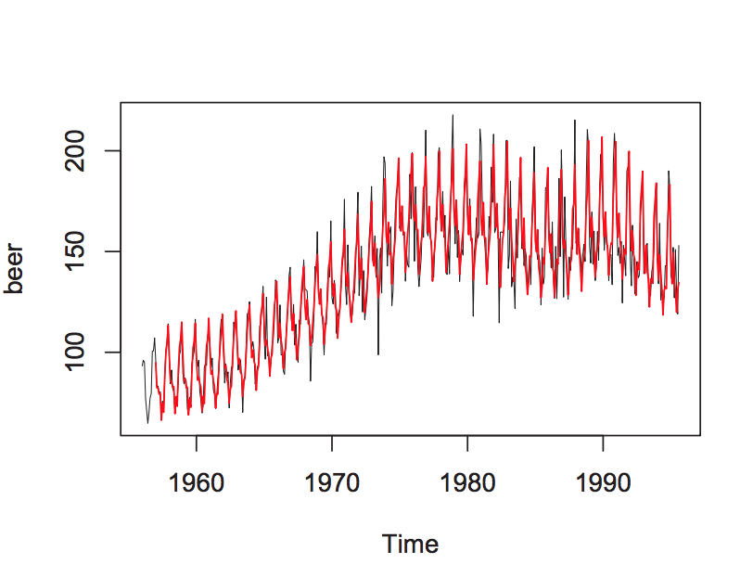
Forecasting and smoothing/filtering
Forecasting:predict future values based on previous values and patterns. Fit a model then predict! See the ses exponential smoothing forecast function
Smoothing/filtering: removing the seasonal effects of a time series by using a smoothing method, see HoltWinters(x,alpha,beta,gamma) function.
It's a zoo in here! ts (base R package) , zoo and xts https://cran.r-project.org/web/packages/xts/vignettes/xts.pdf

Slide 16
Lookback windows
Simple average: arithmetic average of all previous data points.
Strict rolling/“sliding” window: average of all previous n data points
Continuous lookback window/weighted moving average:
Values in the sliding window are given different values
“exponentially downweight” older data,
“Information gradually fades away from people’s memories”
Single Exponential Smoothing (SES): weighted average where we consider all data points assigning them exponentially smaller weights as we go back in time converging to zero.
Alpha = “decay” or smoothing factor → jagged lines are smoothed out.

Slide 17
Subsetting time series
Window() (Time Windows): extracts the subset of the object x observed between the times start and end
stocks ← window(NYSE, 1980) #stock price subset from 1980 onwards
Subset() : more robust than Window, allows subsetting by index values and extraction of values of a specific season or subset of seasons in an year.
plot(subset(gas,month="November"))
subset(woolyrnq,quarter=3)
subset(USAccts, start=49)

Slide 18

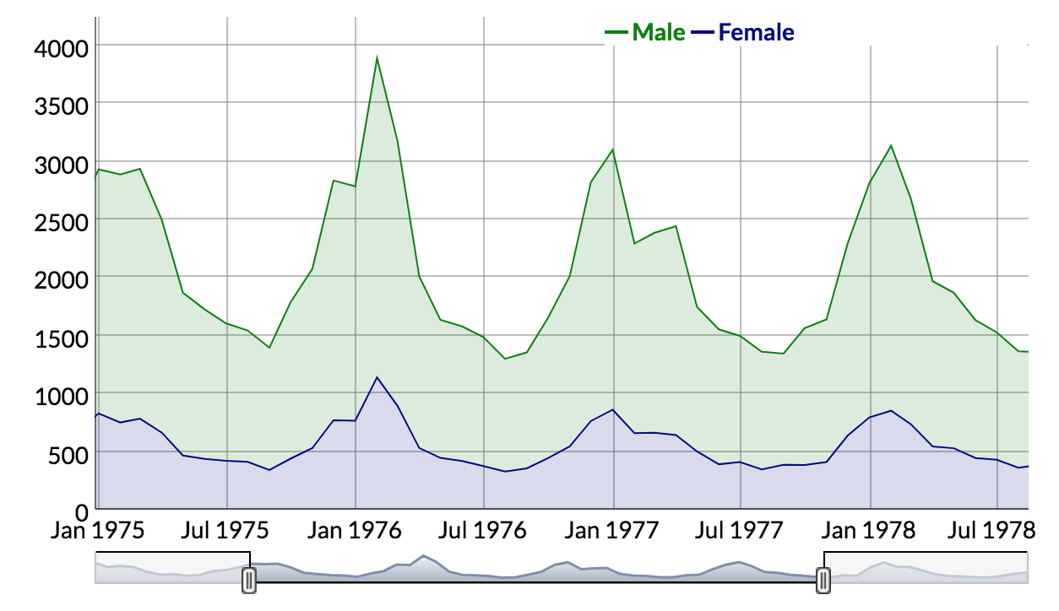
dygraphs for R http://rstudio.github.io/dygraphs/
R interface to the dygraphs JavaScript library.
Rich facilities for charting time series & financial data in R
Xts and xts-like objects in interactive charts
Synchronize and zoom-in on time series
Relatively responsive
Can handle large datasets

Slide 19
Unit 12 demo.

Slide 20
What did you learn today?
Questions?

