Slide 1
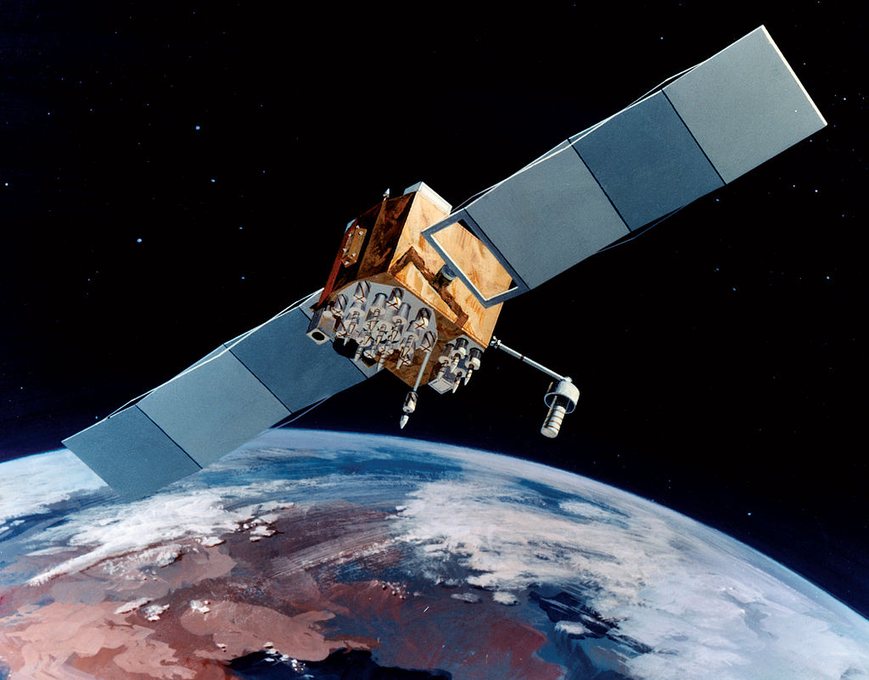
GPS (Global Positioning System)
Jared Wasinger: Computer Science
[USAF 2006]

