Slide 3


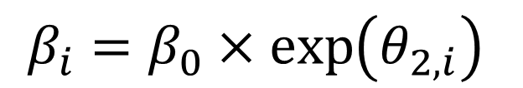
Linear
$$\log\left(V_{i}\left(t\right)\right)= α_{i}+β_{i}t+γR_{i}$$
$$α_{i}=α_{0}+θ_{1,i}$$
$$β_{i}=β_{0}×\exp\left(θ_{2,i}\right)$$

Slide 4

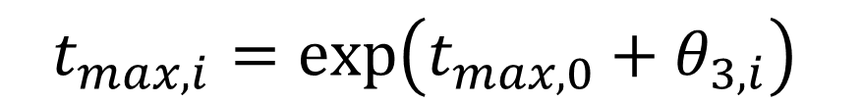
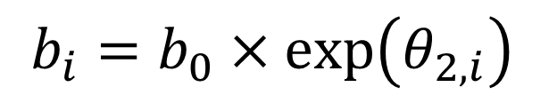
UpDown
$$\log\left(V_{i}\left(t\right)\right)= α_{i}+\ln\left(a+b_{i}\right)+log⁡_sum_\exp\left(\ln\left(b_{i}\right)−a\left(t−t_{max}\right),\ln\left(a\right)+b_{i}\left(t−t_{max}\right)\right)+γR_{i}$$
$$α_{i}=α_{0}+θ_{1,i}$$
$$b_{i}=b_{0}×\exp\left(θ_{2,i}\right)$$
$$t_{max, i}=\exp\left(t_{max, 0}+θ_{3,i}\right)$$

Slide 5

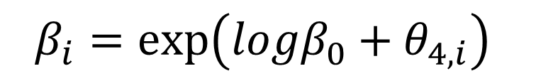
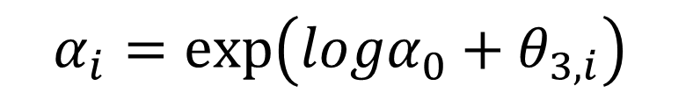

Biexp
$$\log\left(V_{i}\left(t\right)\right)=\ln\left(\exp\left(A_{i}−\left(α_{i}t\right)\right)+\exp\left(B_{i}−\left(β_{i}t\right)\right)\right)+γR_{i}$$
$$A_{i}=A_{0}+θ_{1,i}$$
$$B_{i}=B_{0}+θ_{2,i}$$
$$α_{i}=\exp\left({logα}_{0}+θ_{3,i}\right)$$
$$β_{i}=\exp\left({logβ}_{0}+θ_{4,i}\right)$$

Slide 6
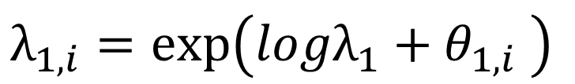


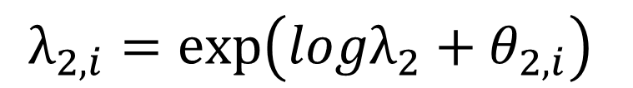
TwoCmpt
$$\log\left(V_{i}\left(t\right)\right)=\log\left(\left(\left(\frac{λ_{1}}{λ_{2}−λ_{1}}\right)\exp\left({logA}_{i}\right)\left(\exp\left(−λ_{1}t\right)−\exp\left(−λ_{2}t\right)\right)\right)+\exp\left({logB}_{i}\right)\exp\left(−λ_{2}t\right)\right)+γR_{i}$$
$$λ_{1,i}=\exp\left(logλ_{1}+θ_{1,i} \right)$$
$$λ_{2,i}=\exp\left(logλ_{2}+θ_{2,i}\right)$$
$${logA}_{i}={logA}_{0}+θ_{3,i}$$
$${logB}_{i}={logB}_{0}+θ_{4,i}$$

Slide 7
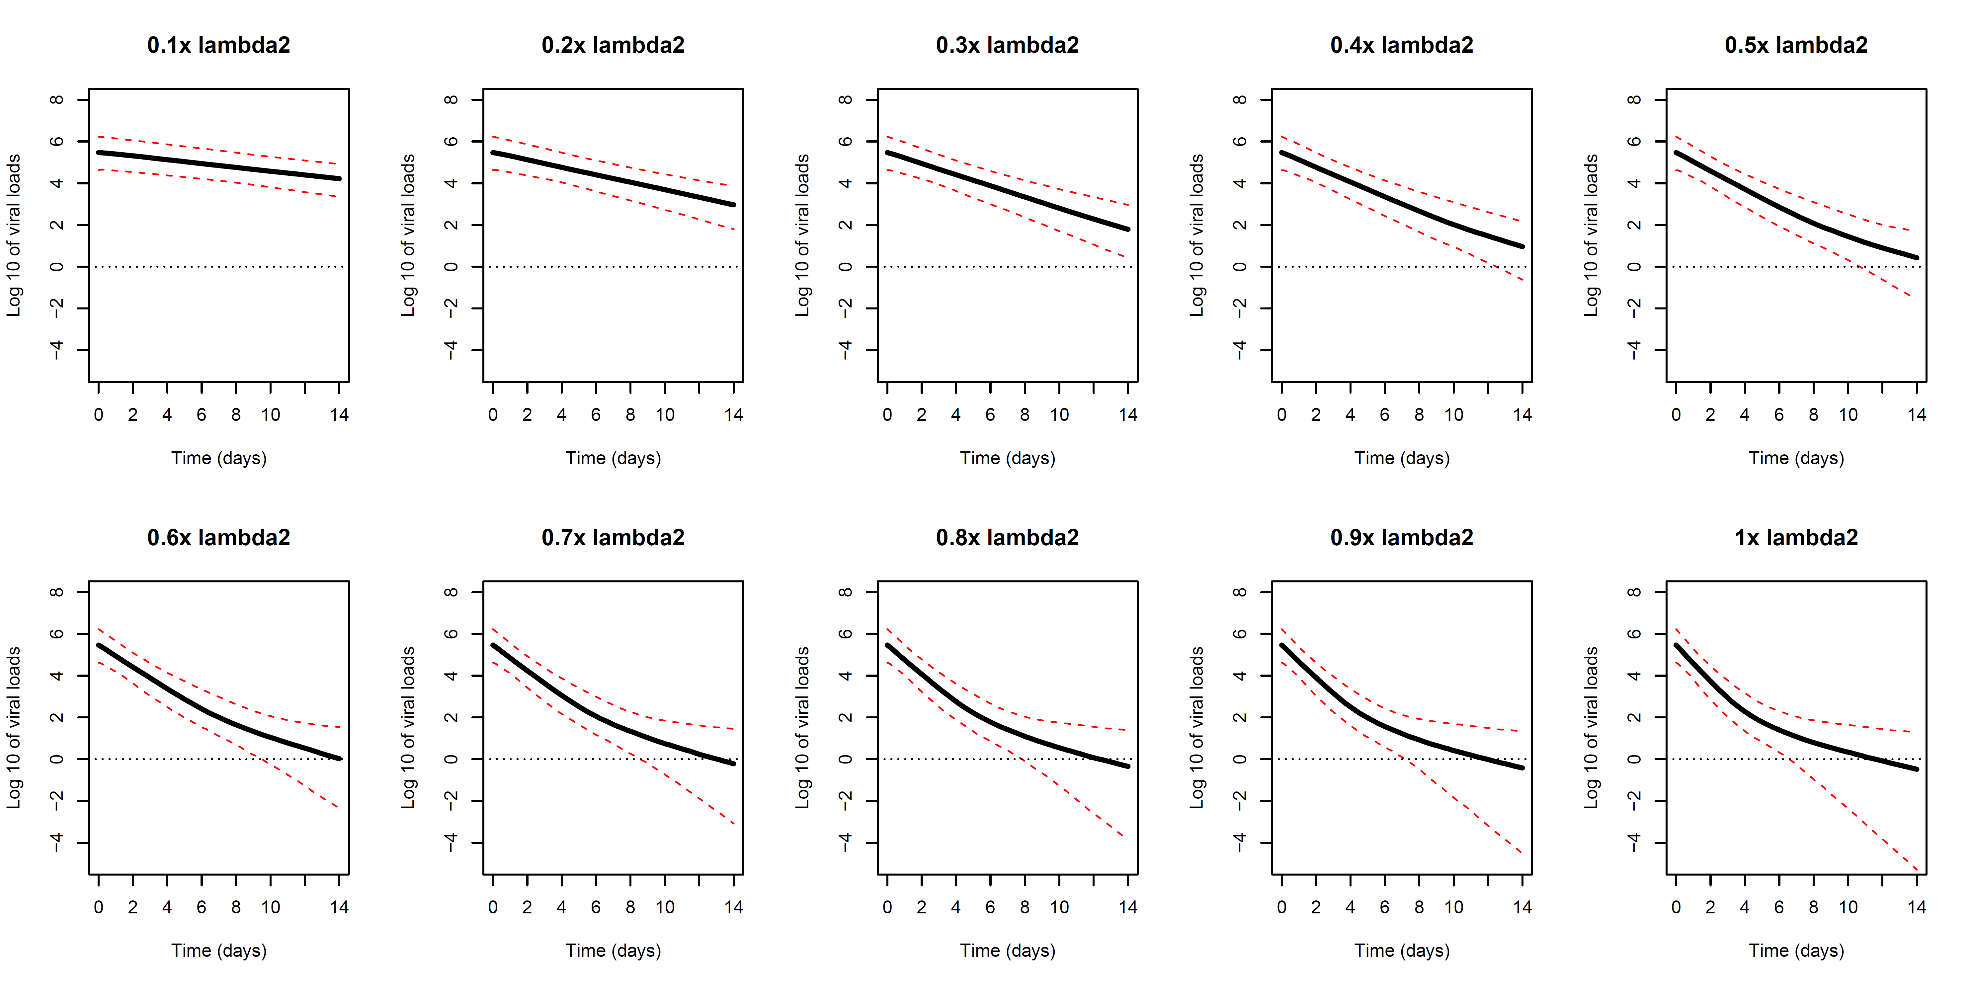
NR_04

