Slide 1




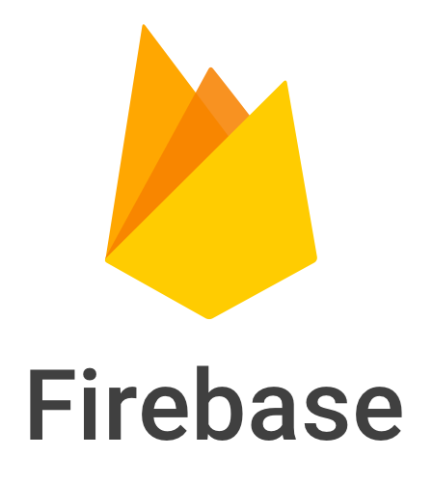
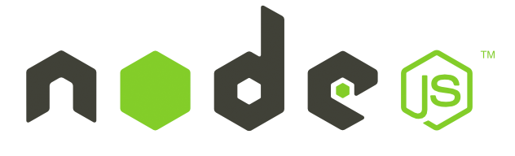

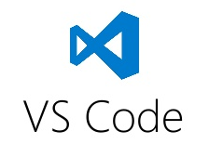
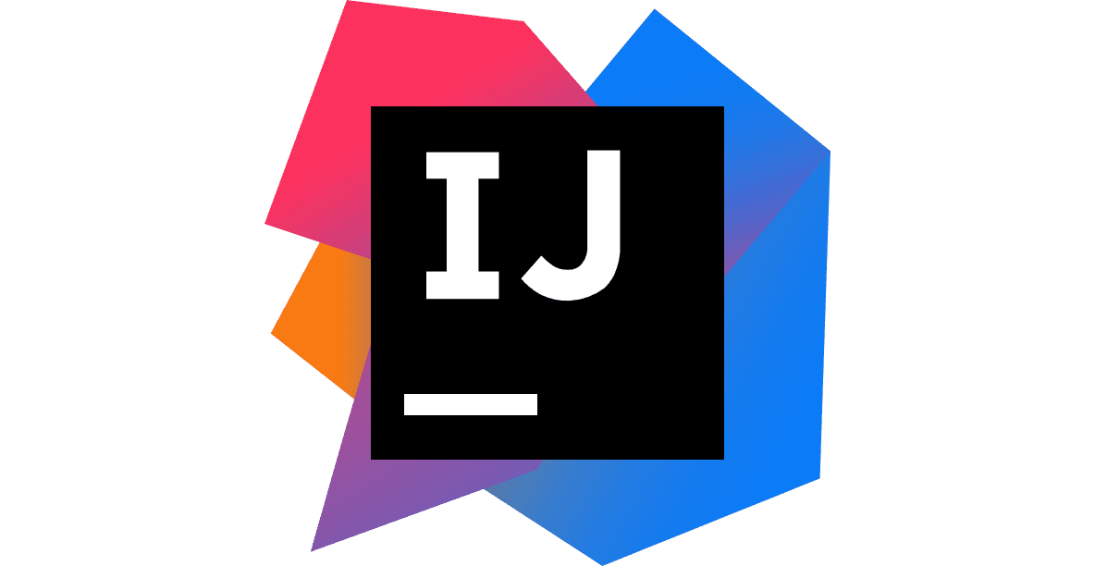
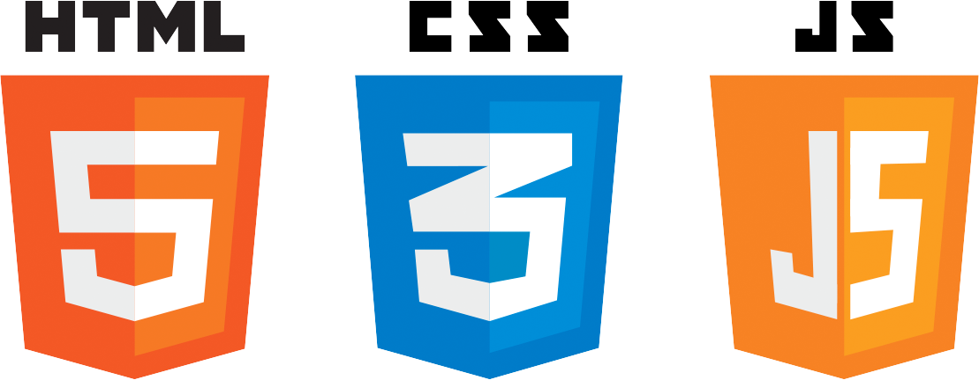

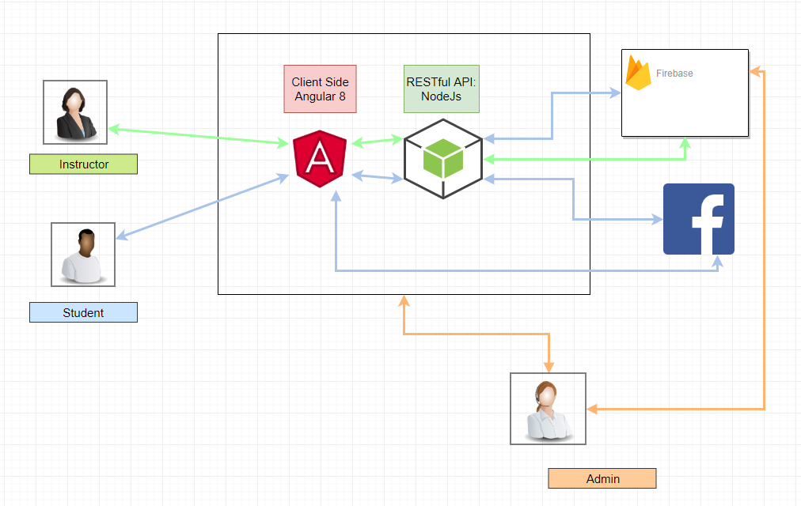
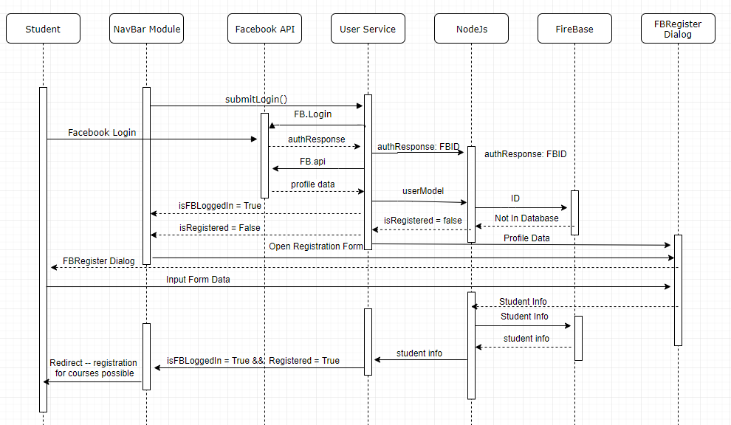
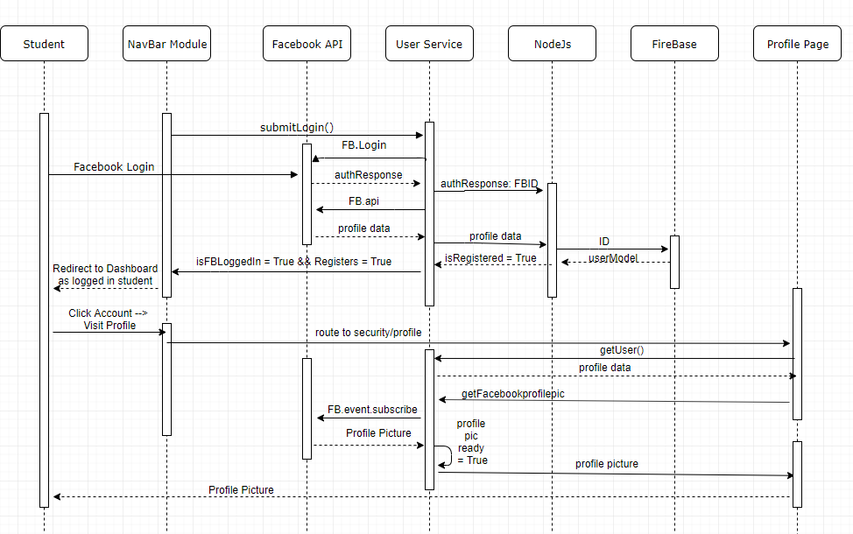
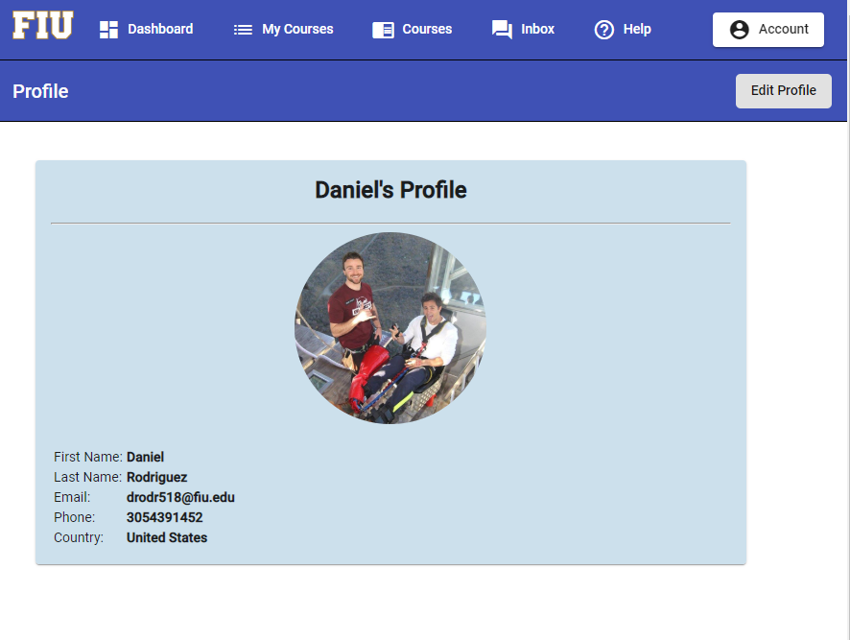
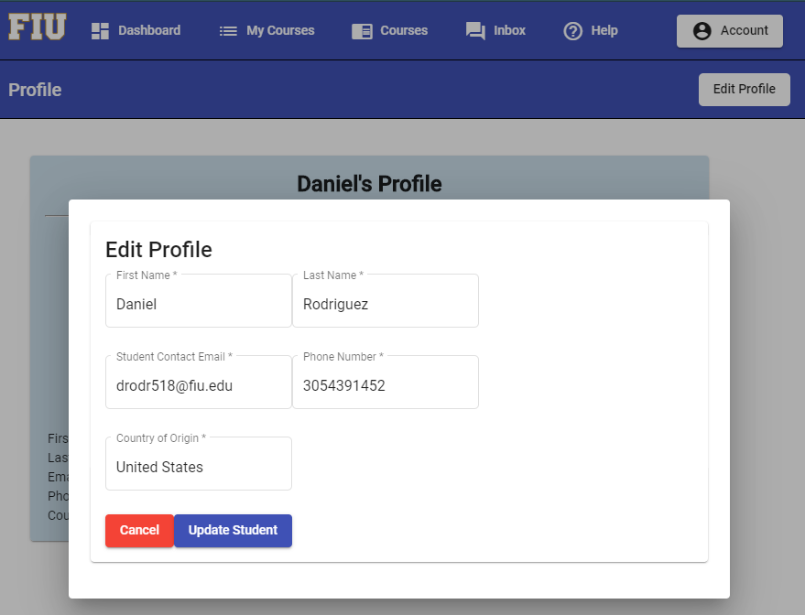
School of Computing & Information Sciences
Fall 2019 Senior Design Project
Basic LMS on Facebook
Students: Danny Rodriguez & Joao Guimaraes
Product Owner: Dr. Alejandro Arrieta, Florida International University
Instructor: Dr. Masoud Sadjadi, Florida International University
Problem
Current System
Requirements
Although access to the internet is becoming more wide spread and internet speed is increasing exponentially every day, the size of the information passing through the internet is also getting larger.
The arms race between data-size and internet speed is problematic, especially for individuals in countries with poor internet connection. This is a specifically prevalent issue for individuals who are trying to expand their knowledge and international students who want to engage with an online course effectively and efficiently.
In our project, we attempted to help remediate this problem.
Student Features:
A student with poor internet should be able to:
Login with his/her Facebook account, navigate and choose to register in the Library of all courses, navigate the course details, including modules, external links, pages, embedded YouTube videos, files, take quizzes, engage in public discussions, send private messages, edit their profile, see their current grades, all from a single access point.
Instructor Features:
An instructor should be able to do everything that a student can do, but also:
Edit Course details, add course information, confirm student enrollment, remove students from a course, add quizzes, release new quizzes, embed YouTube videos, external links, log in without Facebook authentication. with his/her Facebook account, make announcements and much more.
System Design
Facebook Registration Sequence Diagrams
Object Design
Visit Profile Sequence Diagrams
Implementation
Firebase is a cloud-hosted NoSQL database that stores and syncs data between users in real time. Firebase is an improvement from the previous database, PostgreSQL, for several reasons.
  1. Acquired by Google, owner of the most popular website and search engine in the world as well as a leading force in the cloud computing industry, in 2014.
  2. NoSQL databases eliminate scalability issues.
  3. Switching from a SQL database to a NoSQL database, allows an extremely detailed, intricate, type-independent & constantly-expanding database, with no corresponding database model.
By Angular 8 with a RESTful NodeJs server, it allows us to do a SPA, single-page application, with a REST API, the user renders only the required components of the current window, which significantly decreases bandwidth usage.
We built an entirely new system that uses Facebook only as an intermediary for logging in. We re-constructed the entire project with a relatively new tech stack:
The FEAN stack.
Firebase
Express
Angular 8
NodeJs.
Verification
Screenshots
Test Case ID | LMSF-03-09
Description/Summary | Logging in for first time allows student to register in backend.
Precondition | Student has never signed in, does not allow the app to access it’s Facebook information, and they are not in the students or users tables or in any other tables in Firebase.
Expected Results | The student will be prompted to login with Facebook, allow the application to use it’s Facebook profile information, prompted to fill out the register form, and then the Facebook ID as well as the student information filled out in the form will be passed to firebase.
Actual Result | The student was redirected to a Facebook login page, needed to allow the application to use its Facebook information, prompted to complete a registration form, added to the backend with information from the form and the Facebook user ID, logged in and redirected to Home.
Status (Fail/Pass) | Pass
Summary
In Summary, by using the latest developer technologies, a NoSQL database, using Facebook as a means of authentication, and utilizing a FEAN stack, we have, in practice, laid the groundwork for a successful Basic Learning Management System integrated with Facebook and we wish the next development team all the best in the Spring.
Test Case ID | LMSF-03-10
Description/Summary | A student registered in the same class can send a private message to another individual in the same class, to which the student can reply securely in the conversation.
Precondition | The student sending the message must be registered, enrolled in a course, and that course must have at least two other students.
Expected Results | The student will send a message that is only visible to the other student in that same course and a new conversation will be added to the conversations table in the database with the creator of the message, the recipient, the date and time the message was sent, the inbox navigation bar will be automatically populated with fields from the creator, time message was sent, course name, and subject of the message. The replying student will be able to access the private message and upon replying, automatically update the inbox navigation bar with their name and the specific time they replied.
Actual Result | The message is successful sent, inbox navigation bar is populated, backend tables are populated, date and time is correct, conversation is private, reply updates inbox navigation panel, reply is private, saved in the database.
Status (Fail/Pass) | Pass
Acknowledgement
We would like to thank Dr. Alejandro Arrieta for the support, cooperation and confidence he has maintained in both Joao and I throughout this semester.

