Slide 1







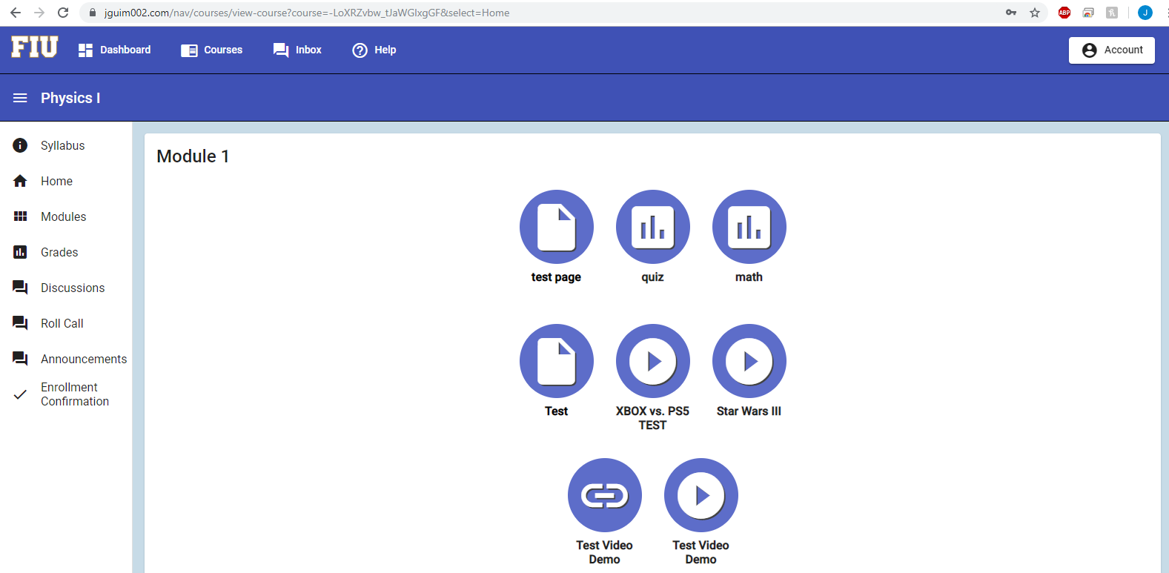
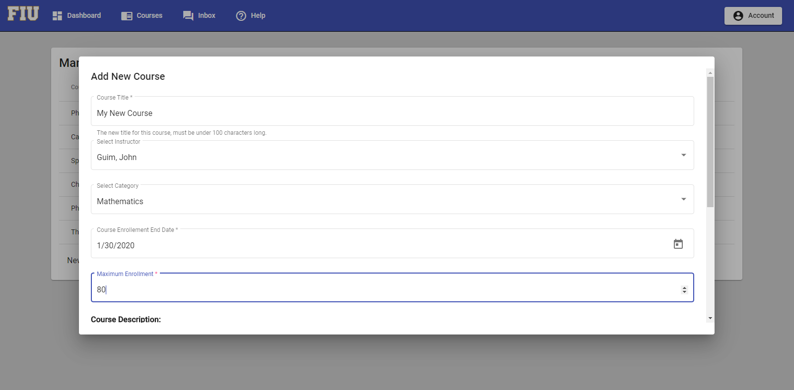
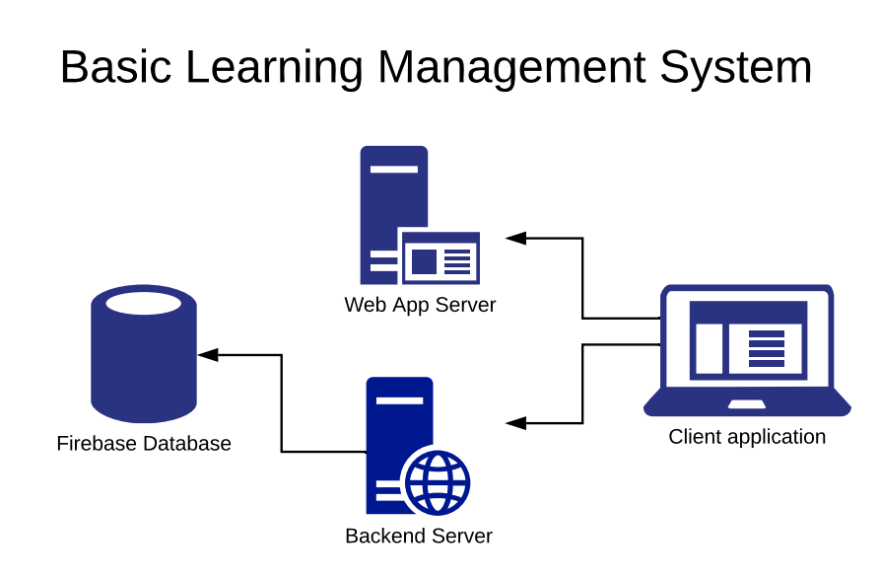
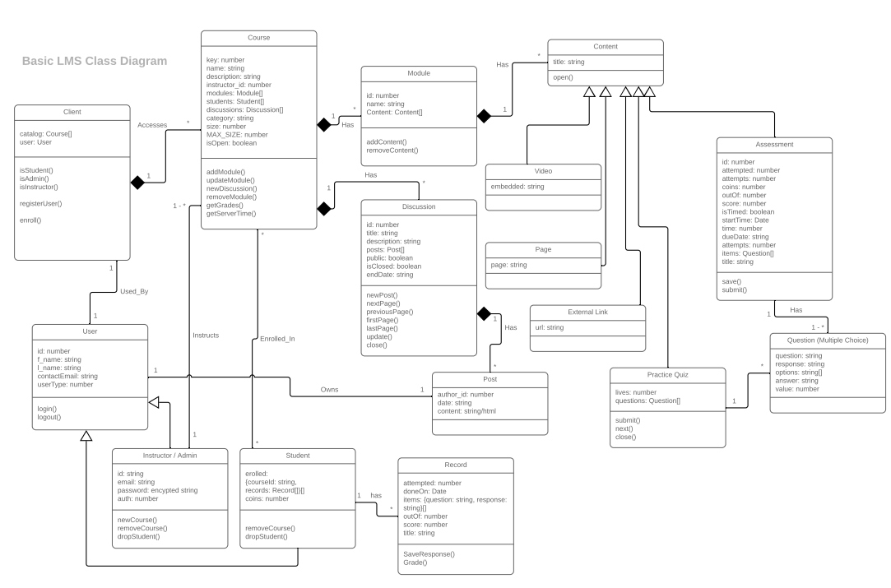
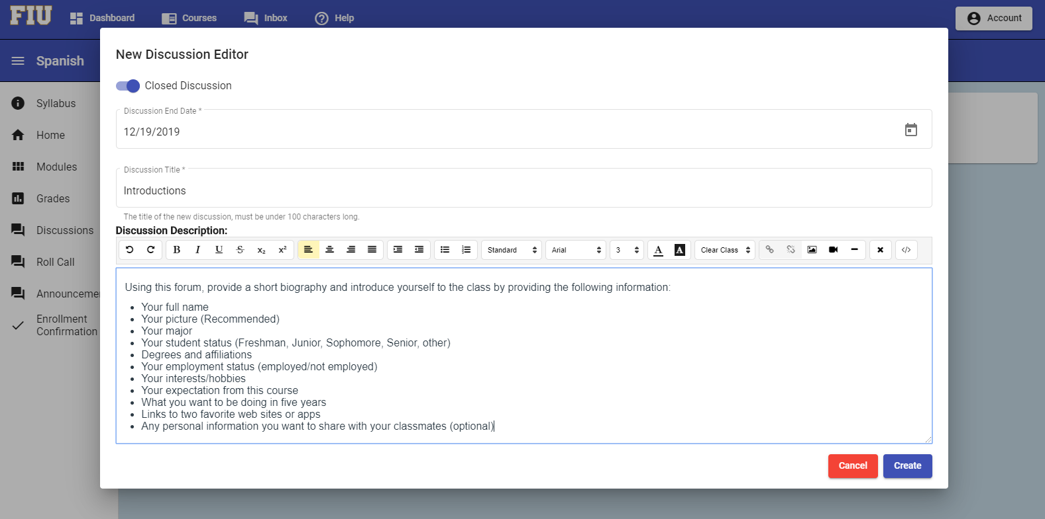
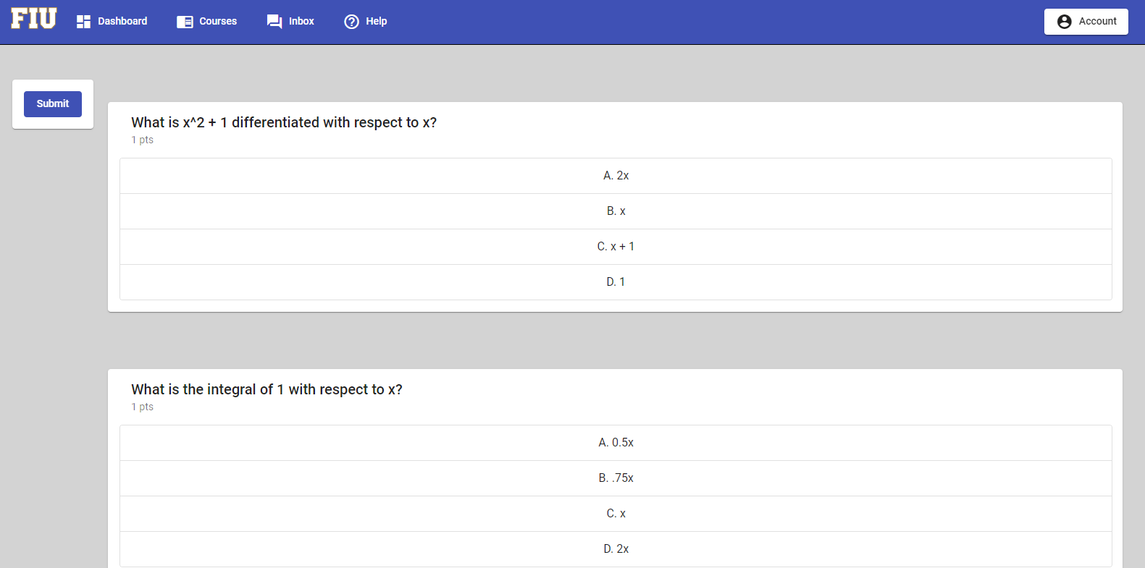
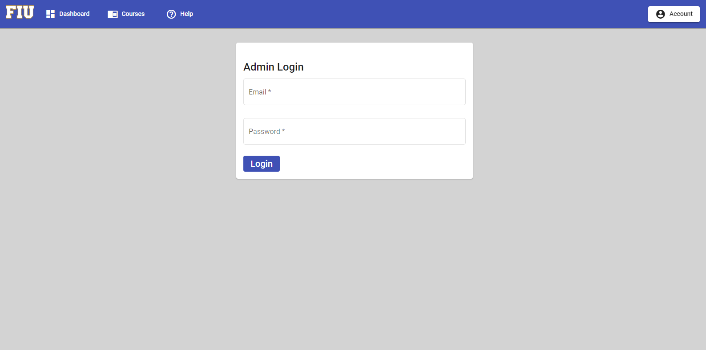
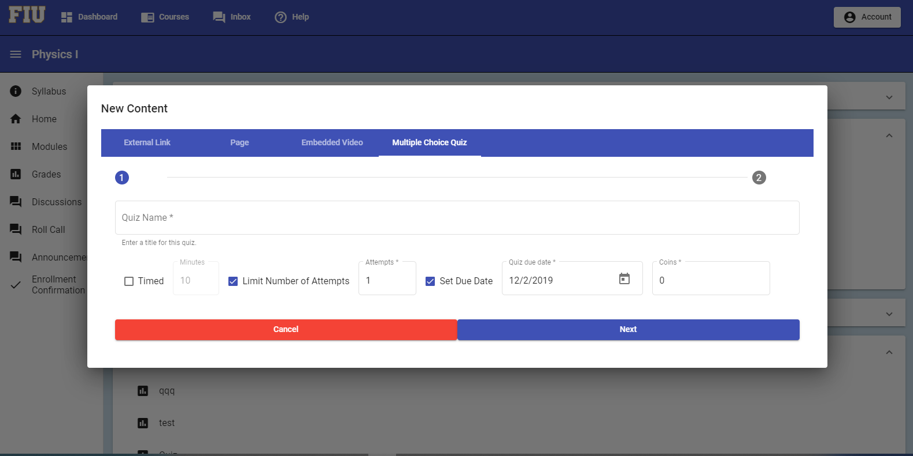
School of Computing & Information Sciences
Fall 2019 Senior Design Project
Basic Learning Management System on Facebook Ver 3.0
Students: Joao Guimaraes & Danny Rodriguez
Product Owner: Dr. Alejandro Arrieta
Instructor: Dr. Masoud Sadjadi, Florida International University
Problem
Current System
Requirements
Online learning has become ubiquitous for its accessibility and convenience, but internet data usage, in South America and other regions, can be extremely limited.
Facebook Groups allows educators to leverage Facebook’s infrastructure and take advance that it’s website is exempt from data usage billing in many countries, but lack the features of a complete learning system.
A lightweight Learning Management System, with federated authentication with Facebook.
An Easy-to-use system to create Courses, with discussions, quizzes, reference pages, and links to videos and other resources.
Federated Authentication with Facebook.
User registration with the Learning System.
Course Enrollment Approvals.
Admin/Instructor Authentication done outside of Facebook
Ability to link to other resources
Ability to share / link to YouTube videos
System Design
Object Design
Implementation
NodeJs, fully JavaScript, was used to build the backend RESTful API for the client application; it utilizes Firebase, a noSQL database, which is linked to a Google Cloud Project.
Angular CLI streamlines the creating of components for the Angular Client Application.
Angular was the JavaScript framework used to develop the Client Application, it uses TypeScript, a super set of JavaScript; it need to be compiled into JavaScript.
Screenshots
Summary
Verification
Students sign-in with Facebook, and are able to register for courses.
Once approved by an admin, users can access any content added by the instructor.
Admins can register more instructors into the system.
Instructors can easily manage courses adding and configuring content.
There is plenty of room for adding new content types and expanding on the gamification angle. The method of payment and using Facebook’s Graph API for notifications is yet to be implemented.
Test Case ID | LMSF-03-07
Description/Summary | Unauthenticated user has no access to courses or it’s contents
Precondition | User is not logged in to Facebook or through the app as an admin, and attempts to navigate to a course page.
Expected Results | User is redirected to registration page.
Actual Result | User is redirected to registration page.
Status (Fail/Pass) | Pass
Test Case ID | LMSF-03-08
Description/Summary | Unauthorized user has no access to restricted admin tools.
Precondition | User is not logged in as an admin and therefore has not authorization to use admin functions or access admin pages.
Expected Results | User is redirected to the home page.
Actual Result | User is redirected to the home page.
Status (Fail/Pass) | Pass
Acknowledgement
We thank Dr. Masoud Sadjadi and Dr. Alejandro Arrieta for assistance, cooperation and mentorship that we received throughout this process

