Slide 1
The Smart Choice in Home Sales
By Jason Wattier, Ravi Kiran Yernena, & Tyler Kotnour

Slide 2
Background: The Smart Choice
100 Best places to live (CNN Money, 2008 and 2010):
2008: Ranked 53
2010: Ranked 9
What makes Ames a great city?
Low unemployment
Low personal and property crime
Low commute times
Good air quality
Ames’ motto is the Smart Choice (City of Ames, 2020).
Top Employers (City of Ames, 2010)
Iowa State University
20.37% of total employment
Iowa Department of Transportation
Mary Greeley Medical Center
McFarland Clinic, P.C.
Sauer-Danfoss Company

Slide 3
Background
2010 Community Facts (United States Census Bureau, 2010):
Population: 58,965
29.6% of people aged 20 to 24
Median population age: 23.8
Race:
White 84.5%
Black or African American: 3.4%
Asian: 8.8%
Other: 3.3%
Housing
Households by Type
Total Households: 22,759
Average Household Size: 2.25
Average Family Size: 2.82
Housing Occupancy
Total Housing Units: 23,876
Occupied housing units: 22, 759

Slide 4
Objective
Providing data-informed insights to realtors and prospective home buyers and home sellers in Ames, IA.
The Smart Choice in home sales:
Target:
Realtors
Home buyers and home sellers
Beyond housing price prediction
Important features that impact housing prices
Insights for negotiations

Slide 5
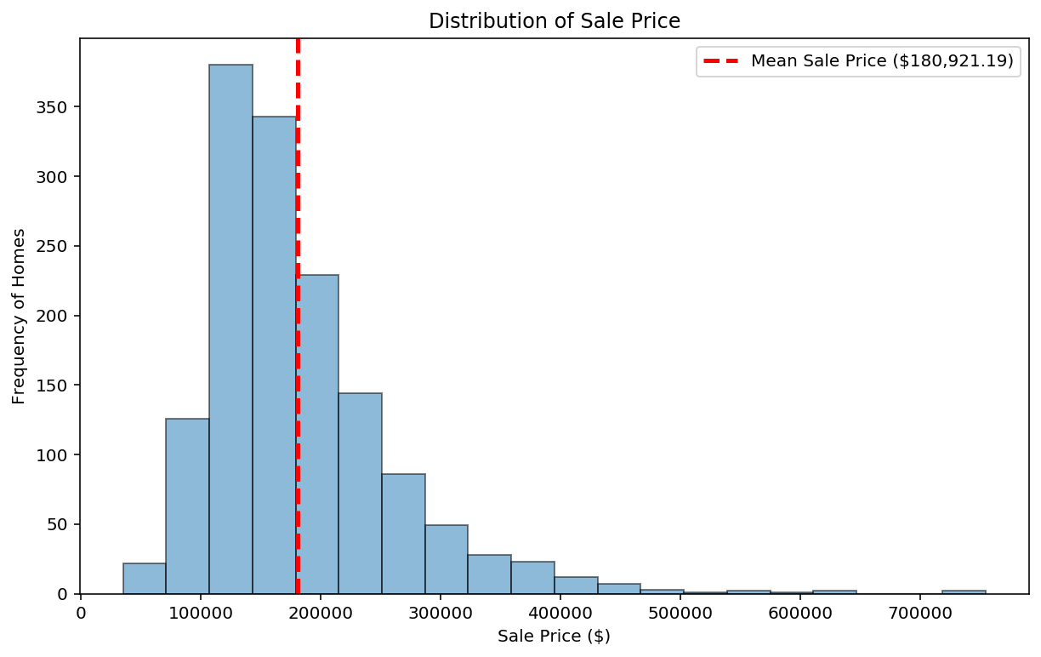
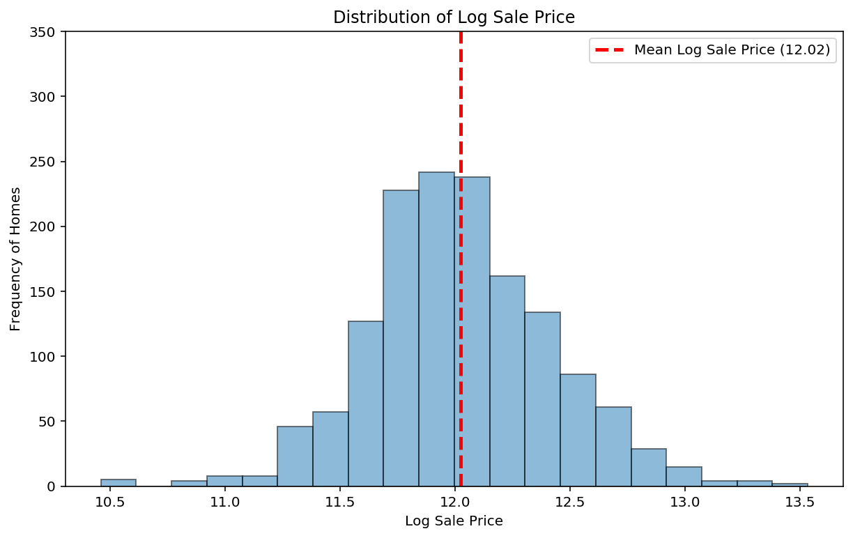
Sale Price
Prediction Target: Sale Price
$60,000
$163,000
$442,000

Slide 6
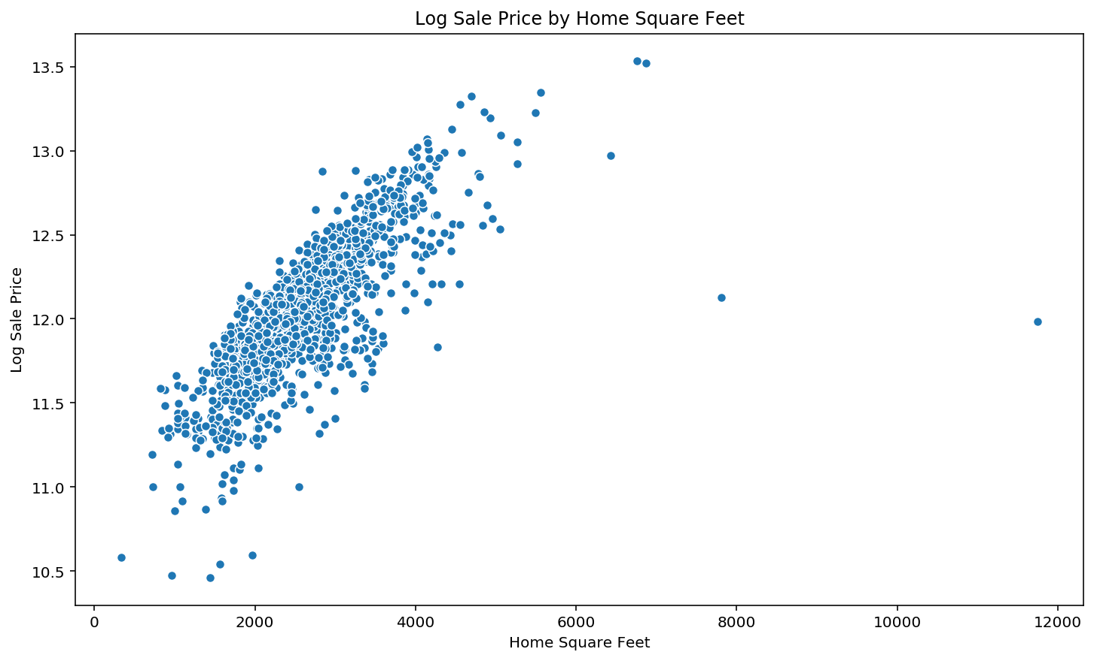
Focus Areas
Total Home Square Feet
Linear trend
Observable outliers
Exceptions to the rule that do not represent the general trend.

Slide 7
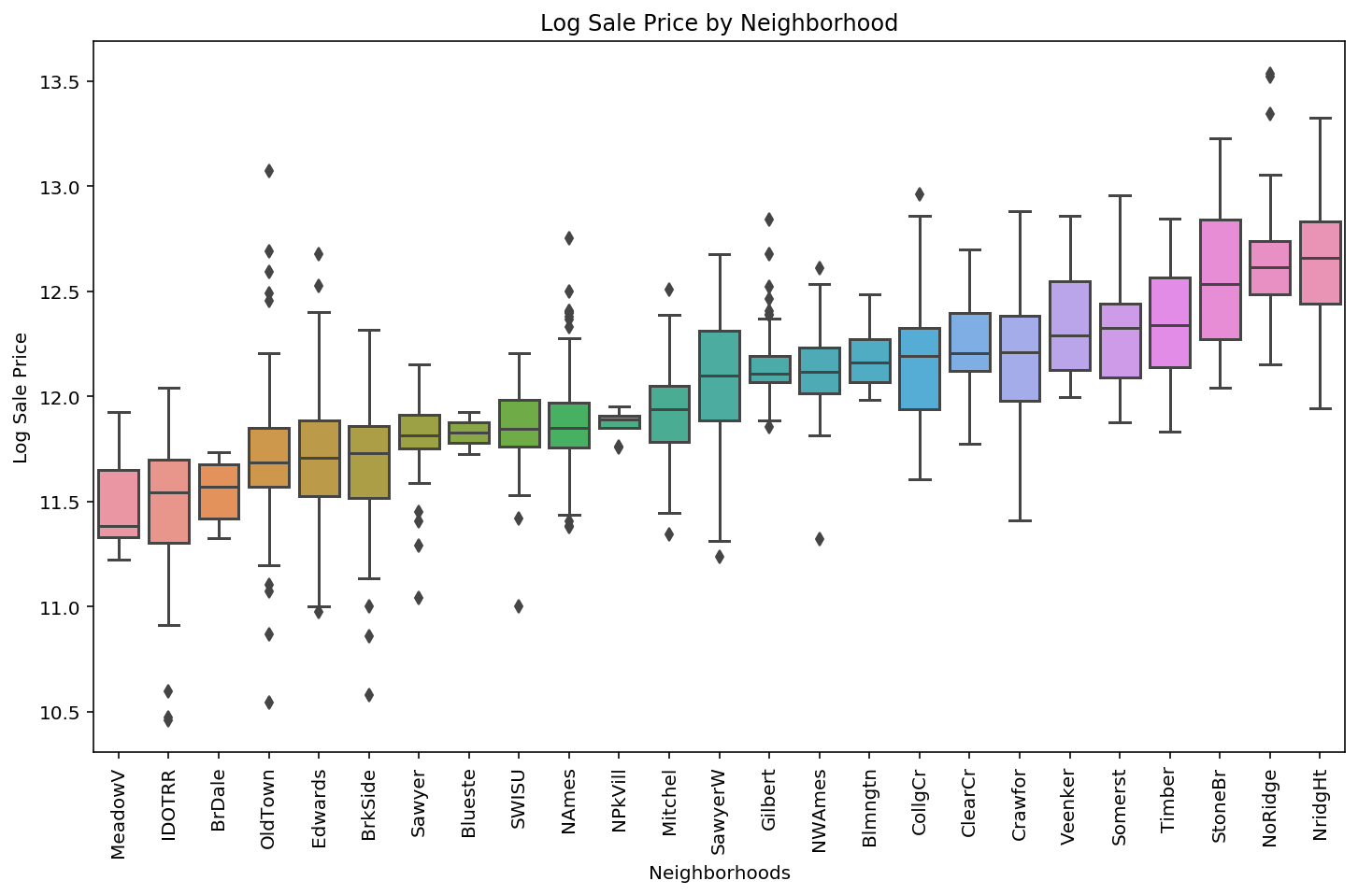
Focus Areas
Neighborhoods
Top 3:
Northridge Heights
Northridge
Stone Brooke

Slide 8
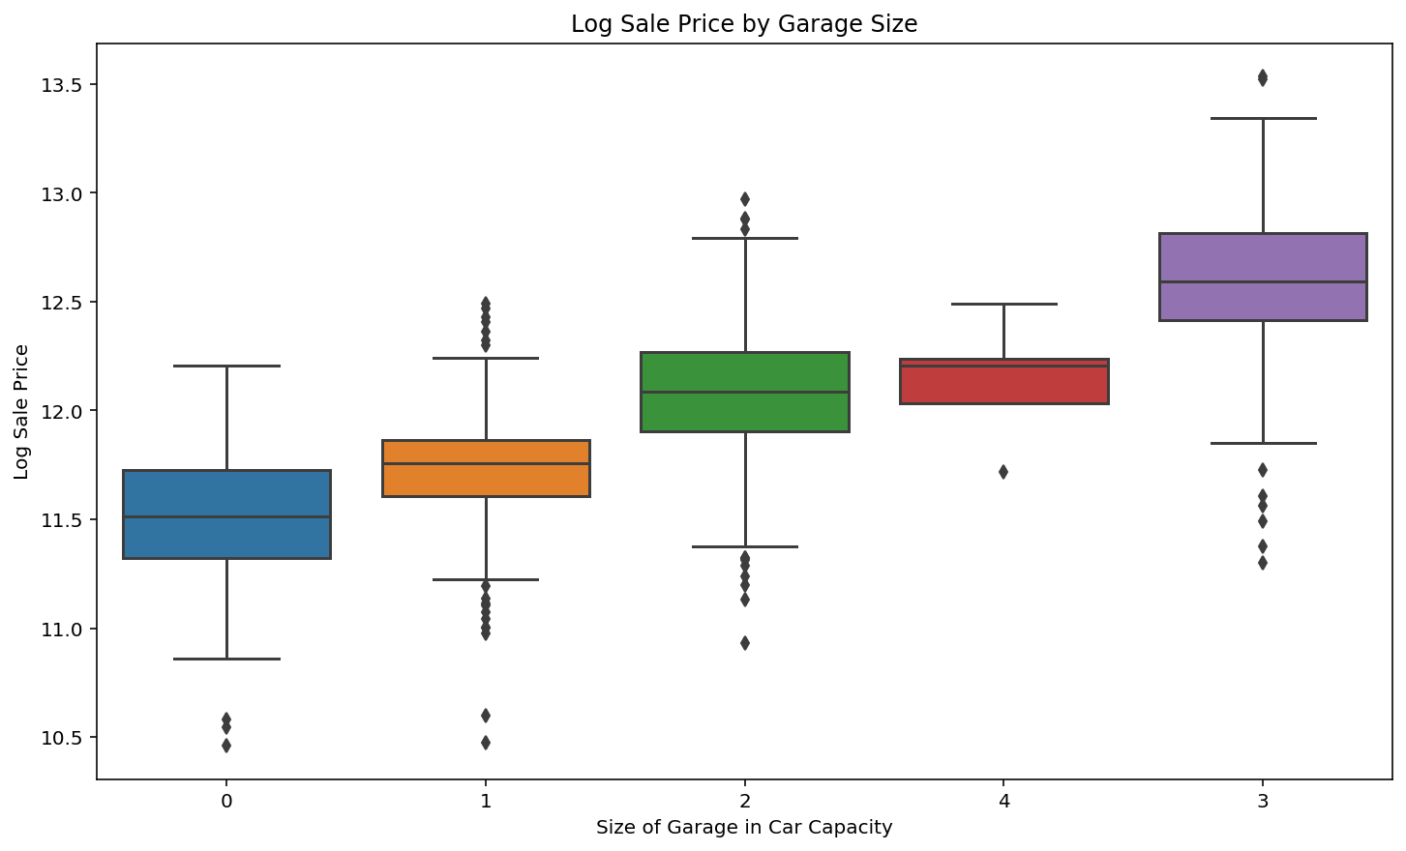
Focus Areas
Garage Size (car capacity)

Slide 9
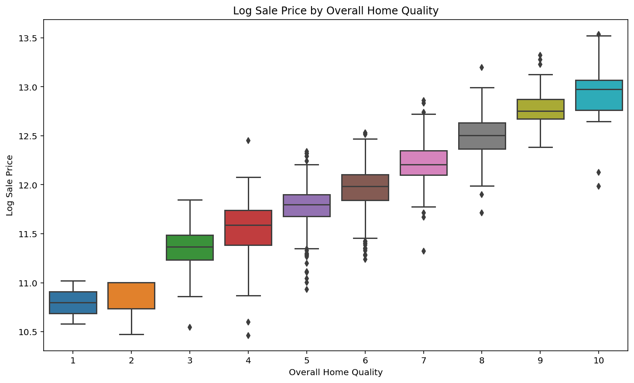
Focus Areas
Overall Home Quality

Slide 10
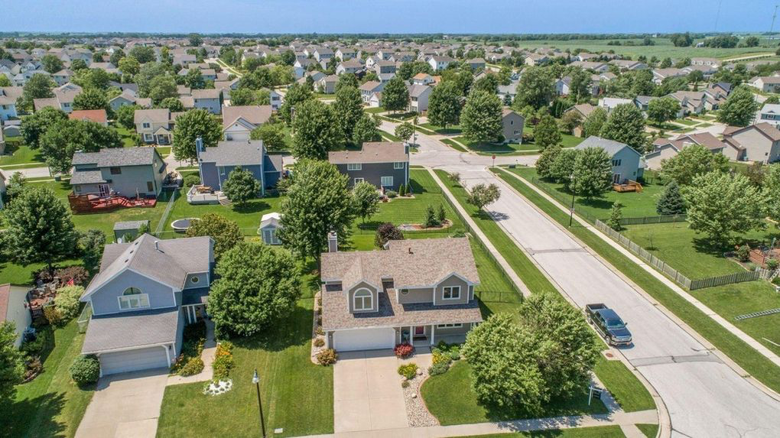
Key Takeaways
Top Influencers on Home Price
Positive Factors
Building Square Footage
Overall Home Quality
Number of Highly-Rated Amenities (e.g., nice kitchen, good basement living space)
Bathroom Count
Negative Factors
Home Age
Lack of Basic Amenities (e.g., lack of central a/c, old electrical system)

Slide 11
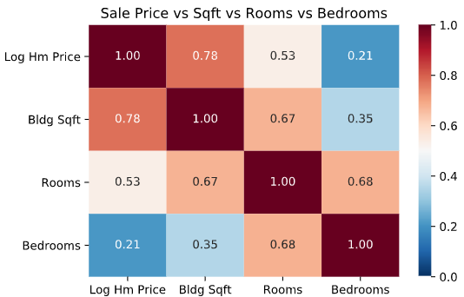
Key Takeaways
Square Footage > # of Rooms > # of Bedrooms

Slide 12
Model Performance - Example Predictions
Example 1 (ID 1095):
1872 Square Foot House
Low Overall Quality Rating
2 Bathrooms
1 Highly-Rated Amenity
Lacking 1 Basic Amenity
10 years since remodel
Actual Sale Price - $129,000
Predicted Sale Price - $131,300
Difference - $2300
Example 2 (ID 1290):
3055 Square Foot House
Good Overall Quality Rating
2 ½ Bathrooms
3 Highly-Rated Amenities
Not Lacking Any Basic Amenity
New Home
Actual Sale Price - $281,000
Predicted Sale Price - $264,700
Difference - $16,300

Slide 13
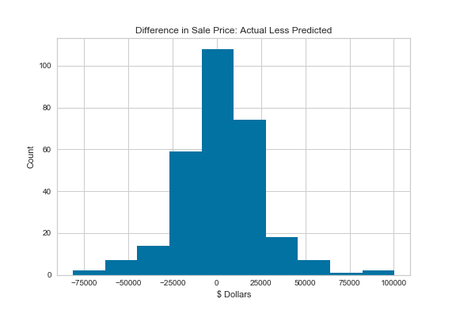
Model Performance Overall
Most predictions are close to the actual sale price
Average difference is $2,000 and
Half of predictions are within 7% of the actual sale price
Notes:
Note that model / takeaways are to utilize are analysis/model insights as a guide, but not the final answer as their are differences in practice.

Slide 14

Conclusion
Ames, IA
Best places to live
Objective
Target
Focus Areas of Research
Future Work
Fine tune model and evaluate if precision range can be narrowed

Slide 15
References
City of Ames. (2010). Comprehensive annual financial report: For year ending June 30, 2010. Retrieved from https://www.cityofames.org/Home/ShowDocument?id=11004
City of Ames. (2020). About us. Retrieved from https://www.cityofames.org/about-ames/about-ames
CNN Money. (2008). Best places to live: Money’s list of America’s best small cities. Retrieved from https://money.cnn.com/magazines/moneymag/bplive/2008/states/IA.html.
CNN Money. (2010). Best places to live: Money’s list of America’s best small cities. Retrieved from https://money.cnn.com/magazines/moneymag/bplive/2010/snapshots/PL1901855.html.
United States Census Bureau. (2010). American fact finder. Retrieved from https://factfinder.census.gov/faces/tableservices/jsf/pages/productview.xhtml?src=C

Slide 16
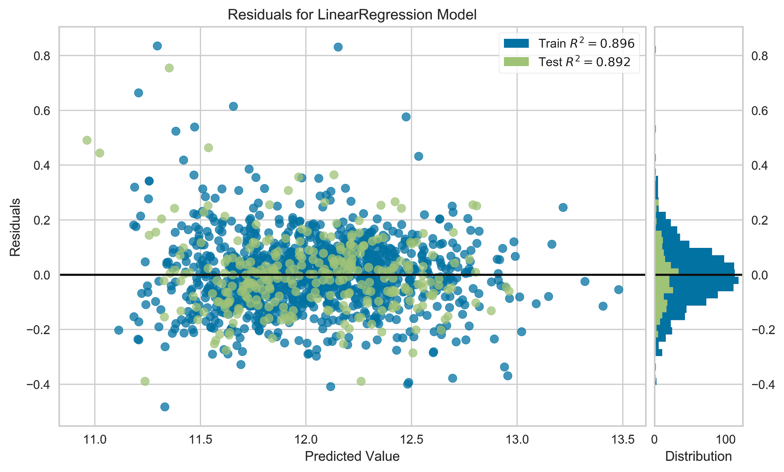
Appendix - Model Information Predicted vs Actual

