Slide 1
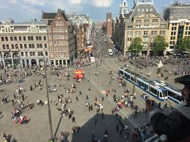
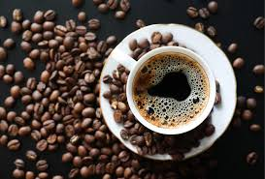

Investing in a Coffeeshop in the citycenter of Amsterdam
The best location!

Slide 2
Problem statement
What is the best place to open a coffee shop in the center of Amsterdam.
Commercial requirements:
Located in the citycenter of Amsterdam (De Dam)
Close to one of the parks in Amsterdam
Not to many other coffeeshops in the surrounding

Slide 3
Methodology
For this analysis we need to have:
Foursquare data (connected with developers API)
IBM Cloud for fast computing
Python 3.7 running in Jupyter Notebooks
(with relevant libraries)

Slide 4
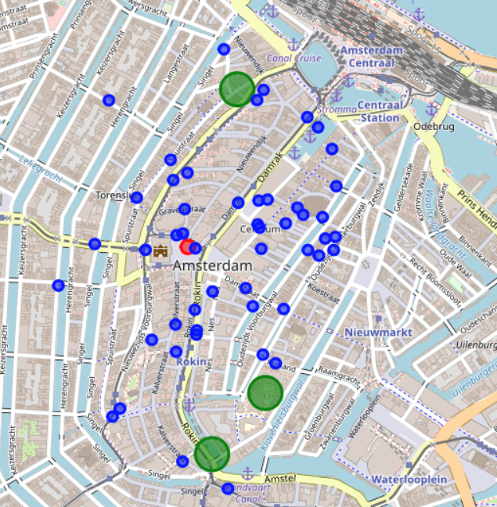
The Results
The Red dots
Citycenter of Amsterdam (De Dam)
Blue dots
Venues within a 500 meter radius from the citycenter
Green circles
Parks within 500 meter radius from the citycenter

Slide 5
Conclusion
Near the red box is the best place to locate a new coffeeshop in Amsterdam

