Slide 1
Benjamin and Charlotte (BnC)
Code Breaking Multiplayer Game
(React + Ninja + Websocket)

Slide 2
Before jumping into code…
I. Multiplayer
II. Project Overview
III. Game Library
Notes:
Why I chose the tools (framework, libraries, etc)
How did I design the challenge
Deeper dive…

Slide 3
Quick Demo
Notes:
https://bnc-client-psi.vercel.app/
https://github.com/jwc20/bnc-game
- ----------- git clone git@github.com:jwc20/bnc-game.git

Slide 4
Multiplayer
Polling vs. Streaming
WebRTC vs. Websocket

Slide 5
Multiplayer on Web App
There are two approaches:
Polling Data
2. Data Streaming
Notes:
Without these two approaches, I would have to make the project using the standard HTTP requests, and making the users
- Enter input
- Refresh the page
https://htmx.org/docs/#swapping

Slide 6
Polling
Polling:
Client periodically sends HTTP request to the server to get data
(Ex.) Send notifications for recent likes in social media
Long/Load Polling:
Client sends HTTP request, server holds the connection open and waits for new data, then responds with that data.
(Ex.) Chat app -> “any new messages?” request
Notes:
Polling:
(Ex.) In the previous startup I worked at, create a Cron Job/scheduler to scan through Likes table in the database -> send notifications -> mark the data as ”sent”
(bnc) Players makes post request to make a guess, after a period of time, other players actions are displayed
Long Polling:
Periodically send HTTP request, after getting the request, the server waits, and sends back response containing the data that was received in the wait
Example:
A chat application where your browser sends a request to the server asking "any new messages?"
The server waits up to 30 seconds for someone to send a message,
then responds either with the new message or "no messages" if the timeout expires.

Slide 7
Problem with Polling
Delayed updates and lags
If we were to use polling for this project,
Then, game events only appear after the polling interval completes
Notes:
game events (winner declared, game over, new player moves)
It would be ok if the interval is 1-5 seconds, but that would be expensive (resource intensive)

Slide 8
Data Streaming
WebRTC
Websocket

Slide 9
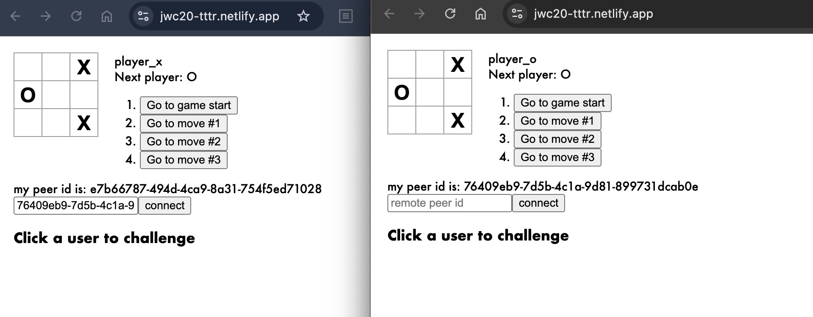
WebRTC
Peer-to-peer connection with two or more users
Continuous data stream
Browser dependent
Communication is handled on the client
Peer.js library
Notes:
Browser dependent
not a problem for most modern browsers (Chrome, Safari, Firefox) but may cause performance problems on mobile browsers.
The problem with webrtc is that, since the connection is p2p and requests are not sent to the server, we can't validate the input or data that is sent and received between users.
https://jwc20-tttr.netlify.app/

Slide 10
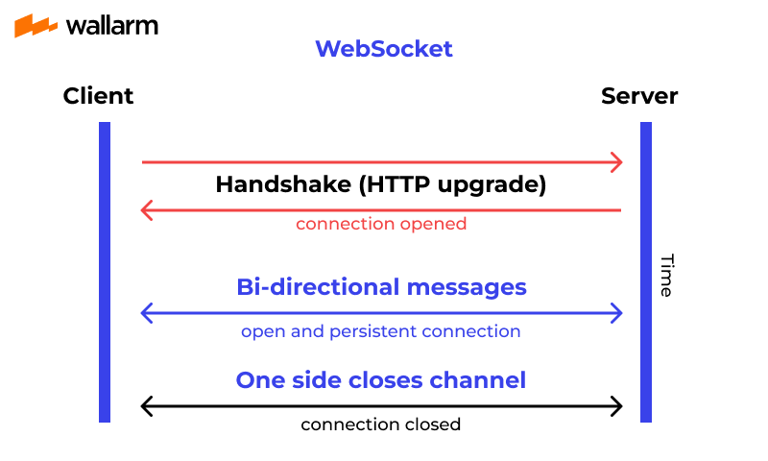
Websocket
Two-way connection that allows both client and server to send small data packets instantly to each other.
Notes:
Typical Websocket Flow
1. Client makes HTTP request to the server asking to open a connection.
2. If the server agrees, it sends a 101 switching protocol as a response.
3. Afterwards, the handshake is complete and TCP/IP connection is left open, allowing two-way, bi-directional messages to be passed between two parties.
4. When one of the party's connection drops off, TCP/IP connection is closed and the TCP resource is unallocated. This is called full-duplex connection.
5. If the connection is active, the server is listens for messages that a user send.
---
TCP/IP is the fundamental networking protocol that enables communication over the internet. It's a two-layer system:
TCP (Transmission Control Protocol): Ensures reliable, ordered delivery of data packets
IP (Internet Protocol): Handles routing data between devices across networks
In your WebSocket example, TCP/IP provides the underlying network connection that stays open, while WebSocket is the higher-level protocol that uses this connection for real-time messaging.

Slide 11
Project Overview
What did I use?
Why did I use it?
How did I use it?

Slide 12
BnC project
Frontend Client
Backend API
TypeScript
React
React-use-websocket
Zustand
React-router
OpenAPI-ts
Python
BncPy (Game Library/Logic)
Django-Ninja
Django-Channels
PostgresSQL
Custom Token Auth. (Knox)
Notes:
Ruff for python linting
eslint

Slide 13
Demo Deployment
App | Service
Frontend Client | Vercel
Backend API | Render
Postgres DB | Supabase
Redis | Redis Cloud
Game Library (bncpy) | Pypi
Notes:
Note:
Render needs to be pinged to keep alive

Slide 14
Django-Ninja
Pydantic
Automatic Documentation
Swagger/OpenAPI.json
Is Django
Use libraries like Django Channels
Native Authentication
Code generation (startproject, startapp cli commands)
Better project organization (MTV pattern)
Notes:
Asynchronous code execution
Built-in Pydantic support for data conversion, validation, and automatic documentation
OpenAPI and Swagger integration
Ninja is built on top of Django’s foundation.
Native Authentication -> I don’t have to install jwt token library, bcrypt library
MVT (Model View Template)

Slide 15

bncpy
Game Logic
Notes:
https://github.com/jwc20/bncpy

