Slide 1

Chemprop++
New Features + Tips and Tricks
for Building Better Models
Kyle Swanson, Kevin Yang, Wengong Jin, Lior Hirschfeld, Tommi Jaakkola, Regina Barzilay

Slide 2
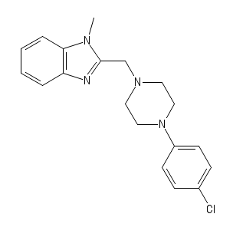
What is Chemprop?
Chemprop is a message passing neural network (MPNN)
MPNNs iteratively aggregate local chemical features to predict properties
Score

Slide 3

Requirements
Python 3.6 via anaconda
For <10K molecules – can use laptop
For >10K molecules – need a GPU
Train in minutes to hours
Predict 1,500 molecules per second

Slide 4
Data, Training, and Predicting

Slide 5
Data
CSV with SMILES strings and property values
Previously: SMILES in first column, properties in remaining columns
NEW: Same default, but optionally specify SMILES/property columns
--smiles_column smiles
--target_columns NR-AR SR-ARE

Slide 6
Training
python train.py --data_path data/bace.csv --dataset_type classification
Trains a default chemprop model
Save model: --save_dir /path/to/save_dir
Full list of options: chemprop/args.py
NEW: --class_balance samples equal number of positive and negative molecules in each batch – may help unbalanced datasets

Slide 7
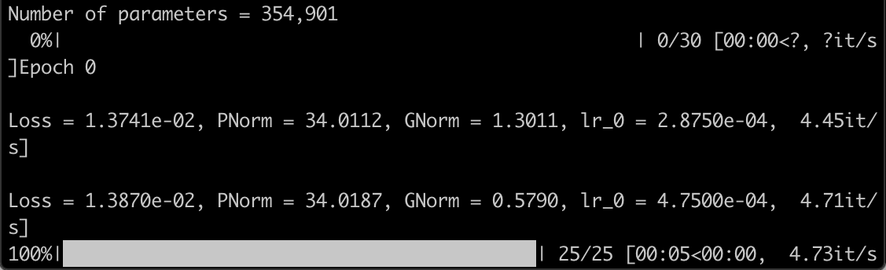
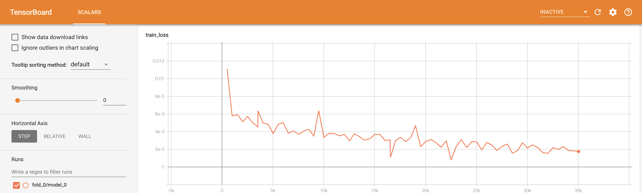
Training output
Loss and metrics printed during training
Summary: save_dir/quiet.log
Full output: save_dir/verbose.log
Graphical interface: tensorboard --logdir save_dir, then localhost:6006

Slide 8
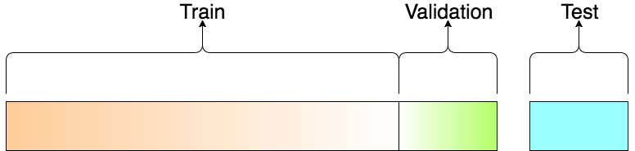
Splitting data
--split_type random
Split data randomly into train, validation, test sets
--split_sizes 0.8 0.1 0.1
Determine sizes of train, validation, test sets
--num_folds 5
Number of cross-validation folds
--separate_val_path /path/to/val.csv
--separate_test_path /path/to/test.csv
Manually specify validation and test data

Slide 9
Reproducibility
--seed 0
Seeds the random data splitting
NEW: --pytorch_seed 0
Seeds the random model weight initialization
Training is now fully reproducible*
*Caveat: “Completely reproducible results are not guaranteed across PyTorch releases, individual commits or different platforms.”

Slide 10
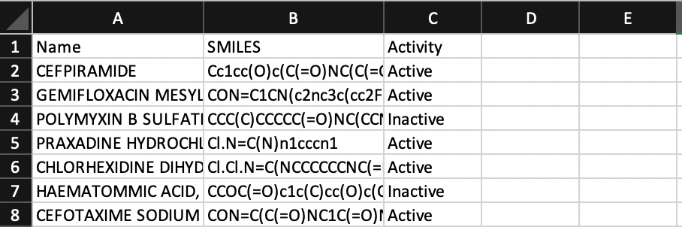
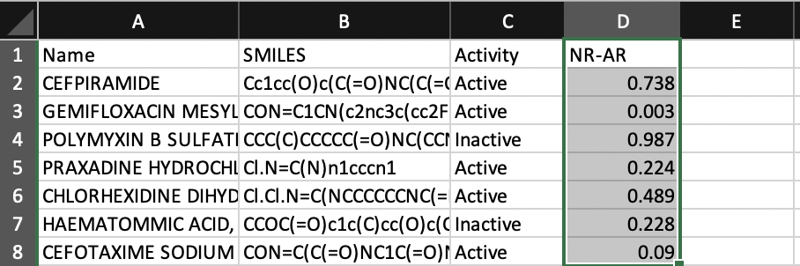
Predicting
python predict.py --test_path data/bace.csv --preds_path preds.csv --checkpoint_dir save_dir
Previously: SMILES in first column
NEW: Optionally specify SMILES column with --smiles_column SMILES
NEW: Data from test_path is copied to preds_path

Slide 11
Enhanced Models

Slide 12

Additional Molecular Features
Score

Slide 13
Additional Molecular Features
Score
--features_generator rdkit_2d_normalized
200 molecular features computed by RDKit
--features_path /path/to/features.npz
Load features precomputed with scripts/save_features.py
Note: Use --no_features_scaling with rdkit_2d_normalized
Add custom features in chemprop/features/features_generators.py
Notes:
Please update both rdkit and descriptastorus for up-to-date features:
conda update rdkit
pip install --upgrade descriptastorus

Slide 14
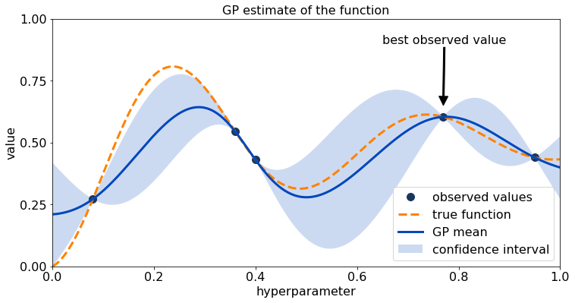
Hyperparameter optimization
Use hyperparameter_optimization.py to optimize model hyperparameters
--num_iters 20
Number of hyperparameter combinations to try
--config_save_path config.json
Where to save best hyperparameter configuration
When training, add --config_path config.json

Slide 15
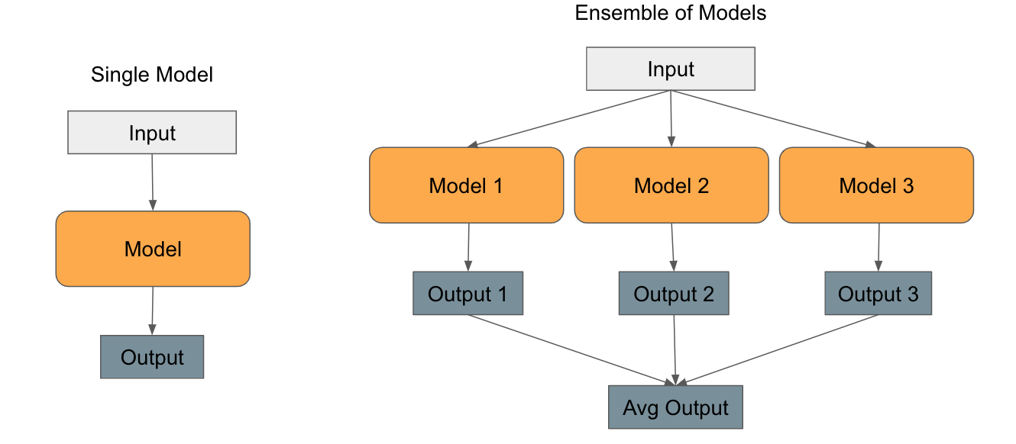
Ensembling
--ensemble_size 5
Trains models with different initial weights
Prediction = average of model predictions

Slide 16
Additional Features

Slide 17
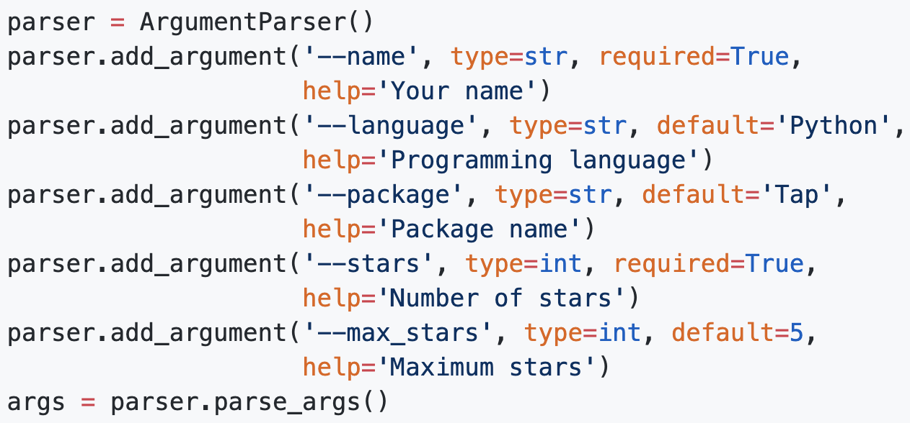
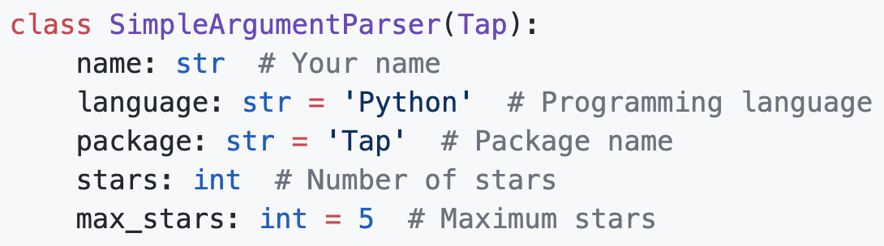
Argument Parsing
Full list of options: chemprop/args.py
Previously, used Python’s built-in argparse
NEW: Cleaner argument parsing with typed-argument-parser
Note: pip install typed-argument-parser

Slide 18
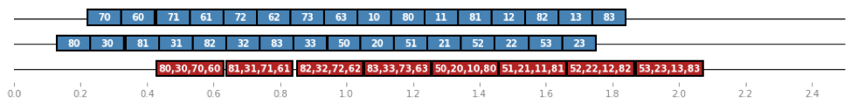
Large Datasets
Previously: memory errors due to caching molecule features
NEW: PyTorch DataLoader
Caching when <10K molecules, parallel loading when >10K molecules
Parallel loading nearly as fast as caching without memory overhead
Automatic but control with: --cache_cutoff 10000 --num_workers 2
Notes:
PyTorch DataLoader suggestion from Drew Wicke
https://medium.com/speechmatics/how-to-build-a-streaming-dataloader-with-pytorch-a66dd891d9dd

Slide 19
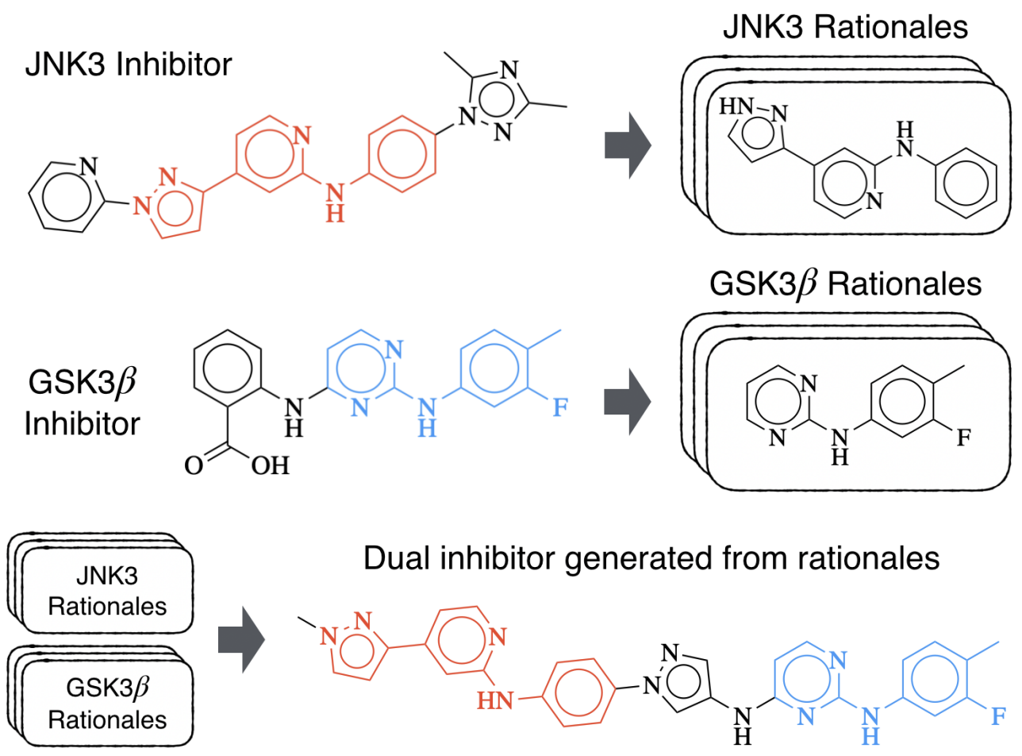
NEW: Model Interpretation
Multi-Objective Molecule Generation using Interpretable Substructures
Wengong Jin, Regina Barzilay, Tommi Jaakkola
Interpret models by finding smallest substructure producing the same prediction
Use interpret.py

Slide 20
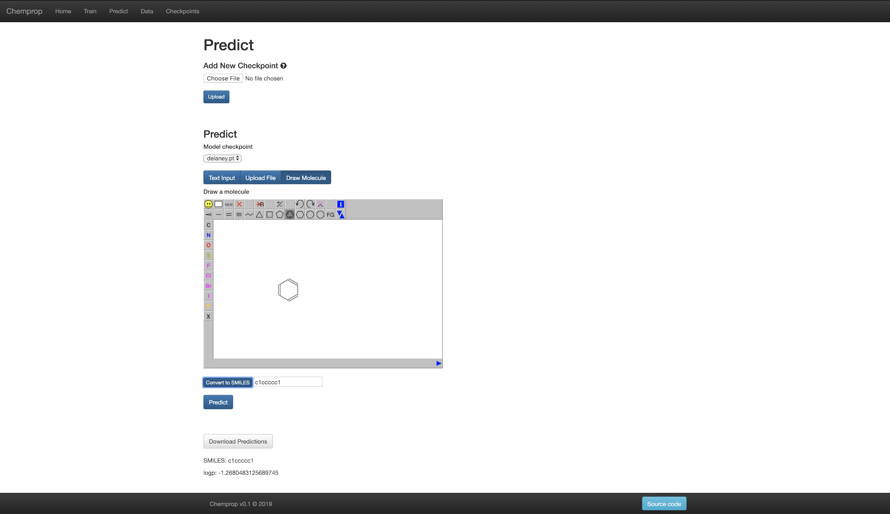
Web Interface
Demo website: chemprop.csail.mit.edu
Local web interface:
python web/run.py
Visit localhost:3000

Slide 21
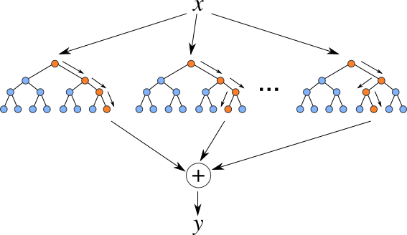
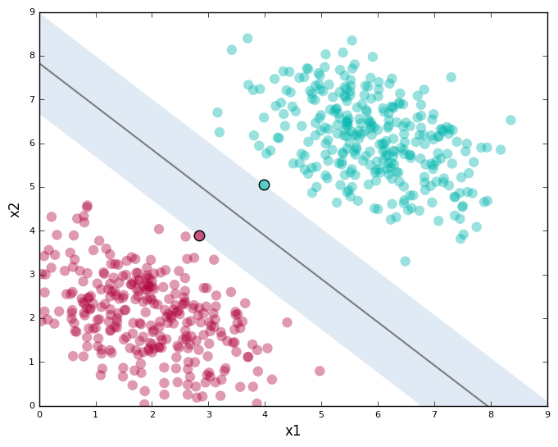
Other ML Models
Chemprop MPNN models are generally best
Other ML models occasionally better for small data
Feed-forward neural network on fingerprints/descriptors with --features_only
Random Forest and Support Vector Machine: sklearn_train.py, sklearn_predict.py

Slide 22
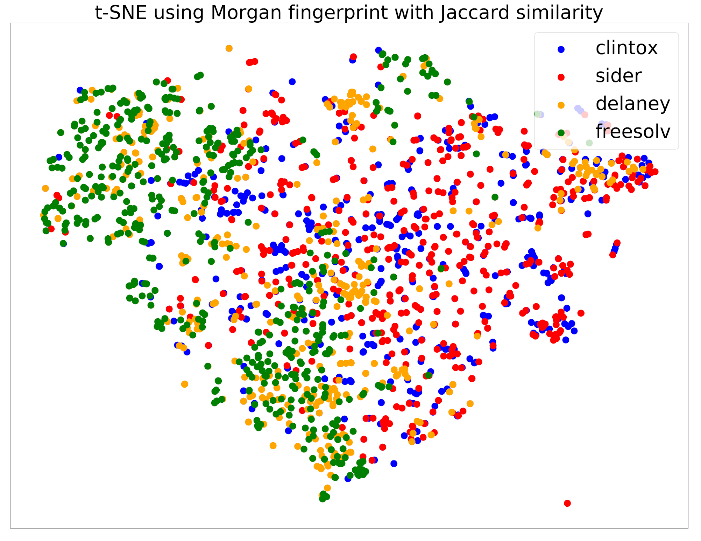
Scripts
Useful scripts in chemprop’s scripts directory
NEW: scripts/tsne.py
t-SNE visualization comparing chemical
spaces of datasets

Slide 23
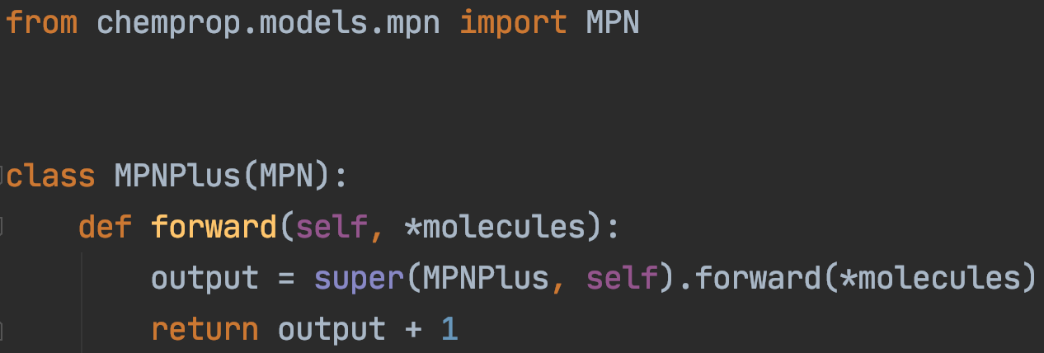
Chemprop as a library
Install chemprop as a library: pip install -e /path/to/chemprop
Flexibility to import and modify any chemprop components

Slide 24
Further Improvements
Thank you for the feedback on chemprop!
Please continue suggesting improvements!
Score

