Slide 1
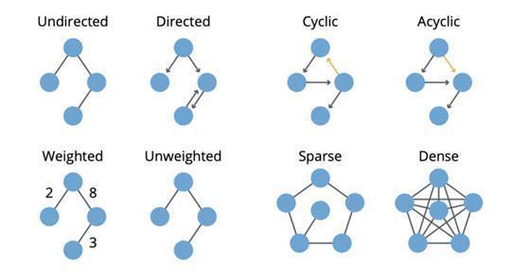
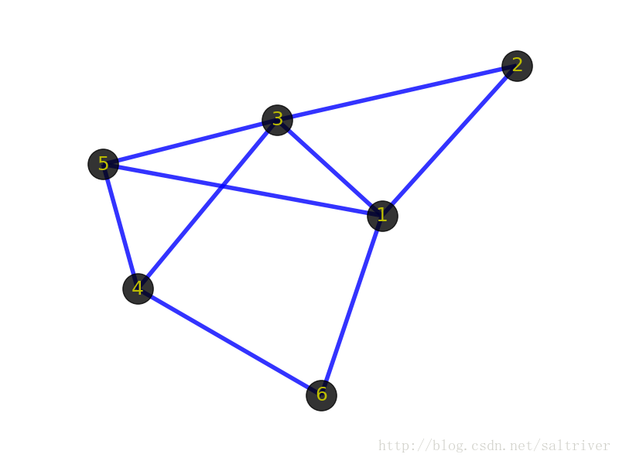
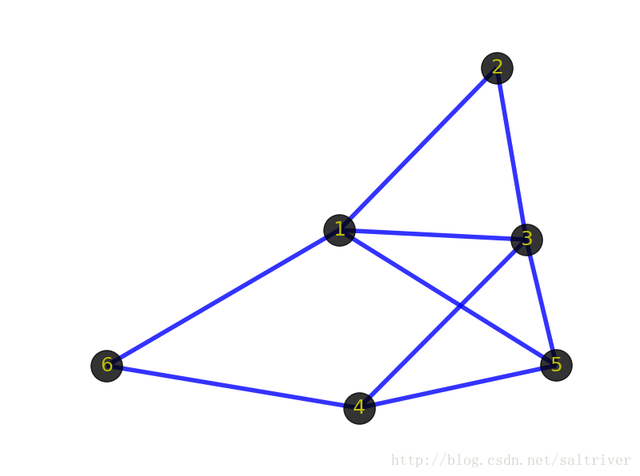
如果可以回到一个给定节点，则该图是有环的(cyclic)。相对地，如果至少有一个节点无法回到，则该图就是无环的(acyclic)。
图可以被加权（weighted），即在节点或关系上施加权重。
如果一个图的边数量相比于节点数量较小，则该图是稀疏的(sparse)。相对地，如果节点之间的边非常多，则该图是密集的(dense)。
同构
Isomorphism

Slide 2
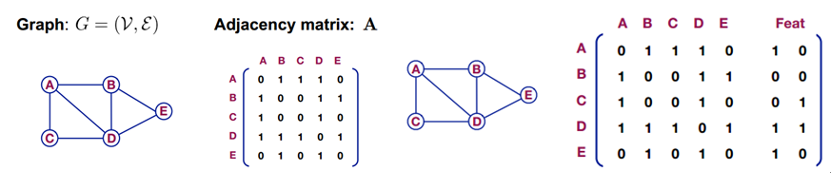
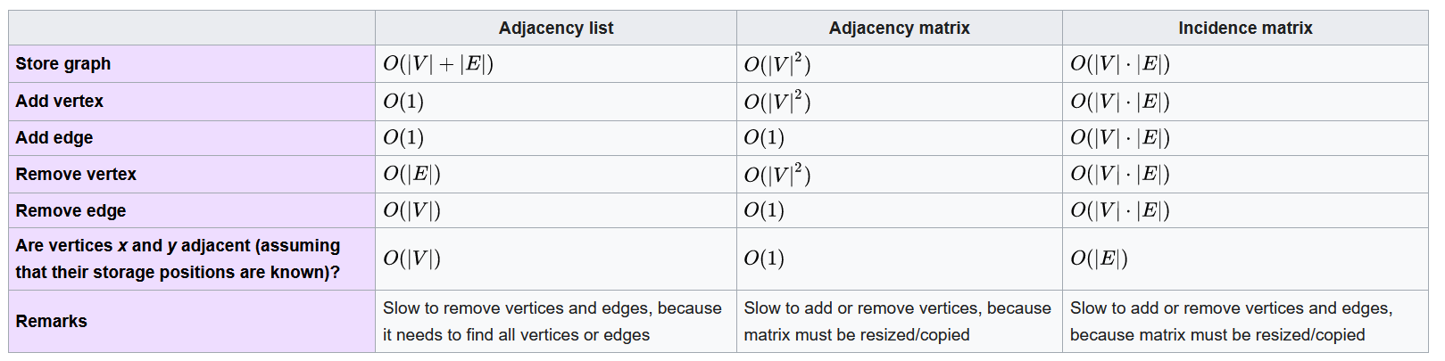
图的基本概念：主要有顶点和边构成，存在一个邻接矩阵A，如果对其中的nodes进行特征表示（Feat）的话如下右图。

Slide 3
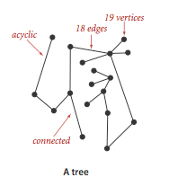
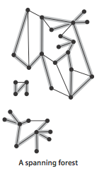
树是一幅无环连通图。互不相连的树组成的集合称为森林。连通图的生成树是它的一幅子图，它含有图中的所有顶点且是一棵树。图的生成树森林是它的所有连通子图的生成树的集合。
https://www.bilibili.com/video/av62661713?from=search&seid=6134263793308325331

Slide 4
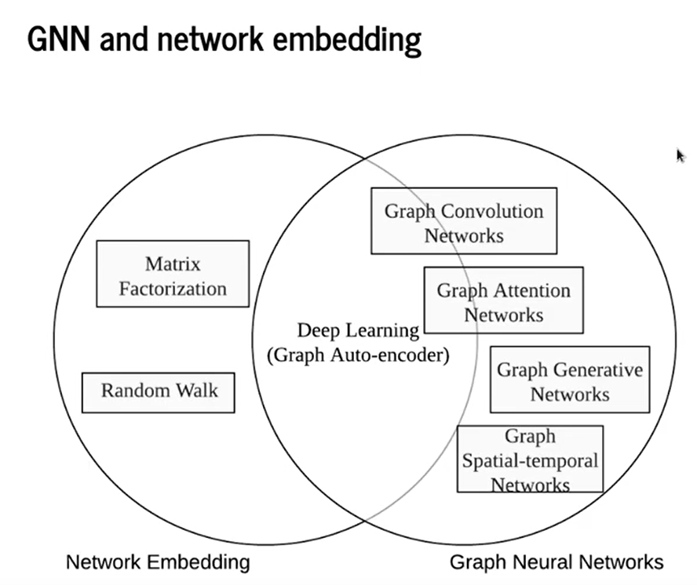
图嵌入、图神经网络、图卷积的关系
图神经网络是一个很宽泛的概念，图神经网络=图+神经网络。我们通俗讲的图神经网络主要指GNN和GCN（类似于深度学习网络中的前馈全连接DNN和CNN）。
图嵌入发展较早，方法主要分为三类：
基于因子分解的方法
基于随机游走的方法
基于深度学习的方法
其中，基于深度学习的图嵌入可以划到图神经网络的范畴。
Taxonomy of GNN
Graph convolution networks
Graph attention networks
Graph autoencoders
Graph generative networks
Graph spatial-temporal networks

Slide 5
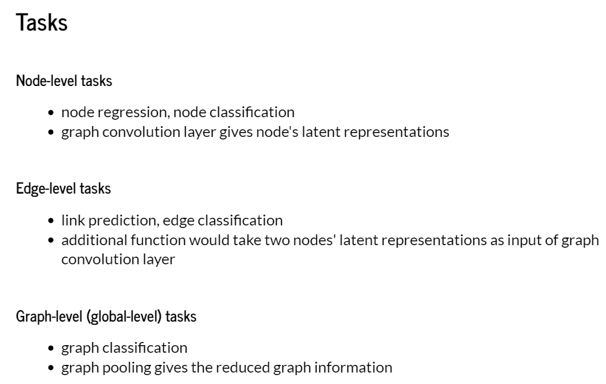
图G=（V，E），很显然，图神经网络就是把整个图G、每个节点V、每条边E转化为稠密向量。当然没必要每次都把G、V、E都进行向量化，哪部分向量化取决于实际的应用场景。一般来说主要包含三类任务： 1 节点层面任务 比如文章最开始提到的引文网络中，节点论文的分类，社交网络中用户标签的分类等。此时，主要关注节点和边层面的特征。 2 边层面任务 比如社交网络中，将用户作为节点，用户之间的关注关系建模为边，通过边预测实现社交用户的推荐。此时，主要关注节点和边的特征。 3 图层面的任务 比如对药物分子的分类。此时，任务不依赖于某个节点或某条边的属性，而是，需要考虑整个图的信息。

Slide 6
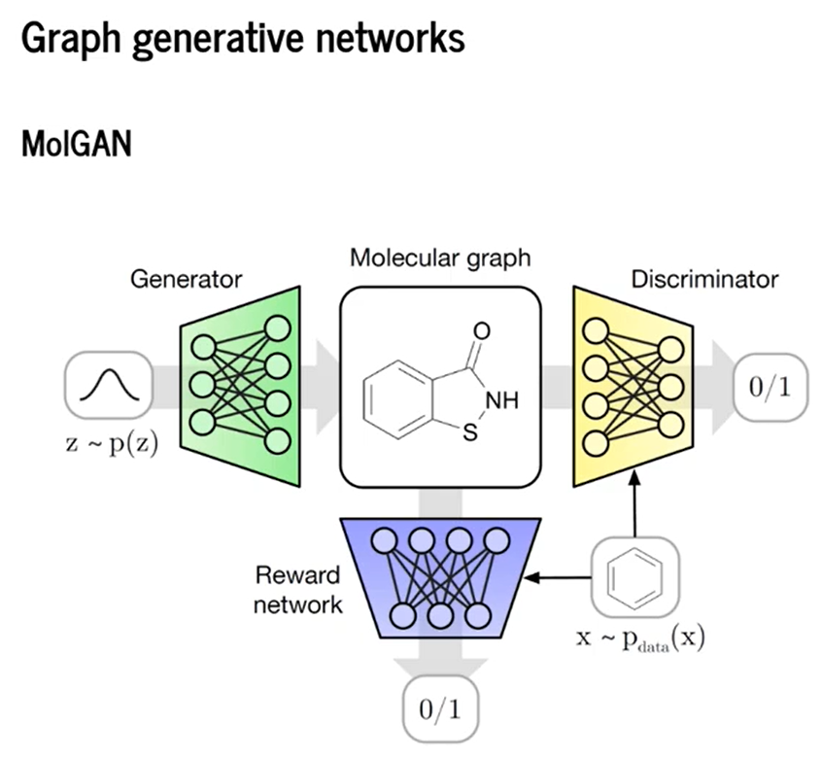

Slide 7
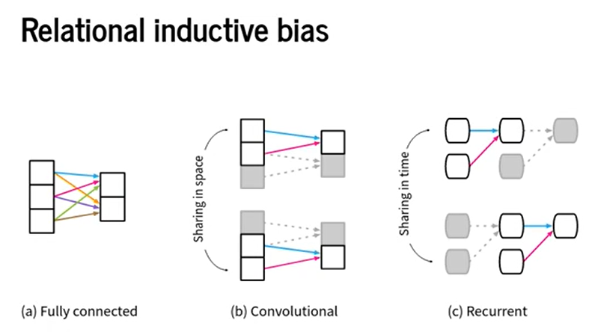

Slide 8
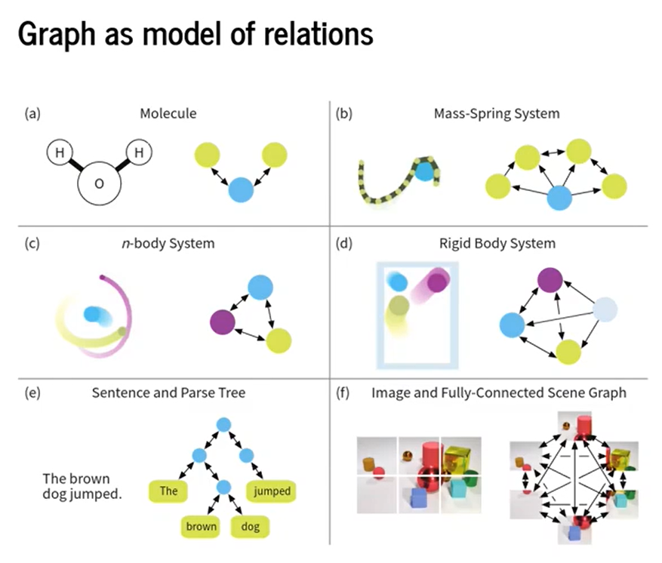
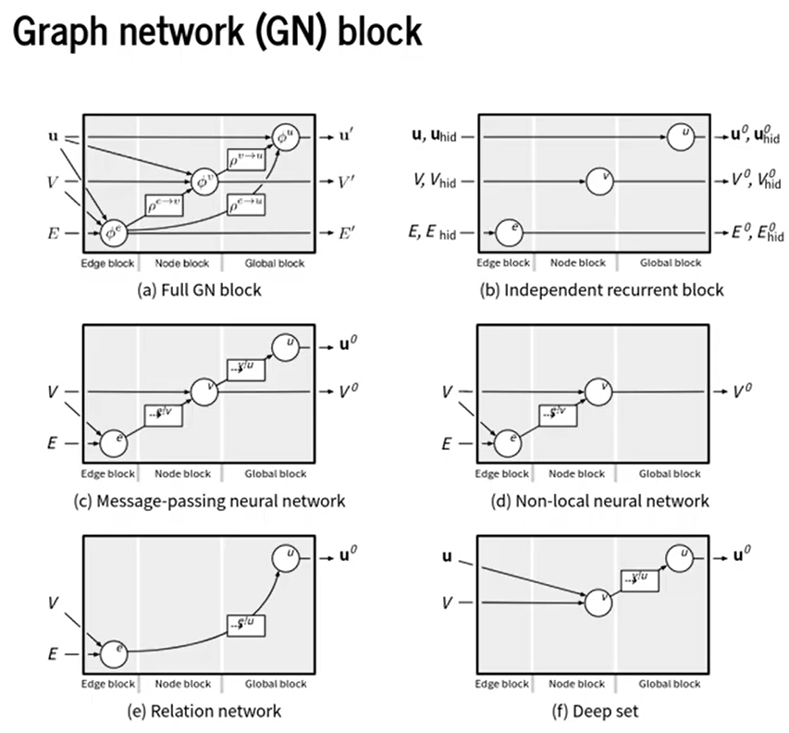

Slide 9
四大图神经网络框架简介
Deep Graph Library（DGL）
New York University（NYU）和Amazon Web Services（AWS）联合推出
PyTorch Geometric（PyG）
德国多特蒙德工业大学研究者推出的基于PyTorch的几何深度学习扩展库
Ant Graph machine Learning system（AGL）
阿里的蚂蚁金服团队推出的大规模图机器学习系统
tf_geometric
受到PyG启发，为GNN创建了TensoFlow版本
Paddle Graph Learning (PGL) 是一个基于 PaddlePaddle 的高效易用的图学习框架。--百度
https://zhuanlan.zhihu.com/p/115342917
https://awesomeopensource.com/projects/graph-neural-networks

Slide 10
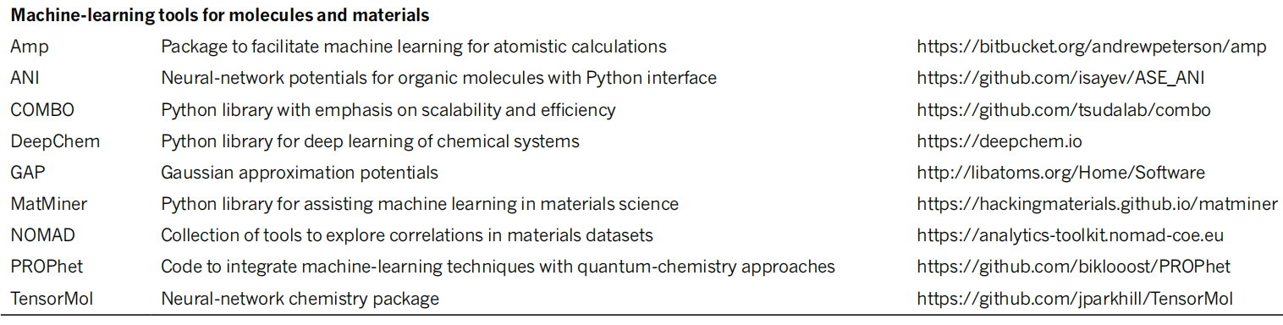
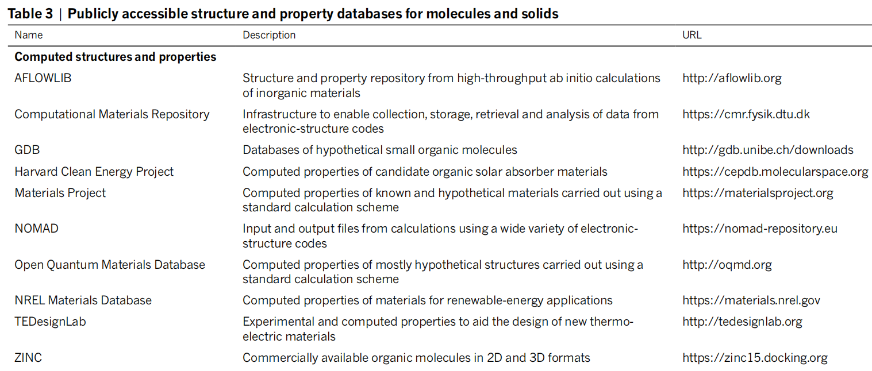
NATUR E | V OL 559 | 26 J U LY 2018

Slide 11
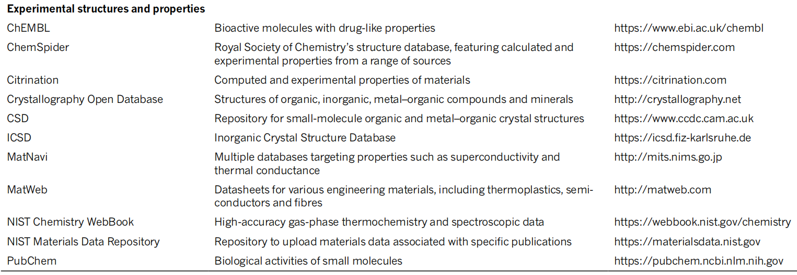

Slide 12
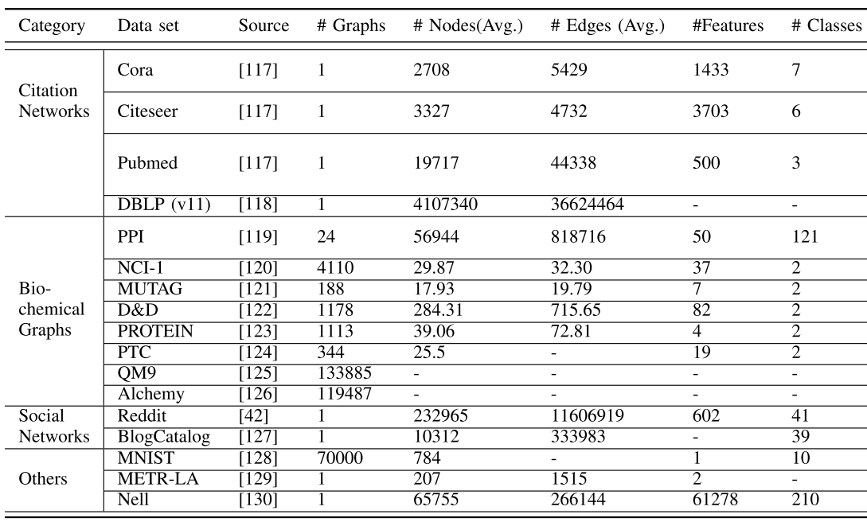
各种开发的数据库
WU et al.: COMPREHENSIVE SURVEY ON GNNs
Biochemical Graphs Chemical molecules and compounds can be represented by chemical graphs with atoms as nodes and chemical bonds as edges. This category of graphs is often used to evaluate graph classification performance. The NCI-1 and NCI-9 data set contain 4110 and 4127 chemical compounds respectively, labeled as to whether they are active to hinder the growth of human cancer cell lines. The D&D and PROTEIN data set represent proteins as graphs, labeled as to whether they are enzymes or non-enzymes. The PTC data set consists of 344 chemical compounds, labeled as to whether they are carcinogenic for male and female rats. Another important data set is the Protein-Protein Interaction network (PPI). It contains 24 biological graphs with nodes represented by proteins and edges represented by the interactions between proteins. In PPI, each graph is associated with one human tissue. Each node is labeled with its biological states. Tox21 program is aimed at developing better toxicity assessment methods. The goal is to quickly and efficiently test whether certain chemical compounds have the potential to disrupt processes in the human body that may lead to adverse health effects.
The QM9 data set records 13 physical properties of 133885 molecules with up to 9 heavy atoms. The Alchemy data set records 12 quantum mechanical properties of 119487 molecules comprising up to 14 heavy atoms. The MUTAG data set contains 188 nitro compounds, labeled as to whether they are aromatic or heteroaromatic.

Slide 13
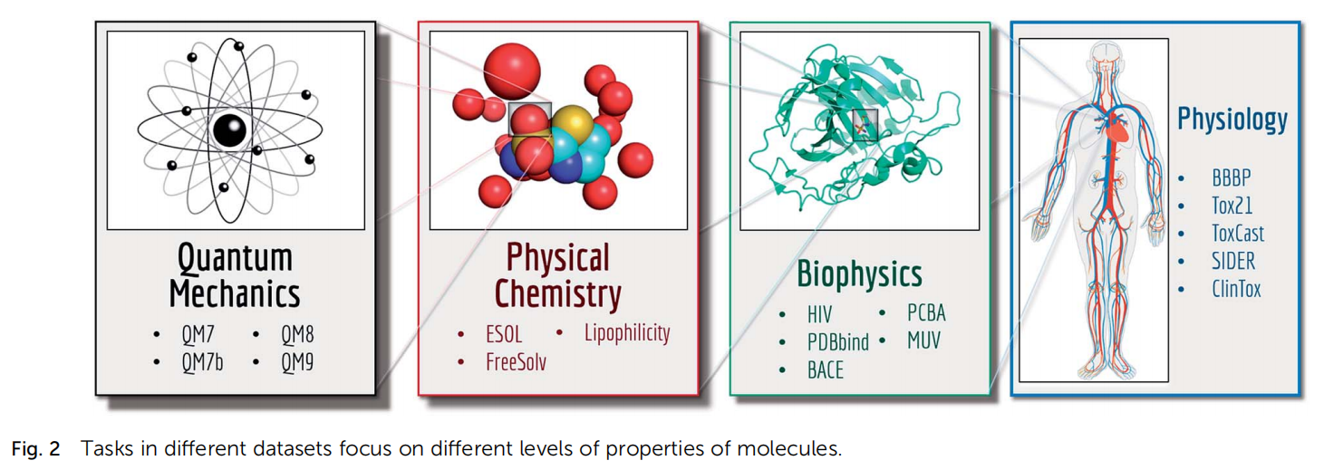
PDBBind is a database of experimentally measured binding affinities for protein-ligand complexes. It contains detailed 3D structures and associated inhibition constants K_{i} for the complexes. http://www.pdbbind.org.cn/
Chem. Sci., 2018, 9, 513–530

Slide 14
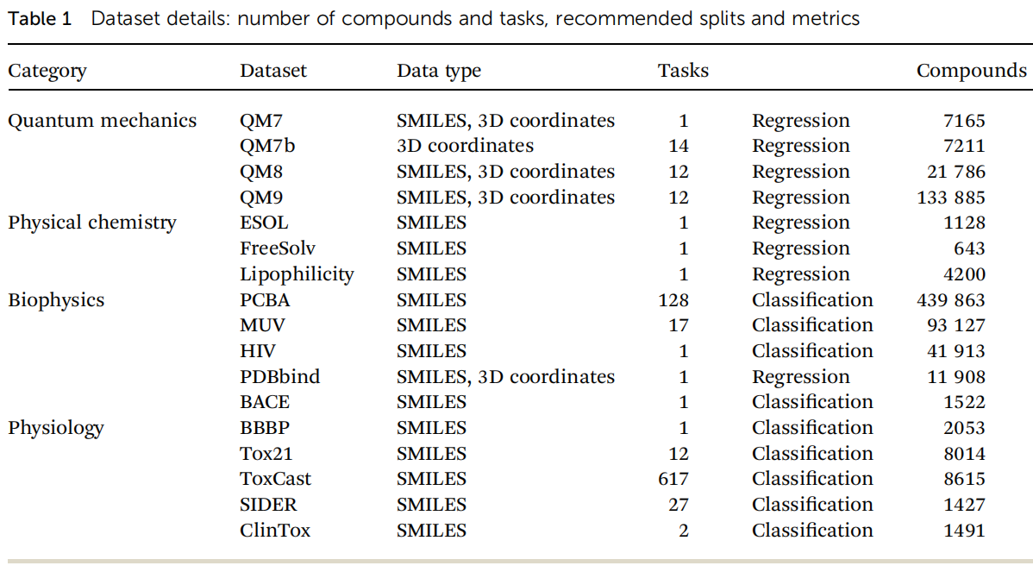

Slide 15
量化数据库
http://quantum-machine.org/
该网址详细归纳介绍了量化的数据库及其相关文献和软件
主页介绍：This website aims to collect useful resources (datasets, benchmarks, etc.) for accelerating the development of a “quantum machine”, a machine that can quickly and accurately simulate quantum-chemical systems from first principles.
https://qmml.org/
https://qmml.org/datasets.html
归纳介绍了量化的数据库
GDB Databases
https://www.gdb.unibe.ch/
https://gdb.unibe.ch/downloads/
GDB-11 enumerates small organic molecules up to 11 atoms of C, N, O and F following simple chemical stability and synthetic feasibility rules.
GDB-13 enumerates small organic molecules up to 13 atoms of C, N, O, S and Cl following simple chemical stability and synthetic feasibility rules.
GDB-17 have enumerated 166.4 billion molecules (11 to 17) of up to 17 atoms of C, N, O, S, and halogens, containing many drugs and typical for lead compounds. The GDB datasets have enumerated up to 166 B organic molecules containing up to 17 heavy (non-hydrogen) atoms. Encoded as canonical SMILES (simplified molecular-input line-entry system) strings, the GDB datasets only provide the molecular formula and chemical connectivity, and do not contain any structural or molecular property information.
2020-04-29: Release of the QMspin database.
2016-11-07: Release of several MD datasets.
2016-05-04: Release of the QM8 dataset.
2014-08-18: Release of the QM9 dataset.
2013-04-05: Release of the QM7b dataset for prediction of multiple molecular electronic properties (atomization energies, HOMO/LUMO eigenvalues, polarizability, etc.) from molecular geometry.
2013-01-01: Release of the QM7 dataset for prediction of atomization energies from molecular geometry.
关于QM7, QM7b, QM9等数据库介绍可见该网址或数据库的文章

Slide 16
ANI-1
a large computational DFT database, which consists of more than 20 M off equilibrium conformations for 57,462 small organic molecules (from GDB-11 database).
1. Smith, J. S., Isayev, O. & Roitberg, A. E. ANI-1, A data set of 20 million calculated off-equilibrium conformations for organic molecules. Sci. Data 4, 170193, 2017. https://doi.org/10.1038/sdata.2017.193
2. Smith, J. S., Isayev, O. & Roitberg, A. E. ANI-1: An extensible neural network potential with DFT accuracy at force field computational cost. Chem. Sci. 8, 3192–3203, 2017. https://doi.org/10.1039/C6SC05720A
Data Records: The data set is provided in an HDF5 based file in a Figshare data repository (https://doi.org/10.6084/m9.figshare.c.3846712). A GitHub repository containing a README file with technical usage details and examples of how to access the data set is supplied online (https://github.com/isayev/ANI1_dataset).
ANI-1ccx and ANI-1x data sets
The ANI-1x data set contains multiple QM properties from 5 M DFT calculations, while the ANI-1ccx data set contains 500 k data points obtained with an accurate CCSD(T)/CBS extrapolation. Multiple QM calculated properties for the chemical elements C, H, N, and O are provided: energies, atomic forces, multipole moments, atomic charges, etc. We provide this data to the community to aid research and development of ML models for chemistry.
1. Smith, J. S. et al. The ANI-1ccx and ANI-1x data sets, coupled-cluster and density functional theory properties for molecules. Sci. Data 7, 2020. https://doi.org/10.1038/s41597-020-0473-z
Data Records: Machine-accessible metadata file describing the reported data: https://doi.org/10.6084/m9.figshare.12046440
All data records [https://doi.org/10.6084/m9.figshare.c.4712477] are provided in a single HDF5 file which is hosted by figshare.
The provided HDF5 file can be iterated through using a python script named “example_loader.py”, which we provide in a publicly accessible GitHub repository [https://github.com/aiqm/ANI1x_datasets]. Using our extraction scripts and examples, all data can easily be accessed.
到目前为止（2020年），ANI-1数据集包含了基于GDB数据库的QM计算的分子结构和性质的最大可用集合。

Slide 17
QM7-X (2021年)
a comprehensive dataset of 42 physicochemical properties for ≈4.2 million equilibrium and non-equilibrium structures of small organic molecules with up to seven non-hydrogen (C, N, O, S, Cl) atoms.
Hoja, J., Medrano Sandonas, L., Ernst, B.G. et al. QM7-X, a comprehensive dataset of quantum-mechanical properties spanning the chemical space of small organic molecules. Sci Data 8, 43 (2021). https://doi.org/10.1038/s41597-021-00812-2
Data Records: The QM7-X dataset is provided in eight HDF5 based files in a ZENODO.ORG data repository [https://doi.org/10.5281/zenodo.4288677]. One can also find there a README file with technical usage details and examples of how to access the information stored in QM7-X (with and without considering duplicates, see createDB.py file).
Machine-accessible metadata file describing the reported data: https://doi.org/10.6084/m9.figshare.13424984
PC9 (2019年)
a new QM9 equivalent dataset (only H, C, N, O and F and up to 9 “heavy” atoms) of the PubChemQC project is presented in this article. A statistical study of bonding distances and chemical functions shows that this new dataset encompasses more chemical diversity.
Glavatskikh, M., Leguy, J., Hunault, G. et al. Dataset’s chemical diversity limits the generalizability of machine learning predictions. J Cheminform 11, 69 (2019). https://doi.org/10.1186/s13321-019-0391-2
Data source: The PC9 dataset has been shaped to mimic the QM9 dataset and has been deposited in the public repository figshare with DOI: 10.6084/m9.figshare.9033977

Slide 18
PubChemQC
http://pubchemqc.riken.jp/
1. PubChemQC PM6: Data Sets of 221 Million Molecules with Optimized Molecular Geometries and Electronic Properties , J. Chem. Inf. Model. 2020, DOI: 10.1021/acs.jcim.0c00740
2. Maho Nakata and Tomomi Shimazaki, "PubChemQC Project: a Large-Scale First-Principles Electronic Structure Database for Data-driven Chemistry", J. Chem. Inf. Model., 2017, 57 (6), pp 1300-1308. (https://pubs.acs.org/doi/10.1021/acs.jcim.7b00083)
Alchemy
https://alchemy.tencent.com/
records 12 quantum mechanical properties of 119487 molecules comprising up to 14 heavy atoms.
Molecular Property Prediction: A Multilevel Quantum Interactions Modeling Perspective, The Thirty-Third AAAI Conference on Artificial Intelligence (AAAI-19), https://arxiv.org/abs/1906.09427

Slide 19
ZINC
https://zinc.docking.org/
a free database of commercially-available compounds for virtual screening. ZINC contains over 230 million purchasable compounds in ready-to-dock, 3D formats. ZINC also contains over 750 million purchasable compounds you can search for analogs in under a minute.
J. Chem. Inf. Model, 2015 http://pubs.acs.org/doi/abs/10.1021/acs.jcim.5b00559
为了缩小化学信息学和生物学之间的差距，我们开发了一套配体注释，可购买性，靶标和生物学关联工具，这些工具已合并到ZINC中，供非计算机专家的研究人员使用。新版本包含超过1.2亿种可购买的“类药物”化合物，实际上是所有待售的有机分子，其中四分之一可立即交付。ZINC将可购买的化合物与高价值化合物联系起来，例如代谢产物，药物，天然产物和文献中带注释的化合物。化合物可以通过其注释的基因以及这些基因所属的主要和次要靶标类别来访问。它提供了新的分析工具，对于非专业人士来说很容易，但对专家来说却没有什么限制。ZINC保留了其原始的3D根源-所有分子都具有生物学相关的，随时可停放的格式。
中文介绍：http://blog.sina.com.cn/s/blog_15d0344a30102y5ni.html
http://www.360doc.com/content/20/0326/19/69241653_901866957.shtml

Slide 20
ChEMBL
https://www.ebi.ac.uk/chembl/
ChEMBL is a database of bioactive drug-like small molecules, it contains 2-D structures, calculated properties (e.g. logP, Molecular Weight, Lipinski Parameters, etc.) and abstracted bioactivities (e.g. binding constants, pharmacology and ADMET data).The data is abstracted and curated from the primary scientific literature, and cover a significant fraction of the SAR and discovery of modern drugsWe attempt to normalise the bioactivities into a uniform set of end-points and units where possible, and also to tag the links between a molecular target and a published assay with a set of varying confidence levels. Additional data on clinical progress of compounds is being integrated into ChEMBL at the current time.
它由欧洲分子生物学实验室（EMBL）的欧洲生物信息学研究所（EBI）维护，位于英国剑桥。维基百科：https://en.wikipedia.org/wiki/ChEMBL
中文简介： https://zhuanlan.zhihu.com/p/268031237
ChEMBL是一个大型的、开放访问的药物发现数据库，旨在收集药物研究和开发过程中的药物化学数据和知识。有关小分子及其生物活性的信息来自几种核心药物化学期刊的全文文章，并与已批准的药物和临床开发候选药物的数据(如作用机制和治疗适应症)相结合。生物活性数据还与其他数据库的数据进行交换，如PubChem BioAssay和BindingDB。
数据库包含了临床实验药物和批准药物的治疗靶标和适应症。临床开发中的化合物主要来自两个来源-美国采用名称(Usan)申请和ClinicalTrials数据库。已批准的药物主要从FDA橙皮书数据库和FDA新药批准年度清单中获取，信息也从英国国家处方和ATC分类中提取。临床实验药物的适应症从ClinicalTrials获得，并通过手动和自动方法的组合映射到医学主题标题(Mesh)和实验因素本体论(EFO)中的疾病ID。已批准药物的适应症从每日医疗(DailyMed)的药物包装标签和ATC分类中获得。批准药物和临床实验药物的治疗靶标都是通过科学文献、药品包装标签和制药公司的pipeline信息等参考来源人工获取的。
CHEMBL数据库的当前版本是2020年5月更新的第27版，包含了1,961,462个不同的化合物和13,382个靶标。
API工具：
https://github.com/chembl/mychembl
https://github.com/chembl/chembl_webresource_client
https://jingyan.baidu.com/article/ea24bc39d49962da63b3316a.html
http://blog.molcalx.com.cn/2018/06/03/knime-chembldb-extractor.html
介绍和教程视频
https://www.youtube.com/watch?v=zqUaxbSAYHQ
https://www.bilibili.com/video/BV1yf4y1r7Zm
IC50、pIC50、EC50、ED50、Ki、Kd、KD、Ka、Km、Kon、Koff概念辨析
https://blog.csdn.net/recher_He1107/article/details/107763232
发表文献：Nucleic Acids Res. 2019; 47(D1):D930-D940. doi: 10.1093/nar/gky1075
Nucleic Acids Res. 2015; 43(W1):W612-20. doi: 10.1093/nar/gkv352

Slide 21
ClinicalTrials临床试验资料库
https://clinicaltrials.gov/
全球最大临床试验注册库和资料库
ClinicalTrials.gov是一种基于网络的资源，为患者，其家庭成员，医疗保健专业人员，研究人员和公众提供方便地获取有关各种疾病和病症的公共和私人支持的临床研究的信息。
ClinicalTrials.gov是美国国立医学图书馆(NML)与美国食品与药物管理局(FDA)1997年开发,2002年2月正式运 行的临床试验资料库。其主旨有二：①向患者、医疗卫生人员和社会大众提供临床试验信息的查询服务;②向医学科研人员和机构提供临床试验注册服务。 ClinicalTrials.gov是目前国际上最重要的临床试验注册机构之一,其注册和查询临床试验均为免费,被誉为公开化、国际化临床试验注册的典范。
中文介绍：https://www.sciping.com/15264.html

Slide 22
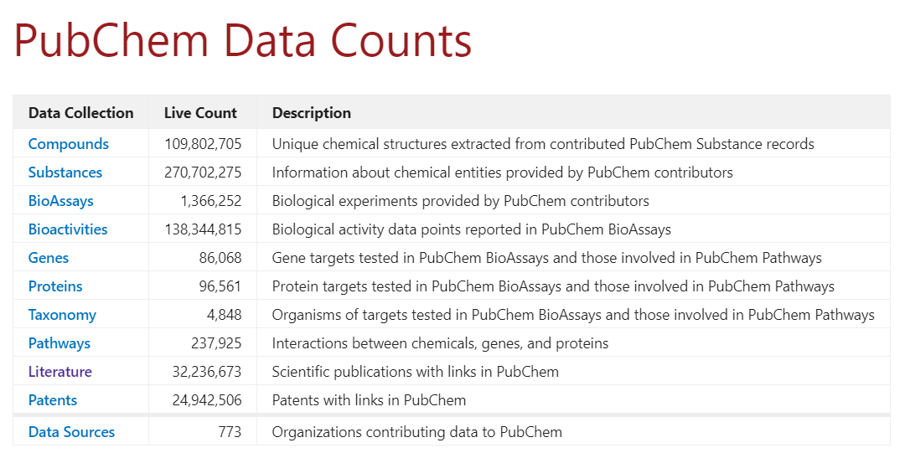
PubChem
https://pubchem.ncbi.nlm.nih.gov/
有机小分子生物活性数据，是一种化学模组的数据库，由美国国立卫生研究院(NIH)管理的美国国家医学图书馆(NLM)下属国家生物技术信息中心(NCBI)开发。该数据库于2004年9月启动，包含了大量分子材料的理化性能介绍，而且对应每个有机分子的应用都能够追根溯源到较为全面的文献报道，生物医药和生化交叉领域的科研人员尤为青睐。我们可以按名称，分子式等标识符搜索查找物化性质，生物活性，安全性和毒性信息，专利，文献引用等。可供检索的化合物有11100万种，物质28700万种，生物活性27300万种、相关文献3200万篇、专利2500万种。
PubChem数据库包括3个子数据库：
1. PubChem BioAssay：用于存储生化实验数据，实验数据主要来自高通量筛选实验和科技文献；
2. PubChem Compound：用于存储整理后的化合物化学结构信息；
3. PubChem Substance：用于存储机构和个人上传的化合物原始数据。
PubChemBeta版包含5部分内容：Bioactivities、Bioassays、Compounds、Patents、Targets。
需引文献：
PubChem in 2021: new data content and improved web interfaces. Nucleic Acids Res. 2021;49(D1):D1388-D1395. doi:10.1093/nar/gkaa971
中文介绍：
http://www.360doc.com/content/21/0218/16/73795974_962595884.shtml
https://www.jianshu.com/p/5b43923b300b
http://t.cn/A6tntRVt
2021-3-14数据
PubChem mostly contains small molecules, but also larger molecules such as nucleotides, carbohydrates, lipids, peptides, and chemically-modified macromolecules. We collect information on chemical structures, identifiers, chemical and physical properties, biological activities, patents, health, safety, toxicity data, and many others.
维基百科：
https://en.wikipedia.org/wiki/PubChem
PubChem contains multiple substance descriptions and small molecules with fewer than 100 atoms and 1000 bonds. ？

Slide 23
PubChem BioAssay (PCBA)
Used in MoleculeNet (DeepChem)
a database consisting of biological activities of small molecules generated by high-throughput screening. We use a subset of PCBA, containing 128 bioassays measured over 400 thousand compounds, used by previous work to benchmark machine learning methods.
The Maximum Unbiased Validation (MUV)
Used in MoleculeNet (DeepChem)
is another benchmark dataset selected from PubChem BioAssay by applying a refined nearest neighbor analysis. The MUV dataset contains 17 challenging tasks for around 90 thousand compounds and is specifically designed for validation of virtual screening techniques.
HIV
Used in MoleculeNet (DeepChem)
The HIV dataset was introduced by the Drug Therapeutics Program (DTP) AIDS Antiviral Screen, which tested the ability to inhibit HIV replication for over 40 000 compounds.47 Screening results were evaluated and placed into three categories: confirmed inactive (CI), confirmed active (CA) and confirmed moderately active (CM). We further combine the latter two labels, making it a classification task between inactive (CI) and active (CA and CM). As we are more interested in discover new categories of HIV inhibitors, scaffold splitting (introduced in the next subsection) is recommended for this dataset.
BACE
The BACE dataset provides quantitative (IC50) and qualitative (binary label) binding results for a set of inhibitors of human b-secretase 1 (BACE-1). All data are experimental values reported in scientific literature over the past decade, some with detailed crystal structures available. We merged a collection of 1522 compounds with their 2D structures and binary labels in MoleculeNet, built as a classification task. Similarly, regarding a single protein target, scaffold splitting will be more practically useful.

Slide 24
ToxCast
Tox21
https://tox21.gov/
https://tripod.nih.gov/tox21/
The Toxicology in the 21st Century (Tox21) program is a federal collaboration among NIH’s NCATS and the National Toxicology Program at the National Institute of Environmental Health Sciences; the EPA; and the FDA. Tox21 researchers aim to develop better toxicity assessment methods to quickly and efficiently test whether certain chemical compounds have the potential to disrupt processes in the human body that may lead to negative health effects. Detailed assay are publicly available on the EPA’s website (www.epa.gov/comptox) and the NIH tripod web site (https://tripod.nih.gov/tox21).
毒性数据库汇总的网址：
https://libguides.tulane.edu/c.php?g=182492&p=1202939
http://www.meddb.info/index.php.en?cat=13
https://www.hsdl.org/?abstract&did=451497
http://toxbank.net/
http://alttox.org/resource-center/databases/
https://www.biostars.org/p/4853/
History and purpose of ToxCast and Tox21
ToxCast and Tox21 are high-throughput chemical screening programs designed in response to the 2007 NRC report “Toxicity Testing in the 21st Century: A Vision and a Strategy”, which called for the use of in vitro assays to determine the effects of thousands of largely untested chemicals on “toxicity pathways”. The ToxCast (Toxicity ForeCaster) program is run by the National Center for Computational Toxicology (NCCT) within the EPA. The goals of this program are to identify in vitro assays and responses that are relevant to in vivo toxicity, to develop predictive models built on the results of multiple assays and chemical properties and to use these assays and models to screen environmental chemicals that have little or no available toxicity data and prioritize them for further testing. The term Tox21 is often used to describe the concept of toxicity testing in the 21st century, but it is also the name of the formal collaboration established to address this issue of developing new toxicity testing strategies. Tox21 leverages the expertise of several federal agencies: US EPA (ToxCast), National Institutes of Health (NIH) National Center for Advancing Translational Sciences (NCATS, formerly the NCGC), National Institute of Environmental Health Sciences (NIEHS) National Toxicology Program (NTP) and the Food and Drug Administration (FDA).
2019年开始，EDSP21 and ToxCast dashboards 已经被迁移到CompTox Chemicals Dashboard

Slide 25
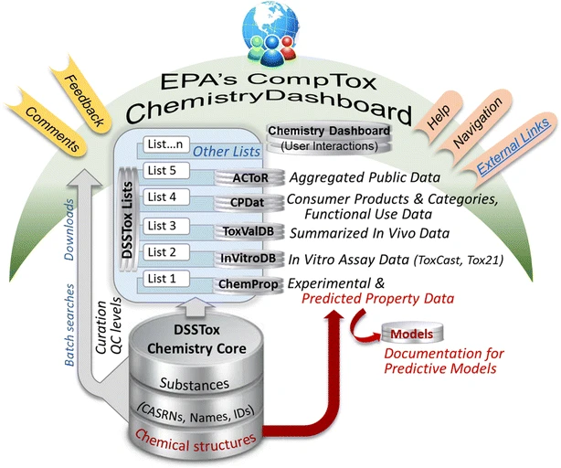
CompTox Chemicals Dashboard
集成大量数据的先进的web端搜索(数据访问下载)平台
https://comptox.epa.gov/dashboard
文献介绍： https://doi.org/10.1186/s13321-017-0247-6
（翻译）尽管有许多在线数据库提供了对化学数据的访问，但人们越来越需要高质量、结构化、精心策划的开放数据，以满足环境科学和计算毒理学社区的各种需求。 美国环境保护署 （EPA） 基于 Web 的 CompTox 化学仪表板正在通过化学信息学层集成不同类型的相关领域数据，该层建立在与化学结构相关的精心策划物质数据库之上，从而满足这些需求。这些数据包括物理化学、环境命运和运输、暴露、使用、体内毒性和体外生物测评数据，与 EPA 的其他数据和公共领域在线资源相连。批量搜索允许以多种不同格式直接映射和下载多个数据流的化学标识符 （ID）。这有助于快速获取可用于收集化学品的可用结构、属性、毒性和生物分析数据（一次数百至数千个）。提供先进的搜索功能，例如，支持使用质谱技术对化学品进行非定向分析和识别。化学数据库的内容目前包含约约760,000种物质，可作为公共领域数据下载。在过去 15 年中，EPA DSSTox 项目中的人工和自动固化技术对仪表板的化学含量进行了聚合。它正在不断发展，同时为用户社区提供一个灵活和动态的基于 Web 的平台，用于数据和资源的集成、处理、可视化和交付。仪表板为全球毒理学家和环境科学家社区的广泛研究和监管计划提供支持。

Slide 26
COVID-19 is an emerging, rapidly evolving situation.
Get the latest public health information from CDC: https://www.coronavirus.gov
Get the latest research information from NIH: https://covid19.nih.gov
Learn more about COVID-19 and you from HHS: https://combatcovid.hhs.gov
The National Institutes of Health (NIH) is the primary agency of the United States government responsible for biomedical and public health research. It was founded in the late 1880s and is now part of the United States Department of Health and Human Services.
The United States National Library of Medicine (NLM), operated by the United States federal government, is the world’s largest medical library. The NLM is an institute within the NIH.
European Bioinformatics Institute: biological databases
欧洲生物信息研究所提供的所有数据库和工具：https://www.ebi.ac.uk/services/all

Slide 27
ACToR (Aggregated Computational Toxicology Resource) 汇总数据的平台
https://actor.epa.gov/actor/home.xhtml
ACToR aggregates data from thousands of public sources on over 500,000 chemicals. It is searchable by chemical name and other identifiers. ACToR is also the data and web applications warehouse for EPA’s computational toxicology information which includes high-throughput screening, chemical exposure, sustainable chemistry (chemical structures and physicochemical properties) and virtual tissues data.
ACToR is the warehouse for EPA web applications which can be used to explore and visualize complex computational toxicology information:
CompTox Chemistry Dashboard: Chemistry data for over 700,000 chemicals and includes chemical structures, experimental and predicted physicochemical and toxicity data.
Toxicity Forecaster (ToxCast) Dashboard: High-throughput screening data on over 9,000 chemicals and information on approximately 1,000 assay endpoints.
Endocrine Disruption Screening Program in the 21st Century Dashboard: High-throughput screening data, rapid exposure estimates, high-quality chemical structures and annotations and physchem property data used by EPA’s Endocrine Disruptor Screening Program to evaluate chemicals for endocrine-related activity.
Chemical product category (CPCat) and exposure databases: Information on which chemicals can be found in categories of products (for example personal care products) and observational data from exposure studies.
Downloadable Computational Toxicology Data and Models: High-throughput screening data, rapid exposure and dose, chemistry data and virtual tissues data and models.
DSSTox, Distributed Structure-Searchable Toxicity Database Network
https://www.epa.gov/chemical-research/distributed-structure-searchable-toxicity-dsstox-database
EPA resource for supporting improved predictive toxicology; maps bioassay and physicochemical property data associated with chemical substances to their chemical structures; incorporates state-of-the-art cheminformatics workflows and provides chemical infrastructure for EPA’s Safer Chemicals Research, including the ToxCast and Tox21 high-throughput efforts
The Toxicology Data Network (TOXNET) is a group of databases hosted on the NLM website that covers “chemicals and drugs, diseases and the environment, environmental health, occupational safety and health, poisoning, risk assessment and regulations, and toxicology”. The TOXNET databases include: HSDB: Hazardous Substances Data Bank; TOXLINE, etc.
（共13个子数据库）详情见：https://en.wikipedia.org/wiki/Hazardous_Substances_Data_Bank
As part of a broader NLM reorganization, most of NLM‘s toxicology information services have been integrated into other NLM products and services.
（但该数据库已经被合并，具体情况见：https://www.nlm.nih.gov/toxnet/index.html）主体合并进了PubChem

