Slide 1
Question:
How could we ensure the safety and security of nursing home residents in an “open nursing home concept”
by Flameingo (Joon Wee, Rui Zhuo and Li Jet)
SP DAAA

Slide 2
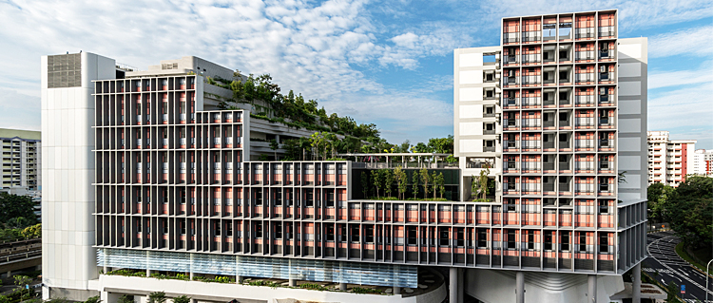
Background info
Open nursing home concept
Open areas
Allows elderly to roam freely
Improves their mental health
Risks and challenges of such nursing homes
Undetected falling
Insufficient caregivers taking care of free-roaming elderly
Falls account for 40% of injury-related deaths for elderly
With this open area, there will be a huge risk of injury from the falls of the elderly
Notes:
With this problem statement, our group first decided to do a bit of research to understand more about this concept.
We found out that an open nursing home concept is the concept of a nursing home having greater open areas, such as gardens, exercise areas, open sitting areas and more. These nursing homes would allow the elderly residents to roam freely, improving their mental health. The elderly living in these nursing homes would not be restricted to rooms and can be able to interact with surroundings hence being more active.
However, with such open nursing homes concepts, there are now more risks that the elderly will face. For instance, there will be higher risks of the elderly falling without being noticed. This concept of open style nursing home will also give caregivers added responsibilities to follow the elderly around and make sure that they are in sight.
According to data in Singapore, falls account for 40% of injury-related deaths for elderly, which shows that it is a serious issue which needs to be tackled in open nursing home concepts.
With that, I will now talk about our group’s solution to the challenges highlighted here.

Slide 3




Our solution –Eldercare 1.0
Make use of existing cameras in the compound
Analyses video to detect falls and detect who it is with the help of opencv
Notifications will also be sent to caregivers
Sending alerts to nurses in the homes
Notes:
This is our solution
As shown these are the key features of our prototype. (read from slides)
Short demo (*insert rz video*)
Cctv detect the elderly falling.
(Explain how the notification will be sent when the elderly falls.

Slide 4
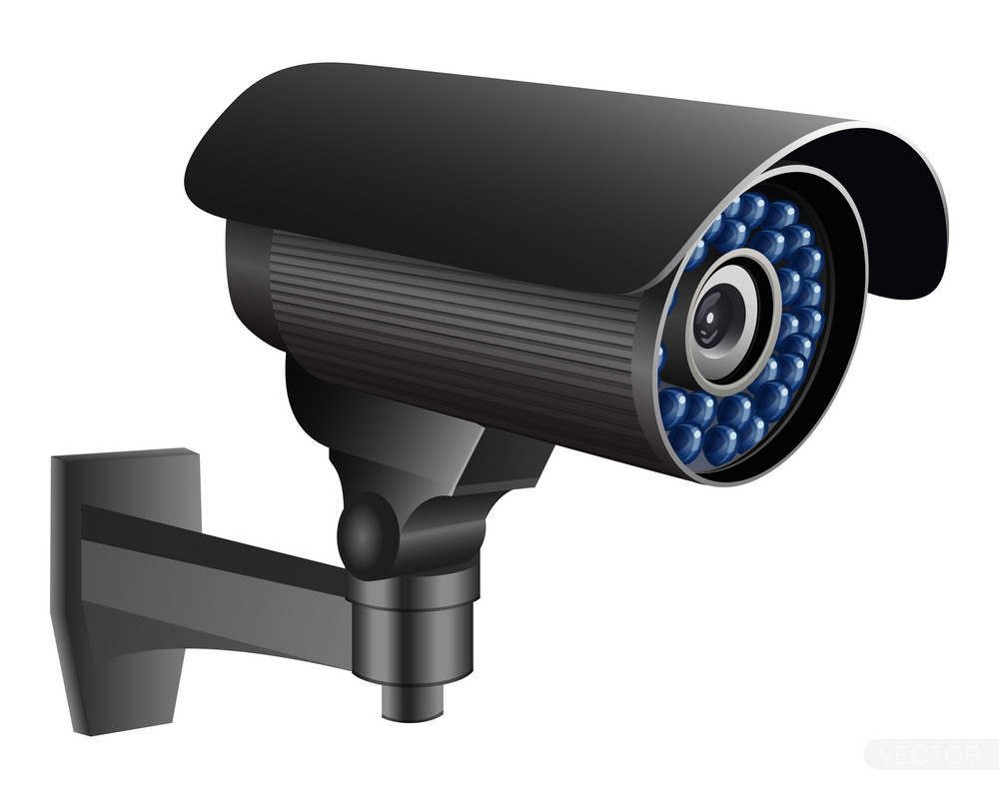

Our solution – Diagram
Uses AI Video to track who falls
Able to tell who is the person who falls
This is important for the safety of elderly!
Notes:
This is our solution
As shown these are the key features of our prototype. (read from slides)
Short demo (*insert rz video*)
Cctv detect the elderly falling.
(Explain how the notification will be sent when the elderly falls.

Slide 5
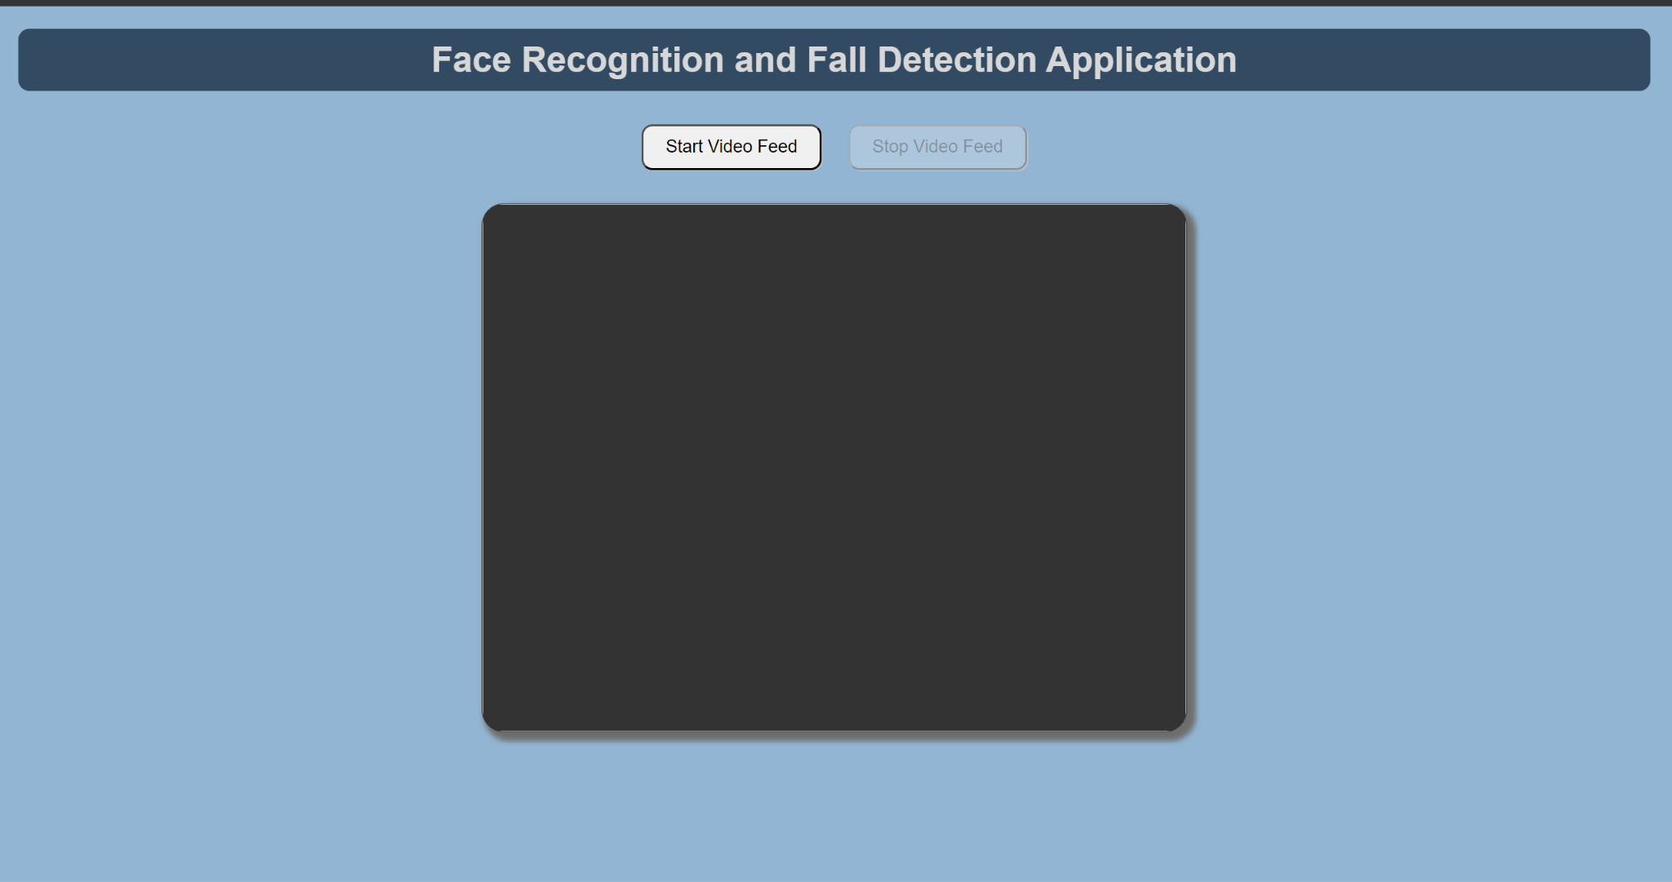
Prototype Demo
Here, we will demo our prototype
http://127.0.0.1:5000/

Slide 6
Value proposition
Cheap to implement. Software on currently available cctv installed.
Able to be used online with our web application.
Saves manpower (the caregivers do not need to follow those elderly that do not need assistance in walking)
The nurses and caregivers will be notified at first instance when the elderly falls.
Notes:
What makes ur soln stand out:
Pretty cheap. Use software on current cctv
It links people to the web. Web integration which enables the nurses or family member to keep track when the elderly fall.
Saving manpower of nurses
Reduce the nurse workload of taking of the elderly
Dont have to need alot of nurses to take care
Free up workload and can take care of other residents
Could be nurses/healthcare personnel

Slide 7
Future Major Improvements
We aim to improve our accuracy of our model with Deep Learning
We aim to train on with falling down video datasets
Improve our sending of message with phone number (Enable notifications to be sent to phone)
For future uses, we hope to collaborate with the government (govtech) to further improve the technology and to be implemented in the near future.

Slide 8
THANK YOU

