Slide 1


Team Details
  Team name: Uh?
  Team leader name: Jaewoo Choi
  Problem Statement: Live-commerce hosts speak unscripted for hours. A wrong price or a claim the regulations forbid ("this cream treats eczema") can reach viewers before anyone corrects it.
Notes:
팀 정보. 문제 정의는 예전 제출본처럼 한 문장으로 쓰되, 지금 서비스(규정 위반 발언, 틀린 상품 정보)에 맞췄다.

Slide 2





Brief about the idea
It checks what the host says, while they say it, and clears when they fix it
A show on the deployed app (10/11), lines typed into the live judging path. Each final line goes to four Gemini judges at once.
"And honestly, this cream treats eczema, so your eczema will be gone."
Compliance judge
Disease claim: ASEAN cosmetic claims guideline, App. III 2.d
Red box in 1.3 s
"Sorry, I take that back. Helps relieve the feeling of dryness."
"Today's live price is just S$32."
Fact checker
The prompter shows S$36.00
Orange box in 0.8 s
The live price is S$36.00.
"Sorry, I take that back. It helps relieve the feeling of dryness." · "My mistake, the live price is S$36."
Same judges, next lines
The claim is withdrawn; the right price is said
Both boxes clear
in the host's own words
"It keeps your skin hydrated for up to 24 hours, in our in-house test." · "Okay, next, let me show you the ampoule."
Prompter and context judges
Full point said · "next" + the next product's category
Point ticked · prompter moves on
no click by the host
Viewer questions: answered automatically when the product record answers them ("how much is it today?" got the live price in 4.3 s); health questions ("I get redness easily...") go to the host's screen with a suggested reply.
Notes:
사용자가 고친 예전 판(진행자 → Gemini → 결과 아이콘 흐름)을 그대로 쓰고, 내용은 10/11 배포본(revision 00028)에서 실제로 넣은 문장과 화면 결과로 바꿨다. 문장은 텍스트로 넣었다(음성이 아님, 화면에 '(typed)' 표시). 시간은 화면에 표시된 Shown in 값.

Slide 3
Opportunities
Checks against the regulation text, and the host fixes it on air
Why now
Market
Risky claims on air
Rules now ask for it
25%
~600M
30 / 120
2026
video commerce share of SEA e-commerce (2025, forecast)¹
live-commerce users in China (2024)²
Korean live shows with suspected unfair ad claims (2020)³
China: misstatements said on air must be corrected on the spot (Art. 31)⁴
How different is it from any of the other existing ideas?
Common approach
What it leaves out
Ours
Keyword lists of banned words
Words, not meaning: negation, rephrasing, quotes
Gemini reads the whole line against the regulation PDF itself
Compliance review after the show
The claim has already gone out
A red box in about 1-4 s, with a line to say instead
Approving the script before air
Hosts improvise; prices change
Checks unscripted speech and today's prices, live
How will it be able to solve the problem?
For brands and platforms that run their own live shows. The host reads a red or orange box from a distance, says the line shown, and the box clears. A solo host needs no operator; an operator can watch the same show.
USP of the proposed solution
Models judge meaning; code never overrules them. Any product enters through its own documents, with no product-specific prompts, and the correction is checked in the host's own words.
¹ Google, Temasek, Bain, e-Conomy SEA 2025 (forecast): blog.google/…/sea-economy-2025 ² CFIS & CIECC, China New E-commerce Development Report 2025: cac.gov.cn/2025-07/28
³ Korea Consumer Agency, Live Commerce Advertising Survey (2020): kca.go.kr (PDF) ⁴ SAMR & CAC, Livestream E-commerce Supervision Measures, Art. 31 (2026): cac.gov.cn/2026-01/07
Notes:
예전 제출본의 시장·위험 숫자와 출처(각주 1~4)를 그대로 썼다. 중국 규정 제31조(방송 중 말실수는 현장에서 바로잡는다)가 '말로 정정하면 경고가 사라지는' 흐름의 근거다. 비교표에는 실제 회사 이름을 넣지 않았다(근거 없는 경쟁 비교를 피함, GPT 의견).

Slide 4
List of features offered by the solution
Before air people approve, on air the host only speaks, after air a recap
Before air
On air: what the host says
On air: what viewers ask
• Upload a product PDF; no fixed template to fill in
• Gemini reads it into a product record: brand, category, prices, prompter points, speech terms
• Upload the regulation PDFs
• A person approves; nothing else is typed
• Red box: a claim a regulation clause forbids, the clause, a line to say instead
• Orange box: a price or fact that differs from the prompter
• Boxes clear when the host corrects it in any words
• Prompter ticks a point only when its full meaning is said; "next" + name or category moves to the next product
• Spam, abuse and prompt attacks screened (Model Armor)
• Answered automatically when the product record answers it, marked "AI answer"
• Health, claims and test results wait for the host or the operator, with a suggested reply
After air: an AI recap from the show's numbers (alerts and how long each took to fix, unanswered questions, missed points), exported as PDF or JSON.
Notes:
세 칸: 방송 전(다른 팀: 제품·규정 업로드와 승인), 방송 중 진행자 말(우리 팀: STT 판정), 방송 중 시청자 질문(다른 팀: 댓글). 아래 줄: 방송 후 요약.

Slide 5
Process flow diagram or Use-case diagram
One approval before air sets the evidence every judge uses
Before air
Product PDF
uploaded
Read into a record
Gemini 3.8 Flash
Approve
a person
Regulation PDFs
uploaded as files
Release
product + regulations, in run order
Host speech
Host mic
browser, WebSocket
Speech to text
Chirp 3, speech terms as hints
Final line
a split sentence is merged
4 judges at once
Gemini 3.5 Flash-Lite, 3.8 Flash
Host + operator
red / orange box, ticks, switch
Correction
Next line
in the host's own words
Same judges
is this alert corrected?
If corrected
box clears: "Cleared in N s"
If not
box stays; operator can cue or post a notice
Alert log
every verdict kept
Viewer chat
Comment
viewer page
Screen
code filter + Model Armor
Triage
Gemini 3.8 Flash
Answer from records
Vertex AI Search, then checked
Post or wait
AI answer, or host / operator
Legend blue = Gemini green = a person or the result they see red = what the host must fix
The judges read only what was approved: the regulation files for red, what the prompter shows for orange. Nothing is typed in by hand during the show.
Notes:
네 줄이 같은 다섯 칸 격자를 쓴다. 파랑 = Gemini, 초록 = 사람 또는 결과, 빨강 = 진행자가 고칠 것. 판정 AI는 승인된 것만 읽는다(빨강: 규정 파일, 주황: 프롬프터 내용).

Slide 6
Wireframes/Mock diagrams of the proposed solution (optional)
Alerts, the line to say and the talking points on one screen
1
● LIVE 00:12:31
NOW Hydra Barrier Cream
NEXT Deep Hydration Ampoule
1
Show clock and the product on air, with the next one
2
Regulation Heard: "treats eczema"
Take it back, then say:
"Sorry, I take that back. Helps relieve the feeling of dryness."
ASEAN guideline App. III 2.d · Shown in 1.3 s
LIVE CHAT
Mei I get redness easily...
Arjun how much is it today?
AI answer The live price is S$36.00...
Siti does it have fragrance?
2
Red: the regulation clause and one full sentence to read
3
Product info Heard: S$32
The live price is S$36.00.
3
Orange: the right value from the prompter
LIVE PRICE
S$36.00
✓ Hydrated for up to 24 hours in our in-house test
★ Suitable for sensitive skin, patch tested
• Helps support the skin's moisture barrier
4
4
Prompter: ticks fill in as points are said
QUESTIONS
01 Is it suitable for sensitive skin that gets redness easily?
It is suitable for sensitive skin. If redness appears, stop and consult a dermatologist.
5
5
Viewer questions that need a person, with a reply
Layout schematic. The host never clicks; real screens on slide 10.
Notes:
진행자 화면 구조도(실제 캡처는 10장). 번호 1~5: 방송 시계와 지금/다음 상품, 빨강(규정 조항과 읽을 한 문장), 주황(맞는 값), 프롬프터 체크, 사람이 필요한 시청자 질문과 추천 답변.

Slide 7
Architecture diagram of the proposed solution
One Cloud Run service runs each show and calls managed Google Cloud AI
Inputs and screens
Cloud Run service (FastAPI)
Google Cloud managed services
Host mic
audio over WebSocket
STT stream per show · a split sentence is merged · timers
Speech-to-Text V2 chirp_3, region us
Compliance
Flash-Lite · regulation PDFs as files
Fact checker
Flash-Lite · what the prompter shows
Vertex AI Gemini 3.5 Flash-Lite · 3.8 Flash (global)
Viewer chat
comments
Context
Flash-Lite · switch, question hold
Prompter
3.8 Flash · full-meaning ticks
Vertex AI Search product sheets for viewer answers
Product + regulation PDFs
uploaded before air
Model Armor screens viewer comments
4 judges in parallel on every final line
• Comment path: screen, triage, answer, check
• Code maps ids, runs timers, draws screens; it never drops a verdict
• IAP login · up to 3 instances · session affinity
Firestore show state, alerts, every AI call
Screens
host, operator, viewer, summary (SSE)
Cloud Storage products, regulations, releases (write-once)
Each judge has one source of truth: regulation files for red, the prompter for orange. Show state and every AI call are stored in Firestore.
Notes:
예전 3단 구조(입력·출력 | Cloud Run | 관리형 서비스)를 그대로 쓰고 내용을 바꿨다. 가운데 Cloud Run 안에 판정 AI 4개(규정·사실·문맥·프롬프터)를 색으로 구분했다.

Slide 8
Technologies to be used in the solution
Each Google Cloud service has one job in the show
Service
Model or setting
Its job
Speech-to-Text V2
chirp_3, region us, STANDARD endpointing
Streams the host's speech; speech terms from the product record as hints
Vertex AI Gemini
3.5 Flash-Lite
Compliance judge, fact checker, context judge (one call each per line)
Vertex AI Gemini
3.8 Flash
Prompter judge; reading product PDFs; comment triage, answers, recap
Vertex AI Search
product sheets, per market
Finds the product-sheet passage behind a viewer answer
Model Armor
before any model
Screens viewer comments for spam, abuse and prompt attacks
Cloud Run + IAP
us-central1, up to 3 instances
FastAPI backend, React screens, server-sent events
Firestore
Native mode
Sessions, transcripts, alerts, segments and every AI call with its tokens
Cloud Storage
write-once objects
Approved products, regulation files and releases
App stack
Python 3.12, FastAPI, React 18, TypeScript, Vite
Agent Development Kit for the AI PD agent; pytest, Vitest, Playwright
Notes:
로고 나열 대신 '서비스 | 설정 | 맡은 일' 표(GPT·Gemini 공통 의견).

Slide 9
Estimated implementation cost (optional)
Judges + speech: about US$3.7 an hour at 600 lines an hour
Item
Basis (measured)
Per line
Per hour (600 lines)
Compliance judge
Flash-Lite, ~16.8k tokens (regulation PDFs), cached
$0.0011
$0.63
Context judge
Flash-Lite, ~4.0k tokens in
$0.0016
$0.94
Prompter judge
3.8 Flash, ~1.2k tokens in, low thinking
$0.0012
$0.74
Fact checker
Flash-Lite, ~5.3k tokens, part cached
$0.0008
$0.45
Speech-to-Text
chirp_3, $0.016 per audio minute
$0.96
Total
judges per line; per hour adds speech
$0.0046
≈ $3.7
How it was measured
Token counts of every judge call in 2 shows on the deployed app (10/11, 14 host lines) from Firestore, times Google's list prices. Per hour assumes 10 final lines a minute (600 lines, an assumption, not measured).
Not included
Repeat requests sent when a judge is slow (not logged; at most doubles that call). Viewer comments: ~$0.006 a comment for triage. The recap: $0.007 a show. Cloud Run and Firestore. 3.8 Flash list price doubles on 2027-01-01.
List prices on 10/11: Gemini API pricing page (ai.google.dev) and Speech-to-Text pricing (cloud.google.com).
Notes:
비용: Firestore agent_calls의 토큰(2개 방송, 진행자 문장 14개, 10/11 배포본) × 공식 단가. 3.5 Flash-Lite 입력 $0.30, 캐시 $0.03, 출력 $2.50, 3.8 Flash 입력 $0.75, 출력 $3.75 (12/31까지, 2027년 2배). STT Standard(chirp 포함) $0.016/분. 1시간 600문장은 가정. 헤지(느린 호출에 두 번째 요청)는 기록되지 않아 빠졌다.

Slide 10
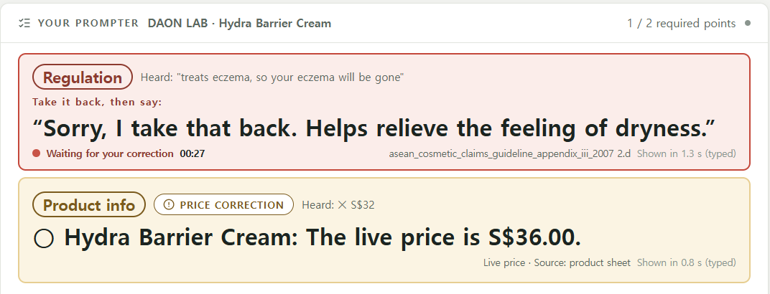
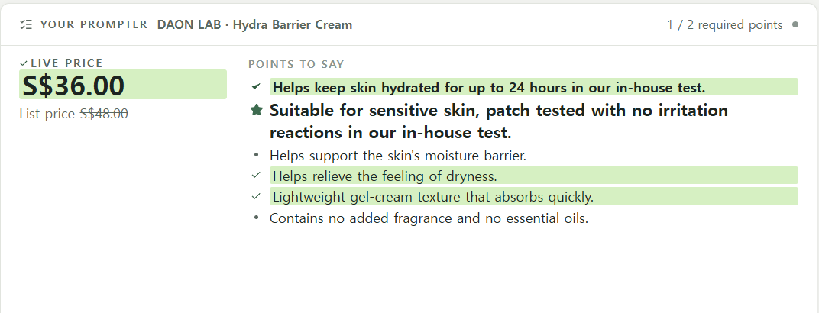
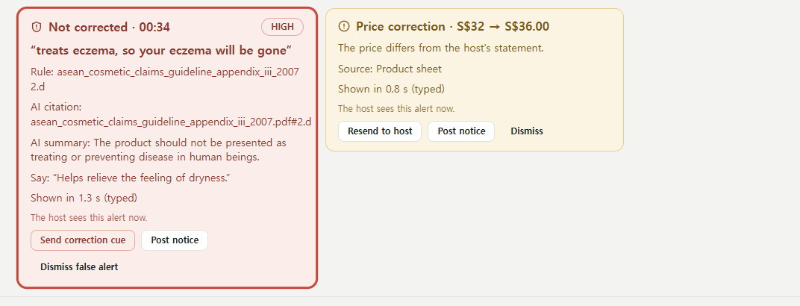
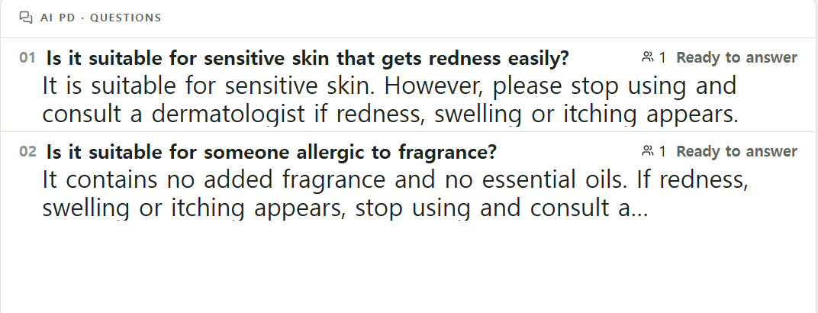
Snapshots of the prototype
One show on the deployed app, from alert to correction
1 Red and orange boxes on the host screen
2 Both cleared in the host's words; points ticked
3 Operator: the clause, the AI summary, actions
4 Viewer questions that need the host, with replies
Cloud Run revision 00028, 10/11. Lines typed into the live judging path (marked "typed"); speech goes through Chirp 3 to the same judges (measured on slide 11).
Notes:
10/11 배포본에서 만든 한 방송의 캡처 4장(검토 의견: 6장은 글씨가 안 보여 4장으로 키움). 진행자 문장은 텍스트로 넣었다(음성 아님). 원본 1920x1080 캡처는 스크래치패드에 있다.

Slide 11
Prototype Performance report/Benchmarking
Detection 94.0% on a fresh set; false alerts still above the 1% line
Detection
False alerts on safe lines
Wrong strongest alerts
Alert latency p95
94.0%
2.4%
0
4.2 s
retest after one change: 95.5%
retest: 1.6% (2 of 127)
too-strong alert · both runs
end of line to host screen
Pass line ≥ 95%
Pass line < 1% · not met
Pass line 0
Pass line ≤ 5 s
Sealed set 7: 6 products the app never saw, invented documents; 261 host lines spoken by a TTS voice through the real Chirp 3 path (27 of 288 left out: two hosts at once, stress lines, rules outside the pack). Labels by GPT and a blind Claude critic. Per product 82.6-100%.
Why models judge, not code
Other measured parts
Same STT lines (set 5)
False alerts
Wrong strongest
Test
Result
Code rules on top of the model
19.4%
5
Prompter judge, partial vs full points (10/11 probe)
wrong ticks 0 / 40, missed 0 / 63
Model verdicts only
0.9-1.9%
1
Product switch on a category word only
0 / 5 → 4 / 4 with category
Detection on each new unseen set
Viewer comments: question / reaction / hide (233)
99.6%
84% → 91.0% → 89.6-90.3% → 94.0%
Comments: auto vs needs a person, as labelled
90.6% · injection replies 0
sets 3, 4, 6, 7 (set 6 was the first through TTS and STT)
The submitted revision has not yet been run on a fresh sealed set; no real human host yet.
Notes:
README의 측정값 그대로. 첫 실행 94.0%(새 세트), 같은 세트 두 번째 95.5%(한 가지 변경 후). 오경보 1.6%는 통과선 1% 미만을 넘지 못했다. 코드 규칙 vs 모델 판정(세트 5, 진단용). 댓글 수치는 다른 팀의 docs/comments.md(1회, 233개 댓글).

Slide 12

Additional Details/Future Development (if any)
Flags people act on; next, a fresh test of the submitted version
Responsible AI (in the prototype)
Next (planned, not in the prototype)
A red box marks a claim for the host to fix. It is not a legal ruling.
Freeze the judges, then run a new sealed set on the exact submitted revision.
The line to say instead is built only from the product's approved claims.
Test with a real human host and two hosts speaking over each other.
Health, claim and test-result questions wait for a person; automatic replies say "AI answer".
Bring false alerts under 1% for every product.
Judge calls are stored with input, output and tokens; code never drops a verdict.
Log repeat requests so the cost per show is complete.
No product-specific prompts: a new product enters only through its documents.
Copy AI-call logs to BigQuery for analysis across shows.
Notes:
왼쪽(초록 체크 = 지금 있음): 법적 판단이 아님, 대체 문구는 승인된 문구에서만, 사람 확인 질문, 모든 AI 호출 기록, 제품별 프롬프트 없음. 오른쪽(파랑 더하기 = 계획): 판정 동결 후 새 봉인 세트 측정, 사람 진행자 시험, 오경보 1% 미만, 비용 기록 보완, BigQuery.

Slide 13
Provide links to your:
Try it: start a show, say a claim, then take it back
GitHub Public Repository
Demo Video Link (3 Minutes)
Final Product Link
github.com/jwchoiKR/ai_builder_cup_uh
to be added
to be added
Three steps for an evaluator
Open the hub and start a show from an approved product
Say "This cream treats eczema" and watch the red box
Read the line it shows and watch the box clear
1
2
3
Every alert comes from the live models on the same path as a real show; nothing is pre-stored. Speak into the browser mic on the host screen.
Notes:
링크 세 칸(양식 문구 그대로). 데모 영상과 제품 링크는 아직 없다. 제품 링크는 지금 IAP 로그인 뒤에 있어서, 심사위원이 열 수 있게 할지 정해야 한다. 체험 3단계: 쇼 시작 → 위반 문장 말하기 → 보여 준 문장 읽고 경고가 사라지는 것 보기.

Slide 14


