Slide 1

KING COUNTY HOME SALES PRICE

Slide 2

Overview
Analyzing the major factors affecting house price
Selecting significant factors influencing general house price
Establishing a statistical model for house price prediction
(aka multiple linear regression model)
Predicting and analyzing the house price

Slide 3

Business Understanding
For the real estate constructors, investors, and agents
Do houses sold in any specific season cost more?
Which features have the strongest relationship with house price?
How much do these features affect the house price?

Slide 4
Data understanding
The house sale prices between 2021. 6 ~ 2022. 6 in King County, Washington
Main features
Sale Price, Date house was sold
Number of Bathrooms, Bedrooms, floors
Square footage of living space, the lot, the basement, the garage, the patio
Square footage of living space per bedroom
Quality of view from the house, condition and grade of the house
The season that house sold
Heat source, Sewer system, and so on

Slide 5
Modeling 1
Figure out
1. The features that have a High Correlation with House Price
2. The features that are Statistically Significant
Select 5 features
1. Square footage of living space in the home
2. Number of Bathrooms
3. Square footage of living space per bedroom
4. Quality of view from the house
5. The season that the house sold

Slide 6
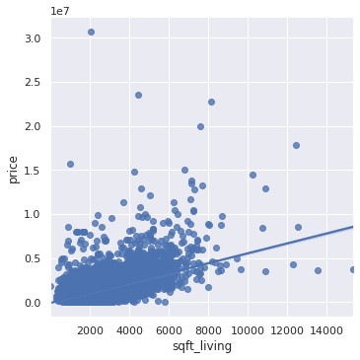
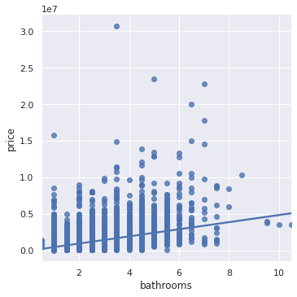
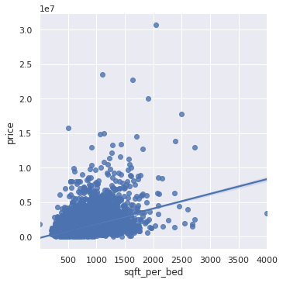
Modeling 2
The model features correlation with house price
Square Footage of Living Space Number of Bathrooms Square Footage of Living Space per bedroom

Slide 7
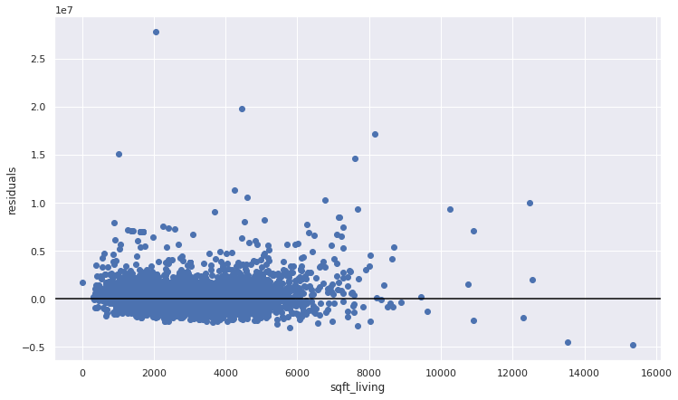
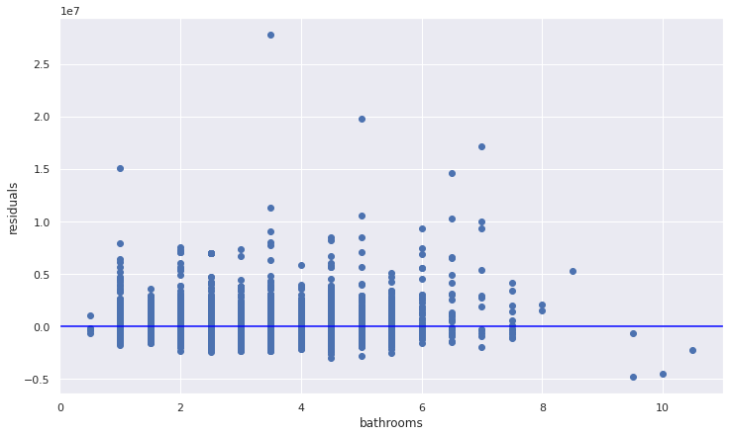
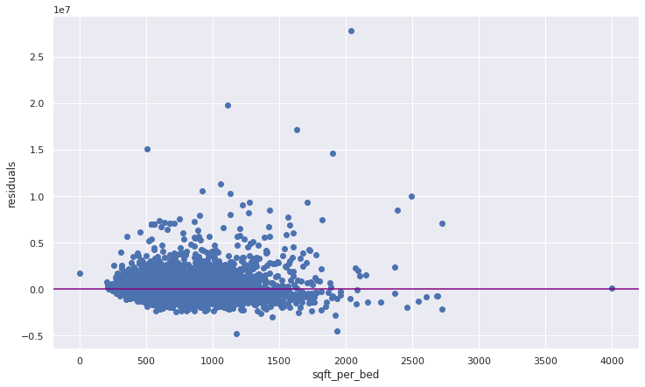
Modeling 3
Model residuals
Square Footage of Living Space Number of Bathrooms Square Footage of Living Space per bedroom

Slide 8
Modeling 4
This model is statistically significant overall (p-value well below 0.05)
This model explains about 38% of the variance in Sale Price
To improve upon this model,
Add the highly correlated non-numerical variables
- Quality of view from the house
- The Season that a house sold

Slide 9
Modeling 5
Build the final model with this strongest correlation variables and interesting variable:
Square footage of living space in the home
Number of bathrooms
Square footage of living space per bedroom
Quality of view from the house
Sell season

Slide 10
Modeling 6
Results
R-Squared: 43%
Sqft living $419, Bathrooms: $58k,
Sqft per bedroom: $394
View EXCELLENT: $1.2M, View FAIR: $225k
View GOOD: $85k, View NONE : - $169k
Sell season Fall : - $194k, Sell season Summer : - $209k
Sell season Winter : - $121k

Slide 11
Results interpreting - Overall
Statistically significant overall,
Explains about 43% of the variance in Sale Price
On average it is off by about $383k in its predictions of the house price.
For each increase of
Square footage of living space - increase about $419
The number of bathrooms - increase about $58k
Square footage of living space per bedroom - increase about $394
in sale price

Slide 12
Results interpreting - View
Compared to a AVERAGE view
Increase about $1.2M for an EXCELLENT view
Increase about $225k for a FAIR view
Increase about $85k for a GOOD view
Decrease about $169k for a NONE view
in sale price

Slide 13
Results interpreting - Season
Compared to sell in Spring
Decrease about $194k for sell in Fall
Decrease of about $209k for sell in Summer
Decrease of about $121k for sell in Winter
in sale price

Slide 14
Recommendation
Making the good price of a house,
Considering
1. the square footage of living space, the number of bathrooms
- the bigger, the more is better
2. Quality of view from the house
- make the excellent view
3. Selling time
- Spring is the best

Slide 15

Thank you !
Email
jwchung60@gmail.com

