Slide 1
Network Analysis of the Panama Papers
R. Earl DeLapp

Slide 2
Motivation

Slide 3
Panama Paper

Slide 4
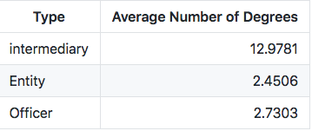
Model
Non-Homophilict: actor associate with different actors
Entity - Officer | 0.29
Entity - Intermediary | 0.17
Officer – Intermediary | 0.0038

Slide 5
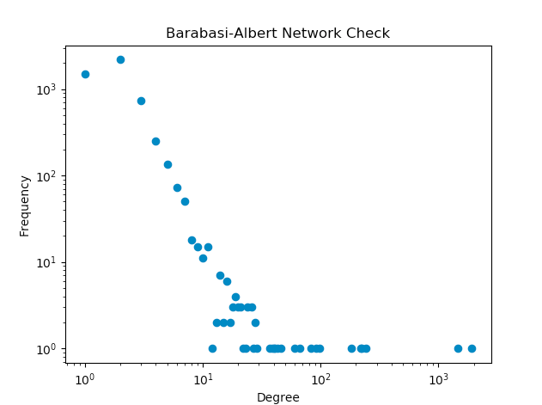
The Model is Disassociate
NAME | TYPE | Number of Degree
Unknown | Unknown | 1931
RAWI_&_CO | intermediary | 1475
BROCK_NOMINEES_LTD | officer | 243
CREDIT_SUISSE__ CHANNEL_ISLANDS_LTD | intermediary | 224
TENBY_NOMINEES_LTD | officer | 219
HELM_TRUST_COMPANY_LTD | officer | 182
ARAB_PALESTINIAN_ INVESTMENT (HOLDING)_COMPANY_LTD | entity | 98
DAMOR_INVESTMENTS_LTD | officer | 92
CACIQUE_INVESTMENTS_LTD | officer | 83
OLYMPIC_GOLD_HOLDINGS_LTD | officer | 67
Notes:
Attribute assortativity coeff for type is negatively dissociated meaning…
Entity and Officer: 0.29
Entity and Intermediary: 0.17
Officer and intermediar: 0.0038
Corr between cc and is slightly assortative at 0.1098. Suggesting the connectivity wrst cc is not completely random. However, this model only looks at two main countries and any other node, dispite cc, that is connected.

Slide 6
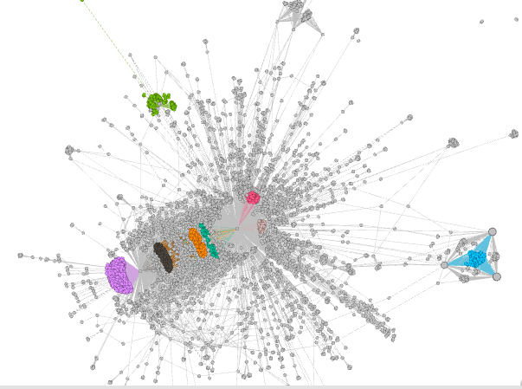
Eigenvector Centrality

Slide 7
Betweeness Centrality

Slide 8
Partition Into Communities

