Slide 1
Youtube Trend Analysis
James Hazzard, Mohammed Musah, & Jacob Wise Dennis

Slide 2
Background
Youtube is a huge media streaming platform; in 2017, in generated 3.88 billion
Successful content creators have created independent media empires worth well in the millions
Many have done so with key help from Youtube’s front page
The algorithm that decides what trends on Youtube is not clear.
“We combine these signals [View count, days to trend, age of the video] to produce a list of videos that showcases what's happening on YouTube, while being relevant to our viewers and reflective of the content on the platform. This means that the video with the highest view count on a given day may not be #1 on Trending, and videos with more views may be shown below videos with fewer views.

Slide 3
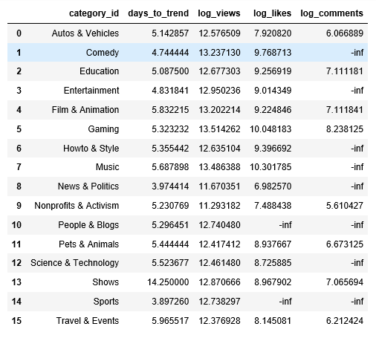
Summary Statistics
Summary Statistics of Means

Slide 4
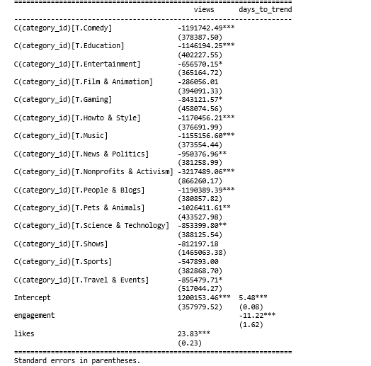
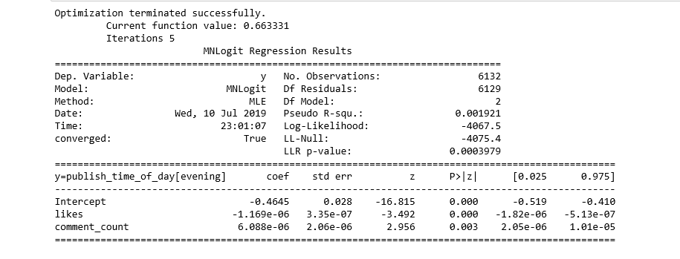
Analysis
AAAlansc
Analysis

Slide 5
Conclusions
The algorithm favors certain categories of media over others; music in particular had the highest grossing spots.
The Algorithm also favored videos from certain channel names, meaning that a premium is in some way placed on videos from channels with histories of trending videos
There is a negative correlation between the number of a days a video is trending and the engagement on the video, suggesting the the “Trending” label has diminishing returns.

