Slide 1
fMRI Data collection, QA and preprocessing
Jennifer Evans
Feb 2017

Slide 2
Checklist of things to do before a scan
Before (>week):
Book time
FMRIF calendar
7T overall times
Request tech
Day of:
Scan request
Run sheet
Screening form (pregnancy test if required)
Scan instructions
After scan:
Data transfer & QA
File run sheet

Slide 3
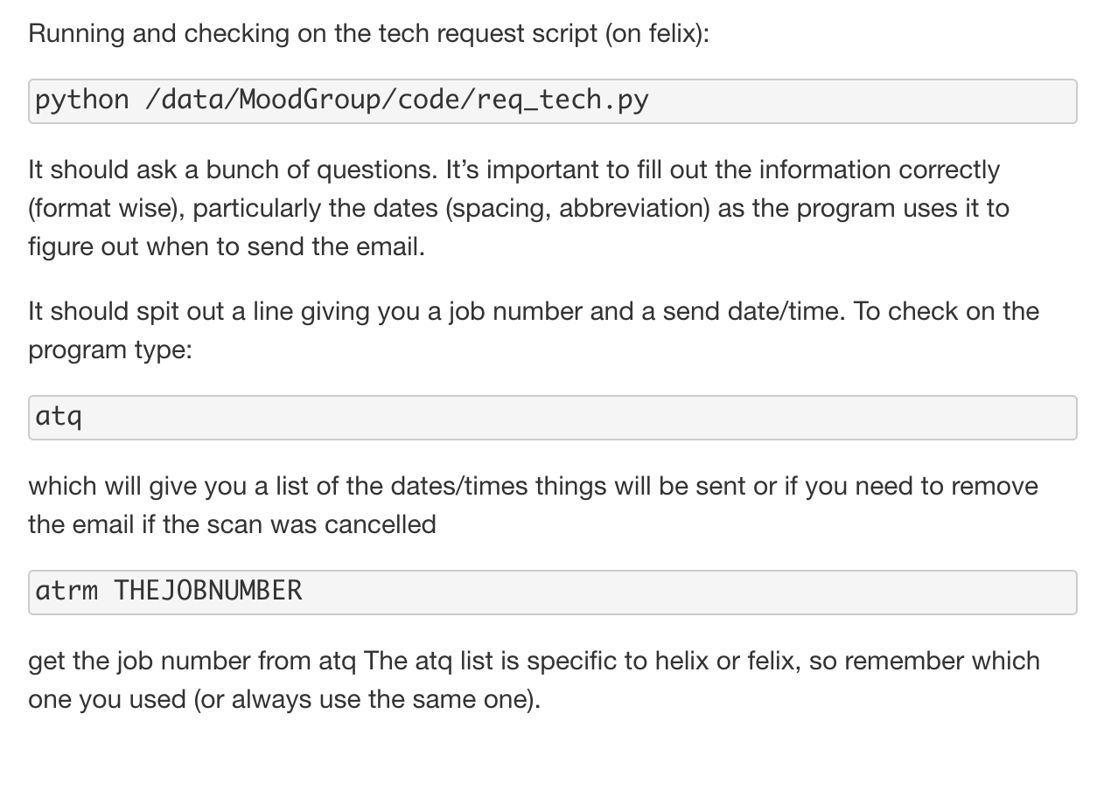
Training reqs & scan requests
If the scan is more than a week away use the req_tech script so that the request goes in first thing (or if you want a copy of the email sent to me).
If you don’t hear back within the day (the request is sent), then forward the request to the list again or a specific tech and cc me.
What to request for ‘Assistance’:
First:
clinical scan
you haven’t been told you can use second
Second: You have been told you can use second person

Slide 4
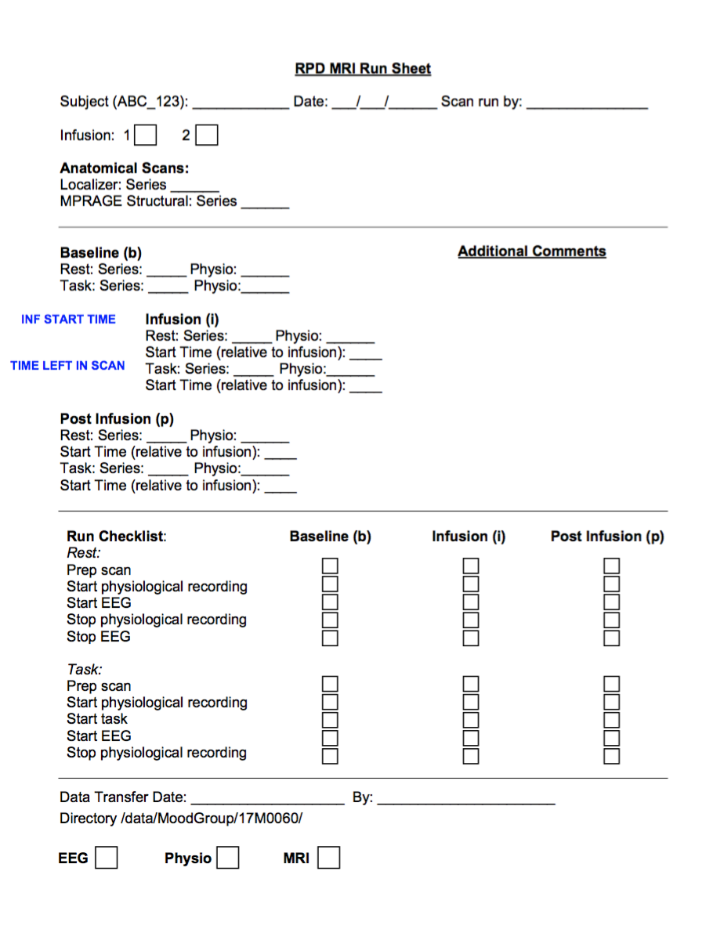
Run Sheets …

Slide 5
Getting the ‘master’ subject number
smb://nimhirp-ds1.nih.gov/snmdzarate$/Database/
Go to the Access SubjectData Database
Open the table labeled “Subject Data”
Determine if the subject you are downloading data for is in the table.
If yes, record the number in the “MasterSubjectID”
If no, add the subject

Slide 6
Where to put the data
Downloaded tar file:
/data/MoodGroup/15M0188/tmp_tar
MRS data
/data/MoodGroup/15M0188/SUBJECT_DIR/mri/SCAN_DIR/mrs
Physio data
/data/MoodGroup/15M0188/SUBJECT_DIR/mri/SCAN_DIR/physio
Untarred dicoms that are converted to nifitis
/data/MoodGroup/15M0188/SUBJECT_DIR/mri/SCAN_DIR/nii
Where:
SUBJECT_DIR is: subj-universal subject ID_RISC###
SCAN_DIR is: date(yyyymmdd)_7T

Slide 7
tar file clean up
Tar files will be moved from f/helix monthly to cahal

Slide 8
An overview of where things will happen
Places where the scripts will be run:
0) the subject database
smb://nimhirp-ds1.nih.gov/snmdzarate$/Database
Getting the subject number
2) the tmp_tar directory (dicoms)
/data/MoodGroup/15M0188/tmp_tar
Unpacking the data from the tar file
Converting the data from dicoms to nifti
3) the subject’s raw data directory
/data/MoodGroup/15M0188_fMRI_analysis/SUBJECT_NAME/
Creating the physiological regressors
4) The subject’s analysis directory
/data/MoodGroup/15M0188_fMRI_analysis/SUBJECT_NAME/
Running the preprocessing script

Slide 9
Dicom -> nifti
Dicom files are a standard medical format
Every imaging analysis program has an original file format
E.g. AFNI *.HEAD/*.BRIK, Analyze,
Nifti is an attempt at a universally accepted format
Can be 2 files *.hdr, *.img or just one *.nii
Use README2nii3.py

Slide 10
How to report problems
Ideally should help reproduced the problem
Make a note of the full command AND the output, with emphasis on the error that was generated. Also include where the command was run.
One way to do this is to copy (right click menu) and paste from the terminal

Slide 11
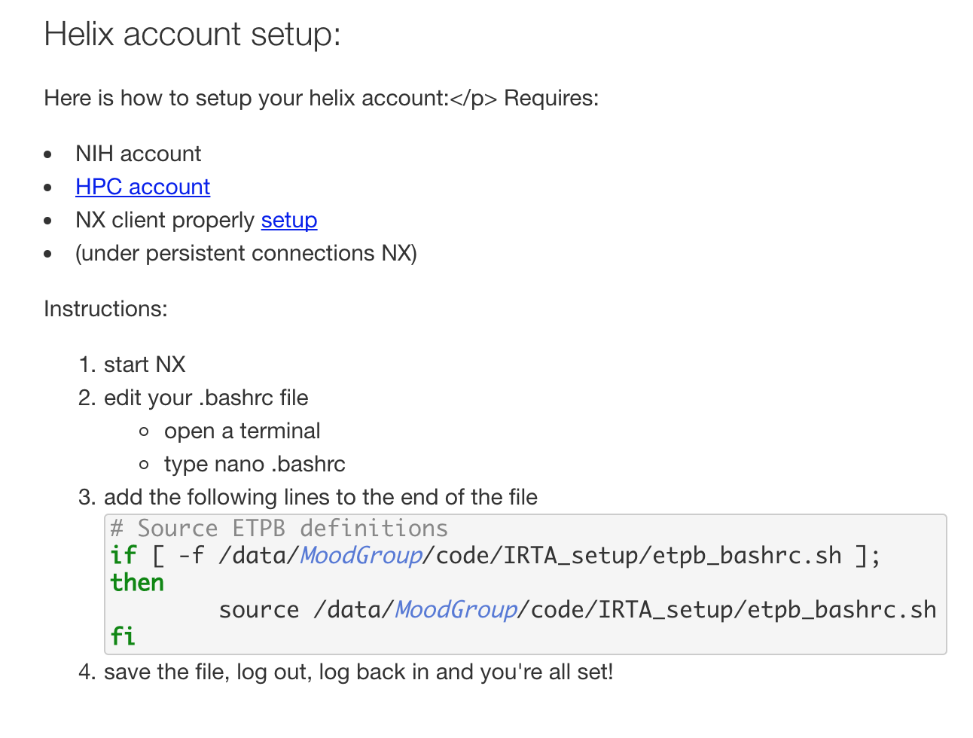
HPC @ NIH
High performance computing @ NIH
https://hpc.nih.gov/docs/connect.html
helix.nih.gov or felix.nimh.nih.gov
Require standard NIH login (separate account)

Slide 12
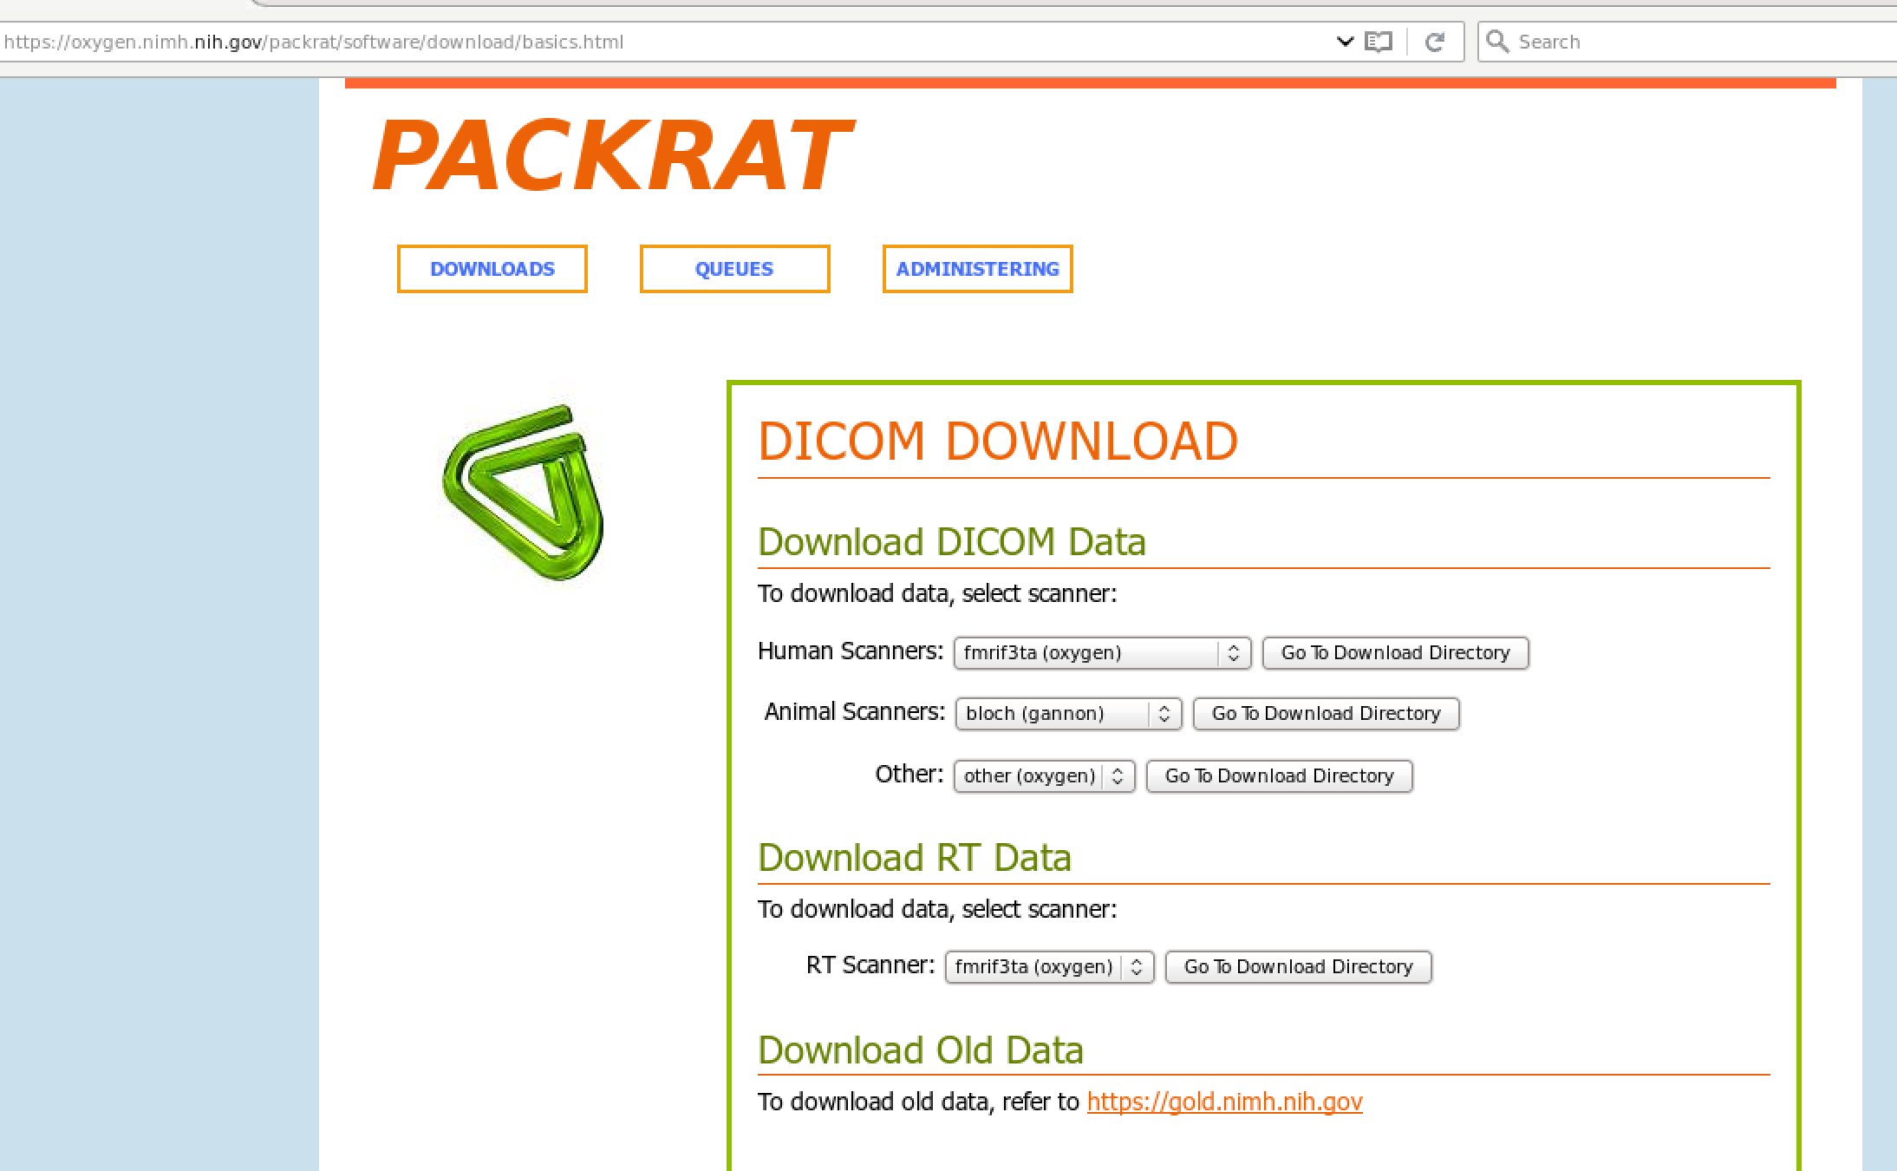
Where to find the scanner data
Requires an NMRF account:
https://foley.nmrf.nih.gov/accounts/RegiDICOMAcct.php
Data from the scanner are pushed to a dicom server called Packrat on the nimh intranet, accessible using your standard NIH network login
https://oxygen.nimh.nih.gov
Should move data ASAP (within a day)

Slide 13
Data format
The downloaded data is stored in a tar file
What is a tar file?
https://kb.iu.edu/d/acfi
It contains a directory structure from the scanner where the data is found in the last directory
The data directory contains a README_Study.txt file describing the scans in each mr_* directory (which also contain a README file)
The data those directories is in dicom format, usually one per volume
To untar the *.tgz file
tar zxvf the_file

Slide 14
A note about PII
PII is not supposed to reside permanently on the HPC computers
PII is contained in:
The name of the tar file
The contents of the tar file:
The dicom file headers (all of them)
The README-Study files
Only put tar files and dicom files in the temporary directory
Clean up after you have expanded and converted the dicoms to nifitis

Slide 15
Shell basics
Change directories: cd the_directory
The current directory is .
One directory up is .. (two levels up is ../.. etc)
List directory contents: ls
ls –l lists the directory contents as a list
Show current directory: pwd
Move the file: mv (also works to rename file)
3dinfo: info about the imaging file
* wildcard for any number of characters
? Any one character
http://www.tldp.org/LDP/Bash-Beginners-Guide/html/Bash-Beginners-Guide.html#chap_01

Slide 16
Data QA
Motion
Physio data quality
tSNR
Behaviour (task response)

Slide 17
Preprocess
Use an afni_proc wrapper script
Basic pipeline
Physio correction
Slice timing correction
motion correction
Alignment to anatomical and standard template (usually MNI)
Task regression (with nuisance regressors)

Slide 18
An overview of where things will happen
Places where the scripts will be run:
0) the subject database
smb://nimhirp-ds1.nih.gov/snmdzarate$/Database
Getting the subject number
2) the tmp_tar directory (dicoms)
/data/MoodGroup/15M0188/tmp_tar
Unpacking the data from the tar file
Converting the data from dicoms to nifti
3) the subject’s raw data directory
/data/MoodGroup/15M0188_fMRI_analysis/SUBJECT_NAME/
Creating the physiological regressors
4) The subject’s analysis directory
/data/MoodGroup/15M0188_fMRI_analysis/SUBJECT_NAME/
Running the preprocessing script

Slide 19
Step 0: Download the data
Get data from Packrat
Put the data in the right subject directory in
/data/MoodGroup/15M01888
Commands: mkdir, mv, cd

Slide 20
Move the data
[evansjw@helix:]$ cd /data/MoodGroup/15M0188/
[evansjw@helix tmp_tar]$ mv ~/Downloads/SUBJECT_NAME-12345678-20160516-4000400071-DICOM.tgz /data/MoodGroup/15M0188/tmp_tar
Check to see if it worked
[evansjw@helix tmp_tar]$ ls
SUBJECT_NAME-12345678-20160516-4000400071-DICOM.tgz

Slide 21
Getting the ‘master’ subject number
smb://nimhirp-ds1.nih.gov/snmdzarate$/Database/
Go to the Access SubjectData Database
Open the table labeled “Subject Data”
Determine if the subject you are downloading data for is in the table.
If yes, record the number in the “MasterSubjectID”
If no, add the subject

Slide 22
Step 1: convert the data from dicom to nifti
Untar the dowloaded data file
Command: tar xzvf
Make the subject’s analysis directory
Command: mkdir
Convert the data to nifti format
Command: README2nii.py
Check to see if it worked

Slide 23
Uncompress (untar) the downloaded scan file
[evansjw@helix:]$ cd /data/MoodGroup/15M0188/tmp_tar
[evansjw@helix tmp_tar]$ ls
SUBJECT_NAME-12345678-20160516-4000400071-DICOM.tgz
[evansjw@helix 20160516_7T]$ tar zxvf SUBJECT_NAME-12345678-20160516-4000400071-DICOM.tgz
SUBJECT_NAME-12345678/20160516-4000400071/
SUBJECT_NAME-12345678/20160516-4000400071/smrs_0012/
SUBJECT_NAME-12345678/20160516-4000400071/smrs_0012/press_vmpfc-00001.dcm
SUBJECT_NAME-12345678/20160516-4000400071/smrs_0012/README-Series.txt
SUBJECT_NAME-12345678/20160516-4000400071/mr_0007/
SUBJECT_NAME-12345678/20160516-4000400071/mr_0007/anat_norm_pd_1.0iso-00170.dcm
SUBJECT_NAME-12345678/20160516-4000400071/mr_0007/anat_norm_pd_1.0iso-00121.dcm
SUBJECT_NAME-12345678/20160516-4000400071/mr_0007/anat_norm_pd_1.0iso-00099.dcm
.
.
.
SUBJECT_NAME-12345678/20160516-4000400071/mr_0005/mpr_range-00069.dcm
SUBJECT_NAME-12345678/20160516-4000400071/mr_0005/mpr_range-00096.dcm
SUBJECT_NAME-12345678/20160516-4000400071/README-Study.txt
[evansjw@helix tmp_tar]$ ls
SUBJECT_NAME-12345678 SUBJECT_NAME-12345678-20160516-4000400071-DICOM.tgz
[evansjw@helix 20160516_7T]$ cd SUBJECT_NAME-12345678/20160516-4000400071/
[evansjw@helix 20160516-4000400071]$ ls
README-Study.txt mr_0001 mr_0002 mr_0003 mr_0004 mr_0005 mr_0006 mr_0007 mr_0008 mr_0009 mr_0010 smrs_0011 smrs_0012

Slide 24
README_Study.txt files
These files describe the type of images stored in each directory
They are used to name the files that will be used in future analyses
[evansjw@helix 20160516-4000400071]$ cat README-Study.txt
Subject:SUBJECT_NAME-12345678, Study:20160516-4000400071, Series:mr_0001, Slices:00015, Organized:20160516_12:32, Description:(MRImageStorage)localizer_250v Subject:SUBJECT_NAME-12345678, Study:20160516-4000400071, Series:mr_0002, Slices:00001, Organized:20160516_12:33, Description:(MRImageStorage)b1_map_250v Subject:SUBJECT_NAME-12345678, Study:20160516-4000400071, Series:mr_0003, Slices:00001, Organized:20160516_12:33, Description:(MRImageStorage)b1_map_250v Subject:SUBJECT_NAME-12345678, Study:20160516-4000400071, Series:mr_0004, Slices:00192, Organized:20160516_12:34, Description:(MRImageStorage)anat_t1_mprage_1.0iso Subject:SUBJECT_NAME-12345678, Study:20160516-4000400071, Series:mr_0005, Slices:00167, Organized:20160516_12:35, Description:(MRImageStorage)mpr_range Subject:SUBJECT_NAME-12345678, Study:20160516-4000400071, Series:mr_0006, Slices:00202, Organized:20160516_12:35, Description:(MRImageStorage)mpr_range_1 Subject:SUBJECT_NAME-12345678, Study:20160516-4000400071, Series:mr_0007, Slices:00192, Organized:20160516_12:36, Description:(MRImageStorage)anat_norm_pd_1.0iso Subject:SUBJECT_NAME-12345678, Study:20160516-4000400071, Series:mr_0008, Slices:00006, Organized:20160516_12:38, Description:(MRImageStorage)nih_epi_2.0iso_tr2_fwd Subject:SUBJECT_NAME-12345678, Study:20160516-4000400071, Series:mr_0009, Slices:00006, Organized:20160516_12:39, Description:(MRImageStorage)nih_epi_2.0iso_tr2_rev Subject:SUBJECT_NAME-12345678, Study:20160516-4000400071, Series:mr_0010, Slices:00300, Organized:20160516_12:52, Description:(MRImageStorage)nih_epi_2.0iso_tr2_rest Subject:SUBJECT_NAME-12345678, Study:20160516-4000400071, Series:smrs_0011, Slices:00001, Organized:20160516_12:54, Description:(1.3.12.2.1107.5.9.1)press_vmpfc Subject:SUBJECT_NAME-12345678, Study:20160516-4000400071, Series:smrs_0012, Slices:00001, Organized:20160516_12:57, Description:(1.3.12.2.1107.5.9.1)press_vmpfc
Make sure all the “descriptions” are unique for the scans that count
Usually the ones with epi in the description
If not, copy and edit the file, then edit the descriptions
[evansjw@helix 20160516-4000400071]$ cp README-Study.txt README-Study.txt.orig
[evansjw@helix 20160516-4000400071]$ gedit README-Study.txt

Slide 25
Convert the dicoms to NIFTIs (*.nii)
Make the subject’s analysis directory
[evansjw@helix 20160516-4000400071]$ mkdir /data/MoodGroup/15M0188/SUBJECT_DIR/mri/SCAN_DIR
Now create the nifti files with README2nii
[evansjw@helix 20160516-4000400071]$ python README2nii3.py -h
usage: README2nii2.py [-h] [--file FN] [--out_dir OUT_DIR] [--pref PREF]
Convert some data downloaded from PackRat into NIFTIs according to the README-Study file
optional arguments:
-h, --help show this help message and exit
--file FN README-Study.txt filename to be used for getting directories and filenames
--out_dir OUT_DIR Output directory
--pref PREF Prefix to prepend to the filename (e.g. subject number)

Slide 26
Cont’d
[evansjw@helix tmp_tar]$ python README2nii3.py --file README-Study.txt --out_dir /data/MoodGroup/15M0188/SUBJECT_DIR/mri/SCAN_DIR/nii
mr_0001
('mr_0001/localizer_250v-00001.dcm null\n', '')
Null
localizer_250v
Dimon version 4.14 (April 19, 2016) running, use <ctrl-c> to quit...
-- scanning for first volume
-- first volume found (5 slices)
-- scanning for additional volumes...
-- run 1: 1 2 3
…
run # 1 : volumes = 3, first file (#0) = mr_0001/localizer_250v-00001.dcm
++ writing dimon file list to dimon.files.run.001
….
to3d -prefix localizer_250v.nii -time:zt 5 3 0.0086sec alt+z -@
++ to3d: AFNI version=AFNI_16.1.13 (May 4 2016) [64-bit]
++ Authored by: RW Cox
++ It is best to use to3d via the Dimon program.
++ Counting images: total=15 2D slices
[7m*+ WARNING:[0m If images are wrong, try using '-assume_dicom_mosaic'?
++ Each 2D slice is 512 X 512 pixels
++ Voxel dimensions: 0.5469 X 0.5469 X 6.0000 mm
++ Image data type = short
++ Reading images: ...............
++ Command line TR=0.0086s ; Images TR=0.0086s
++ 3D dataset written to disk
mv localizer_250v.nii /data/MoodGroup/15M0188_fmri_analysis/TB/raw
…

Slide 27
Check for success
[evansjw@helix 20160516_7T]$ cd /data/MoodGroup/15M0188/SUBJECT_DIR/mri/SCAN_DIR/nii
[evansjw@helix raw]$ ls
anat_norm_pd_1.0iso.nii b1_map_250v.nii localizer_250v.nii nih_epi_2.0iso_tr2_rest.nii
anat_t1_mprage_1.0iso.nii b1_map_250v_2.nii nih_epi_2.0iso_tr2_fwd.nii nih_epi_2.0iso_tr2_rev.nii
Hooray! We have properly named nifti files!

Slide 28
What could possibly go wrong?
Wrong output directory was specified

Slide 29
Step 2: Deal with physio data
Physio data:
Siemens – collected using BIOPAC, stored in their proprietary format
Copy over separately
GE – collected using the NIH realtime system and included in the tar file in a ‘realtime’ directory as simple text files
There are two steps in this process that are combined in one script:
A) Convert from biopac to 1d
B) Create the physiological regressors (slibase file)
Use phys2slibase2.py

Slide 30
Step 2: cont’d running phys2slibase
Run this program from the subject’s fMRI analysis raw directory
[evansjw@helix raw]$ python /data/MoodGroup/jwe/MG_scripts/phys2slibase.py -h
usage: phys2slibase2.py [-h] [--phys_fn PHYS_FN] [--card_fn CARD_FN]
[--resp_fn RESP_FN] --fMRI_fn FMRI_FN
[--phys_pref PHYS_PREF] [--srate SRATE]
Generate "slibase" regressors for an fMRI run if necessary convert BIOPAC
AcqKnowledge data to 1D files, checks the number of TRs against the input fMRI
run file and names the output according to the run prefix
optional arguments:
-h, --help show this help message and exit
--phys_fn PHYS_FN BIOPAC *.acq file to convert
--card_fn CARD_FN cardiac data text file
--resp_fn RESP_FN respiration data text file
--fMRI_fn FMRI_FN fMRI *.nii file associated with the physio file
--phys_pref PHYS_PREF
output physio file name prefix
--srate SRATE physio sampling rate

Slide 31
Step 2: create the slibase files from the BIOPAC data
[evansjw@helix raw]$ ls
anat_norm_pd_1.0iso.nii b1_map_250v.nii nih_epi_2.0iso_tr2_ee_run1.nii nih_epi_2.0iso_tr2_iat_run1.nii nih_epi_2.0iso_tr2_rest.nii
anat_t1_mprage_1.0iso.nii localizer_250v.nii nih_epi_2.0iso_tr2_ee_run2.nii nih_epi_2.0iso_tr2_iat_run2.nii nih_epi_2.0iso_tr2_rev.nii
[evansjw@helix subj_dir]$ python phys2slibase.py --fMRI_fn nih_epi_2.0iso_tr2_rest.nii --phys_fn /path_to_phys_file/subj_phys.acq
300
300.0
------------------------------------------
Setting up environment variables
---
.
.
.
File raw/resp_MMZ-102BL0000.1D exists and will be read.
Reading file
File raw/card_MMZ-102BL0000.1D exists and will be read.
Reading file
Estimating phase for R
Estimating phase for E
Computing RVT from peaks
[evansjw@helix MZ102]$ ls
anat_norm_pd_1.0iso.nii card_MMZ-102BL0000.1D nih_epi_2.0iso_tr2_ee_run1.nii nih_epi_2.0iso_tr2_iat_run2.nii resp_MMZ-102BL0000.1D
anat_t1_mprage_1.0iso.nii card_raw_MMZ-102BL0000.1D nih_epi_2.0iso_tr2_ee_run2.nii nih_epi_2.0iso_tr2_rest.nii trig_MMZ-102BL0000.1D subj_name.rvt.slibase.1D

Slide 32
Step 2: successful output
several *.1D files should be created
GE and Siemens:
*slibase.1D – the physio regressors for preprocessing
Siemens only
card, (card_raw) – the heart beat/cardiac trace
resp – the breathing/respiration trace
trig – a file showing the MR triggers (helpful for debugging)
Problems:
There are fewer TRs in the physio file than in the scan – can’t make regressors

Slide 33
Step 3: preprocess the data
This will be slightly different for every task (maybe)

Slide 34
Step 3: resting state data
make and run the afni_proc file
Run mk_ap.sh from the subject’s raw directory
There are 6 inputs to the script separated by a space
subject name
slibase file for the scan
anatomical
functional scan (epi)
scan name
[evansjw@helix raw]$ bash mk_ap_rest.sh subj_name subject_run.rvt.slibase.1D anat_t1_mprage_1.0iso nih_epi_2.0iso_tr2_rest run_name
Should spit out a lot of output which will take 15ish minutes to complete or produce an error really quickly

Slide 35
Step 3: IAT data

Slide 36
Step 3: output
should create a results directory

Slide 37
Step 2a: BIOPAC to 1d
The BIOPAC software (AcqKnowledge) saves data in a proprietary format *.acq which needs to be converted into simple text files that can be used with AFNI (*.1D) or any other software.
Use biopac21d.py
[evansjw@helix RIL203]$ python /data/MoodGroup/jwe/MG_scripts/biopac21D.py -h
usage: biopac21D.py [-h] --fn FN [--nTR NTR] [--firstTR FIRSTTR] [--matchMR MATCHMR] [--READMEfn READMEFN] [--fsrate FSRATE]
Convert BIOPAC AcqKnowledge data to 1D files, with the option of naming it
according to the README-Study file
optional arguments:
-h, --help show this help message and exit
--fn FN BIOPAC *.acq file to convert
--nTR NTR number of TRs to truncate the physio to
--firstTR FIRSTTR start TR, in case there is something weird in the file
--matchMR MATCHMR Try to find the matching MR scan from the README file
using the file prefix and match number of TRs
--READMEfn READMEFN README-Study.txt filename to be used for filenames
--fsrate FSRATE sampling rate to save the physio data at

Slide 38
Step 2a cont’d
[evansjw@helix physio]$ ls
RIL203.acq
[evansjw@helix physio]$ python /data/MoodGroup/jwe/MG_scripts/biopac21D.py –fn subj_physio.acq
Number of TRs found in the file : 300
[evansjw@helix physio]$ ls
subj_physio.acq card_raw_subj.1D card_subj.1D resp_subj.1D trig_subj.1D
4 new *.1D files should be created
card, (card_raw) – the heart beat/cardiac trace
resp – the breathing/respiration trace
trig – a file showing the MR triggers (helpful for debugging)

