Slide 1
CEIS 114 Final Project
Jonathen M. Weidman
Natalie Sommer
Nov. 24
12/19/24

Slide 2
Module 2 Overview
In this module I was starting out with setting up a ESP32 microcontroller onto a breadboard. I was tasked with setting it up to detect networks. In this module, I was more challenged with trying to learn a new program. I had never used Wokwi before but after using it I quite enjoy it.

Slide 3
Rubric – Due at the end of Week 2
Activity | Requirement(s) | Points
ESP32 installed and powered ON | Screenshot of circuit | 15
WiFi Scan | Screenshot of Serial Monitor | 15

Slide 4
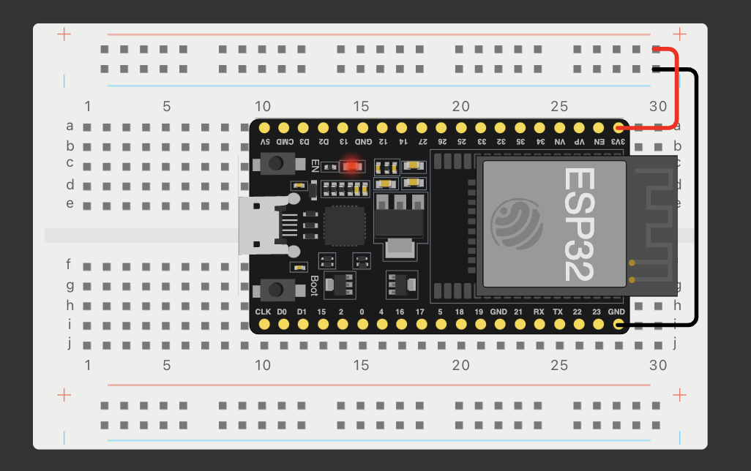
ESP32 (Screenshot)
Microcontroller mounted and powered ON

Slide 5
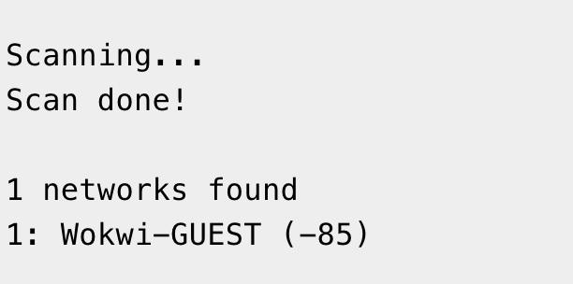
ESP32 WiFi Scan
Screenshot of Serial Monitor showing the available networks

Slide 6
Module 3 Overview
In this module, I added a series of different color LEDs to signify a traffic light and write the code to get the lights to cycle like a traffic light. This part of the project was a little more difficult for me to get right as I was still getting the hang of the program.

Slide 7
Rubric – Due at the end of Week 3
Activity | Requirement(s) | Points
Include a screenshot of your circuit | Picture of the breadboard with LEDs ON. | 30
Screenshot of code showing your name in comment | Screenshot of code in the Code Editor showing your name in one of the comments. | 30

Slide 8
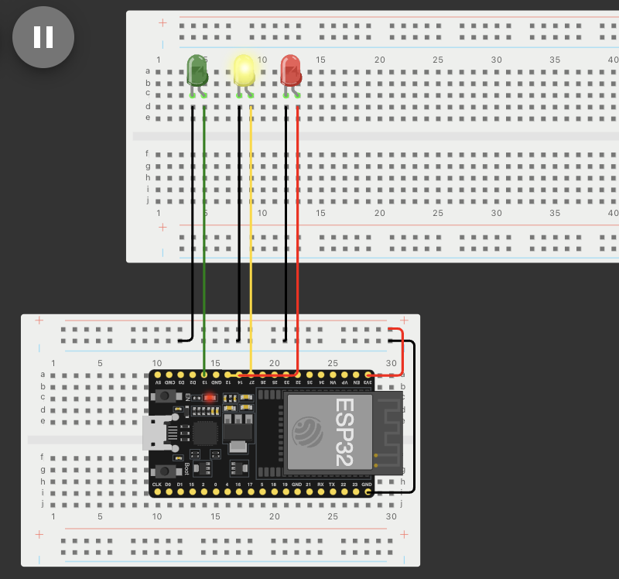
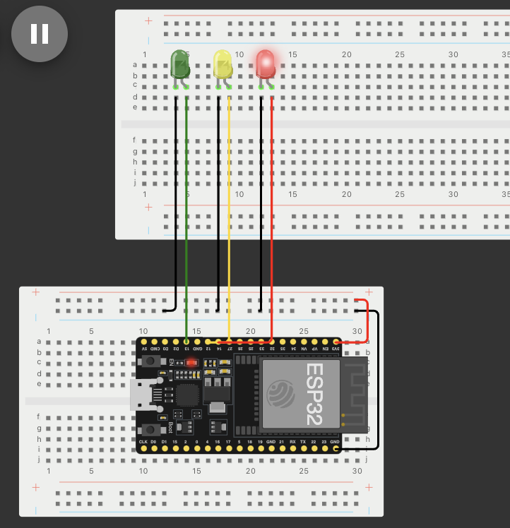
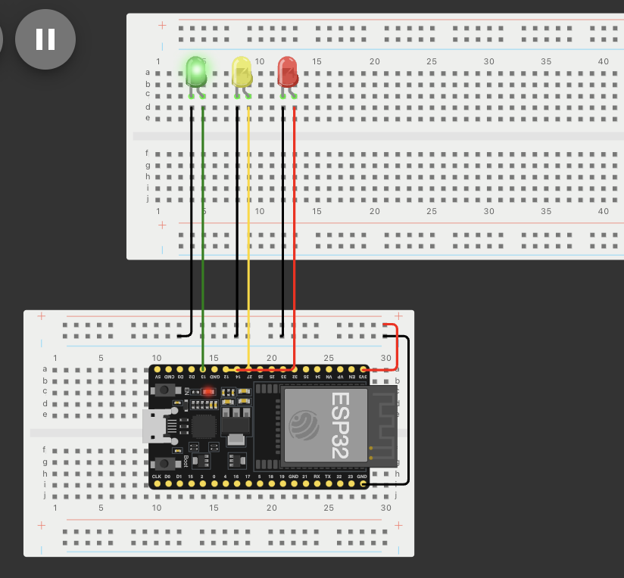
Picture of circuit with working LEDs
ESP 32 Board
Colored LEDs: Red, Yellow and Green
Wires
Breadboard

Slide 9
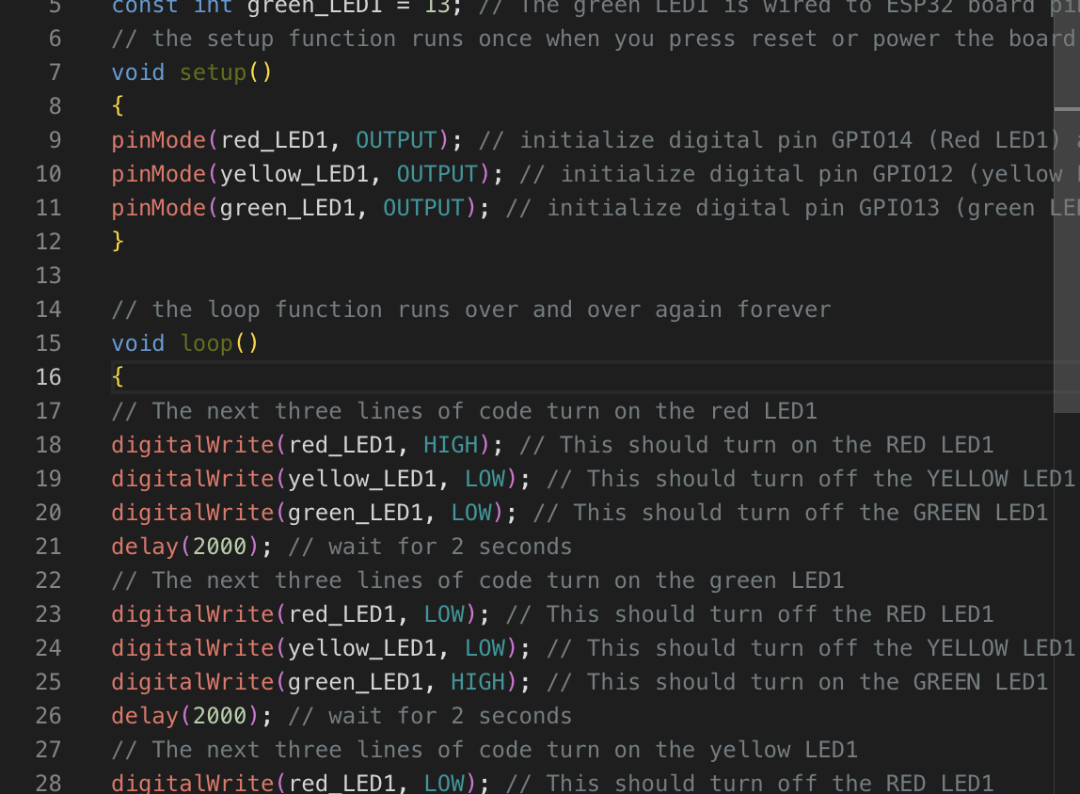
Screenshot of code in the Code Editor
Screenshot of code in the Wokwi Code Editor showing your name in the comment

Slide 10
Module 4 Overview
I added another set of LEDs to the breadboard. This time they switched colors to be opposite of the other side. While one light was green the other was red. This began to get easier for me as I was getting the hang of it.

Slide 11
Rubric – Due at the end of Week 4
Activity | Requirement(s) | Points
Include a screenshot of your circuit | Screenshot of the breadboard with LEDs ON. | 30
Screenshot of code showing your name in comment | Screenshot of code in the Code Editor showing your name in one of the comments | 30

Slide 12
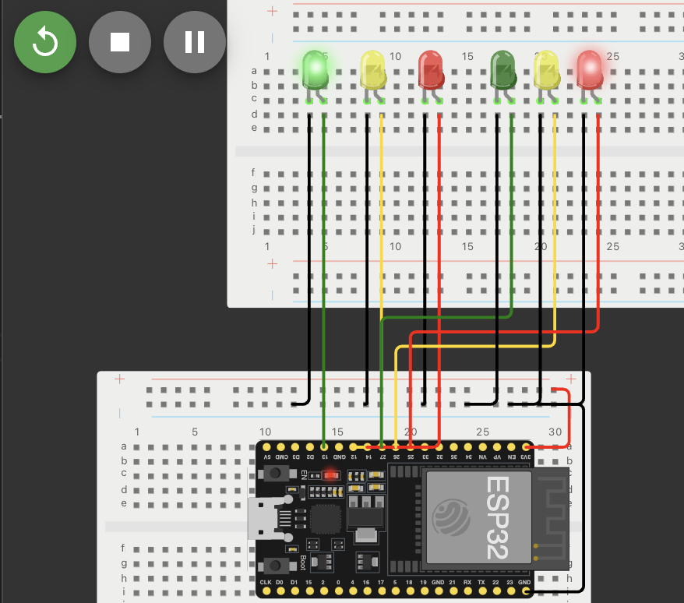
Picture of circuit with working LEDs
ESP 32 Board
Colored LEDs: Red, Yellow and Green (two sets)
Wires
Breadboard

Slide 13
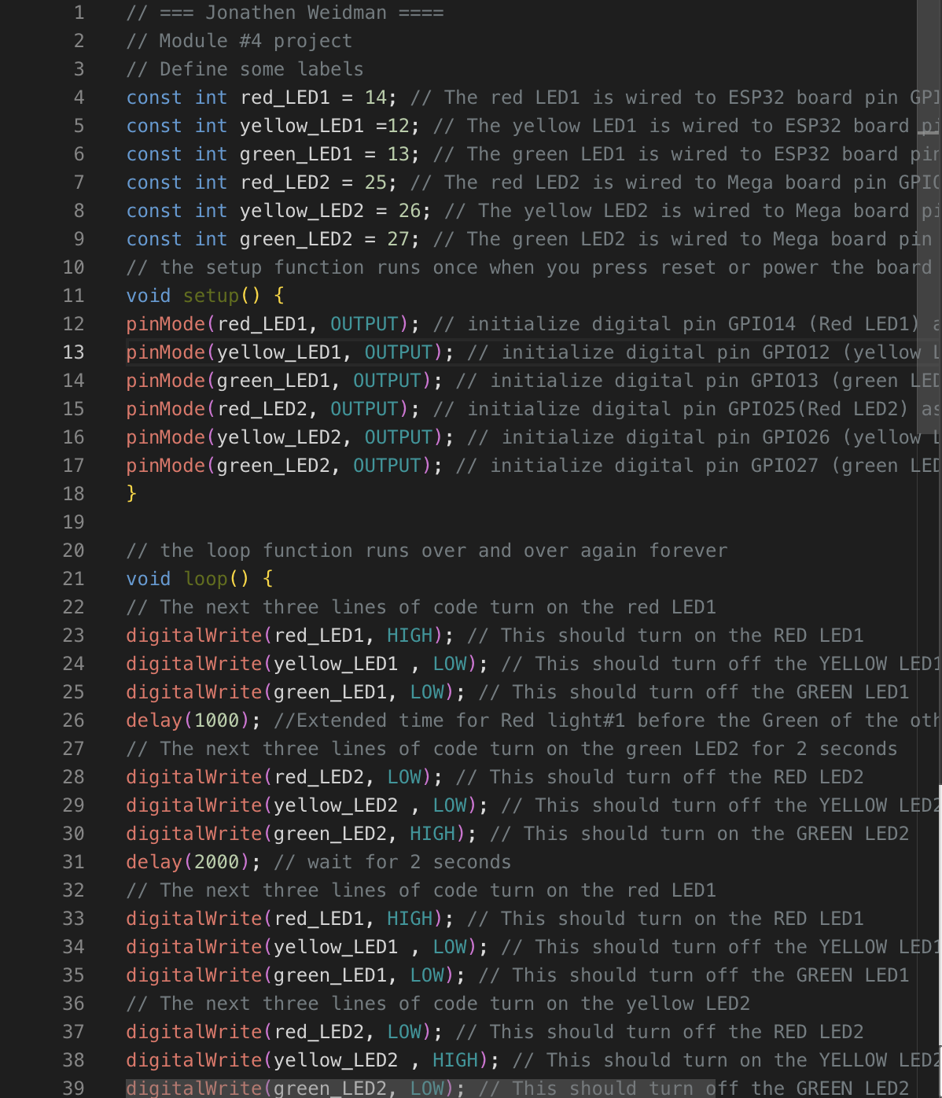
Screenshot of code in Wokwi
Screenshot of code Wokwi Code Editor showing your name in the comment

Slide 14
Module 5 Overview
In week 5, I added a button for the cross walk that would turn all lights to red and allow pedestrians to safely cross the road. I found it challenging in this week to figure out how the button worked to get it to do what I needed it to do.

Slide 15
Rubric – Due at the end of Week 5
Activity | Requirement(s) | Points
Include a picture of your circuit | Picture of the breadboard with LEDs ON | 20
Screenshot of code showing your name in comment | Screenshot of code in Wokwi showing your name in one of the comments | 20
Screenshot of output in Serial Monitor | Screenshot of Serial Monitor from Wokwi | 20

Slide 16
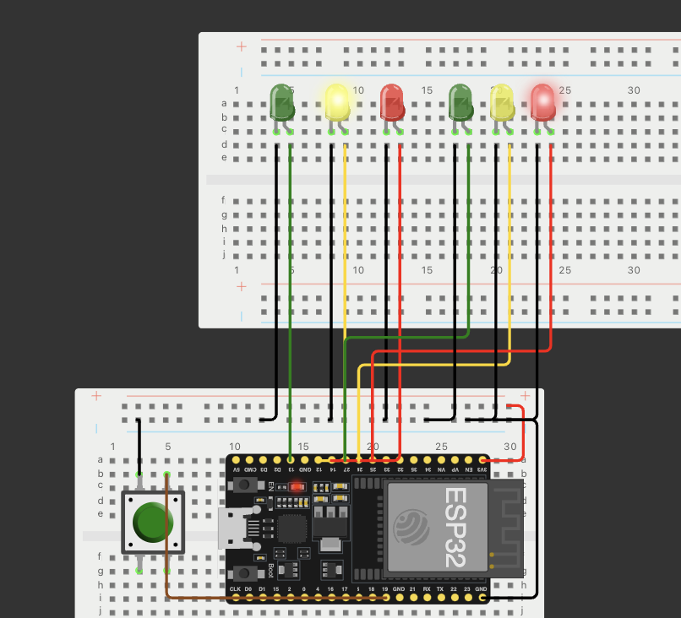
Screenshot of circuit with working LEDs
ESP 32 Board
Colored LEDs: Red, Yellow and Green (two sets)
220 Ohm Resistors (optional)
Push Button
Wires
Breadboard

Slide 17
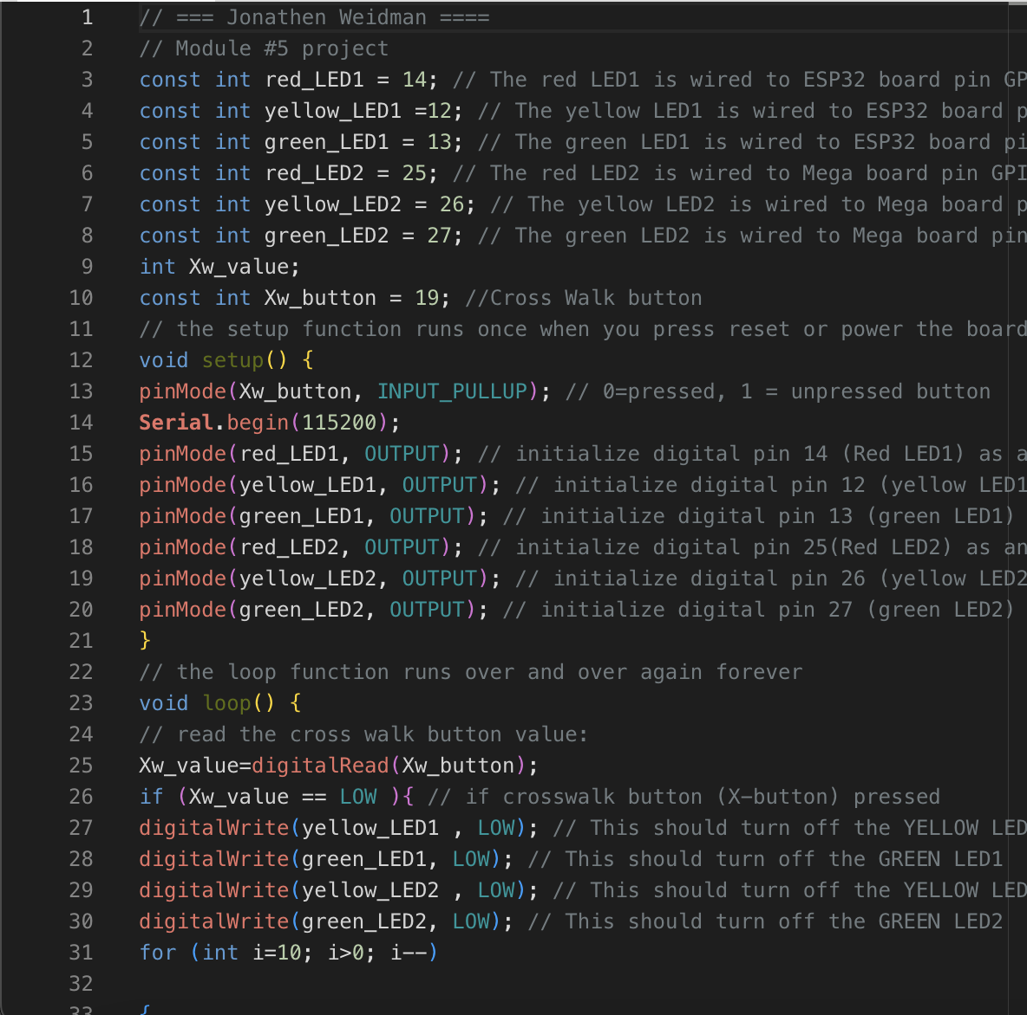
Screenshot of code in Wokwi
Screenshot of code in Wokwi Code Editor showing your name in the comment

Slide 18
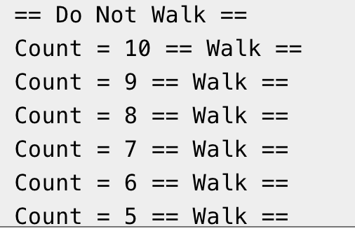
Screenshot of Serial Monitor in Wokwi
Screenshot of output in Serial Monitor

Slide 19
Module 6 Overview
Week 6 I added a buzzer and an LCD display for the cross walk. When the button was pressed the buzzer would go off to a count down of how long was left for the pedestrians to cross. The display showed whether it was walk or don’t walk with a visible count down.

Slide 20
Rubric – Due at the end of Week 6
Activity | Requirement(s) | Points
Include a picture of your circuit | Picture of the breadboard with LEDs ON and LCD displaying message. | 20
Screenshot of code showing your name in comment | Screenshot of code showing your name in one of the comments | 20
Screenshot of output in Serial Monitor | Screenshot of Serial Monitor | 20

Slide 21
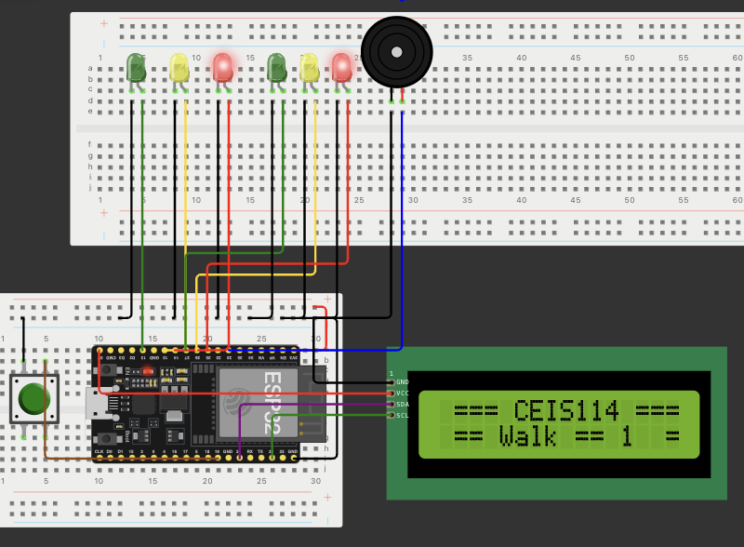
Picture of circuit with working LEDs and LCD display
ESP 32 Board
Colored LEDs: Red, Yellow and Green (two sets)
220 Ohm Resistors (optional)
Push Button
LCD Unit with Message Display
Wires
Breadboard

Slide 22
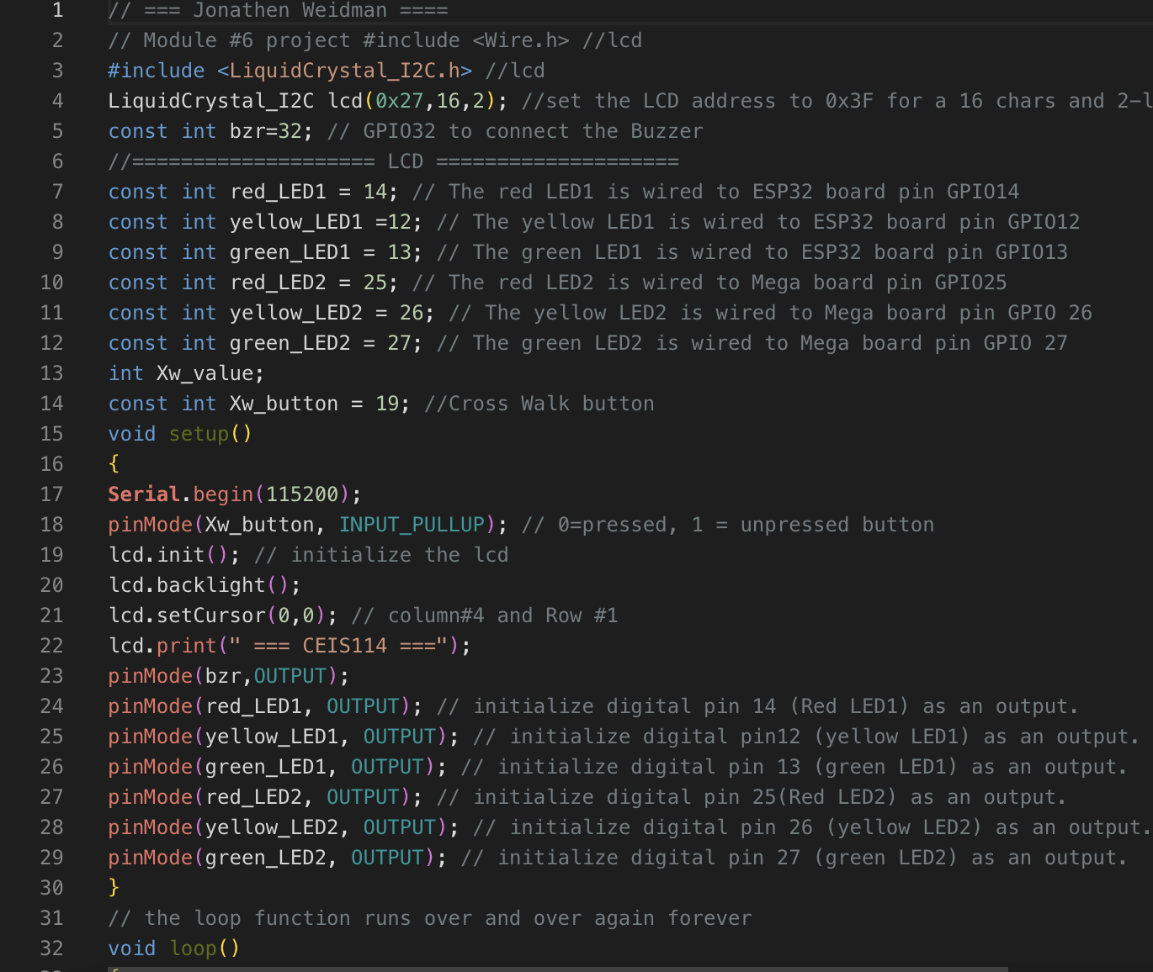
Screenshot of code in Code Editor
Screenshot of code in Code Editor showing your name in the comment

Slide 23
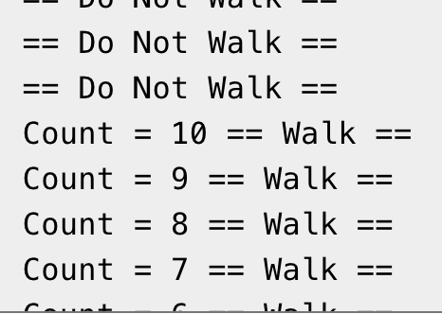
Screenshot of Serial Monitor
Screenshot of output in Serial Monitor

Slide 24
Challenges
In this course I’d say most of my challenges were learning new programs. Assembling the device piece by piece was fun. Although, I did struggle to get the wires connected just right. The code was another point that stumped me a lot. I was able to get through my challenges by taking a step back and looking everything over once more.

Slide 25
Career Skills
I learned the assembly of different components to a single device. Being able to make multiple devices operate in sync to achieve one goal will be a help in my career. The multitude of possibilities I could achieve with this skill is endless.

Slide 26
Conclusion
In conclusion, this project showed me some weaknesses that I need to work on. In this course I was challenged to make the lights operate cooperatively to achieve a goal of safety for traffic and for pedestrians. Making multiple devices work together was not an easy task, but a task that I pushed through.

Slide 27
References
https://wokwi.com/
CEIS114 Lessons

