Slide 1
Pasco Municipal Code
AI Reference
Technical Overview for City of Pasco IT
https://psd1.net/pmc1/PMC-AI-Technical-Overview.pptx
http://orionhs.us/20260410 (short link to presentation)
Source: https://psd1.net/pmc1/pmc1.zip
John Weisenfeld · Physics Teacher, Orion High School · April 10, 2026 · jweisenfeld@psd1.org
http://orionhs.us/pmc

Slide 2



Slide 3
John’s Observations
(If You Only Read One Slide)
1
Not all AI are created equal.
2
You have to pay something to get access to “best” models.
3
If you start paying, you have to stay on top of costs. They can balloon quickly.
4
“All these chatbots are a strategy to get you locked in long term” (Nate B. Jones)
John Weisenfeld · jweisenfeld@psd1.org http://orionhs.us/pmc

Slide 4
Which Tool is Which? (More Versions as of 4/8/2026)
pmc1 is Gemini-based.
pmc2 is Claude-based.
pmc3 is ChatGPT-based.
Try it live:
https://psd1.net/pmc1
https://psd1.net/pmc2
https://psd1.net/pmc3
Ask it anything about the
Pasco Municipal Code

Slide 5
Please Share Freely (The Original, Gemini)
Public tool — no login required. Share freely: http://orionhs.us/pmc
Hosted on psd1.net (cPanel server)
Capacity: dozens of concurrent users without issue
Flash queries typically cost $0.07-$0.15*
No user data collected — all sessions are anonymous
*See Appendix Slides for Breakdown
$0.11
per typical query

Slide 6
What the Tool Does (The Original, Gemini)
Natural language questions about the PMC
Cites exact section numbers (§X.XX.XXX)
Cross-references related titles & chapters
Flags gaps, conflicts, and ambiguities
English & Spanish & ??? — auto-detected
Multiple Google Gemini models available
Try it live:
http://orionhs.us/pmc
Ask it anything about the
Pasco Municipal Code

Slide 7
How It Works (The Original, Gemini)
PMC Document
~938,000 tokens
Uploaded once
Gemini Files API
Explicit Cache
12-hour TTL
User Query
Full context
Streamed response
PHP backend proxy keeps API key secure — never exposed to the browser
Server-Sent Events (SSE) deliver streaming responses in real time
NOTE: I have since walked back
explicit caching

Slide 8
Source Code Structure (The Original, Gemini)
index.html
Chat UI — single file, ~700 lines
api-proxy.php
Server-side proxy; streaming, caching, logging
cache-create.php
Uploads PMC to Gemini Files API (daily cron)
cache-ping.php
Keeps Files API URI alive every 23 hours
strip-html.php
HTML → clean text (~60% size reduction)
PMC-clean.txt
Clean document — 3.75 MB, ~938k tokens
gemini_usage.log
Per-query token & cache usage log
query_logs/
Anonymized monthly query logs

Slide 9
Understanding Query Costs (The Original, Gemini)
Layer 1 — Files API
Document uploaded once
Valid 48 hours
Refreshed nightly by cron
Layer 2 — Context Cache
Gemini holds document in hot memory
Valid 12 hours (lazy — created on first query)
Cache storage: $1.00 per 1M tokens/hour
$0.01
Flash-Lite / cached query
$0.10
Flash 2.5 / cached query
$0.99
Pro 2.5 / cached query
Cache storage is the dominant cost: ~$9/day baseline. Recommended for city deployment: Flash model with implicit caching (no storage fee) — estimated $50–100/month at typical staff usage.

Slide 10
Replicating for Any City Department
Any Document
Zoning, HR, Budgets, Permits
Own Folder
Isolated deployment per dept
Custom System Prompt
Defines AI expertise & tone
2–4 Hours
Estimated setup per department
Shared API Key
Or each dept provisions their own
Under $200/mo
Typical(?) city staff usage
All code is open source and sharable — no licensing or vendor lock-in

Slide 11
What You'd Need to Self-Host
✓
Web server with PHP 7.4+ and cURL (Linux cPanel or equivalent)
✗
No database required
✓
Google Gemini API key (free at aistudio.google.com, usage-billed)
✗
No user authentication required (optional)
✓
Source document in text or HTML format
✗
No Docker or containers
✓
Cron job scheduler (standard on any Linux server)
✗
No special hardware

Slide 12
Next Steps (from Claude ☺)
1
Share the live tool with planners and department heads
2
Schedule a 30-minute call to walk through the source code
3
Identify one city department as a pilot deployment
4
John shares all source code — no strings attached
John Weisenfeld · jweisenfeld@psd1.org http://orionhs.us/pmc

Slide 13
Appendix Slides
What are the real costs
when you use Gemini?
(What happened on 4/8)

Slide 14
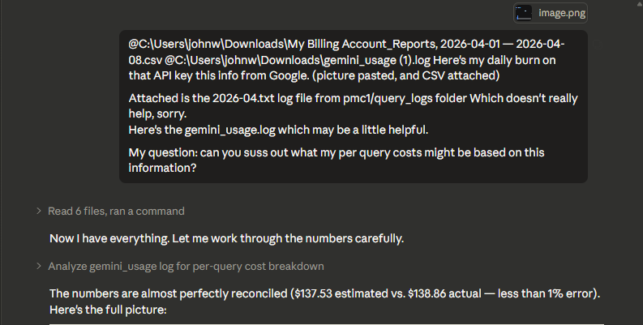
Notes:
I asked Claude to corroborate the logs of Gemini usage with the Gemini daily costs.

Slide 15
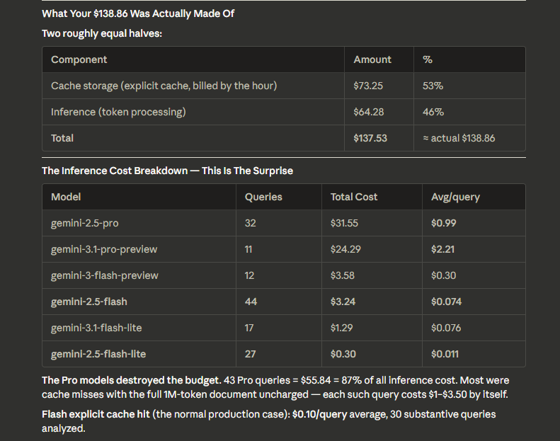
Notes:
Total costs has two components, caching and inference (queries).

Slide 16
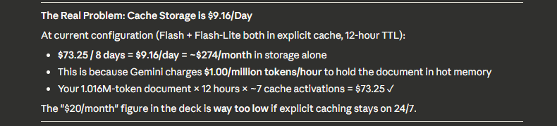
Notes:
Caching is a large cost. You need to ask yourself, what caching gets you? Faster responses? Better responses?

Slide 17
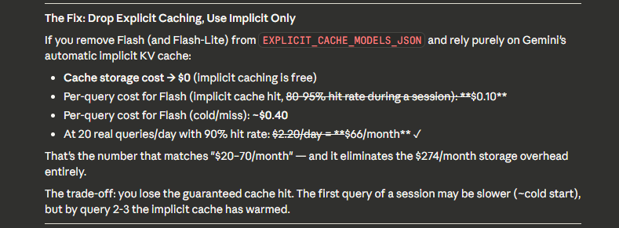
Notes:
I made this change on Wednesday 4/8/2026 to remove Explicit caching. Making a cache in the cloud has too many failure modes, and I deemed not enough payoff.

Slide 18
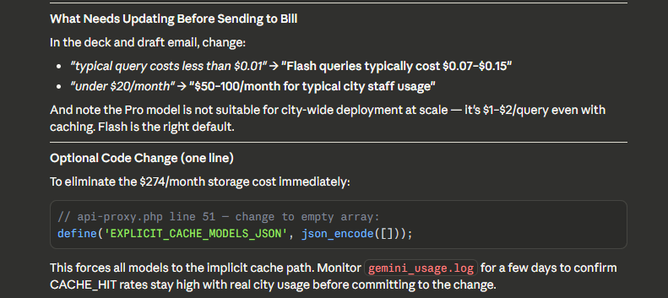
Notes:
This change happened on 4/8/2026.

Slide 19
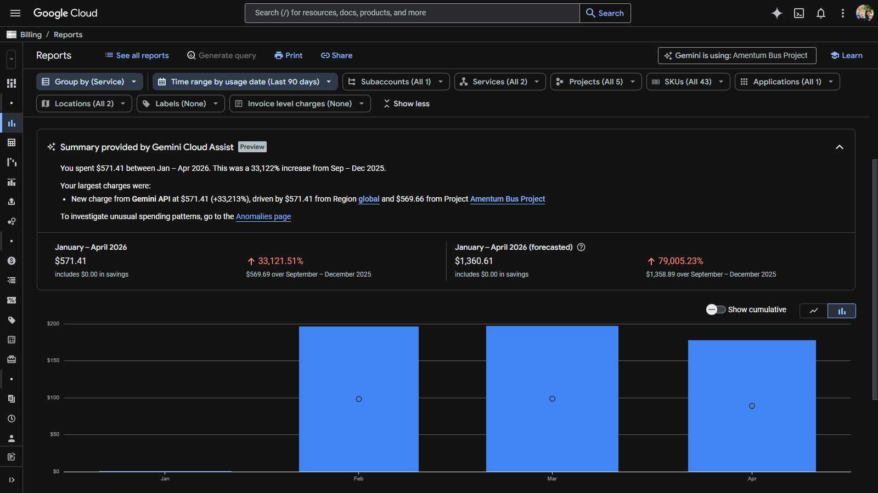

Slide 20
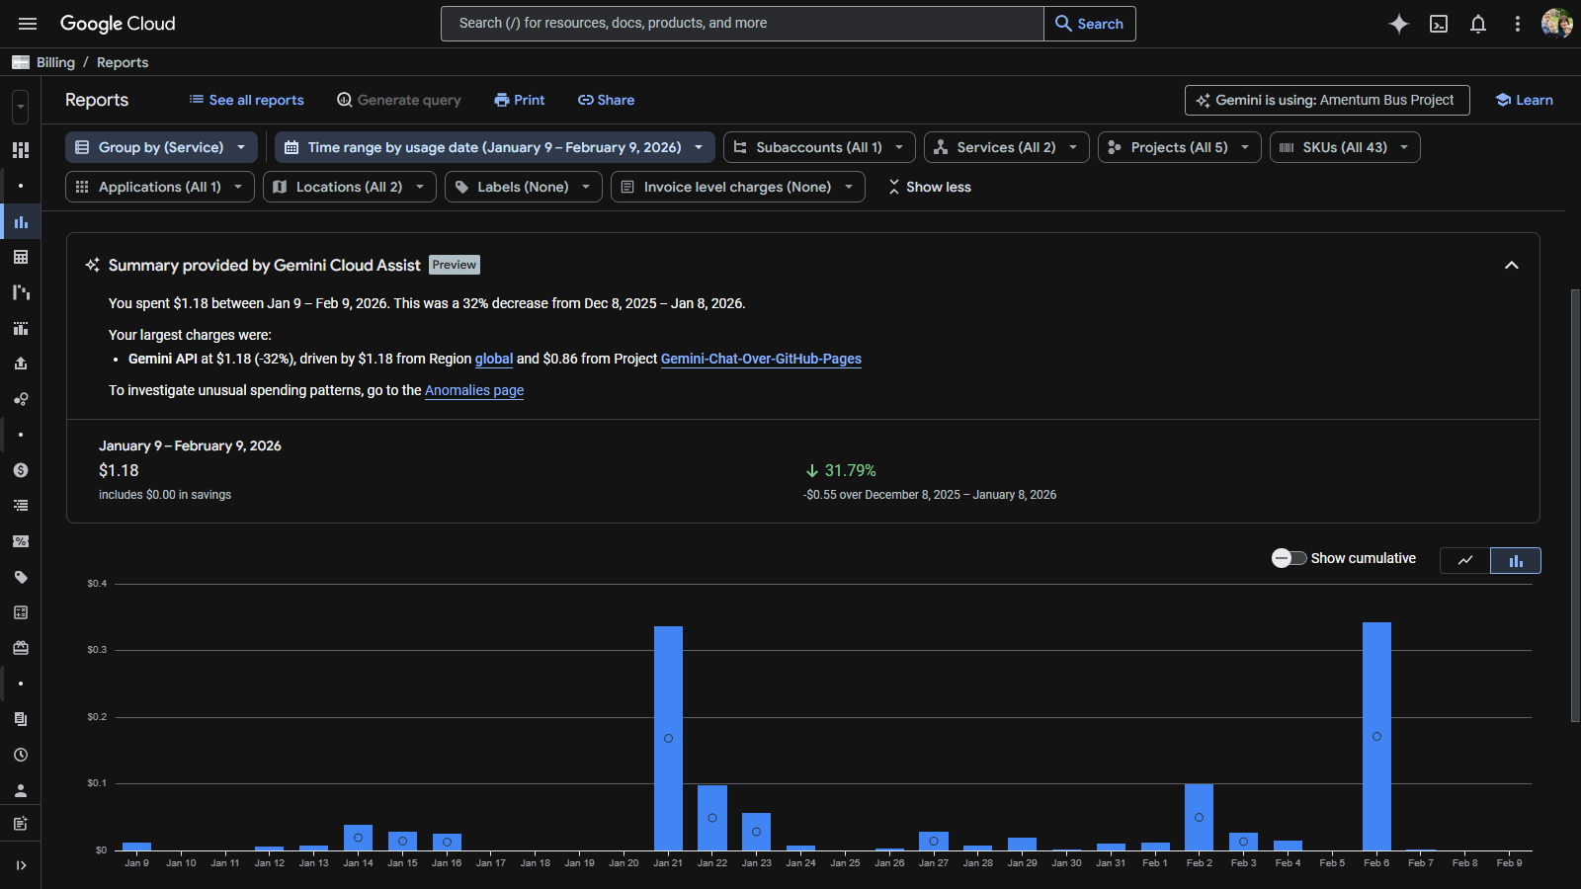

Slide 21
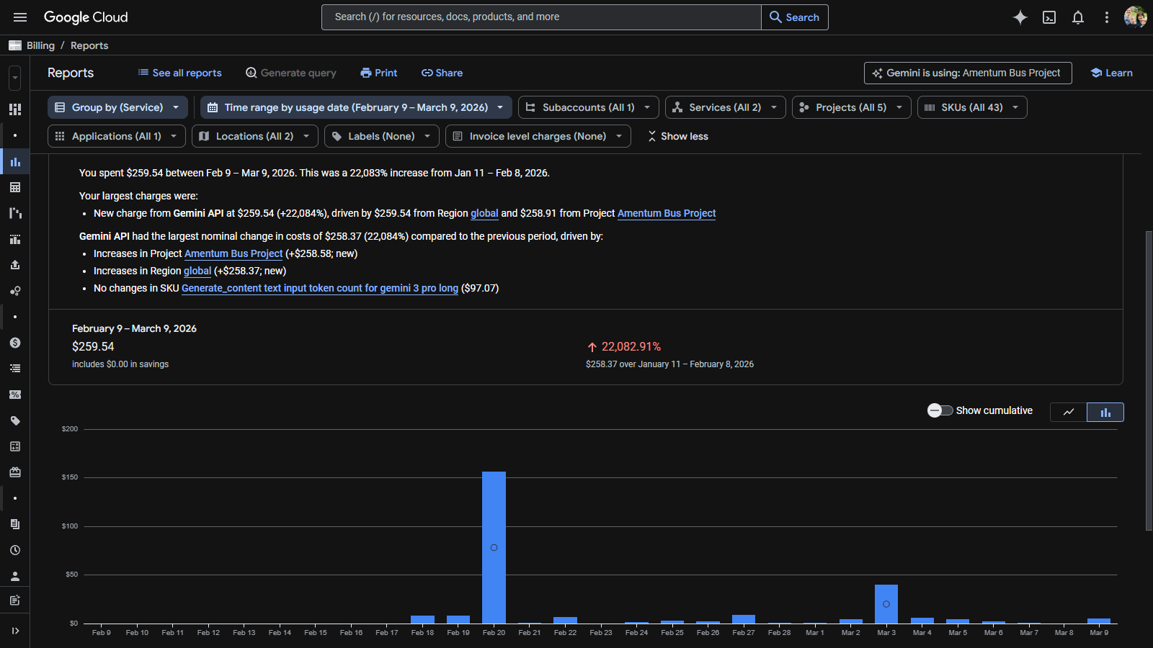

Slide 22
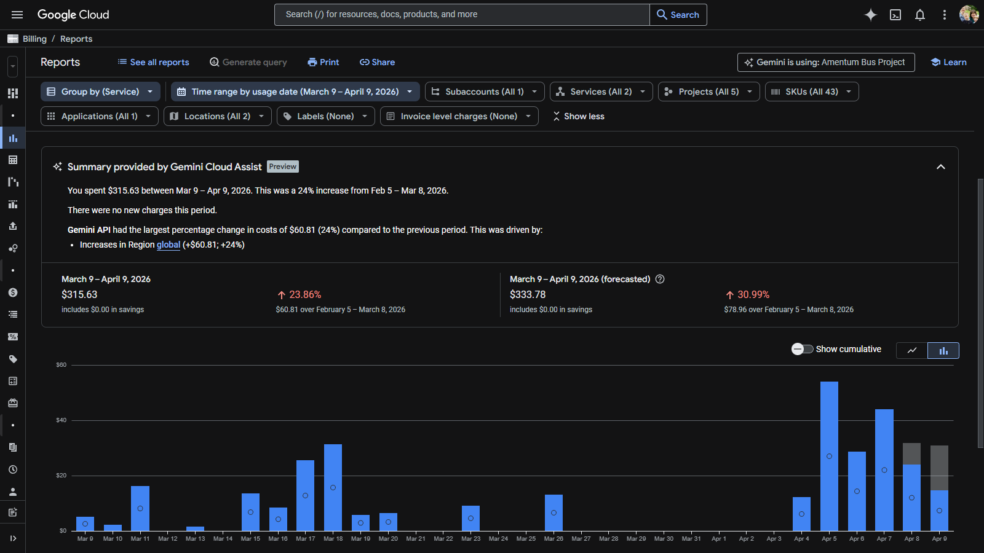

Slide 23
Appendix Slides
What are the real costs
when you use Claude?
(Is Gemini really best?)

Slide 24
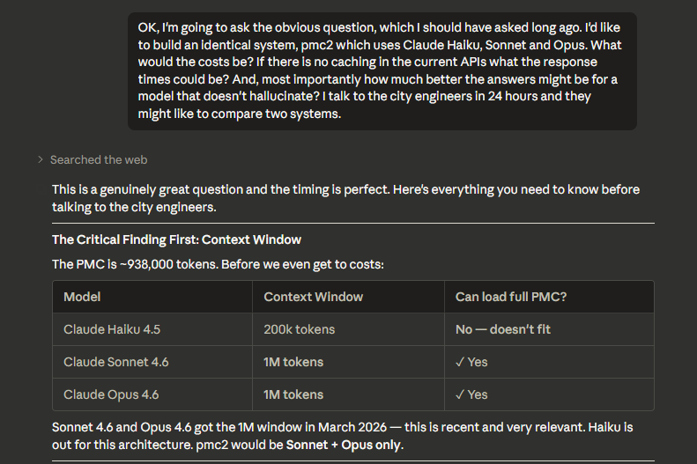

Slide 25
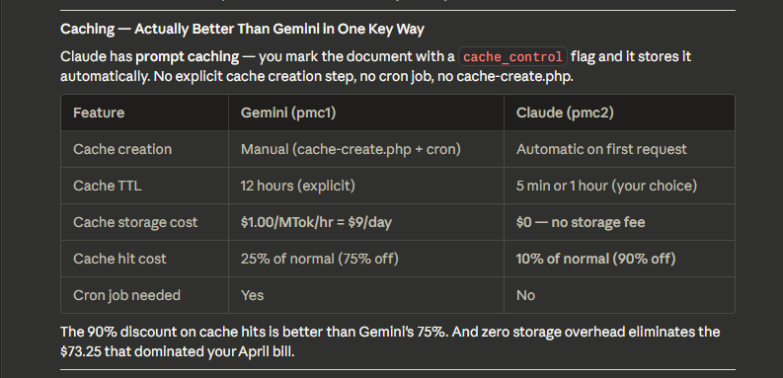

Slide 26
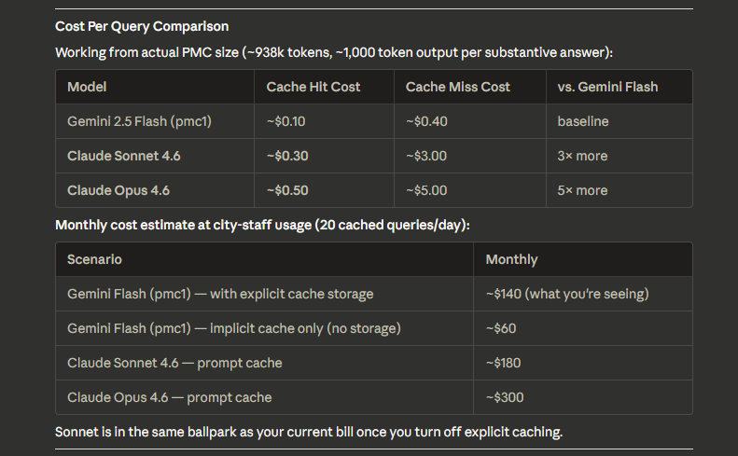

Slide 27
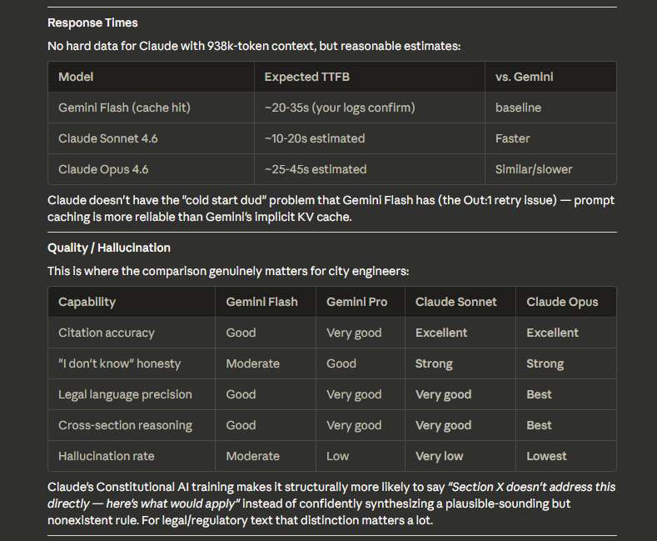

Slide 28
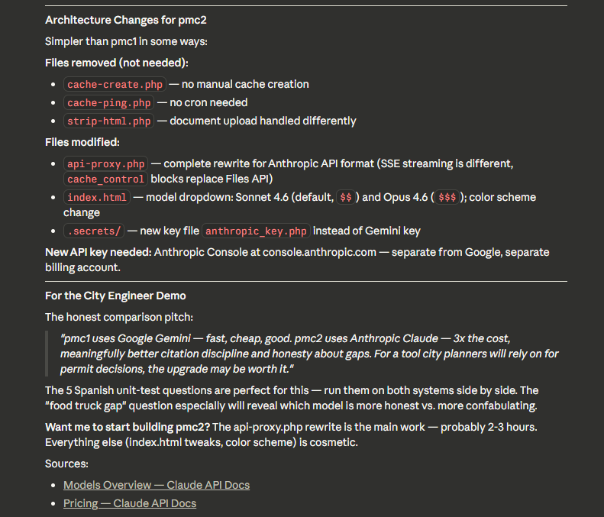

Slide 29
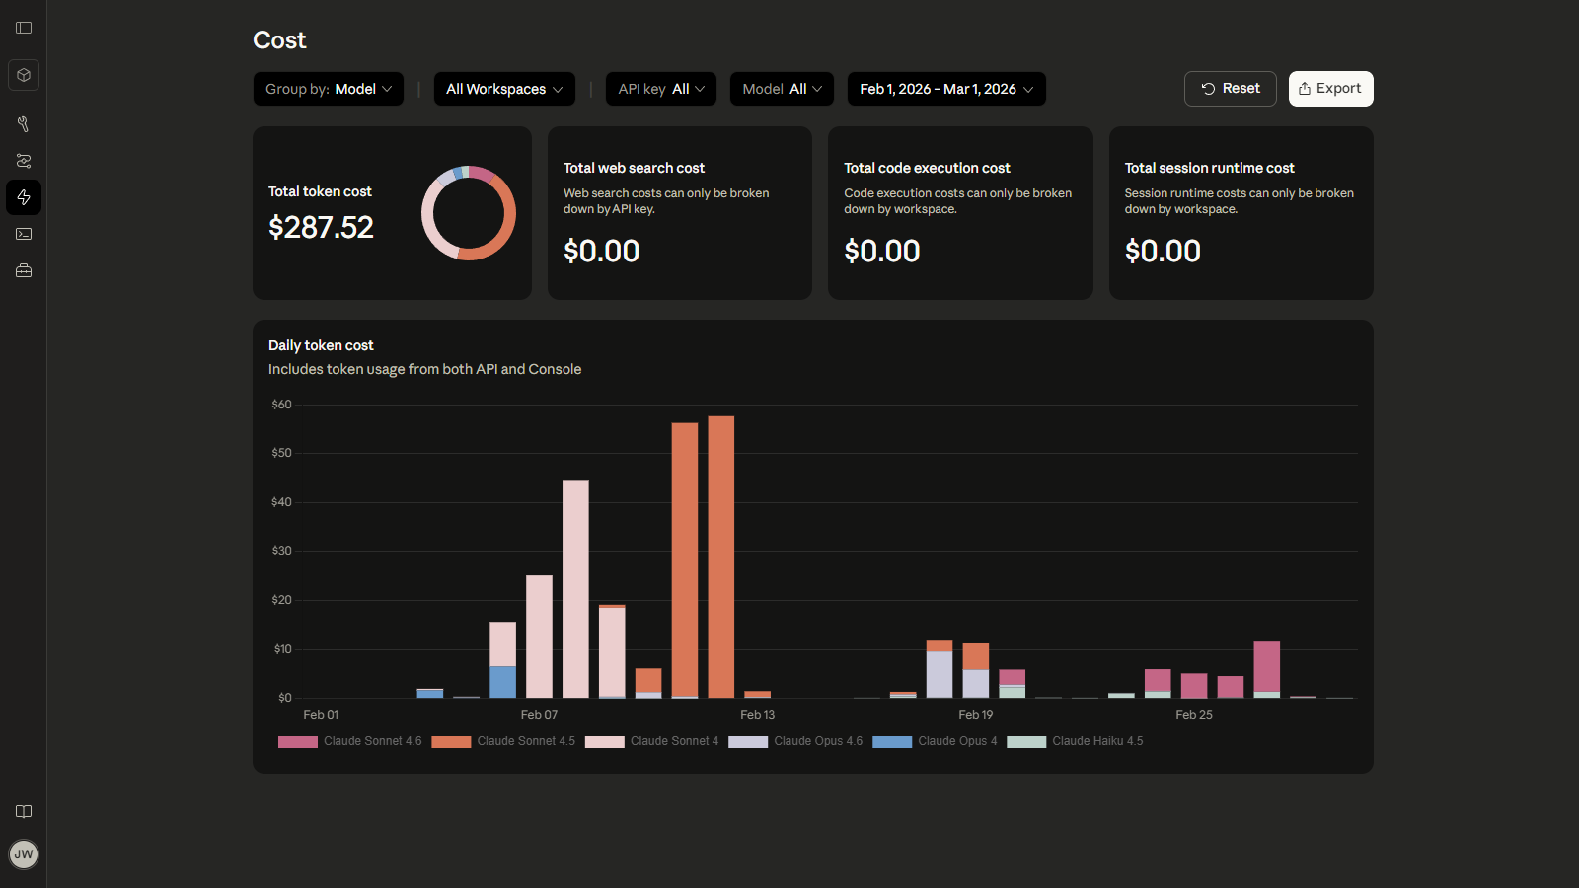
Watch the burn!

Slide 30
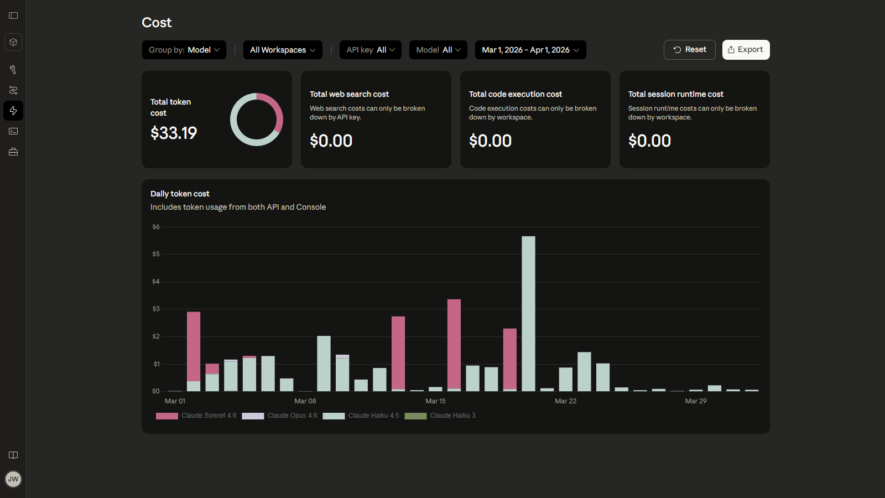
That’s Better!

Slide 31
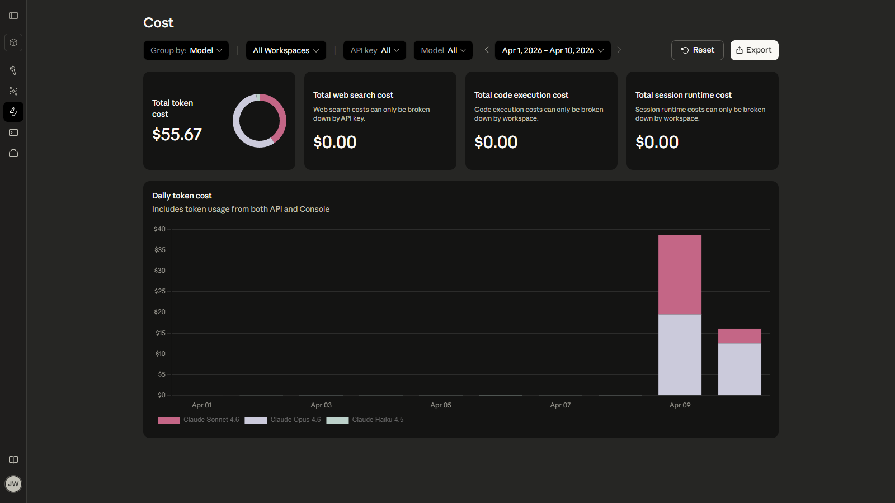
Ruh-Roh!

Slide 32
Appendix Slides
What are the real costs
when you use ChatGPT?
(It’s the best? Isn’t it?)

Slide 33
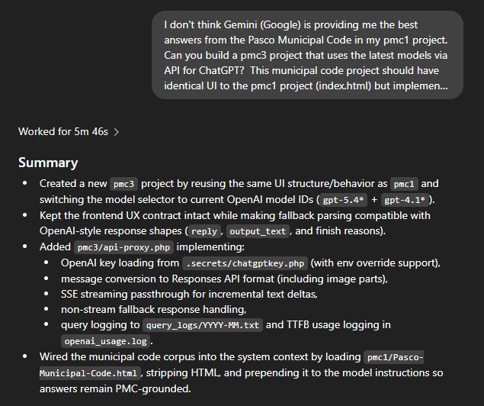

Slide 34
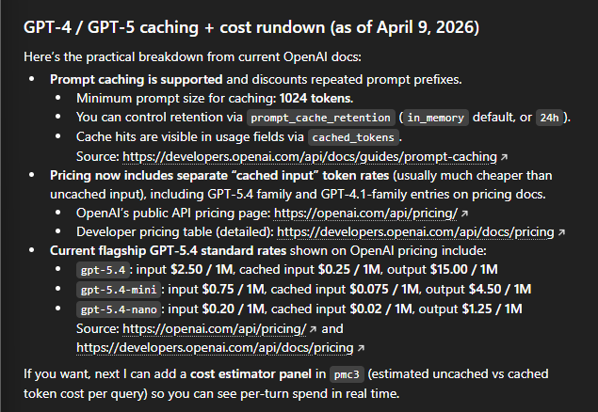

Slide 35
Appendix Slides
Ask a Question
Any Language
Response is in Same Language
Even Complicated Questions

Slide 36
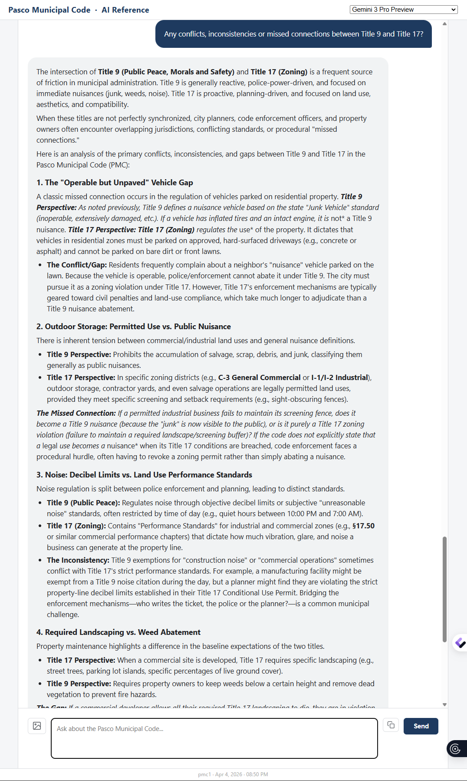

Slide 37
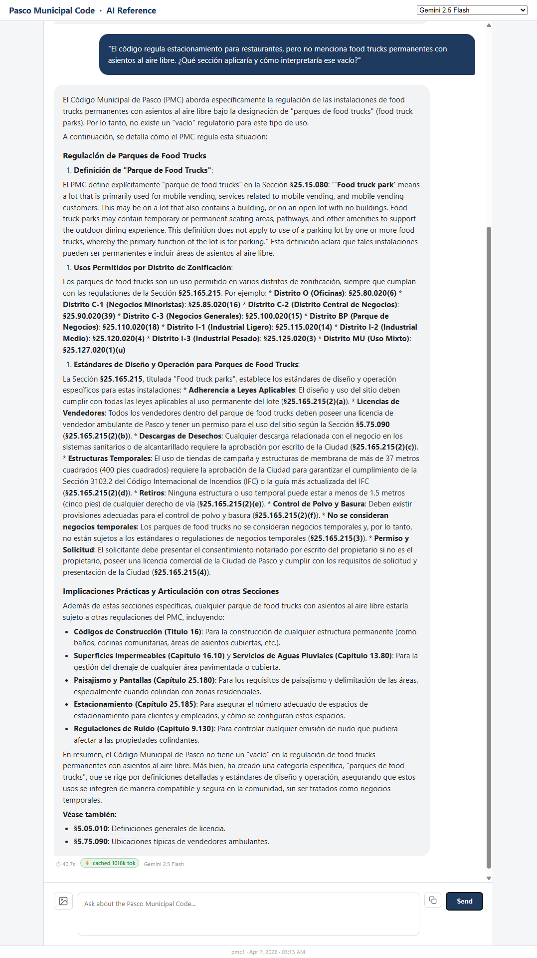

Slide 38
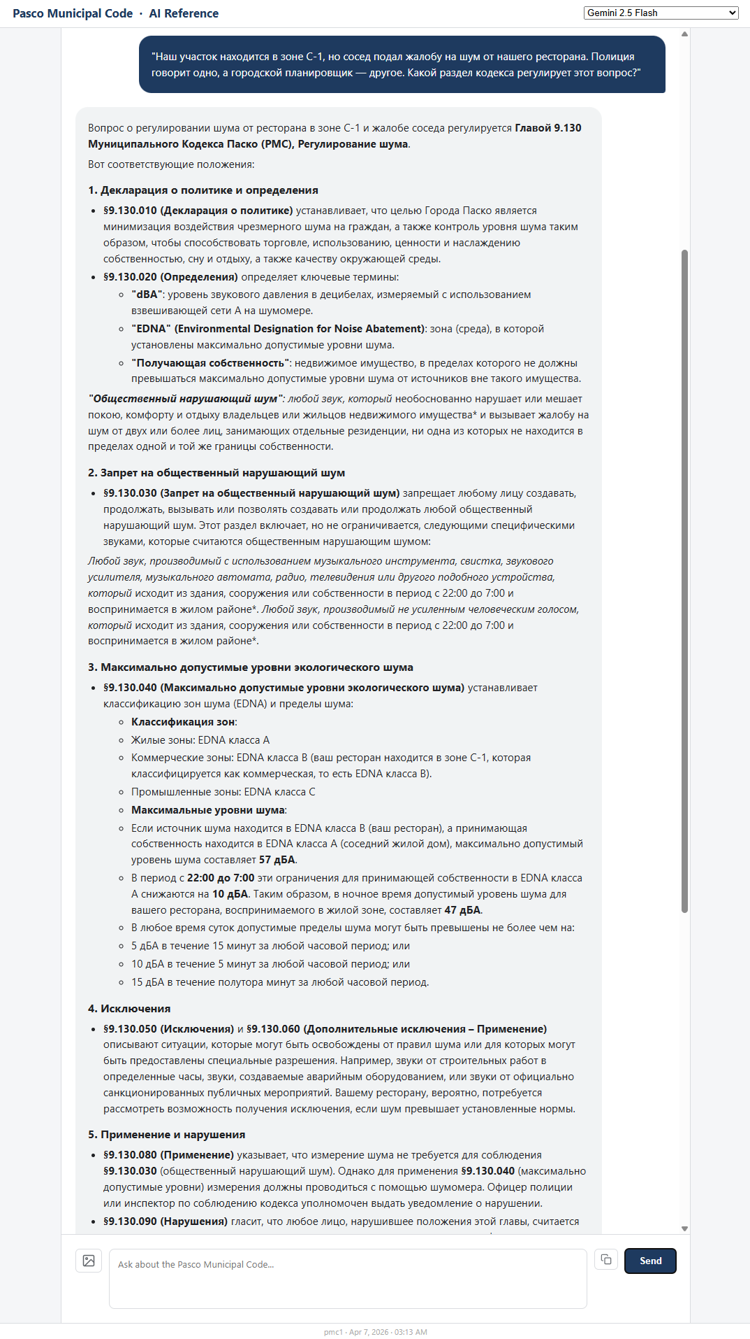

Slide 39
Appendix Slides
Backstory
“Design a Bus Stop
Civil Engineering Project”

Slide 40

Proposal
Notes:
http://psd1.net/pmc1/Can-High-School-Students-and-AI-Design-a-Bus-Stop-Shelter.pdf

Slide 41
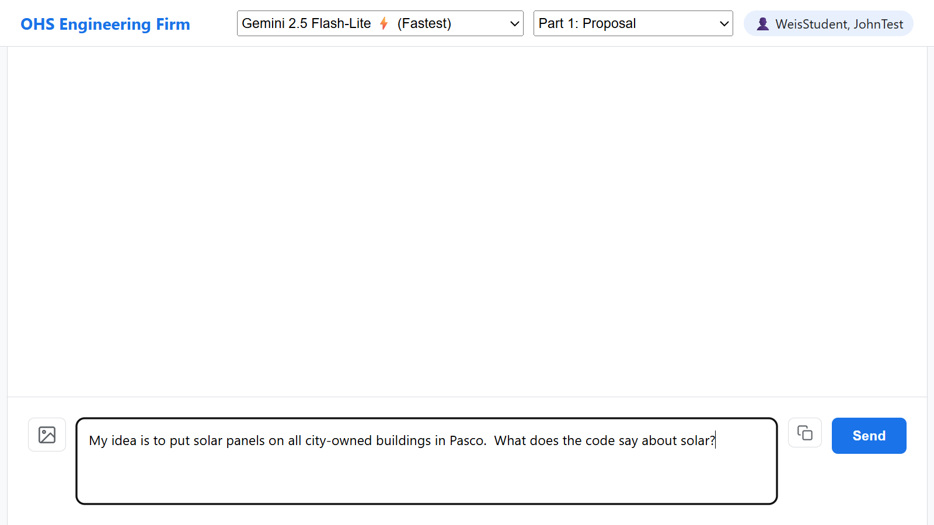
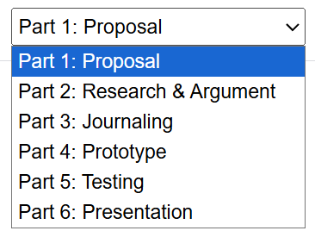
AI-Enhanced
Engineering Coach

Slide 42
