Slide 1

geecon Conferencing App
Jürgen Weismüller
08/Nov/2013

Slide 2
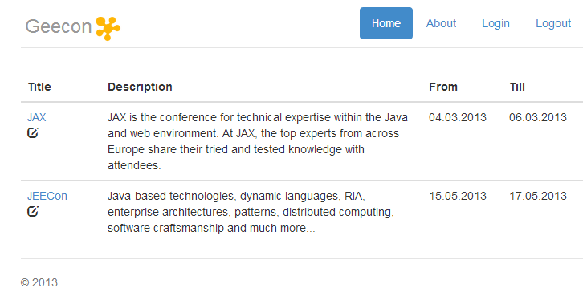
GUI

Slide 3
Domainmodel (1/3)
Conference
0..*
Talk
1
Room
0..*
Location
0..*
SpeakerAssignment
1
1
Speaker

Slide 4
Domainmodel (+ Components)
Conference
Conference
0..*
Talk
Organizational
1
Room
0..*
Location
0..*
SpeakerAssignment
1
1
Speaker

Slide 5
Domainmodel (JPA View)
Conference
@ManyToOne
Conference
Talk
@ManyToOne
Organizational
@ManyToOne
@OneToMany
1
0..*
Room
Location
0..*
SpeakerAssignment
@OneToMany
1
@OneToOne
1
Speaker

Slide 6
Modules
artifact modules
geecon-dist
geecon-ear
common module for non-functional aspects
geecon-mod-common-api
geecon-mod-common-ejb
business modules for api and ejb
geecon-mod-conference-api
geecon-mod-conference-ejb
geecon-mod-orga-api
geecon-mod-orga-ejb
other
geecon-rest
geecon-test
geecon-web

Slide 7
Maven Structure
geecon
geecon-parent-api
geecon-parent-ejb
geecon-mod-common-api
geecon-mod-common-ejb
geecon-mod-orga-api
geecon-mod-orga-ejb
geecon-mod-conference-api
geecon-mod-conference-ejb

Slide 8
JEE Allocation
4-letter component id
geecon-mod-yourname-api
…geecon.yourname.domain
YourEntity.java
…geecon.yourname.service
YourNameService.java
@Table("xxxx_yourname")
@Entity
<<interface>>
@Path(/yourresource)
geecon-mod-yourname-ejb
…geecon.yourname.service
YourNameServiceBean.java
META-INF
named-queries-yourname.xml
@Stateless
… implements YourNameService
<named-query…
Each component is mainly independent, no single point of knowledge

Slide 9
Technical Stack
AngularJS 1.2.0-rc3
JAX-RS 1.1
EJB 3.1
JBoss 7.2.0
CDI 1.0
JMS 1.1
JPA 2.0
MySQL / MariaDB

Slide 10
AngularJS
Framework for building SPAs
☑ modern and fast
☑ no server footprint
☑ responsive design, together with bootstrap
☑ own leightweight programming model
☑ no obfuscation of HTML5 output
Drawbacks?
😐 two programming models and knowledge areas
😐 security considerations

Slide 11
AngularJS
Template (partial)
<tbody ng-repeat="conference in conferenceList">
<td>{{conference.title}}</td>
<td>{{conference.dateFrom | date:'dd.MM.yyyy'}}</td>
Controller
geeconApp.controller('HomeController',
function ($scope, ConferenceService) {
$scope.conferenceList = ConferenceService.list();
});
Service
geeconApp.factory('ConferenceService', function ($resource) {
var conferenceService =
$resource(constants.serverAddress
+ 'conferences/:conferenceId', {}, {});
conferenceService.list = function () {
return conferenceService.query();
};
…

Slide 12
Naming Conventions (EJB)
Entities get their name out of the domain model without suffix
e.g. Conference
All Service-Interfaces own the suffix Service
e.g. ConferenceService
All SLSB own the Suffix ServiceBean
e.g. ConferenceServiceBean

Slide 13
Coding Conventions
Java
Oracle Coding Conventions
Project specific Eclipse Formattig Rules
JavaScript
Common JavaScript best-practices (https://github.com/airbnb/javascript)
AngularJS recommendations

Slide 14
Naming Conventions (CDI)
All Managed Beans own the suffix of their kind
e.g. MonitoringInterceptor
Their profession is an active doing - so we use the gerund form for the verb
e.g. MonitoringInterceptor
The according Annotations use the passive
e.g. @Monitored or @Audited

Slide 15
Deployment Structure
geecon-ear.ear
lib
geecon-mod-***.api
META-INF
application.xml
persistence.xml
talk-hornetq-jms.xml
geecon-mod-***.ejb
geecon-rest.war
geecon-web.war

Slide 16
by example: persistence.xml
<persistence-unit name="primary">
<jta-data-source>java:jboss/datasources/GeeconDS</jta-data-source>
<mapping-file>META-INF/named-queries-conference.xml</mapping-file>
<mapping-file>META-INF/named-queries-orga.xml</mapping-file>
<jar-file>geecon-ear.ear/lib/geecon-mod-common-api.jar</jar-file>
<jar-file>geecon-ear.ear/lib/geecon-mod-conference-api.jar</jar-file>
<jar-file>geecon-ear.ear/lib/geecon-mod-orga-api.jar</jar-file>
<properties>
…
</properties>
</persistence-unit>

Slide 17
Demo
&
Code

Slide 18
Problems
Modularization and getting JPA working
Decorators not working with EJBs exposed with Resteasy
workaround: use interceptor
Queue injection with CDI does not work with producer field due to classloading issues
workaround: producer method
There's not practical JavaScript editing with Eclipse
workaround: use WebStorm

Slide 19
Time Consumption
AngularJS
Project-Structure Maven
Tests/Arqu.
MBean, Ops
Functional Stuff
EJB
JPA

Slide 20
Where do we go tomorrow?
Complete Client functionality
BeanValidation
Maven Release Build
More tests…

Slide 21
Thank you!

