Slide 1

Audiobooks by Audible
A web scraping project By James Welch

Slide 2
Background
Audible is a publisher and distributor of audiobooks and podcasts.
The company was founded in 1995 and acquired by Amazon in 2008.
Audible reports 200,000 audio programs and over a billion hours listened a year.
Currently Audible provides two pricing tiers at $7.95 and $14.95 per month.
Both tiers provide a monthly credit which can be exchanged for a book.

Slide 3
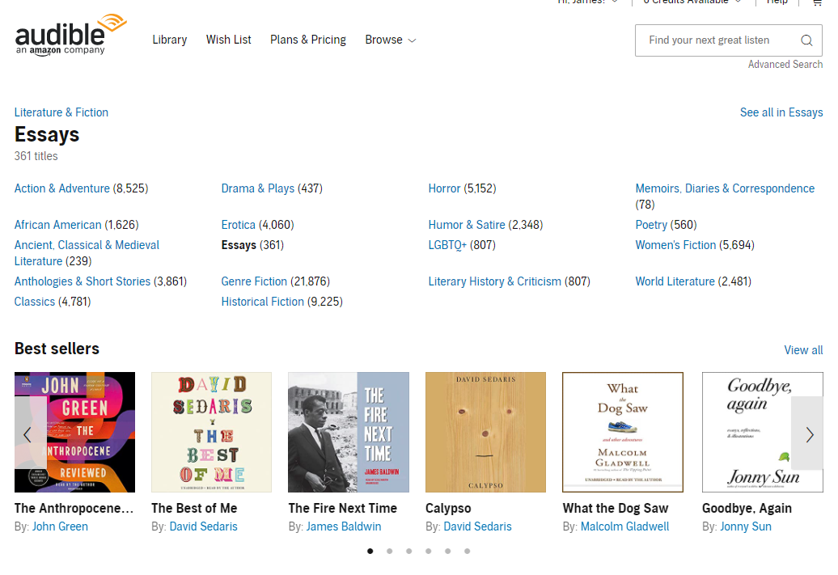
Category Scraping
Parent Category
Alt: Results Page URL
Category Name
Number of titles
Sub-Categories
Bold: No Sub-Categories
Results Page URL
Scrape Category Structure & Information
Link to Category Best Sellers
Scrape Title Information from Results Page

Slide 4
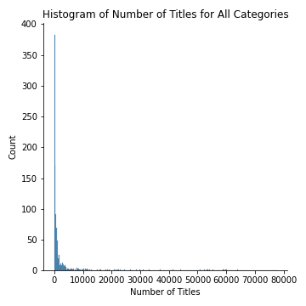
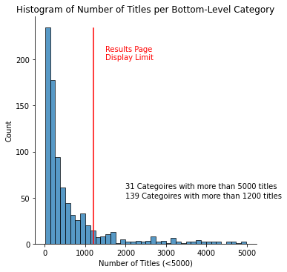
Skewed Title Distribution
Top-Level Categories

Slide 5
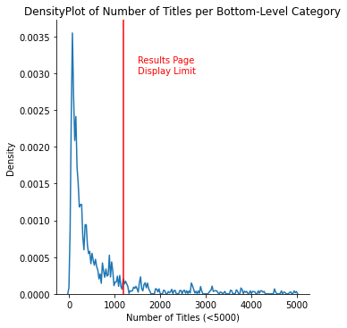
Skewed Title Distribution
Top-Level Categories

Slide 6
Network connectivity Histogram?

Slide 7
Network graph

Slide 8
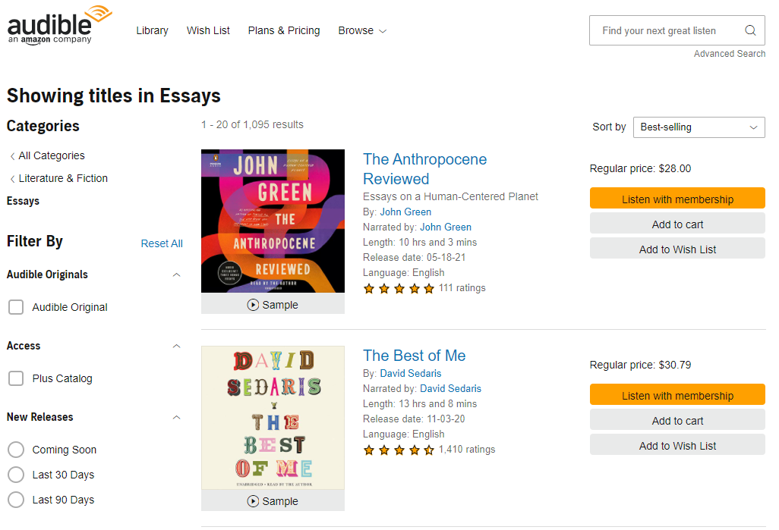
Title Scraping
Category Name
Title Information:
Title
Subtitle
Author
Narrator
Length
Language
Start Rating
Number Ratings
Price
Scrape Category Structure & Information
Link to Category Best Sellers
Scrape Title Information from Results Page

Slide 9
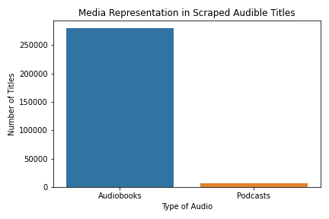
Collected Titles
Over 622,065 titles were scraped across all categories.
Due to the layouts of the categories, many titles are present in more than one category, leading to duplicates in our data.
After cleaning, 279,241 unique audiobooks were found.
As well as 6,959 podcasts.

Slide 10
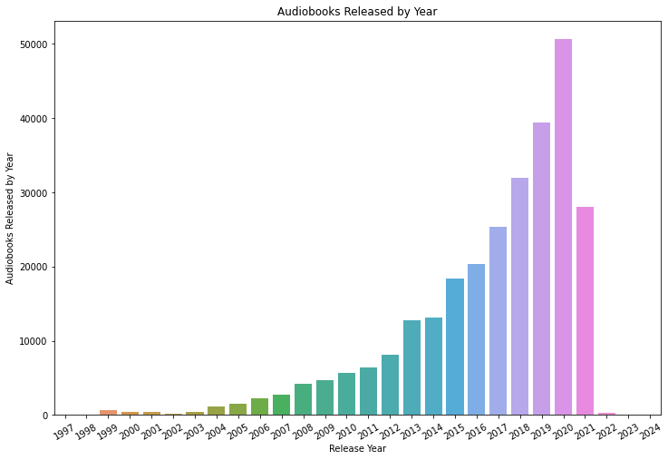
Growth
Since 2002, the number of titles in audibles library has been increasing almost

Slide 11
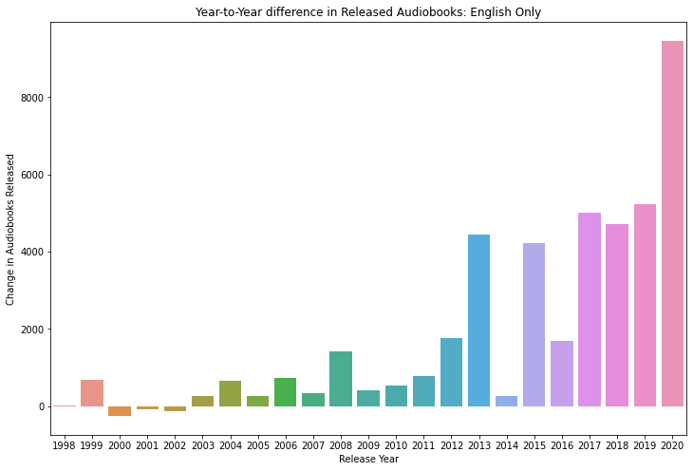
Growth: GRAPH IS WRONG
present value - past value = total / present value = total x 100 = growth percentage. So, your final equation is 470 - 342 = 128 / 342 = 0.374 x 100 = 37.4. This would make your growth percentage 37.4%.

Slide 12
Growth: What's up with 2013/2014
present value - past value = total / present value = total x 100 = growth percentage. So, your final equation is 470 - 342 = 128 / 342 = 0.374 x 100 = 37.4. This would make your growth percentage 37.4%.

Slide 13
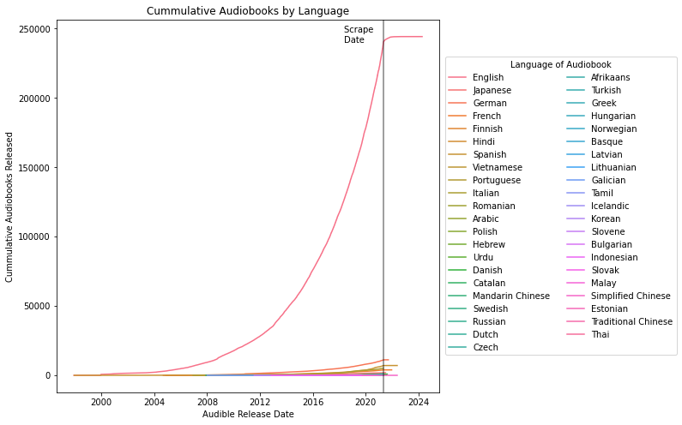
Language
44 languages are represented in Audible’s library.
English being the most common language.
Surprisingly, recent growth doesn’t seem to be reflected in other languages.
Netflix has recently partnered with hundreds of dubbing studios to add alternate language options.

Slide 14
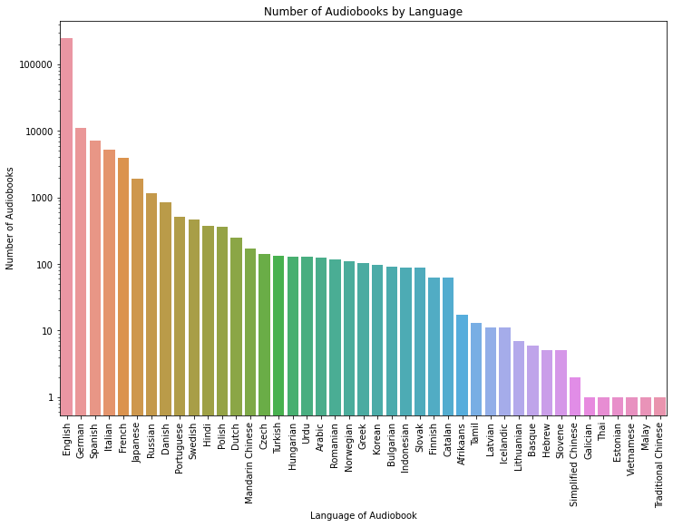
Language
44 languages are represented in Audible’s library.
English being the most common language.
Surprisingly, recent growth doesn’t seem to be reflected in other languages.
Netflix has recently partnered with hundreds of dubbing studios to add alternate language options.

Slide 15
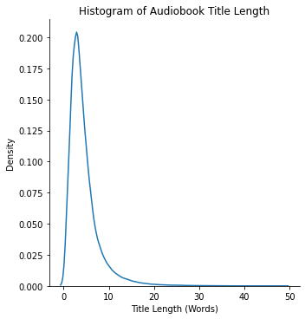
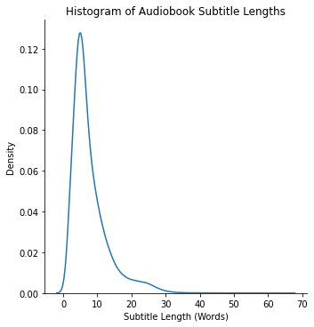
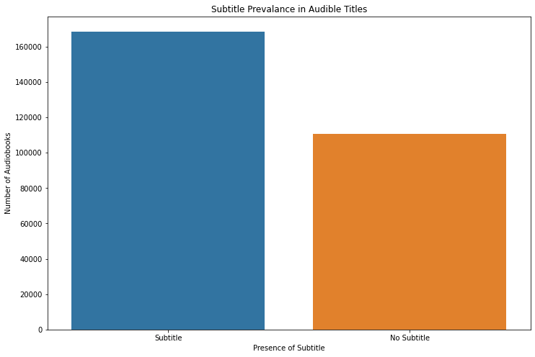
Title and Subtitle

Slide 16
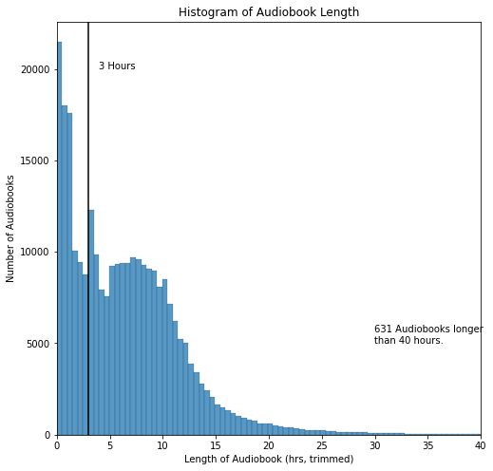
Length

Slide 17
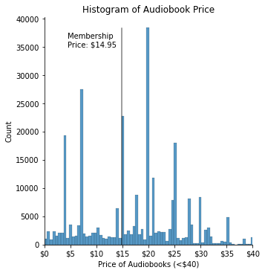
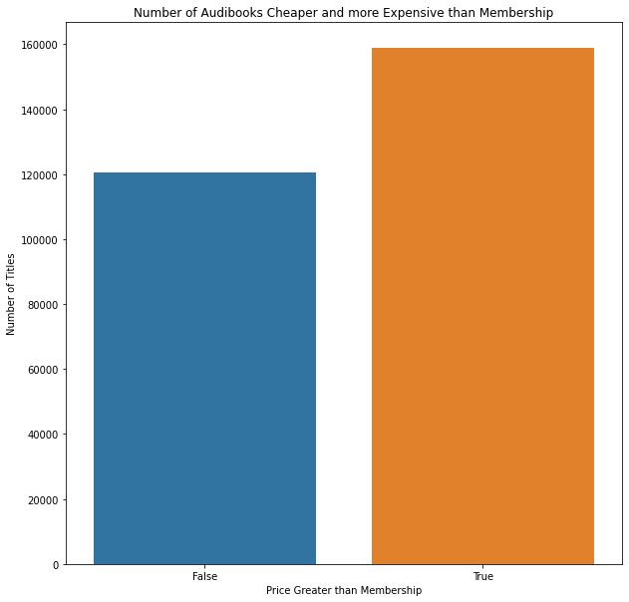
Price

Slide 18
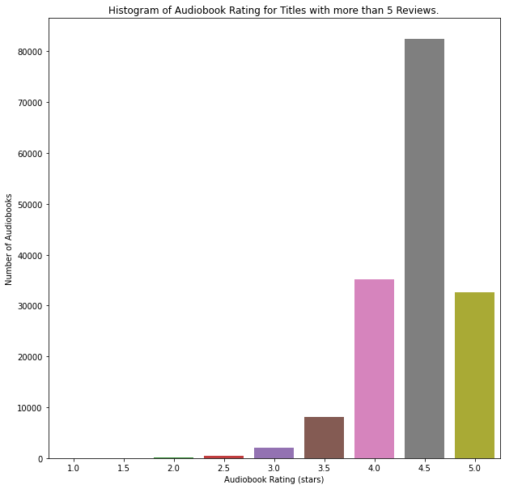
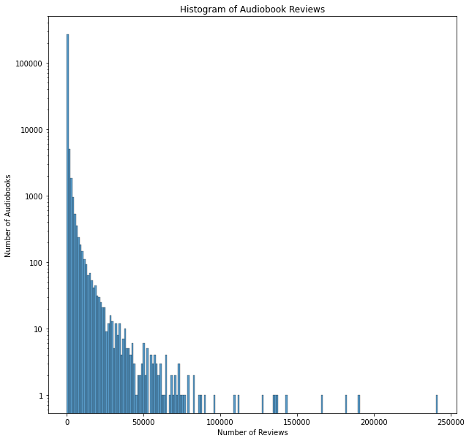
Reviews

Slide 19
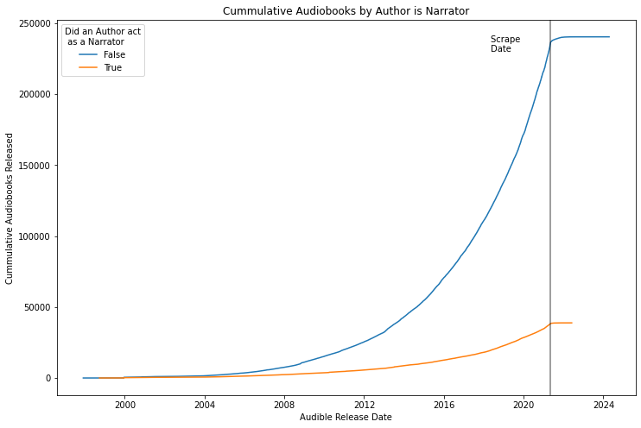
Author as Narrator

Slide 20
Conclusion

Slide 21
Future Work
Audible data collection could be expanded by fine grain review data.
Capture plus vs premium plus titles?
Audible might have dynamic categories. Number of titles increased and decreased across categories.
Attempted to scrape Amazon books
- Amazon displays a CAPTCHA page after ~500 site visits
- Page will be returned for several hours before
- Using proxy service (ScraperAPI) avoided bans but required payment.
BookShop.org
- A new online book shop which shares income with local books stores.
- Similar data to Amazon but less reviews.
- Slightly elevated prices compared to Amazon.

Slide 22
Acknowledgements
Audible for not banning me.
ScraperAPI for help which I didn’t end up using in this project.
Ed Robertson & Unsplash for the photo.

