Slide 1

Audiobooks by Audible
A web scraping project By James Welch

Slide 2
Background
Audible is a publisher and distributor of audiobooks and podcasts.
The company was founded in 1995 and acquired by Amazon in 2008.
Audible reports 200,000 audio programs and over a billion hours listened a year.
Currently Audible provides two pricing tiers at $7.95 and $14.95 per month.
Both tiers provide a monthly credit which can be exchanged for a book.

Slide 3
Timeline
1995 launch
1998 hardware release
1999 CEO passes
2003 Exclusive itunes distributor
2005 Direct download program
2007 iphone debuets
2008 Amazon Acquisision
2008 Sci-fi & Fantasy Exclusives
2011 ACX
2012 A-list collection
2017 1 billion listening hours / year
2016-2018 short form programming
2020 Audible Originals
2020 new pricing tier w/ exclusive content

Slide 4
Amazon & Books
Search
New Books
Organic Discovery
Distribution
Audio Creation Exchange
Amazon Books
Redirect
Dubbing
Audible
Reviews
Goodreads

Slide 5
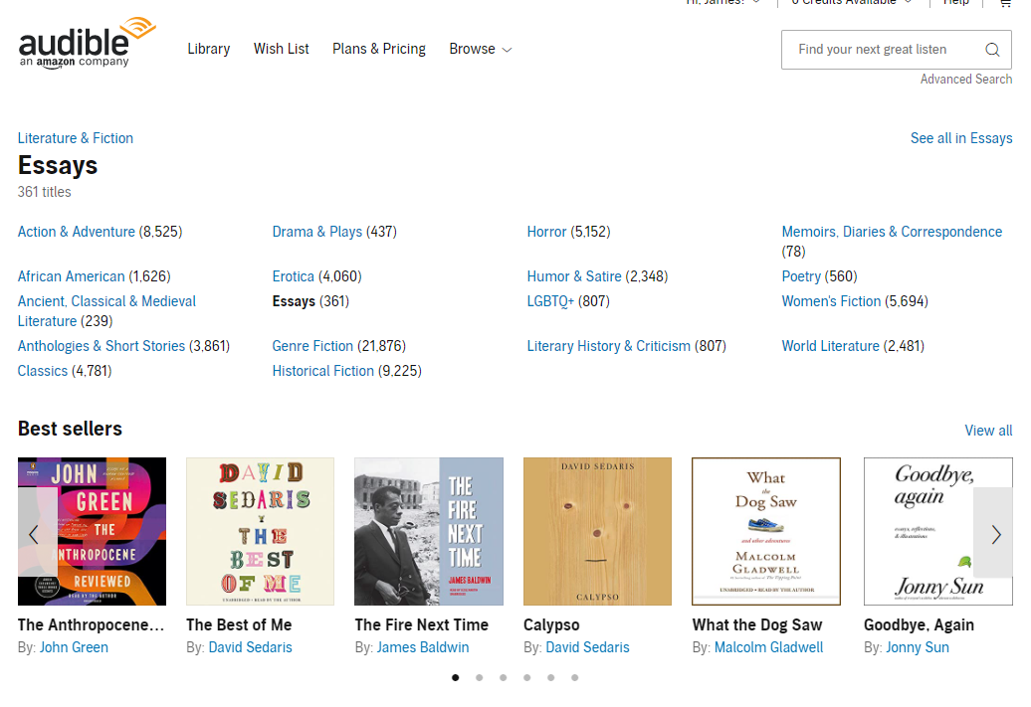
Category Scraping
Parent Category
Alt: Results Page URL
Category Name
Number of titles
Sub-Categories
Bold: No Sub-Categories
Results Page URL
Scrape Category Structure & Information
Link to Category Best Sellers
Scrape Title Information from Results Page

Slide 6
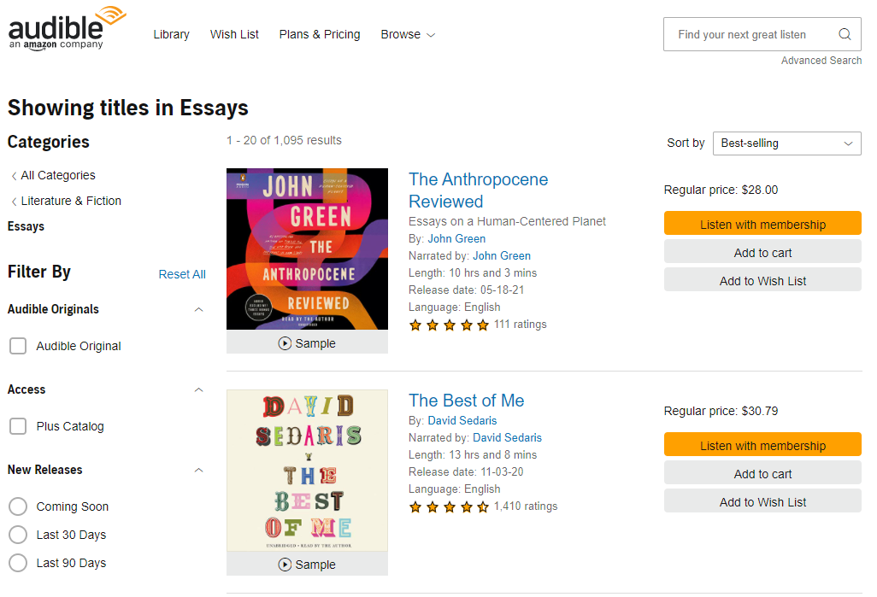
Title Scraping
Category Name
Title Information:
Title
Subtitle
Author
Narrator
Length
Language
Start Rating
Number Ratings
Price
Scrape Category Structure & Information
Link to Category Best Sellers
Scrape Title Information from Results Page

Slide 7
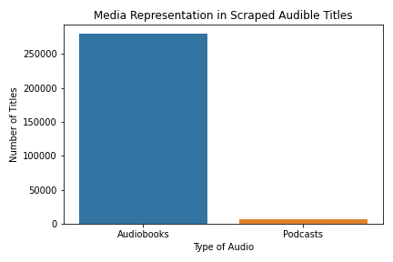
Collected Titles
Over 622,065 titles were scraped across all categories.
Due to the layouts of the categories, many titles are present in more than one category, leading to duplicates in our data. <Categories act like Tags>
After cleaning, 279,241 unique audiobooks were found.
As well as 6,959 podcasts. <incidentally scrapped>

Slide 8
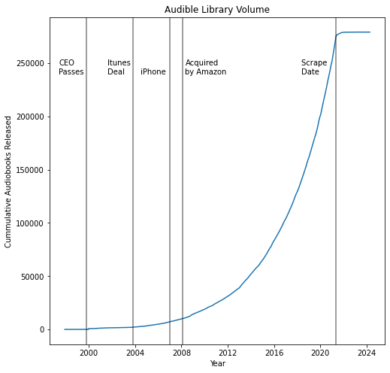
Growing Library
Show the library growing with bars for time.

Slide 9
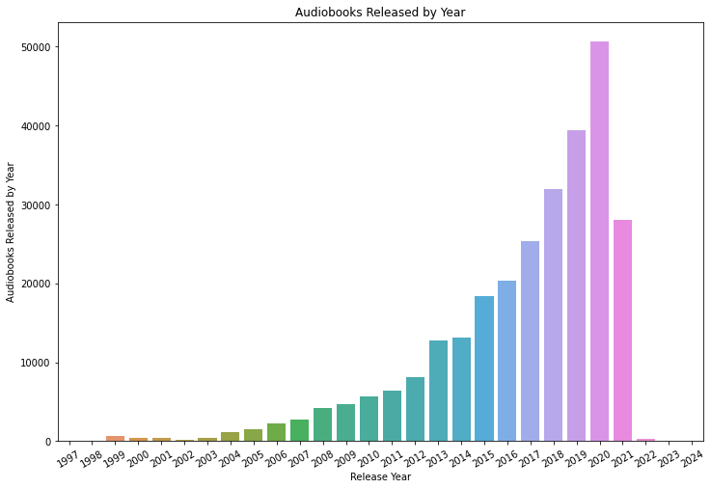
Growth
Since 2002, the number of titles in audibles library has been increasing yearly.
Some posted titles aren’t scheduled to be released till 2024.

Slide 10
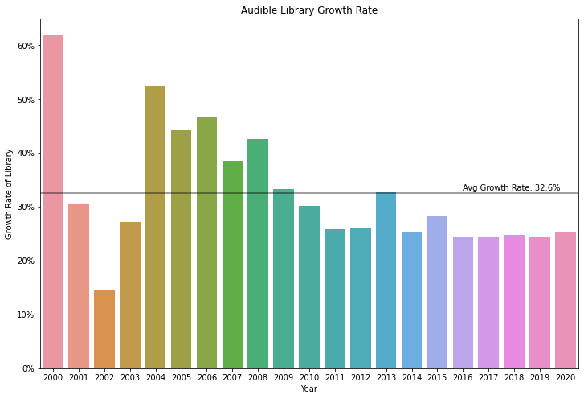
Consistent Yearly Growth
A
2013 disjuncture: ACX
((Current Year – Previous Year ) / Previous Year) * 100 = % Growth

Slide 11
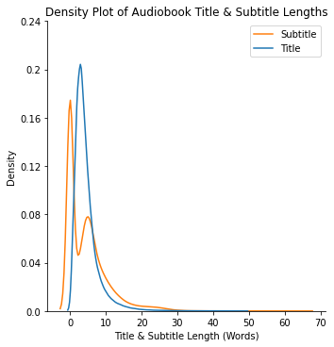
Title and Subtitle
Most Common Title Length: 3 words.
Most Common Subtitle Length: 0 or 5 words.
60% of Audiobooks include a Subtitle.

Slide 12
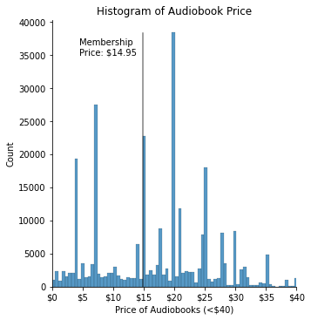
Price
The price of the full Audible Membership is $14.95,
57% of audiobooks are more expensive than the membership.

Slide 13
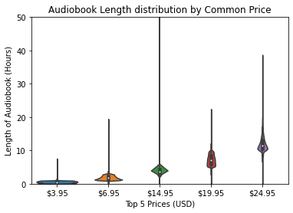
Price
The price of the full Audible Membership is $14.95,
Hours:
0.08
1.0
3.0
5.0
10.0

Slide 14
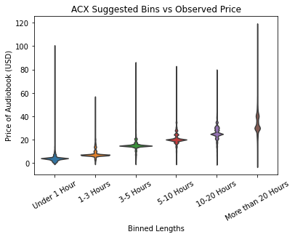
Price
The price of the full Audible Membership is $14.95,
ACX suggests
(mean runs ~$2 higher)
Length (Hours) | ACX Suggested | Observed Pricing (Mode/Median)
< 1 | < $7 | $3.95
1 – 3 | $7 – $10 | $6.95
3 – 5 | $10 - $20 | $14.95 *
5 – 10 | $15 - $25 | $19.95
10 – 20 | $20 - $30 | $24.95
20+ | $25 - $35 | $29.95

Slide 15
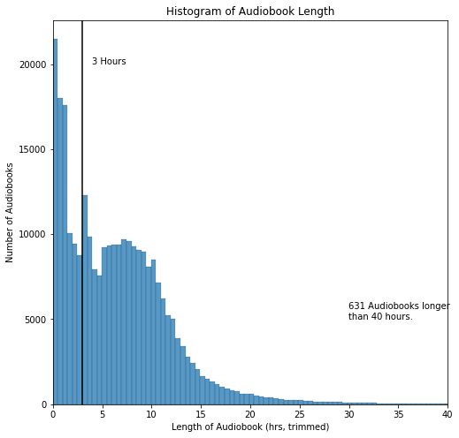
Length
Most books are ___ hours
With half being longer than __.
Interesting, a Y combinator blog reported 3 hours as the cutoff for a royalty increase.
Unfortunately, Audible does not provide clear information.
Perhaps there is a similar effect at 5 hours?

Slide 16
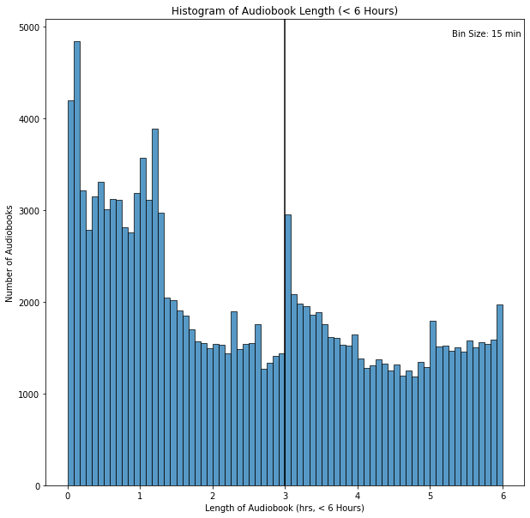
3 hour deep dive
Most books are ___ hours
With half being longer than __.
Interesting, a Y combinator blog reported 3 hours as the cutoff for a royalty increase.
Unfortunately, Audible does not provide clear information.
Perhaps there is a similar effect at 5 hours?

Slide 17
Price by Length

Slide 18
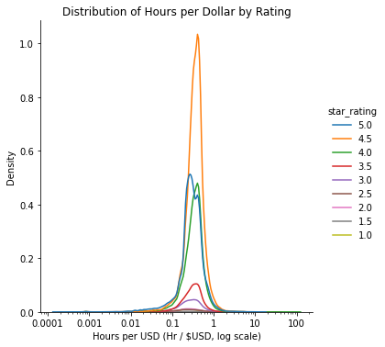
Bang for buck?

Slide 19
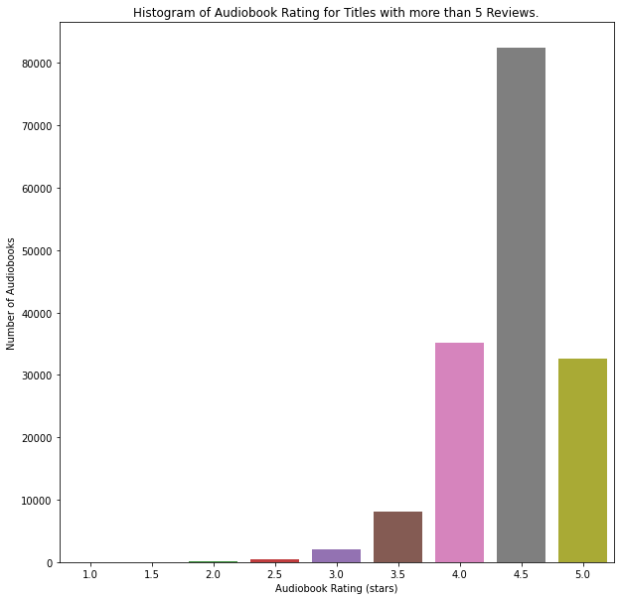
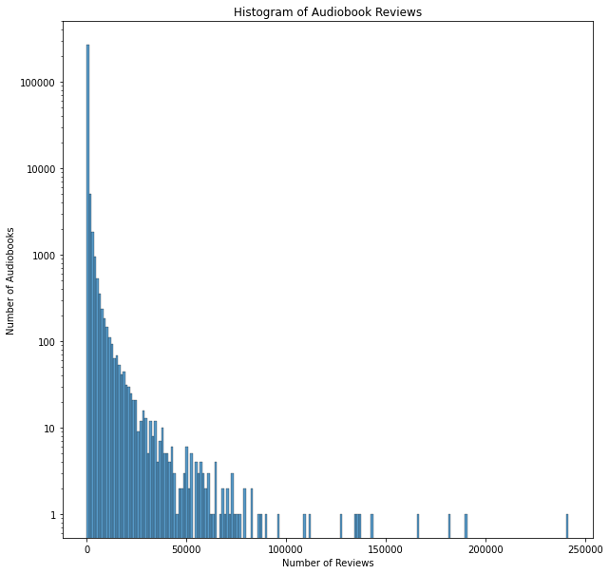
Ratings & Reviews
Ready Player One
Where the Crawdads Sing
Born a Crime
Becoming

Slide 20
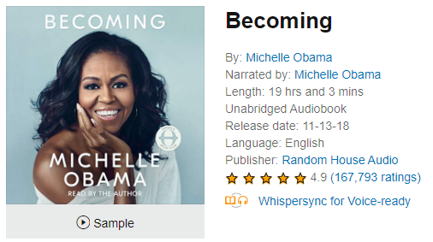
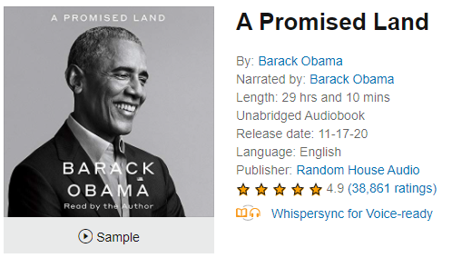
Obama vs. Obama
As an alternative to hiring and sharing revenues with a
https://www.audible.com/pd/A-Promised-Land-Audiobook/0525633723
https://www.audible.com/pd/Becoming-Audiobook/B07B3BCZ9S
Yes
Oprah’s
Book Club?
No

Slide 21
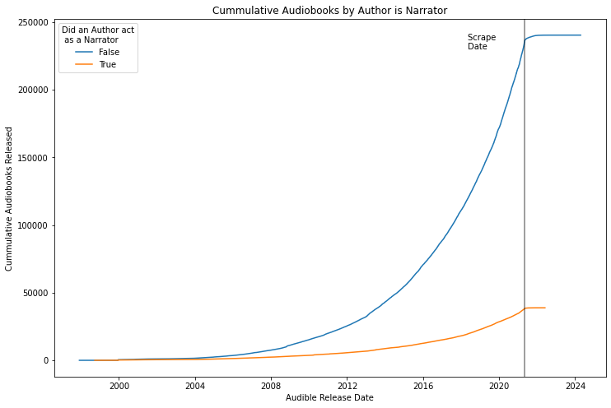
Author as Narrator
As an alternative to hiring and sharing revenues with a
No clear differences between audiobooks narrated by authors and those narrated by professionals.

Slide 22
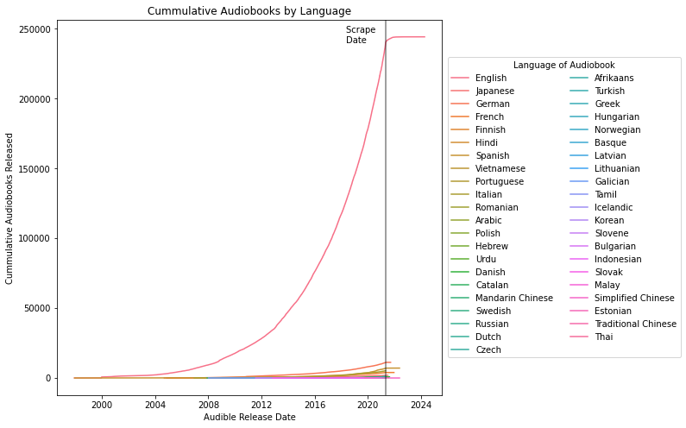
Language
44 languages are represented in Audible’s library.
English being the most common language.
Surprisingly, recent growth doesn’t seem to be reflected in other languages.
Netflix has recently partnered with hundreds of dubbing studios to add alternate language options.

Slide 23
Translation Expansion
Most Sources price audiobook voice acting at $200 / finished hour.
Given the evergreen nature of the content, may be a good investment for the Author or Audible.
Some graphic
Top 5 picks for translation

Slide 24
Conclusion
We learned all this about audible
Here is a cool solution
Things could have gone better
So in the future

Slide 25
Future Work
Dig Deeper
Podcasts & Audible Originals
Category Analysis
Notes:
Category information
Podcasts
Audible data collection could be expanded by fine grain review data.
More creative graphs
Better formatting in the notebook
Felt like I couldn’t find a through line
Capture plus vs premium plus titles?
Audible might have dynamic categories. Number of titles increased and decreased across categories.

Slide 26
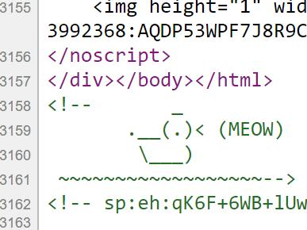
Future Work
Attempted to scrape Amazon books
Roadblock: CAPTCHA after 500 page visits
Solution: ScraperAPI proxy service
Alternative Approach
Bookshop.org
Similar selection & data
Prices are slightly elevated

Slide 27
Acknowledgements
Audible for not banning me.
ScraperAPI for help which I didn’t end up using in this project.
Ed Robertson & Unsplash for the photo.

Slide 28
