Slide 1

Audiobooks by Audible
A web scraping project By James Welch

Slide 2
Background
Whats up with Audible

Slide 3
Collected information
Category Spider | Title Spider
Name & URL | Title & Subtitle
Number of Titles | Author, Narrator, Language
Super-category: Name & URL | Stars & Number of Ratings
Flag for bottom category | Book Length & Release Date
 | Category name
 | Flag for Podcasts
Scrape Category Structure & Information
Link to Category Best Sellers
Scrape Title Information from Results Page

Slide 4
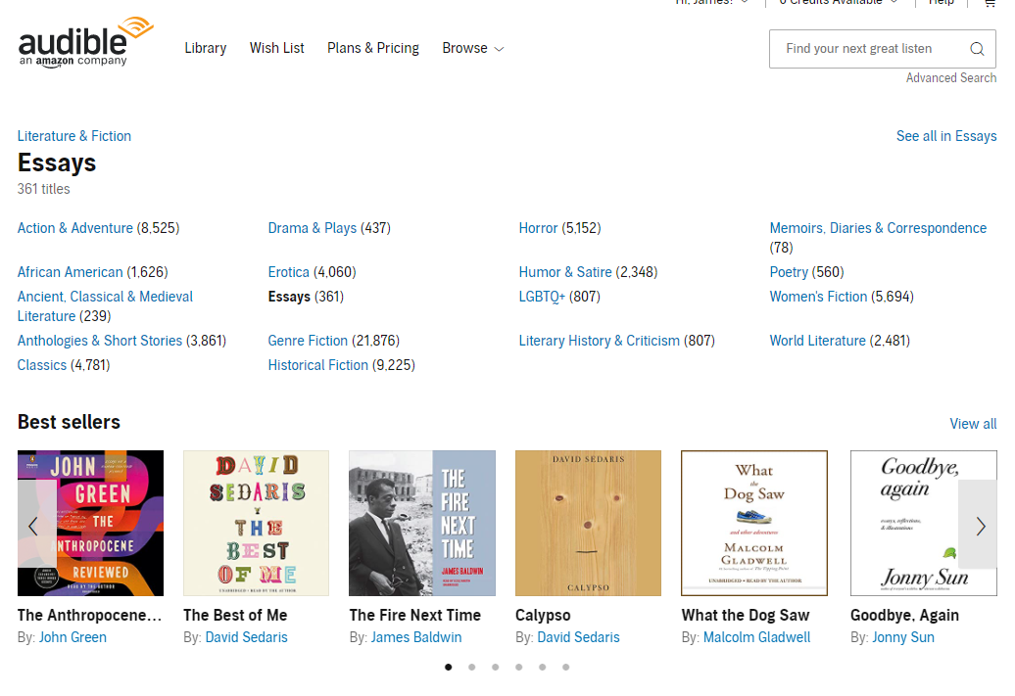
Category Scraping
Parent Category
Alt: Results Page URL
Category Name
Number of titles
Sub-Categories
Bold: No Sub-Categories
Results Page URL
Scrape Category Structure & Information
Link to Category Best Sellers
Scrape Title Information from Results Page

Slide 5
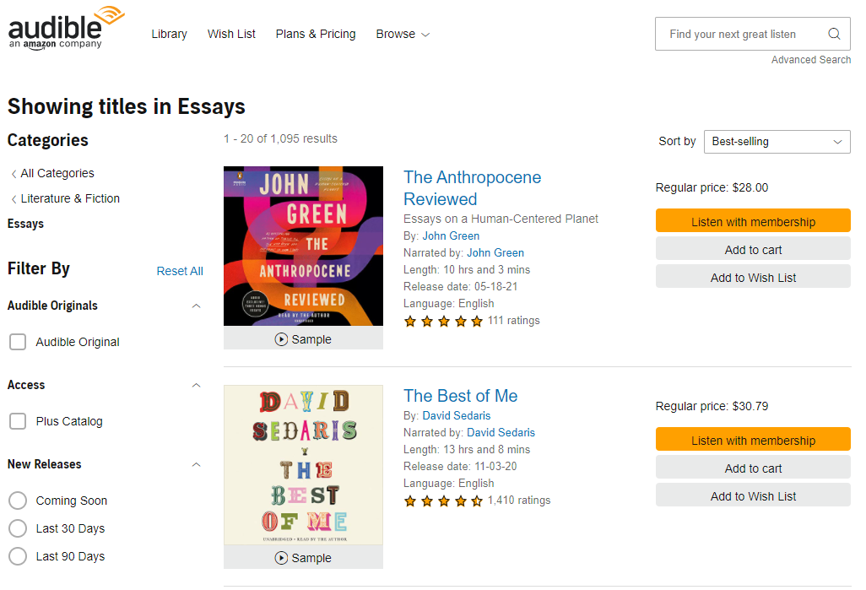
Title Scraping
Category Name
Title Information:
Title
Subtitle
Author
Narrator
Length
Language
Start Rating
Number Ratings
Price
Scrape Category Structure & Information
Link to Category Best Sellers
Scrape Title Information from Results Page

Slide 6
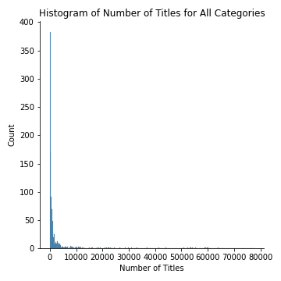
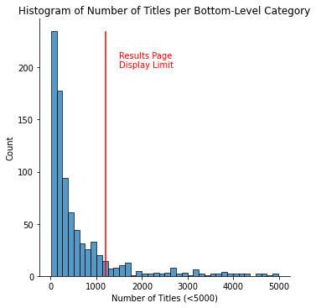
Book Categories
Top-Level Categories

Slide 7
Book Categories
Top-Level Categories

Slide 9
Network diagram

Slide 10
Correlations

Slide 11
Timeseries

Slide 12
Conclusions

Slide 13
Future Work
Audible data collection could be expanded by fine grain review data.
Audible might have dynamic categories. Number of titles increased and decreased across categories.
Attempted to scrape Amazon books
- Amazon displays a CAPTCHA page after ~500 site visits
- Page will be returned for several hours before
- Using proxy service (ScraperAPI) avoided bans but required payment.
BookShop.org
- A new online book shop which shares income with local books stores.
- Similar data to Amazon but less reviews.
- Slightly elevated prices compared to Amazon.

Slide 14
Acknowledgements
Audible for not banning me.
ScraperAPI for help which I didn’t end up using in this project.
Ed Robertson & Unsplash for the photo.

