Slide 1
A homebrewed freezer Management App
A Shiny App by James Welch

Slide 2





Background
Our company makes “Froyo”.
Froyo can be made with a variety of strains and is produced by one-of-six lines which can be pooled into a single batch.
One batch might require multiple storage containers before being placed in a freezer for long term storage.
These batches are then thawed and used by multiple groups. Some focus on specific strains, others experiment with multiple.
Production and usage are not tightly linked so the contents of the freezers constantly fluctuates.

Slide 3
Processing
& R&D
Strains
Production Lines
Storage

Slide 4
The Problem
Our current approach, an excel sheet, does not adequately address our problems.
Manual data entry leads to non-standard entries.
Tracked values drift from actual contents.
Some batches are not tracked or persist in database.
Version conflict on Dropbox is surprisingly common.
After understanding the problem, we want to get a better understanding of what stakeholders want to use.

Slide 5
Stakeholder Priorities
Managers
Operators
Tracking of how material is being used and by whom.
Reason for removal.
Clear understanding of weight of material available.
Run Charts to predict needs of material.
No data loss if Shiny app is not maintained.
Wide ranging database integrations
Standardization in sample name and locations.
Ease of batch entry and modification.
One-click to remove bags of material.
Understand who else might need material.
Age of available material.
Integrating process measurements into database.

Slide 6



Other Solutions
Lab environment specific solutions
Two systems are already in use.
In-house systems are inadequate or too costly.
Actual database software
Specially built for this exact purpose.
Tech-hesitancy is a strong force.
Microsoft Access
Get integrations with other Microsoft Office tools.
Mobile solutions are a strong plus in lab environment.

Slide 7
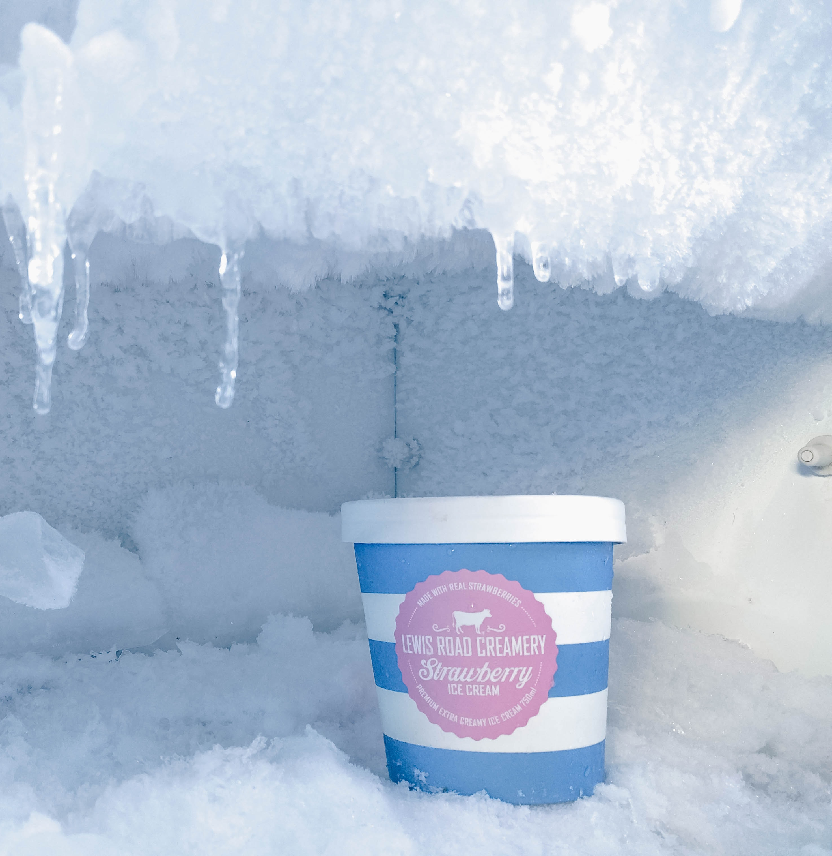

Let’s take a look…

Slide 8
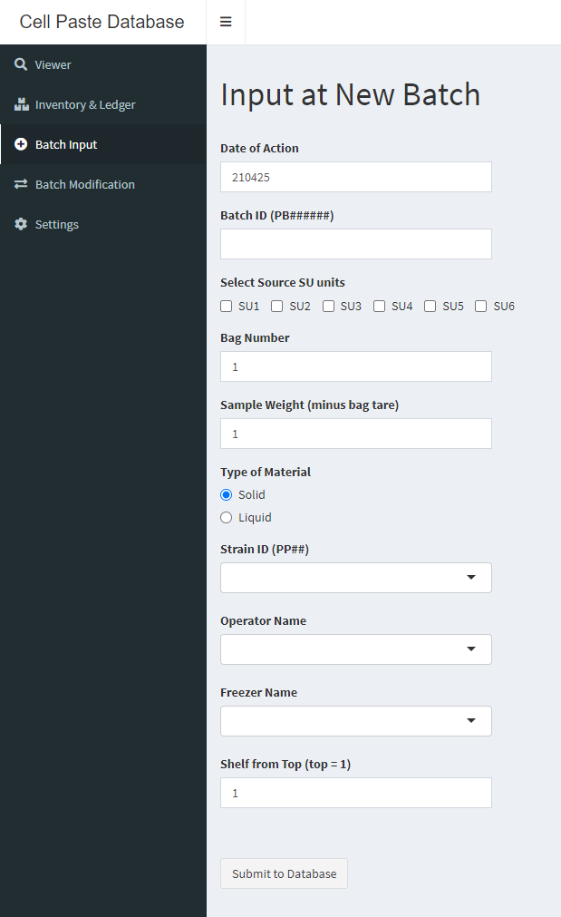
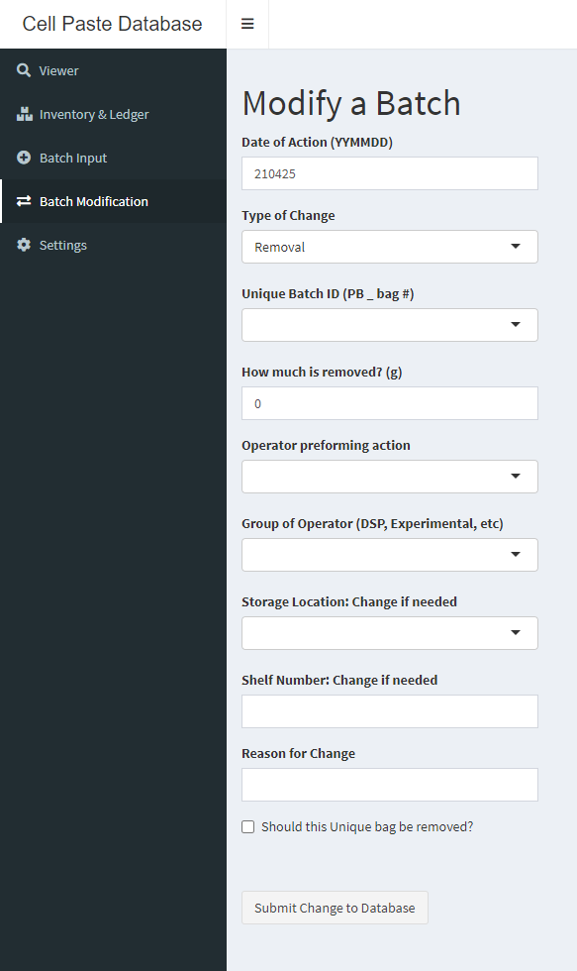

Slide 9
Conclusions
Solves problems spawned from current system.
All (reasonable) priorities from stakeholders were addressed.
Shiny app makes visualization, data entry, and updating easy.
Designed for usage by personnel without training.
Can be implemented over internet with static excel sheets.
All features work on mobile.
With approval our team can begin using this solution today.

Slide 10
Future Work
Some design improvements:
Stricter validation of data entry
Easy multi-bag entries
Flexible data collection
Clear workflow for taking stock
More narrow data analysis features for different workflows.
Integration with other company “databases”.
Increased scale and flexibility for many different use cases could approach a useful product.

