Slide 1

Detecting the Red Flags of Fraud in Medicare Claims
James Welch

Slide 2

Fraud effects all of us
Medicare is the US healthcare system for the elderly and special cases; coving 65 million people.
Improper payments can amount to ~$50 billion each year.
Pervasive fraud increases insurance premiums on all patients.
We are using a dataset of Medicare information to predict and prevent fraud.

Slide 3
1. Investigate

Slide 4
Provided Data
Beneficiary Information
Inpatient & Outpatient Claims
Provider Key

Slide 5

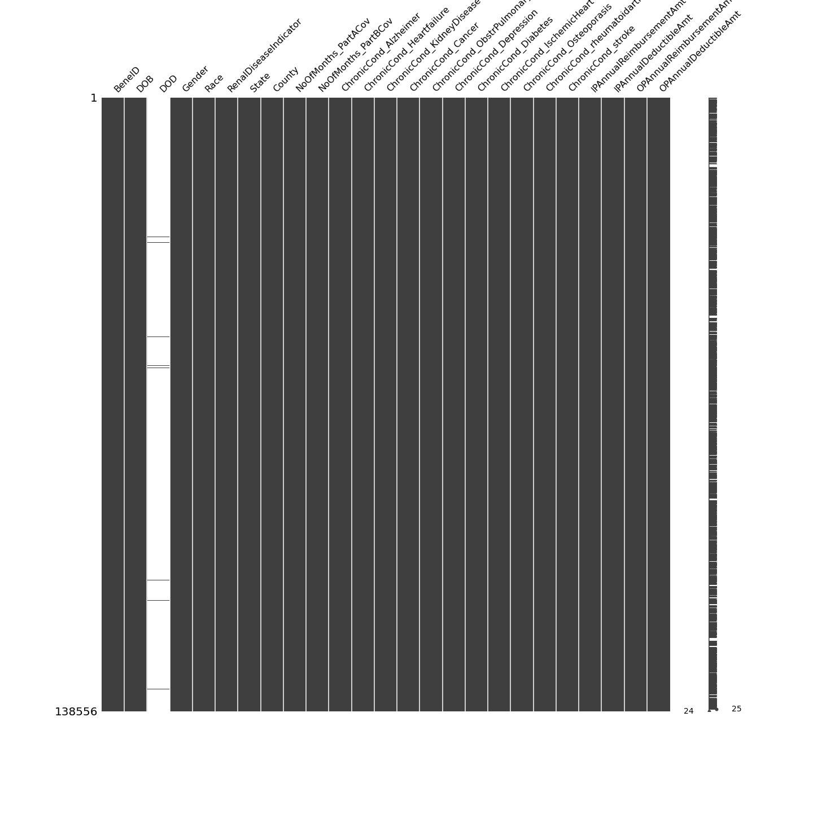
Missingness
Provider Key
Beneficiaries (patients)

Slide 6
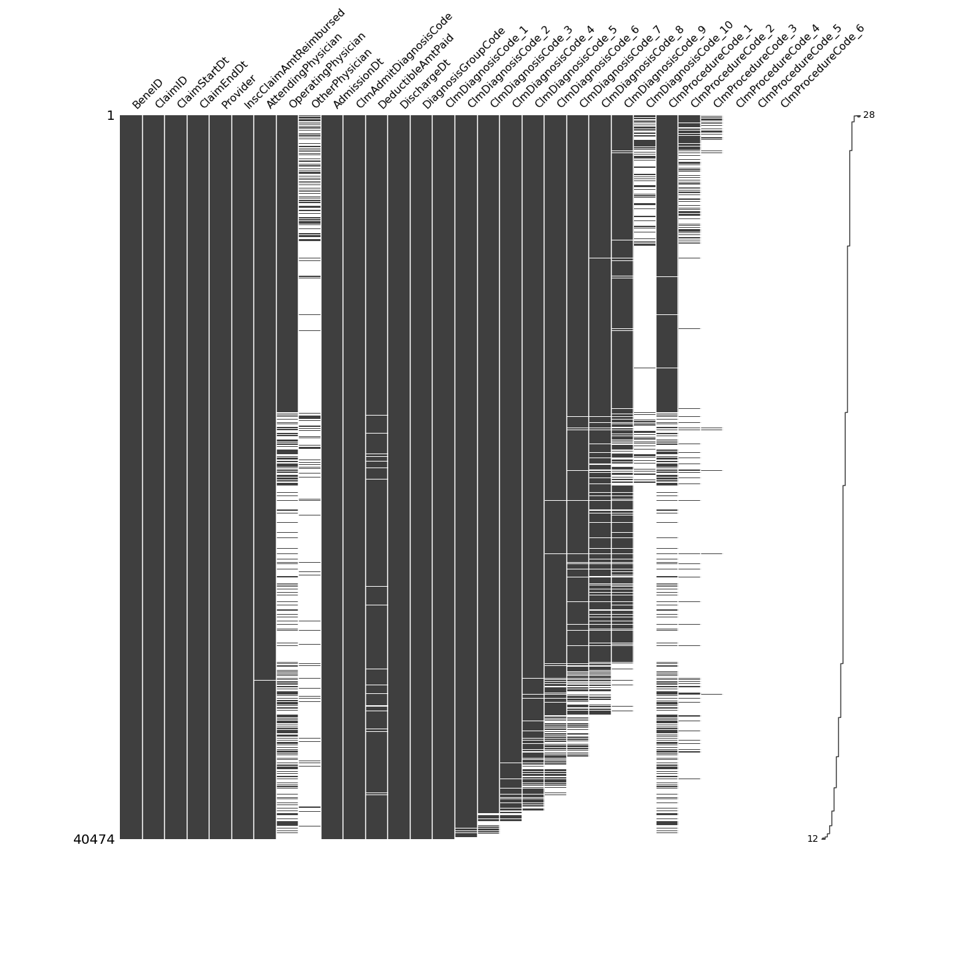
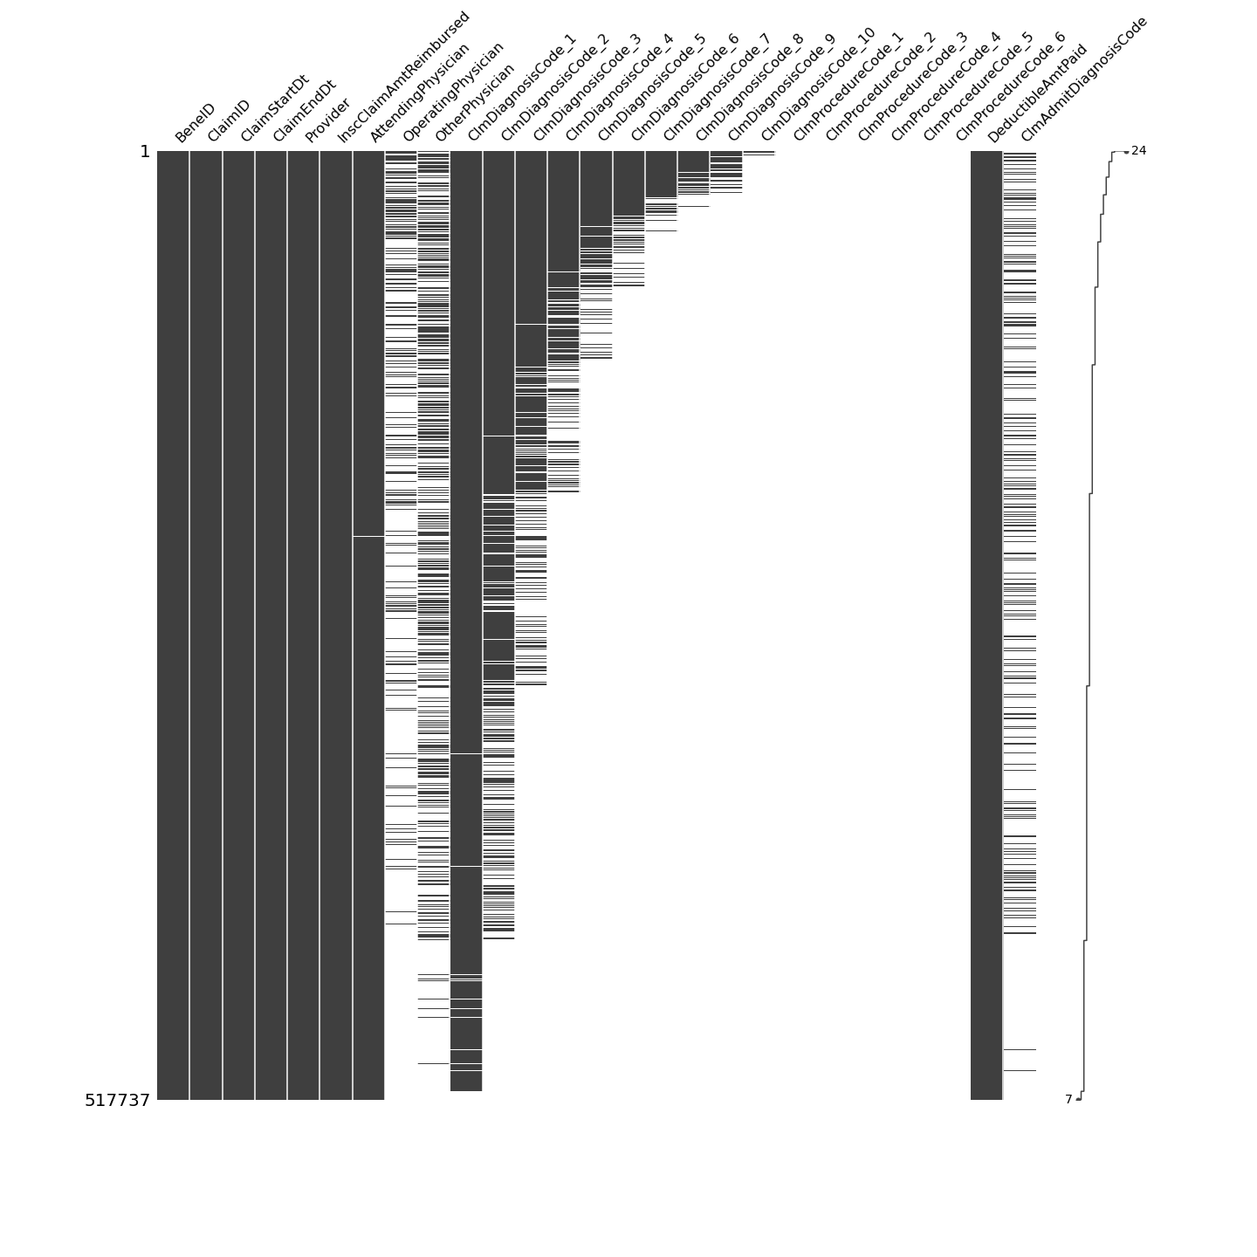
Missingness
Inpatient Claims
Outpatient Claims

Slide 7
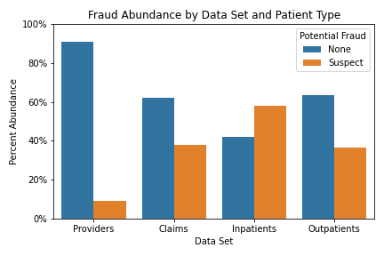
Fraud Prevalence Differs Between Tables
Our providers key has a 9% fraud abundance.
Combined claims: 38%
The increase in abundance is driven by the higher average claims seen by suspect providers.

Slide 8
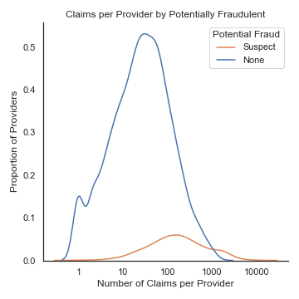
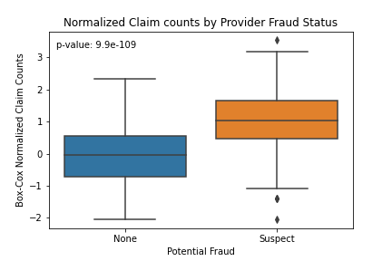
Suspect Providers Submit More Claims

Slide 9
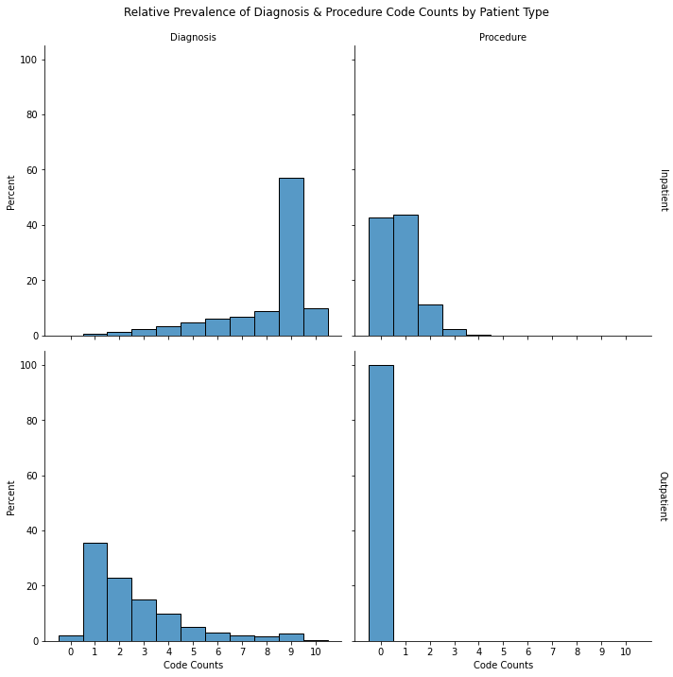
Diagnosis and Procedure Codes
ICD-9-CM codes for diagnosis & Procedure
Inpatients have a high number of diagnosis codes and multiple procedure codes.
Outpatients receive diagnosis but few treatments.

Slide 10
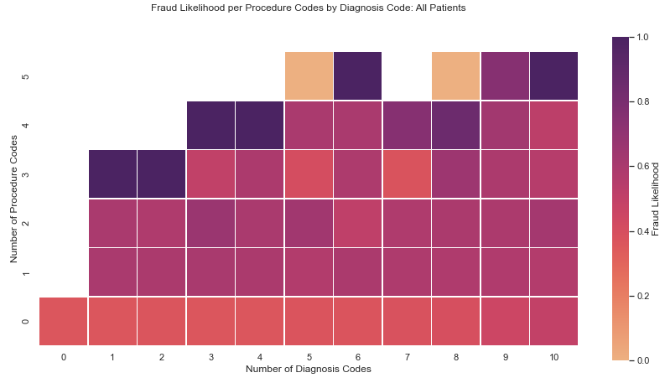
Ratio of Diagnoses to Procedures
Higher numbers of procedures generally increase the likelihood of fraud.
However, very few claims have more than 1 procedure codes.

Slide 11
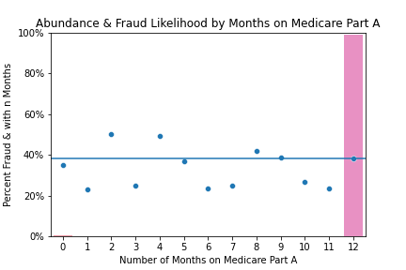
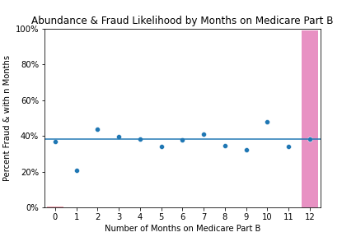
Imbalanced Features

Slide 12
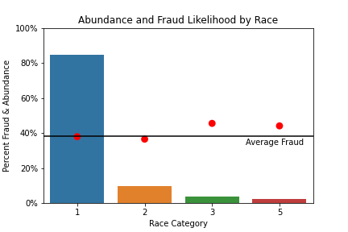
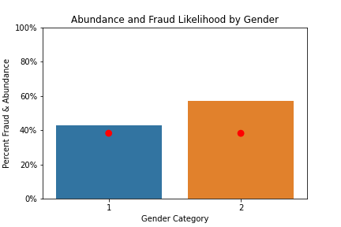
Protected Classes

Slide 13
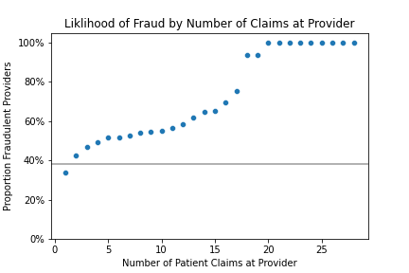
Engineered Features
Accumulating:
Time Since last claim
Total days claimed
Cumulative Visits
Cumulative Provider Visits
Cumulative Payments
Others:
Cost per: Physicians, Codes, days of care
Counts of Codes and Physicians
Date discrepancies

Slide 14
2. Modeling

Slide 15
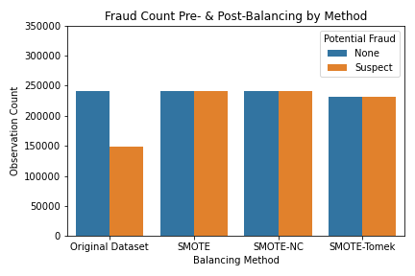
Up-sampling via SMOTE Methods
Balancing Classes increases accuracy of model.
SMOTE: Synthetic Minority Over-sampling Technique.
Nominal and Continuous
Trim Tomek Links

Slide 16
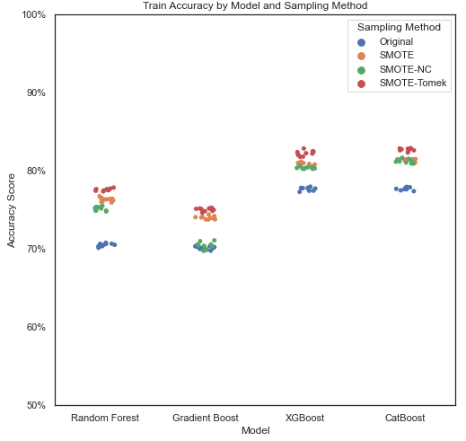
Model Comparison
SMOTE up-sampling increases accuracy in untuned models.
Removing Tomek links further improves score.
XGBoost & CatBoost have 82% accuracy when used with the SMOTE-Tomek data set.
Hyperparameters tuned using RandomizedSearchCV, scoring by Recall

Slide 17
Claim is ______
Perfect Provider
Fraudulent provider
Acceptable
Fraud
Claim Appears Fine
All claims by good providers are good
Bc F.provs submit fine claims
We expect a lot of these
Acceptable
nice
Claim predicted
as…
Nope
Some amount of provider claims are suspect.
Claim is Bad news
Bad news
nice
Fraud
Want to minimize False Negatives

Slide 18
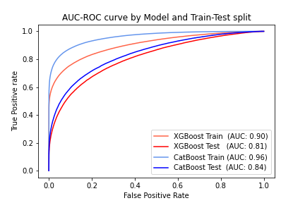
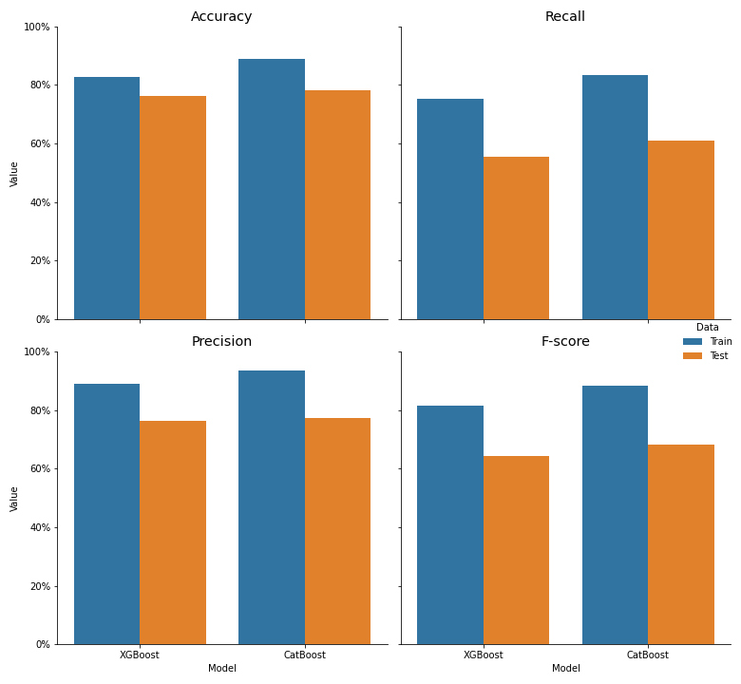
CatBoost Preforms Better after Tuning

Slide 19
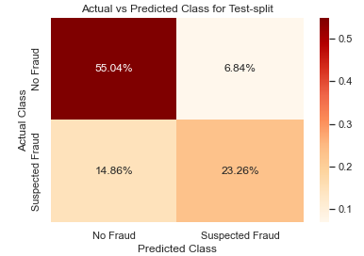
Model Evaluation
CatBoost Model shows signs of overfitting.
False Negatives are a significant contributor of error.
Metric | Unsampled Train Split | Test Split
Accuracy | 89% | 78%
Recall | 84% | 61%
Precision | 93% | 77%
F1-score | 88% | 68%

Slide 20
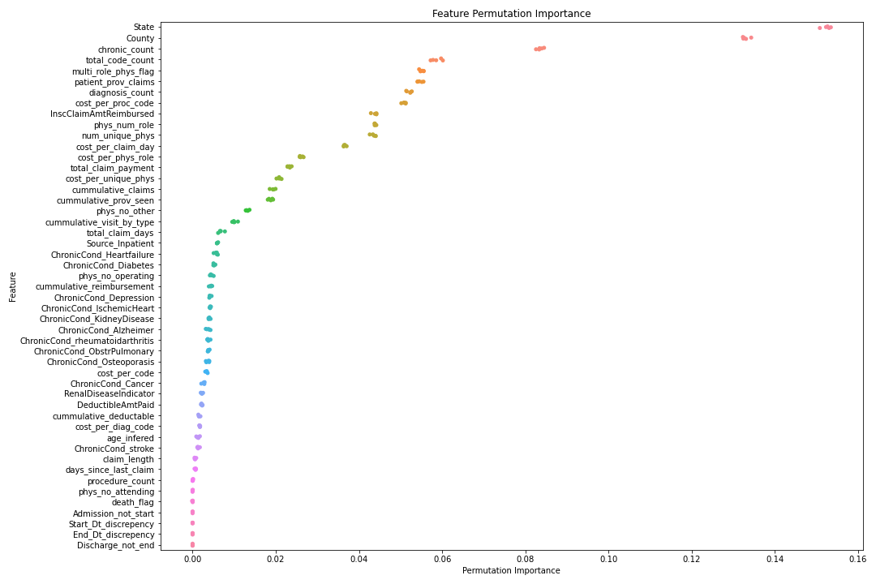
Permutation Importance
The decrease in score when a feature is shuffled.
State & county
Codes counts and some cost features
Booleans have low feature importance

Slide 21
3. Aggregation

Slide 22


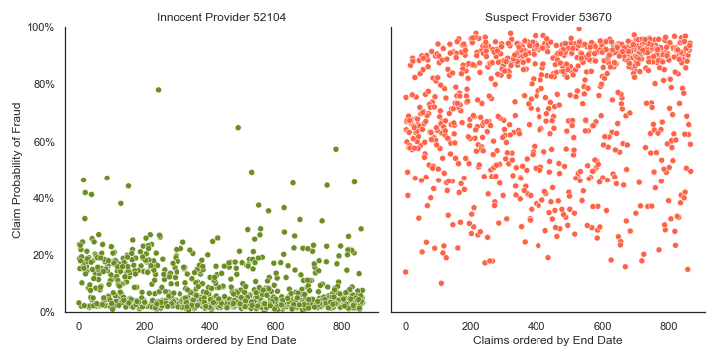



Can we predict Provider Fraudulence?
Claims
Providers

Slide 23
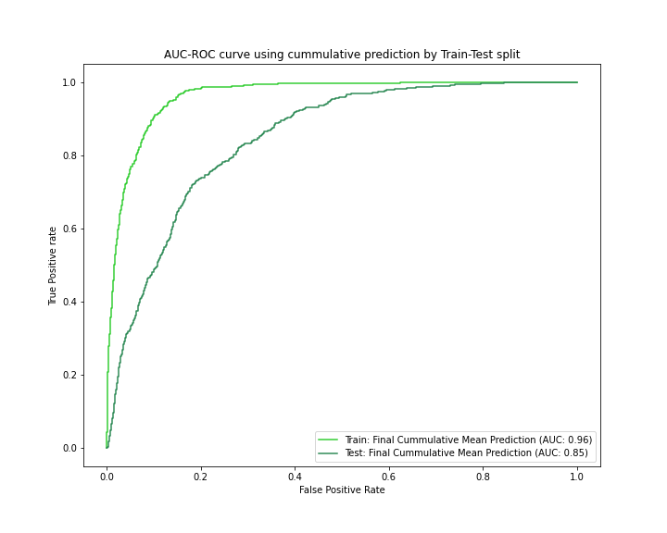
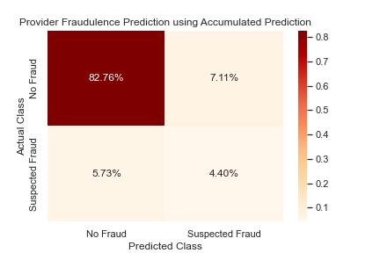
Aggregating Predictions
Metric | Value
Accuracy | 87%
Recall | 43%
Precision | 38%

Slide 24
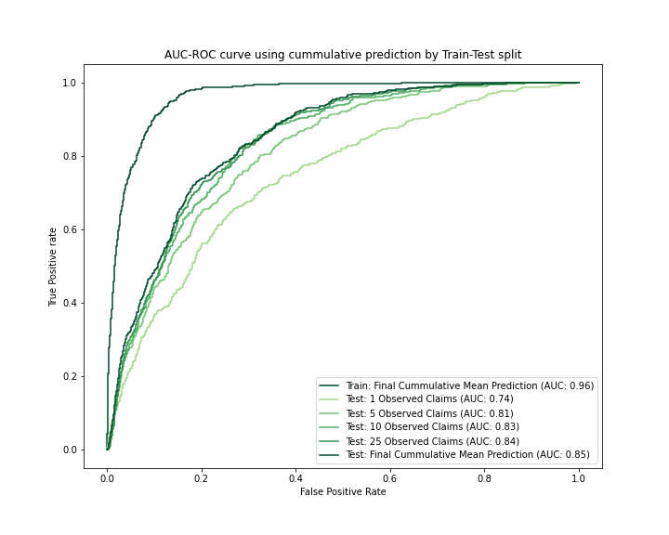
How many claims are needed?
We have more data than we need, so perhaps we can make predictions quicker.
But 90% of Fraudulent Providers submit more than 10 claims
Most claims are submitted in 0-5 days inecrements.
# Claims or fewer | Percent of Providers
1 | 100%
5 | 86%
10 | 75%
25 | 55%

Slide 25
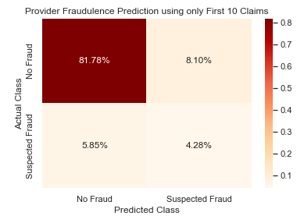
Limiting to 10 Claims Maintains Accuracy
All claims
First 10 claims
Rule Used | Accuracy | Recall
All Provider Claims | 87% | 43%
First 10 Claims | 86% | 42%

Slide 26
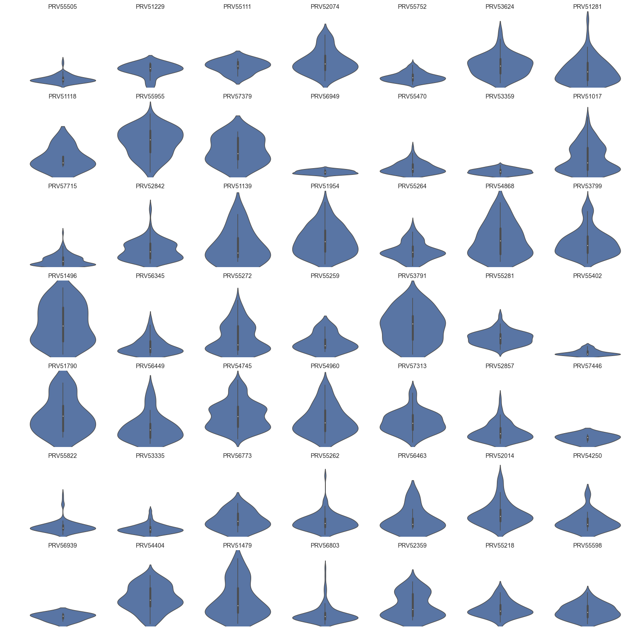
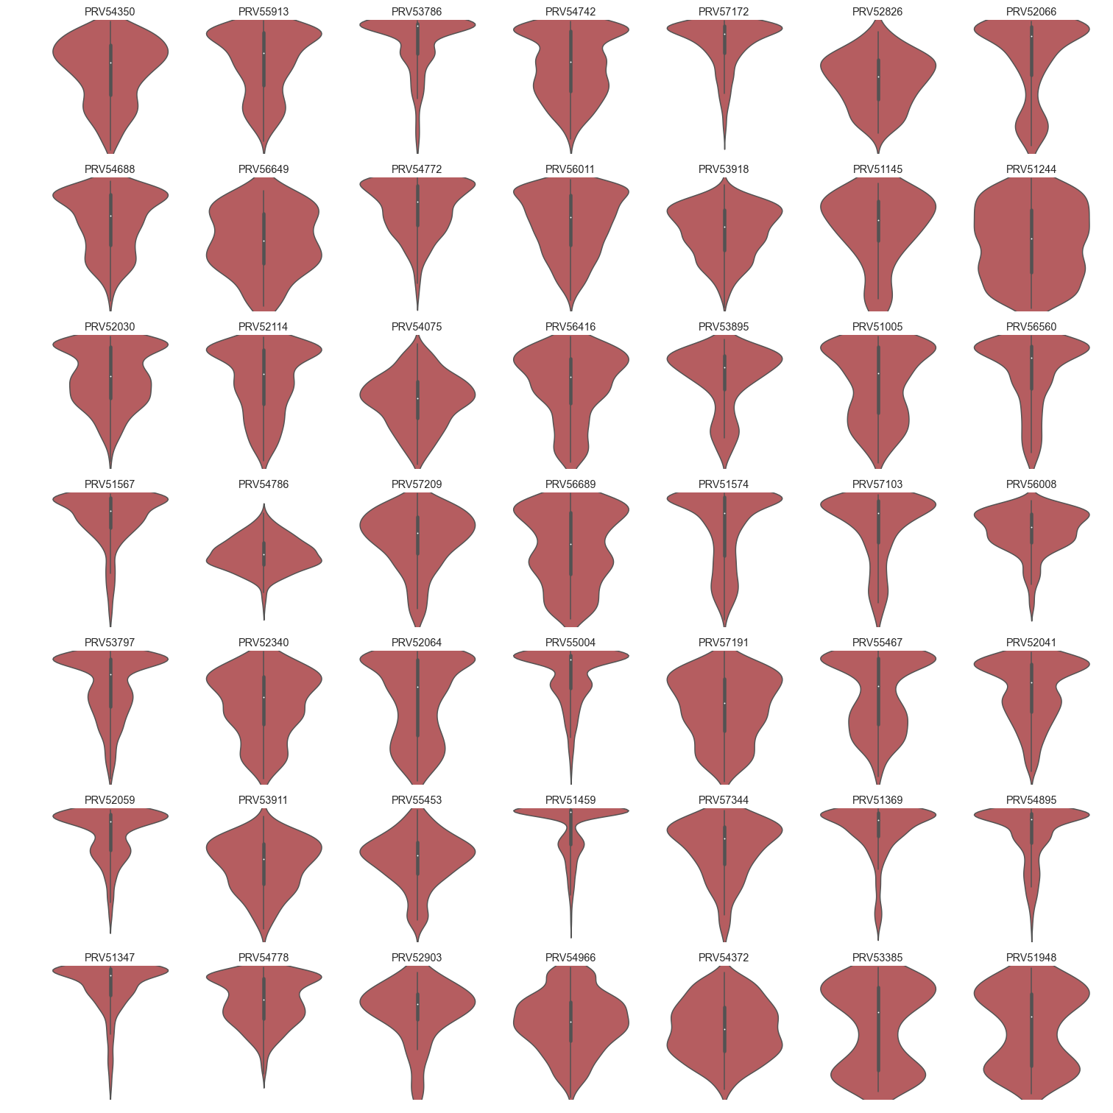
Distribution of Claims by Provider
Providers Labeled as Innocent
Providers Labeled as Suspect
Probability of Fraud by Claim

Slide 27
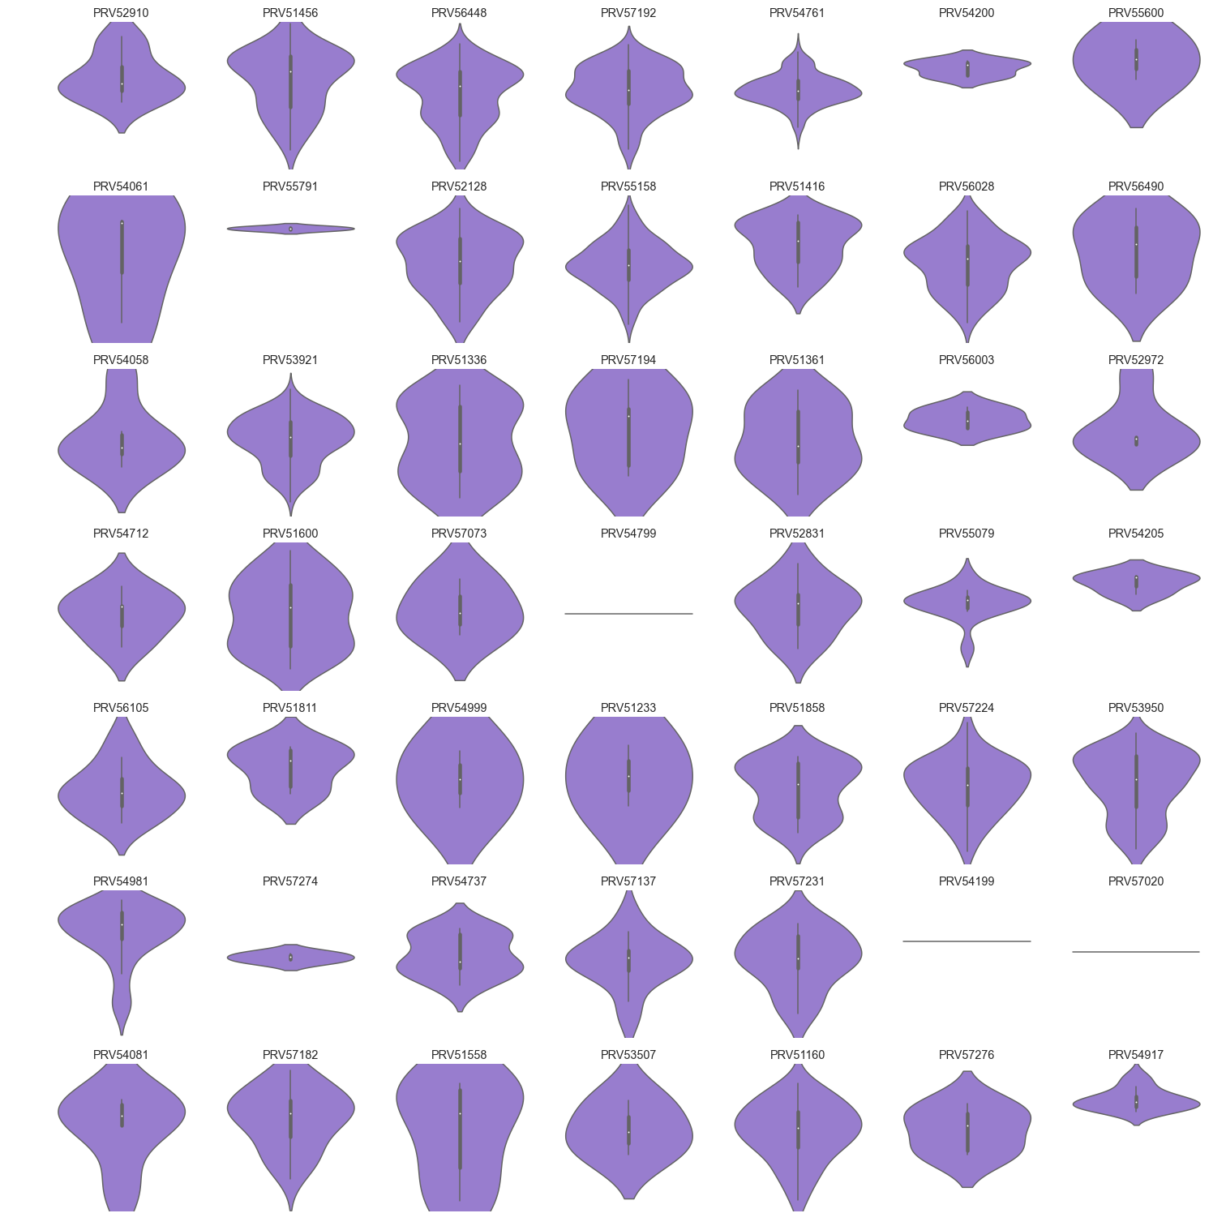
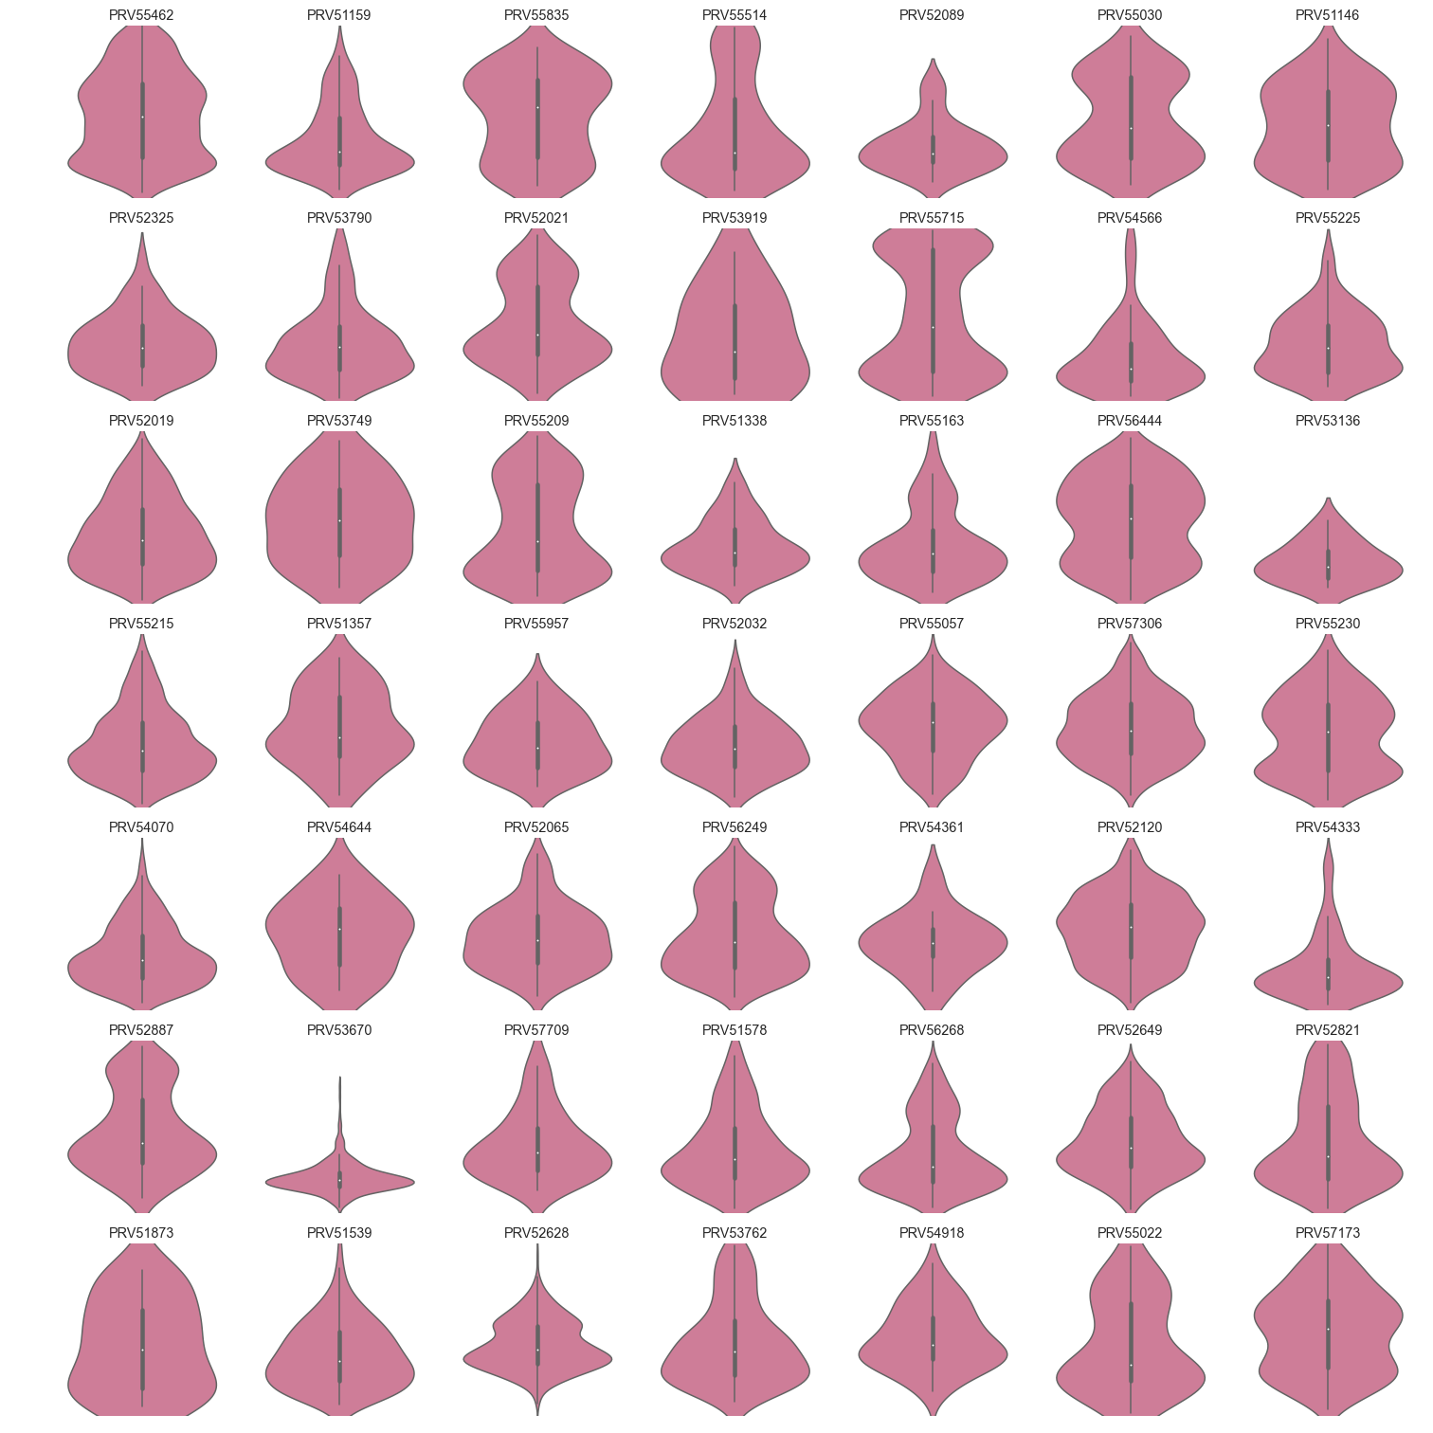
What do mis-labeled providers look like?
Incorrectly Labeled as Suspect
Incorrectly Labeled as Innocent
Probability of Fraud by Claim

Slide 28
Fraudulent Providers
Predicted Class
Innocent
Suspect
Innocent
Actual Class
Suspect

Slide 29
Conclusions
On a claim basis, we can predict claims the fraudulence of claims with a 78% accuracy.
Using these claim predictions, the fraudulence of providers can be predicted with 89% accuracy but incorrectly labeled providers persist.
These metrics hold even when using few claims per provider, allowing more opportunities to catch fraudulent providers.

Slide 30
Next Steps
Claim Specific Labeling
Diagnosis and Procedure Code Match
Provider Information Aggregation

