Slide 1

Detecting the Red Flags of Fraud in Medicare Claims
James Welch

Slide 2
Template
adfas

Slide 3
Whats up
Medicare is bad
How bad?>
Why bad?
What can we do?
The data

Slide 4
Template
adfas

Slide 5

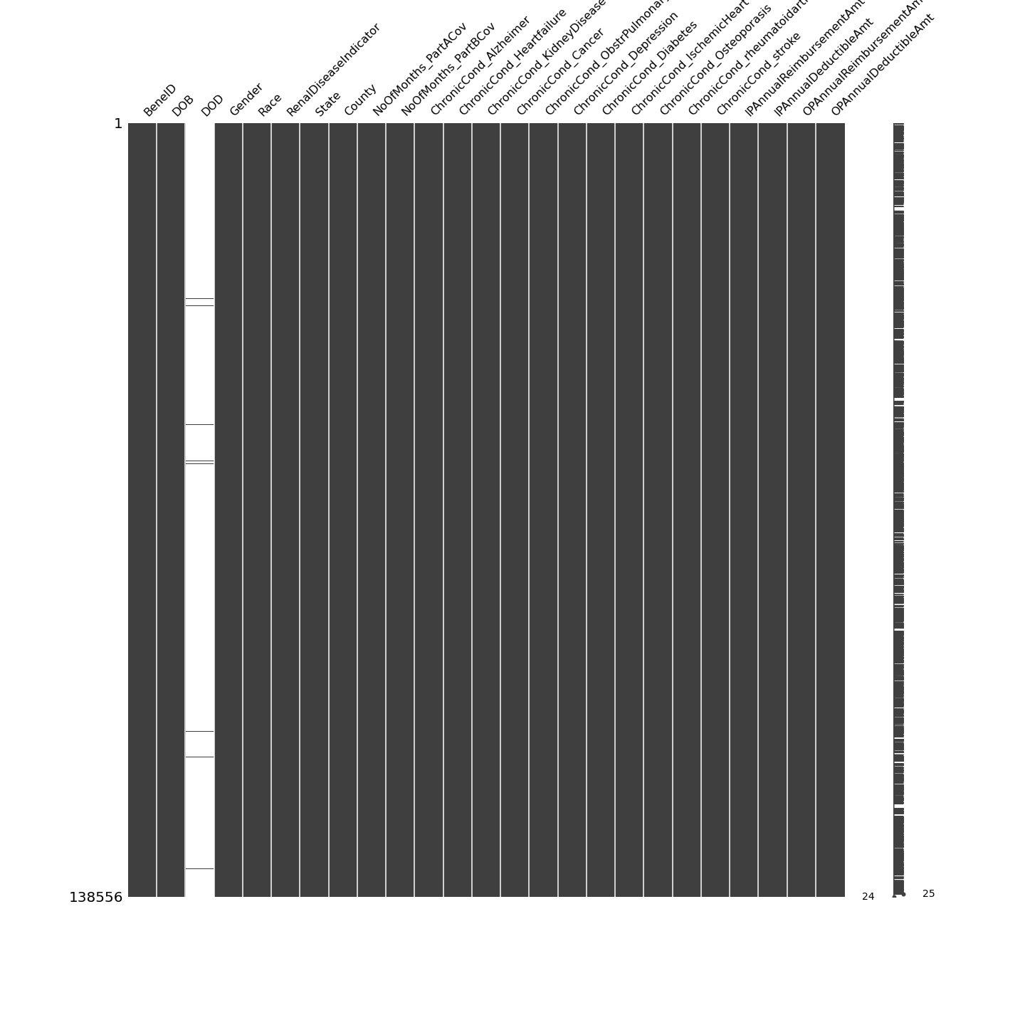
Missingness
Provider Key
Beneficiaries (patients)

Slide 6
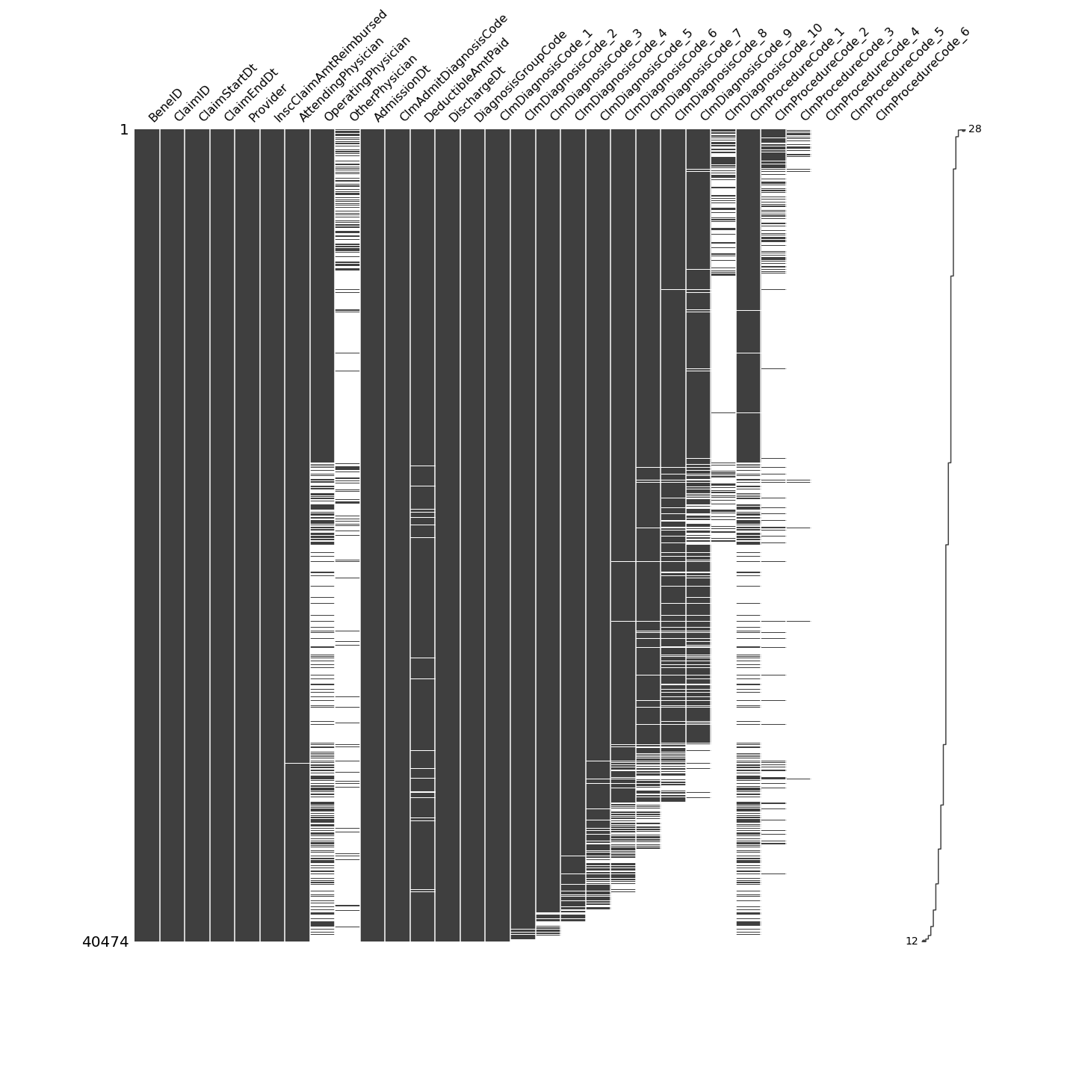
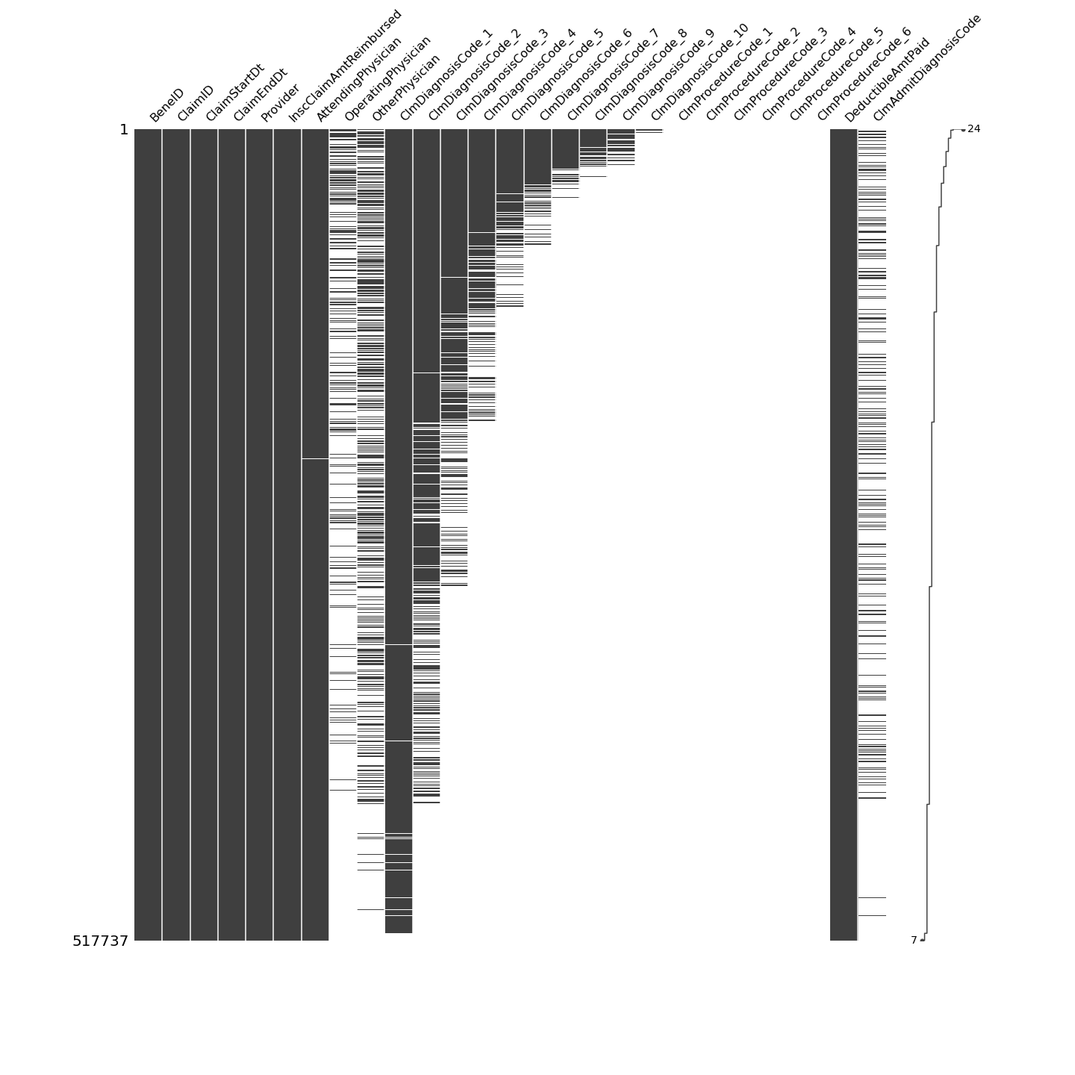
Missingness
Inpatient Claims
Outpatient Claims

Slide 7
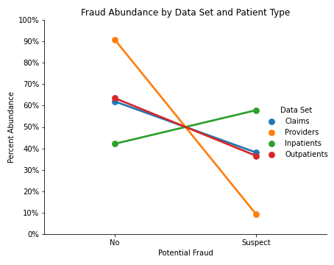
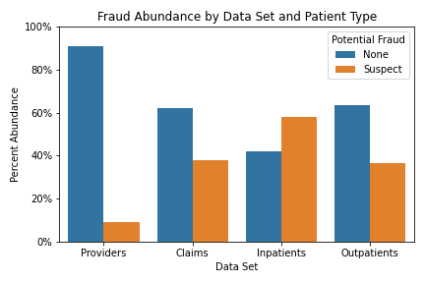

Slide 8
Fraudulent Providers just be different
Histogram of days / patients
significance

Slide 9
Codes

Slide 10
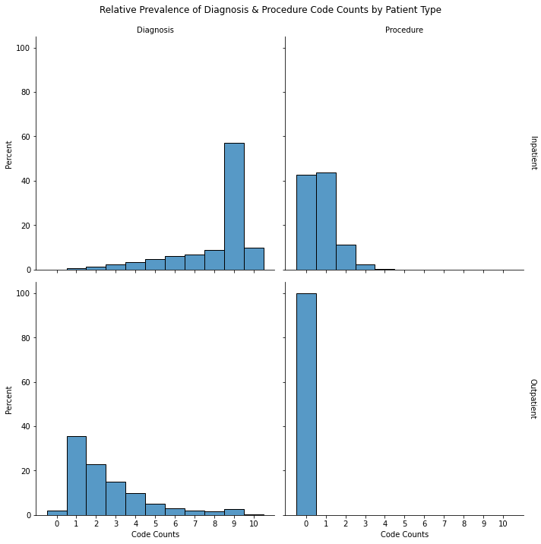

Slide 11
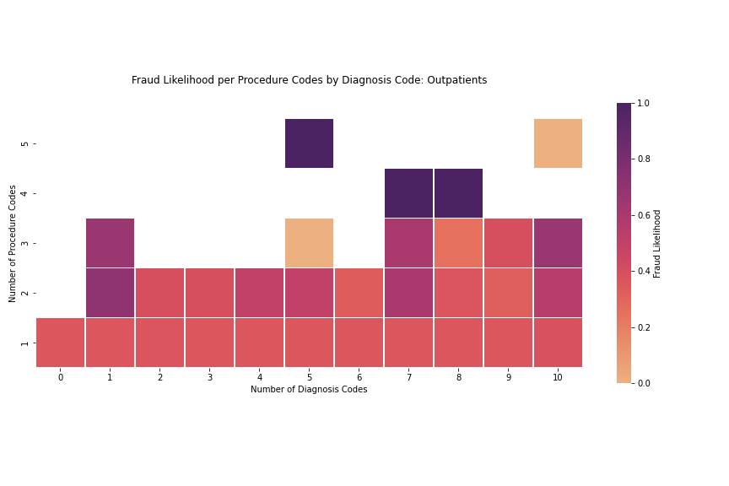
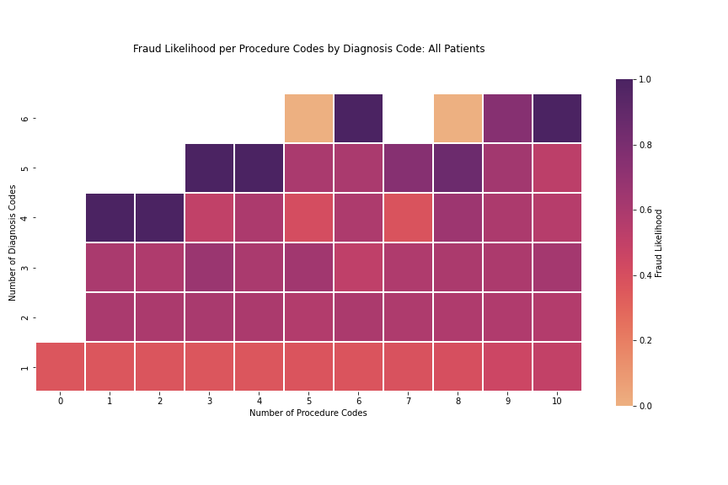
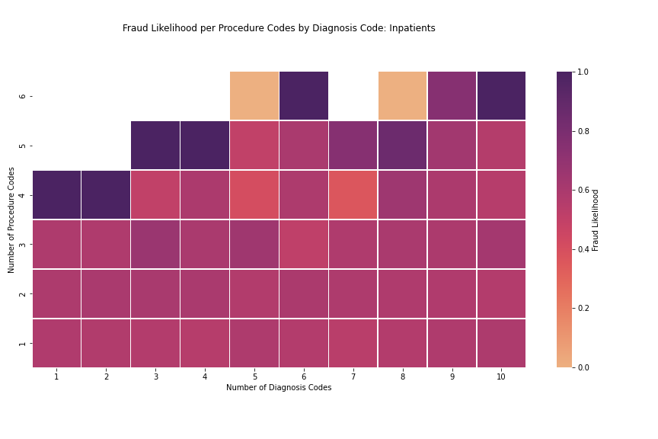

Slide 12
Dates

Slide 13
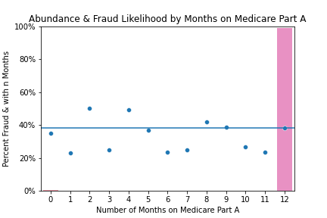
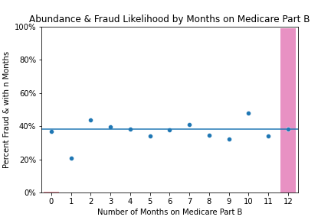
Imbalanced Features

Slide 14
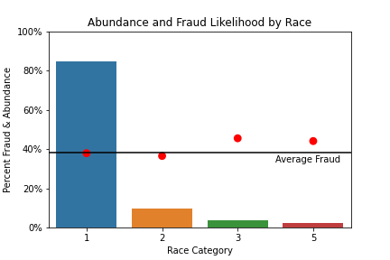
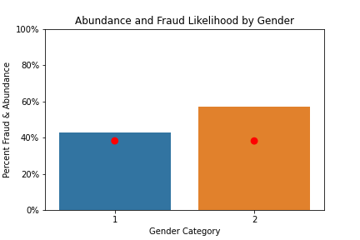
Sensitive Features / Protected Classes

Slide 15
Payments

Slide 16
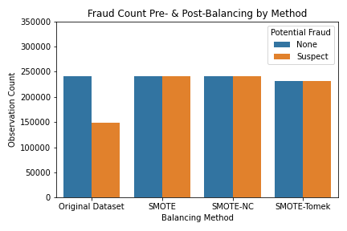
Up-sampling via SMOTE Methods
Claims is more balanced than Providers
Balancing classes increases out-of-box accuracy (right word?)
Advantages of SMOTE-NC and SMOTE-Tomek.

Slide 17
Model Comparison
Balancing provided by SMOTE increases accuracy.
____ is best out of SMTOE methods
___ is best out of models
Used for hyperparameter tuning

Slide 18
Model Evaluation
After tuning, the model shows…
False positives are okay since we expect most claims are fine… False negatives mean we

Slide 19
Claim is ______
Perfect Provider
Fraudulent provider
Acceptable
Fraud
Claim Appears Fine
All claims by good providers are good
Bc F.provs submit fine claims
We expect a lot of these
Acceptable
nice
Claim predicted
as…
Nope
Some amount of provider claims are suspect.
Claim is Bad news
Bad news
nice
Fraud
Want to minimize False Negatives

Slide 20
Conclusions
adfas

Slide 21
Next Steps
Claim specific data
NLP of diagnosis + procedure codes
*something informed by modeling…

Slide 22
Thoughts
sketchy providers make up most visits so we can have more false positives because they submit more so can be caught other ways...

