Slide 1

Detecting the Red Flags of Fraud in Medicare Claims
James Welch

Slide 2

Fraud effects all of us
Medicare is the US healthcare system for the elderly and special cases
How bad?>
Pervasive fraud increases insurance premiums on all patients.
What can we do?
The data

Slide 3
Provided Data
Beneficiary Information
Inpatient & Outpatient Claims
Provider Key

Slide 4

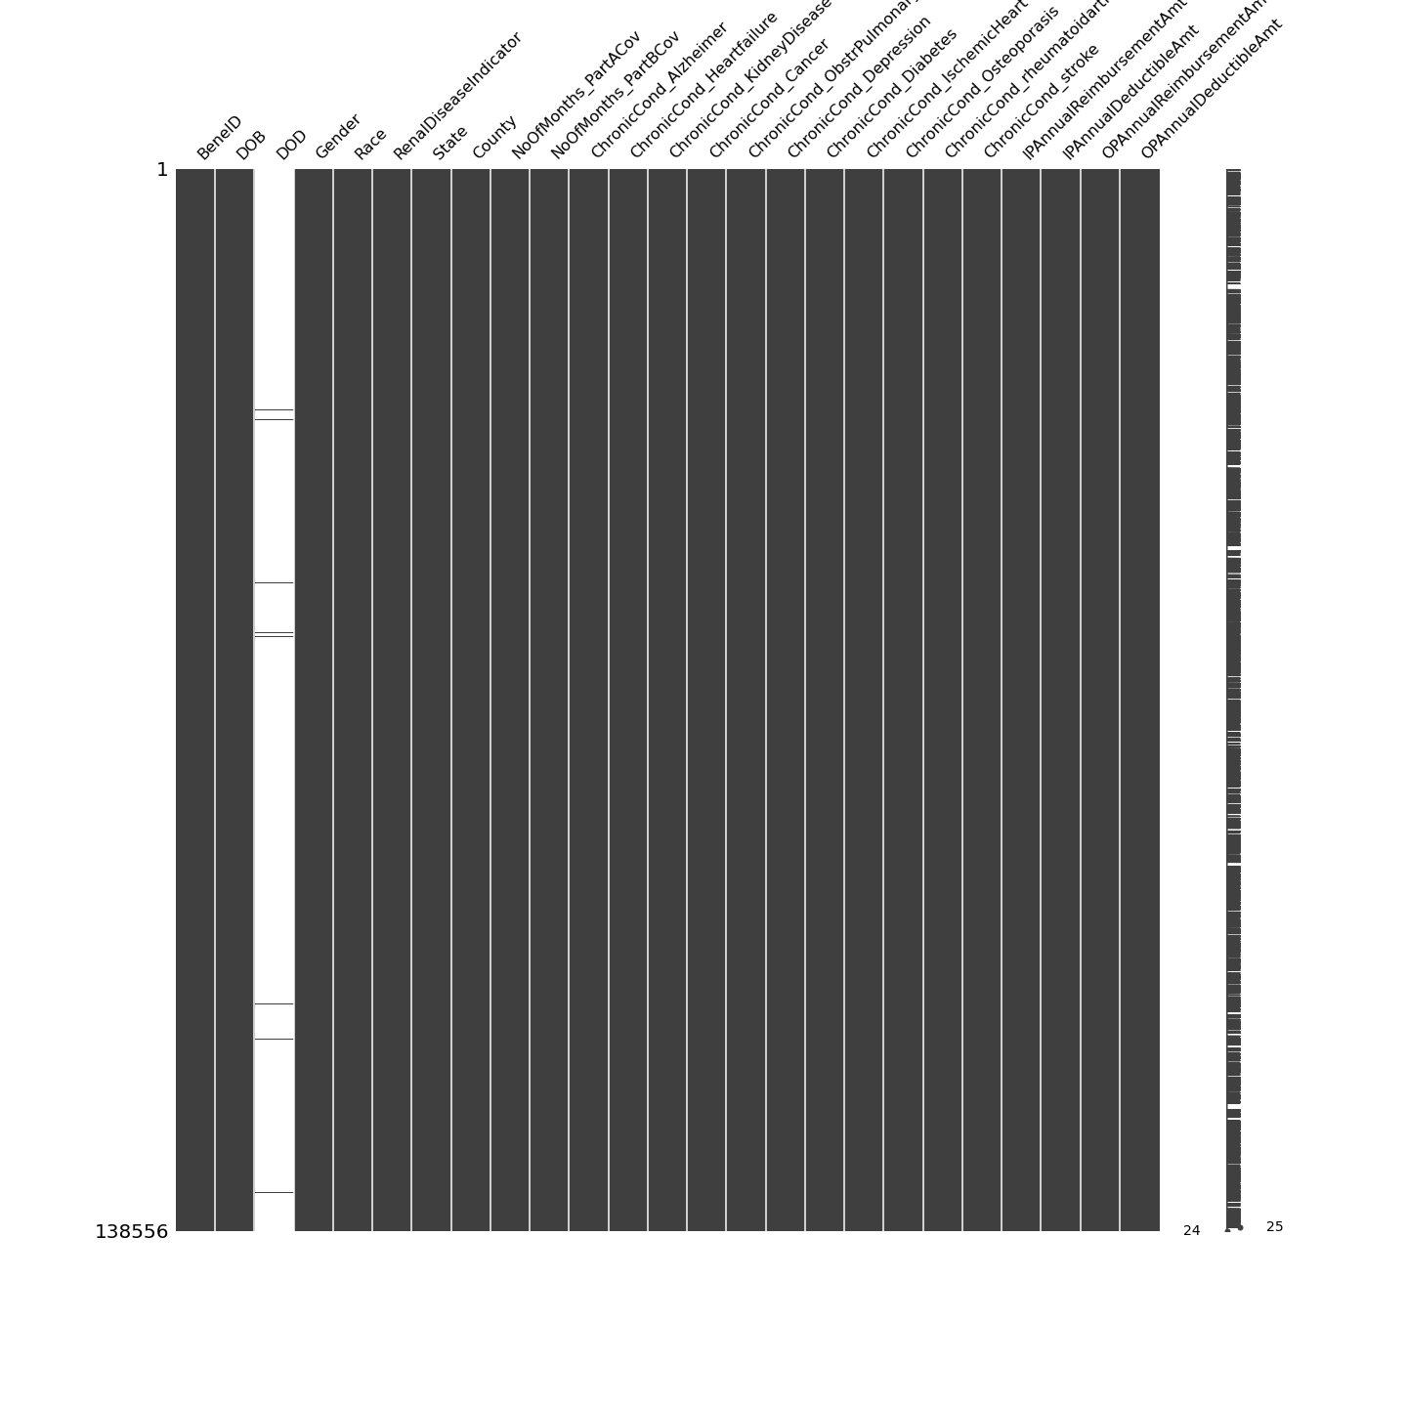
Missingness
Provider Key
Beneficiaries (patients)

Slide 5
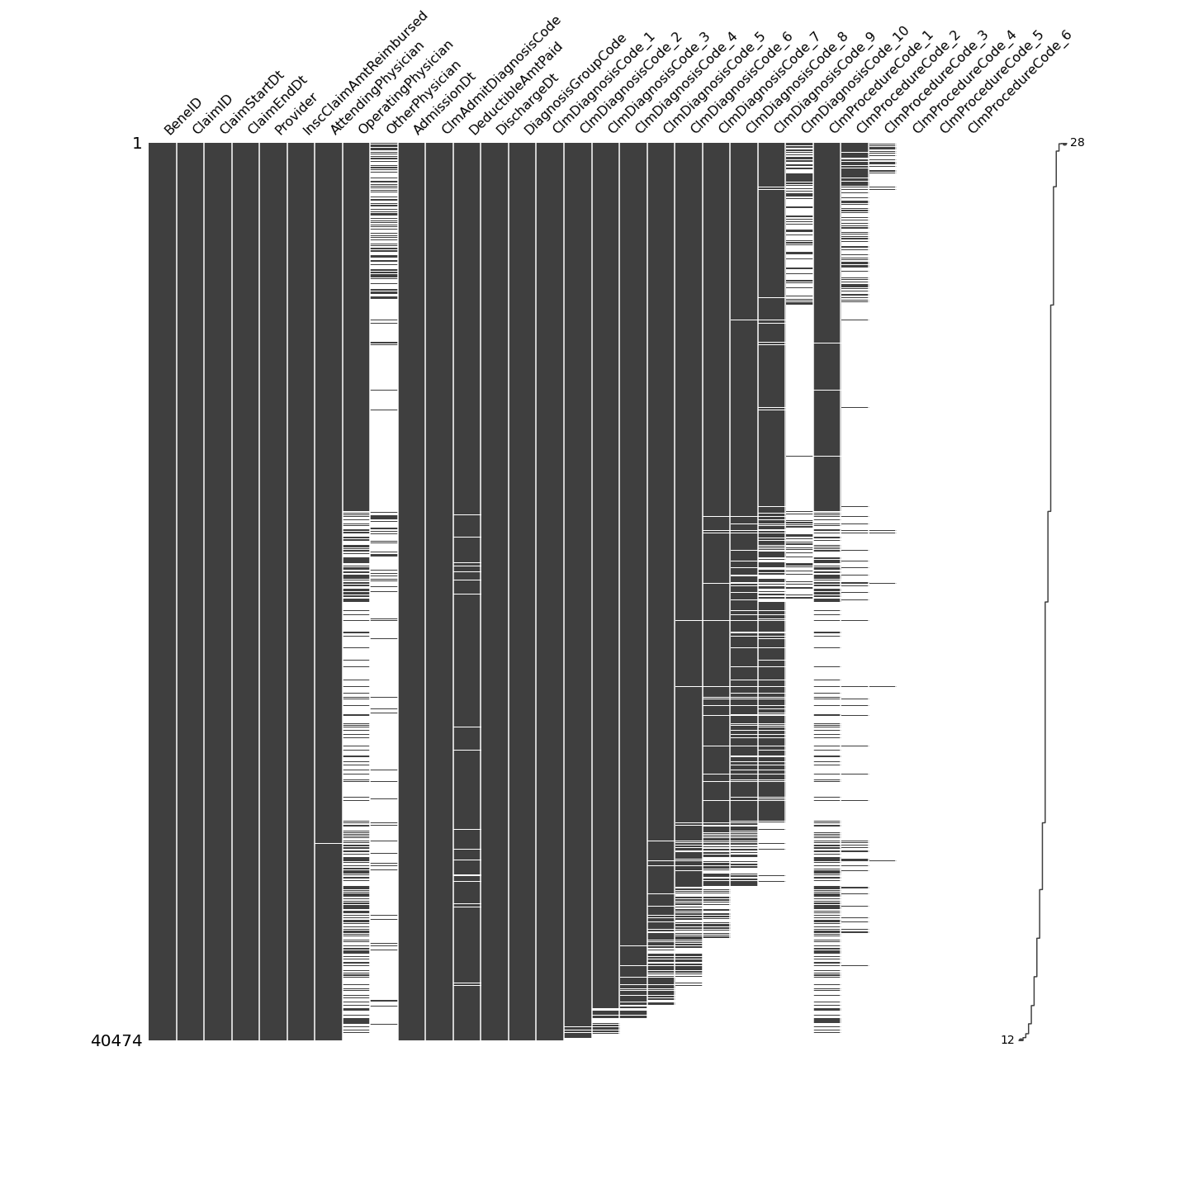
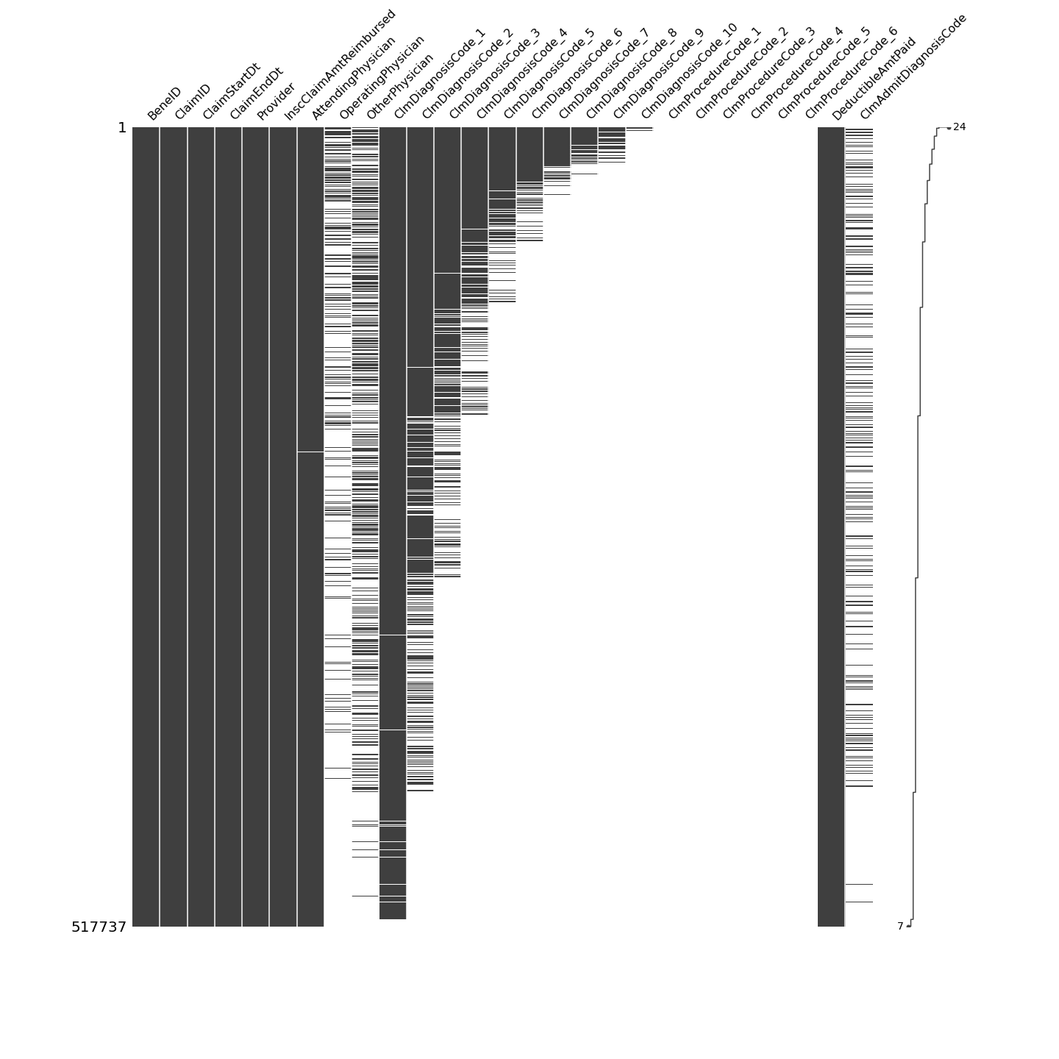
Missingness
Inpatient Claims
Outpatient Claims

Slide 6
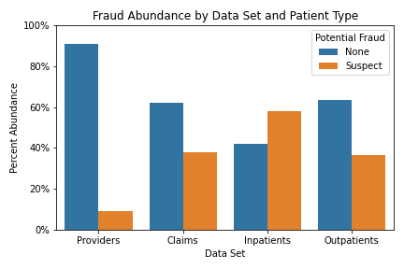
Fraud Prevalence Differs Between Tables
Our providers key has a 9% fraud abundance.
Combined claims: 38%
The increase in abundance is driven by the higher average claims seen by suspect providers.

Slide 7
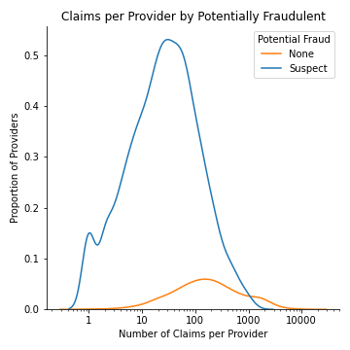
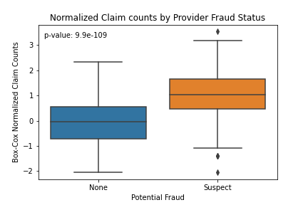
Suspect Providers Submit More Claims

Slide 8
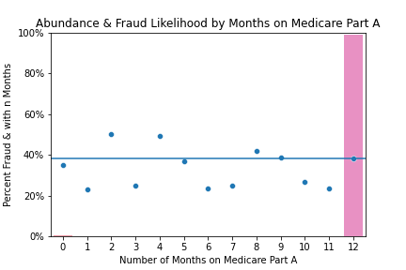
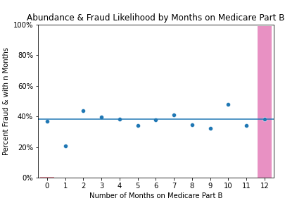
Imbalanced Features

Slide 9
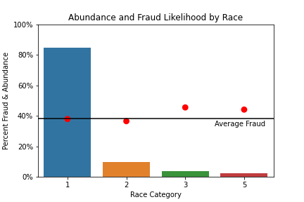
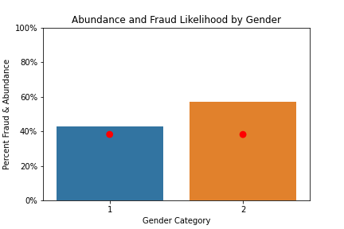
Protected Classes

Slide 10
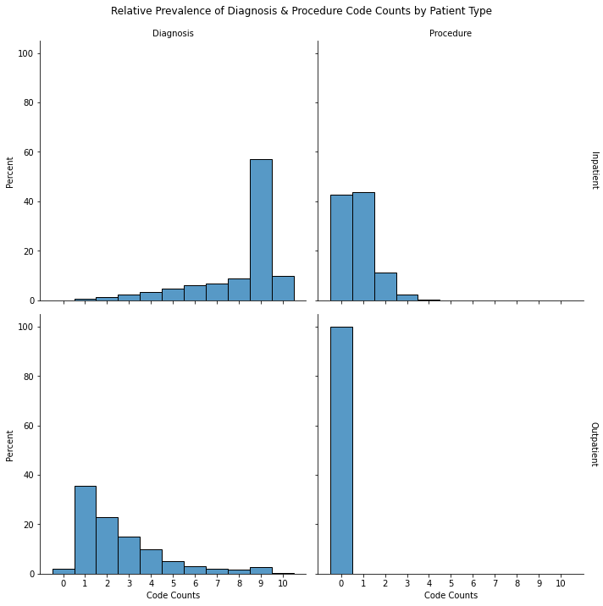
Diagnosis and Procedure Codes
ICD-9-CM codes for diagnosis & Procedure
Inpatients have a high number of diagnosis codes and multiple procedure codes.
Outpatients receive diagnosis but few treatments.

Slide 11
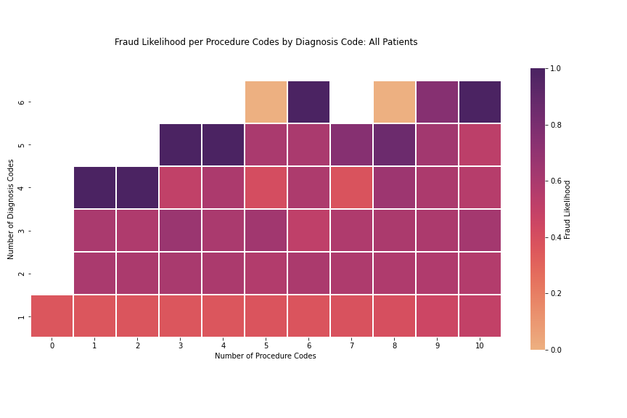
Matrix of diagnosis & Procedure Codes
adfas

Slide 12
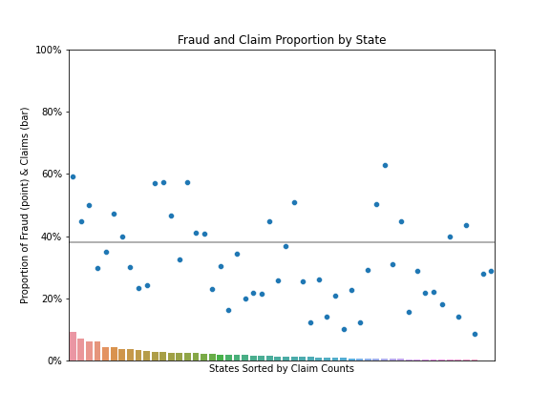
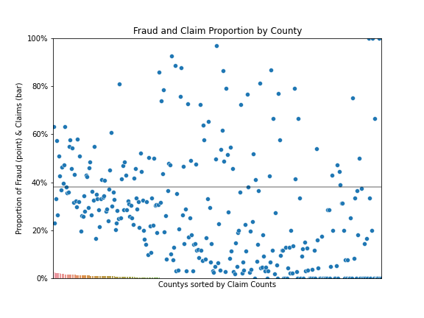
State and County

Slide 13
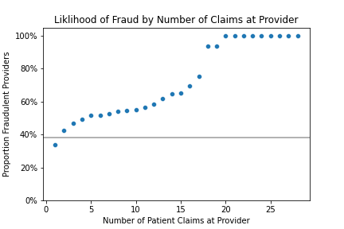
Engineered Features
Accumulating:
Time Since last claim
Total days claimed
Cumulative Visits
Cumulative Provider Visits
Cumulative Payments
Others:
Cost per: Physicians, Codes, days of care
Counts of Codes and Physicians
Date discrepancies

Slide 14
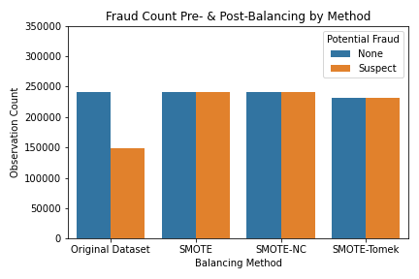
Up-sampling via SMOTE Methods
Balancing Classes increases accuracy of model.
SMOTE: Synthetic Minority Over-sampling Technique.
Nominal and Continuous
Trim Tomek Links

Slide 15
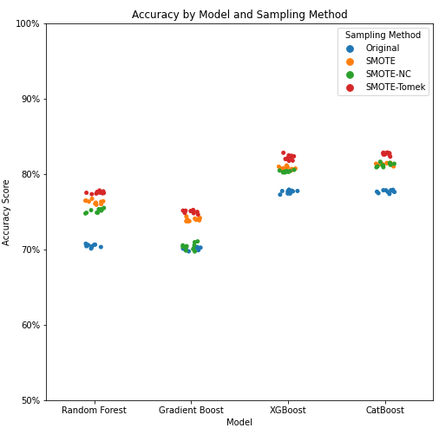
Model Comparison
SMOTE up-sampling increases accuracy in untuned models.
Removing Tomek links further improves score.
XGBoost & CatBoost have 82% accuracy when used with the SMOTE-Tomek data set.
Hyperparameters tuned using RandomizedSearchCV, scoring by Recall

Slide 16
Claim is ______
Perfect Provider
Fraudulent provider
Acceptable
Fraud
Claim Appears Fine
All claims by good providers are good
Bc F.provs submit fine claims
We expect a lot of these
Acceptable
nice
Claim predicted
as…
Nope
Some amount of provider claims are suspect.
Claim is Bad news
Bad news
nice
Fraud
Want to minimize False Negatives

Slide 17
Model Evaluation
** Metrics, Confusion Matrixs, AUC-ROC graphs.

Slide 18
Permutation Importance
State & county pick up on data leakage (same provider submitting in area)
Other features…

Slide 19
Aggregating Predictions
** Metrics, Confusion Matrixs, AUC-ROC graphs.

Slide 20
How many claims do we need?
adfas

Slide 21
Distribution of Claims by Provider
Examples of 0 and 1 class, 42 / each

Slide 22
What do mis-labeled providers look like?
adfas

Slide 23
Magic Sauce?
adfas

Slide 24
Conclusions
On a claim basis, we can predict with…
On a provider level we get …
This method yield a good prediction with only __ claims.
This gives us many chances to detect and defeat fraud.

Slide 25
Next Steps
Claim Specific Labeling
Diagnosis and Procedure Code Match
Provider Information Aggregation

