Slide 2
Whats up

Slide 3
Background

Slide 4
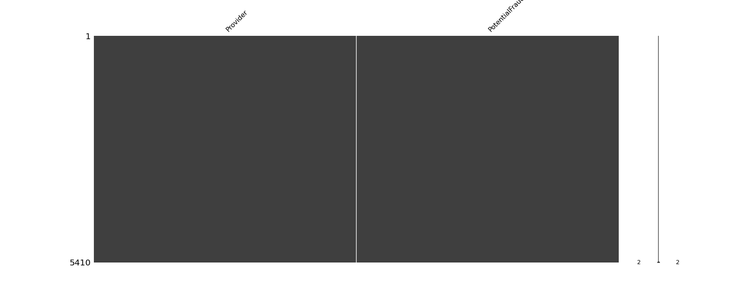
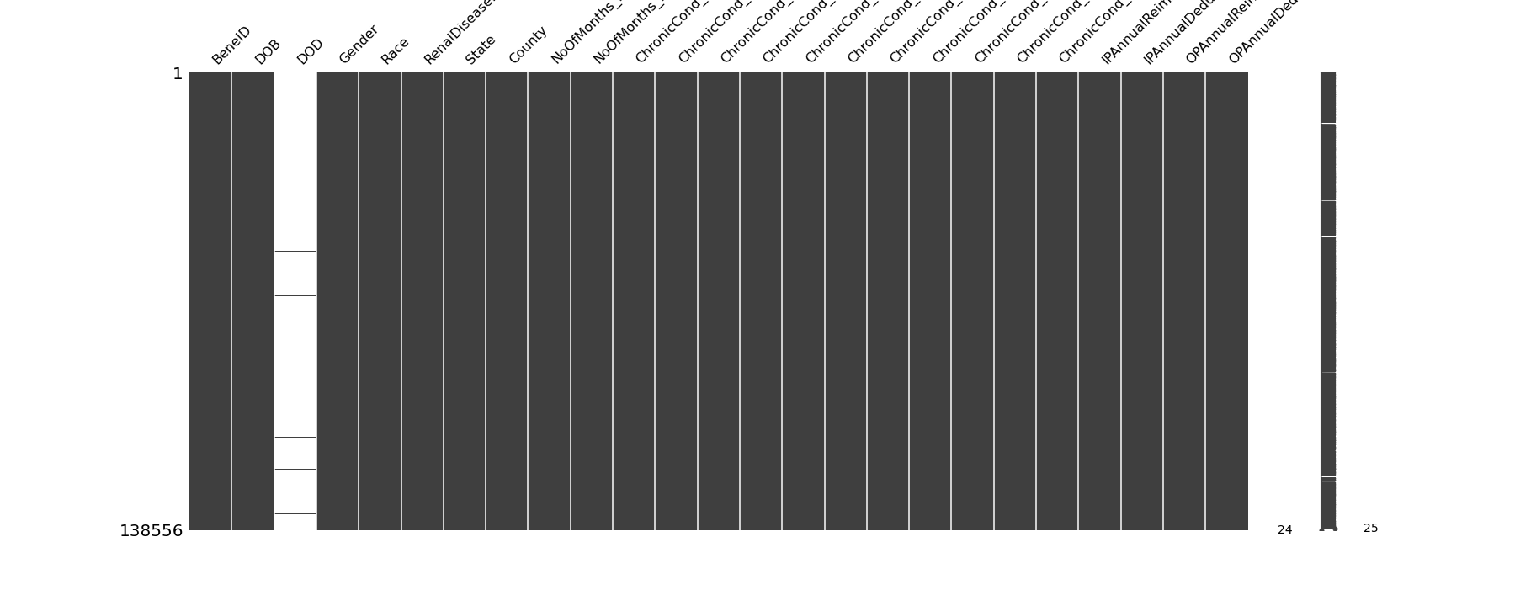
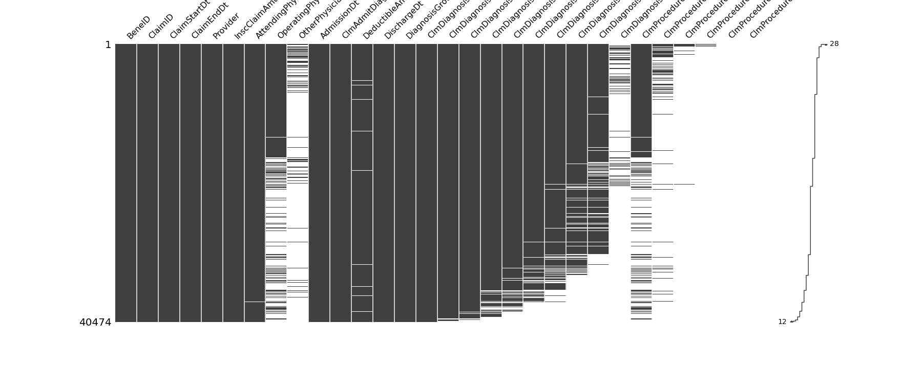
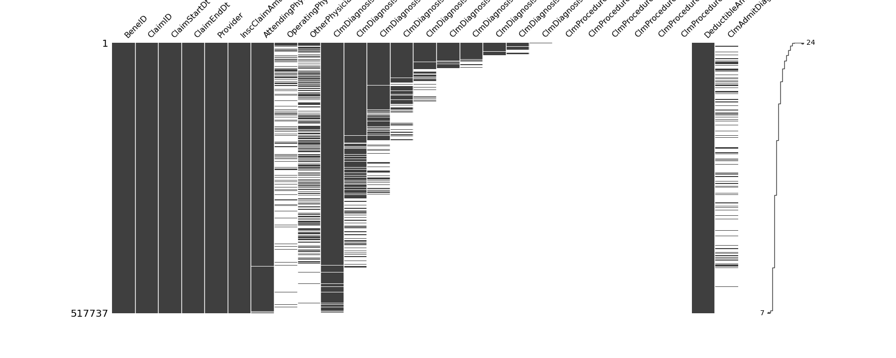
Missingness
Provider Key
Beneficiareis (patients)
Inpatient Claims
Outpatient claims

Slide 5
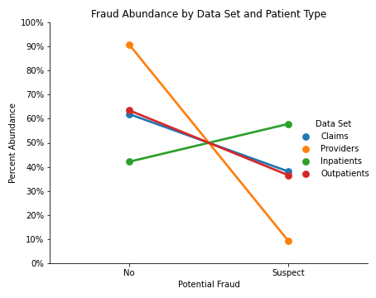

Slide 6
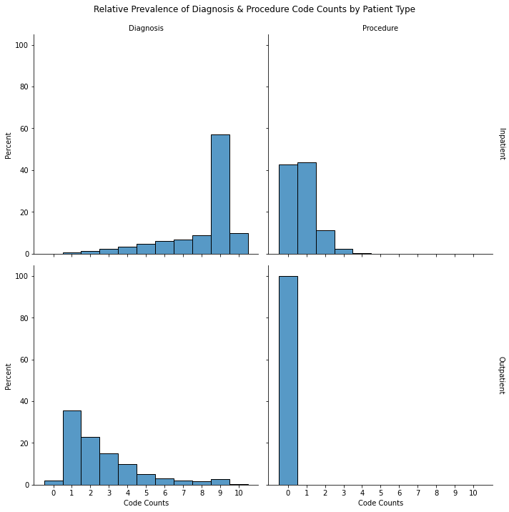

Slide 7
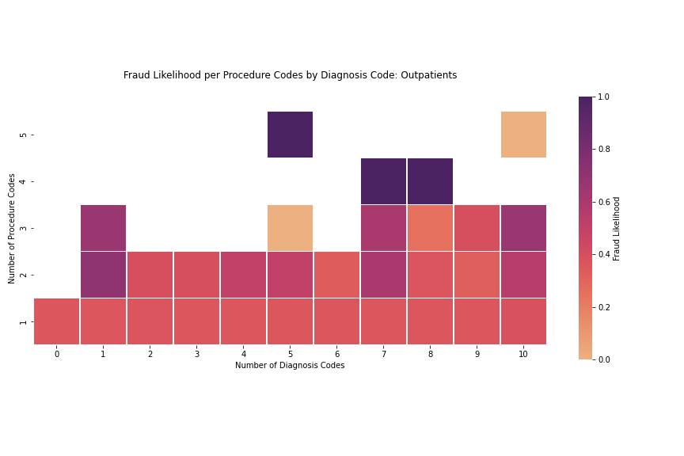
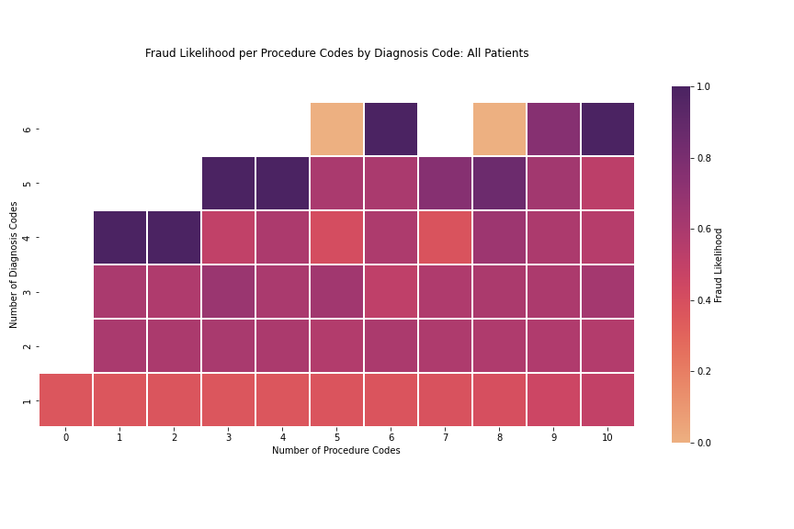
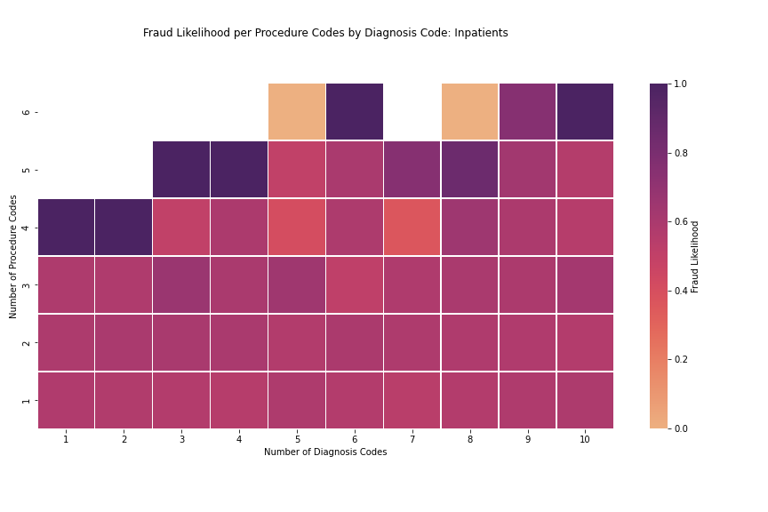

Slide 8
Dates

Slide 9
Codes

Slide 10
Payments

Slide 12
Thoughts
sketchy providers make up most visits so we can have more false positives because they submit more so can be caught other ways...

