Slide 1

Proactive CFPB Complaint Monitoring
Functional specification for a cloud-native risk analytics application
MSDS 434
Functional Specification
Jazz Weller
Notes:
For my final project, I am planning to build a proactive CFPB complaint monitoring and risk analytics application. The goal is to help financial institutions monitor complaint trends before they become larger operational, audit, or regulatory concerns.

Slide 2

Project purpose
Move complaint monitoring from reactive review prep to proactive risk awareness.
Problem
Regulatory and audit reviews can become stressful when teams need to explain complaint trends after the fact.
The application will surface patterns in complaint volume, issue types, company responses, and timeliness so teams can monitor risk areas earlier.
Trend
Monitor
Flag
Complaint volume
Response behavior
Emerging issues
MSDS 434 • Functional Specification • 2
Notes:
The business problem is that complaint information is often gathered and explained reactively. The project is meant to give risk, compliance, and complaint operations teams a more proactive way to see where issues are growing.

Slide 3
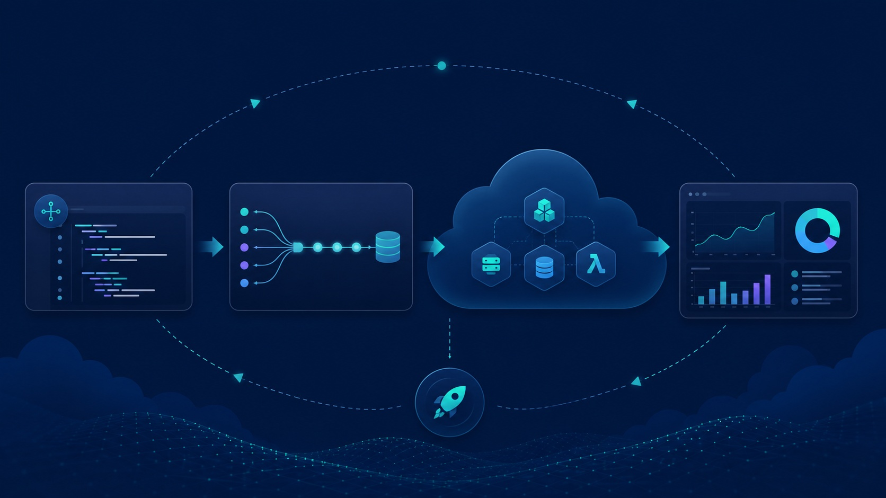
Intended users
Designed for practical decision support, not just model output.
Risk analysts
Compliance teams
Complaint operations
Managers & audit prep
Monitor products, issues, and complaint categories that may require closer review.
Understand patterns that may point to regulatory attention or control gaps.
Track response timeliness, response outcomes, and operational handling metrics.
Quickly summarize trends and prepare for internal or external review conversations.
User need: a clear, filterable, cloud-accessible view of complaint risk signals.
The dashboard should help users answer “what is changing, where, and why should we care?”
MSDS 434 • Functional Specification • 3
Notes:
The intended users are risk analysts, compliance teams, complaint operations teams, and managers preparing for audit or regulatory reviews. The application is not meant to replace judgment. It is meant to help users see patterns faster.

Slide 4

Data source & fields
CFPB Consumer Complaint Database via Google Cloud BigQuery public datasets.
Complaint timing
Complaint details
Entity details
Response outcomes
Project scope
date received
date sent to company
timely response indicator
product
sub-product
issue / sub-issue
complaint narrative
company
state
ZIP code
submission channel
company response
consumer disputed
closed with / without relief
Prioritize fields needed for trend, timeliness, and risk monitoring.
MSDS 434 • Functional Specification • 4
Notes:
The data source is the CFPB Consumer Complaint Database from BigQuery public datasets. The main fields I plan to use include dates, product and issue information, company and geography fields, response outcome, and timeliness. Complaint narratives may be used if there is time for basic text analysis.

Slide 5

Functional requirements
Core functions for a lightweight complaint risk monitoring application.
1
Filter complaint records
Product, issue, company, state, submission channel, and time period.
2
Summarize complaint volume
Total complaints, monthly trend, growth rate, and top categories.
3
Monitor response patterns
Company response types and timely response percentage.
4
Flag rising risk areas
Simple indicators for categories with increasing volume or repeated issues.
5
Optional text analysis
Use complaint narratives for keyword analysis or simple classification if scope allows.
Primary design goal: simple enough for non-technical risk users
MSDS 434 • Functional Specification • 5
Notes:
The core functions are filtering, trend viewing, complaint volume summaries, response timeliness, and simple flags for rising risk areas. Text analysis is optional and would be treated as an enhancement rather than the main project requirement.

Slide 6
Expected outputs
A dashboard or lightweight web app with practical risk signals.
KPI
Metric
Rank
Flag
View
Total complaints
Timely response %
Top issue types
Rising categories
Company response
Dashboard views
Risk summary
Documentation
Volume trends over time
Top products and issue categories
Geographic / company filters
Categories increasing over time
Repeated issue patterns
Response timeliness concerns
README, data dictionary notes, setup steps, and model/app limitations in GitHub.
Success = a clear, reproducible tool that turns public complaint data into usable monitoring views.
MSDS 434 • Functional Specification • 6
Notes:
The expected output is a dashboard or lightweight web application. It should include complaint volume summaries, trend charts, top complaint categories, response timeliness metrics, response breakdowns, and risk flags. The success criteria are clarity, usefulness, and reproducibility.

Slide 7
Preferred technical approach
Cloud-service-based application with PaaS-style deployment.
Data layer
Processing layer
App layer
Deployment layer
BigQuery public dataset for CFPB complaint data; limit queries to control cost.
Python for data cleaning, feature creation, validation, and optional modeling.
Lightweight dashboard or web app for filters, metrics, trend charts, and risk flags.
Cloud Run or App Engine can reduce server management while supporting cloud deployment.
Why not manage everything manually?
The project goal is the analytics application, not server administration. Managed cloud services let the project stay focused on risk monitoring, data quality, and user-facing functionality.
GitHub remains the source of truth for code, SQL, docs, issues, and deployment files.
MSDS 434 • Functional Specification • 7
Notes:
I would prefer a cloud-service-based approach with PaaS-style deployment. Since the data is already in BigQuery, it makes sense to use cloud services for data access and possibly deployment. The advantage is that I can focus on the analytics and application design rather than managing infrastructure.

Slide 8
Advantages & disadvantages
The cloud-service approach fits the project, but the tradeoffs need to be managed.
Advantages
Disadvantages
✓
Less infrastructure to manage
!
Learning curve for permissions and deployment
✓
BigQuery aligns with the dataset location
!
Query costs must be monitored
✓
Better scalability than local-only work
!
More dependence on one cloud provider
✓
Managed deployment options reduce setup burden
!
Debugging can be harder than local execution
✓
GitHub supports reproducibility and SDLC tracking
!
Cloud setup could distract from analytics work
Decision: use managed cloud services, but keep scope focused and monitor cost/query usage.
MSDS 434 • Functional Specification • 8
Notes:
The biggest advantages are reduced infrastructure management, scalability, and a more realistic cloud-native design. The disadvantages are the learning curve, cloud configuration, billing concerns, vendor dependence, and debugging complexity. I think the advantages outweigh the disadvantages if I keep the scope focused.

Slide 9
GitHub & lifecycle support
The repository becomes the project record from planning through delivery.
Plan
Build
Validate
Deploy
README, functional spec, scope, assumptions, data dictionary notes, and issues.
Branches for dashboard work, data processing, and optional ML experiments.
Test scripts, query checks, calculation validation, and reproducible setup notes.
Deployment files and possible GitHub Actions workflow for cloud updates.
Project checkpoint
A strong final version should clearly show the data path, application features, cloud deployment choice, and limitations. The priority is a reliable monitoring tool; ML/NLP is an enhancement only if time allows.
Final direction: practical, cloud-based risk analytics application for proactive CFPB complaint monitoring.
MSDS 434 • Functional Specification • 9
Notes:
GitHub supports the full software development lifecycle. I can use it for planning, version control, documentation, branching, validation, and deployment support. My final direction is a practical cloud-based risk analytics application, with optional machine learning only if the main dashboard is working well.

