Slide 1
Recognizing American Sign Language
Jason Weng

Slide 2
Introduction
What
Build a program that will recognize American Sign Language (ASL)
Why
About 2 million people use ASL
many resources that are taken for granted by users of spoken languages are not available to users of ASL
Notes:
It is estimated that American Sign Language (ASL) is used by up to 2 million people in the United States.
For instance, when an ASL user encounters an unknown sign, looking it up in a dictionary is not an option.

Slide 3
Method/Approach
Supervised Learning
Classification
Neural Networks
Notes:
I will have labels

Slide 4
CNN LSTM Architecture
Long-term Recurrent Convolutional Network(LRCN)
Have spatial structure in their input such as the 2D structure or pixels in an image
Have a temporal structure in their input such as the order of images in a video
Notes:
using Convolutional Neural Network (CNN) layers for feature extraction on input data combined with LSTMs to support sequence prediction.
CNN LSTMs were developed for visual time series prediction problems and the application of generating textual descriptions from sequences of images (e.g. videos)
This architecture is used for the task of generating textual descriptions of images.

Slide 5
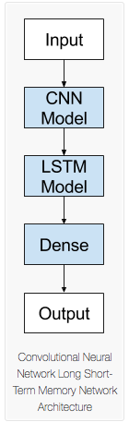
Model
Input
2D images (360x360x3)
19,000 (Training)
4,000 (Test)
Output
Number 0-58

Slide 6
Model
CNN
Conv2d, filters = 8, activation = sigmoid
MaxPooling2D, filter = 2x2, and stride = 2
Conv2d, filters = 16, activation = sigmoid
MaxPooling2D, filter = 2x2, and stride = 2
LSTM
LSTM, dropout = 0.5
Dense
Dense, activation = softmax
Optimizer
Adam, learning rate of 0.001
Notes:
This layer creates a convolution kernel that is convolved with the layer input to produce a tensor of outputs
Pooling: The objective is to down-sample an input representation, to reduce its dimensions. Prevents overfitting and reduces computational costs
outputs a probability distribution, i.e. the values of the output sum to 1

Slide 7
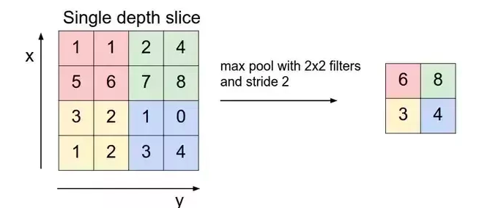

Slide 8
Prepare Data
Split video
Extract video to images
Crop images
Notes:
FFMpeg is basically a open source platform which provides various libraries to work with multimedia based data.
Such as it allow:
To convert one video format to another format
To convert video file to audio file
To create a slideshow video from multiple images

Slide 9
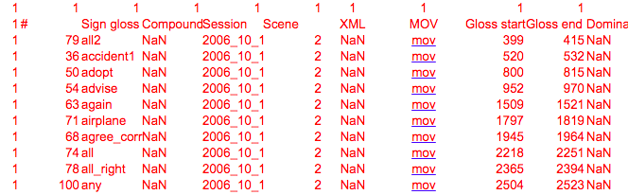
Split Video
Given in frames
Divide by 60 or 30

Slide 10
Extract Video to Images
Input: 1-2 sec video
Output: ~40 images

Slide 11
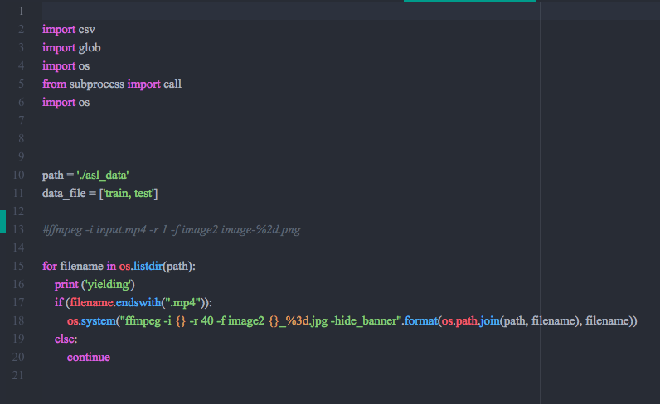

Slide 12
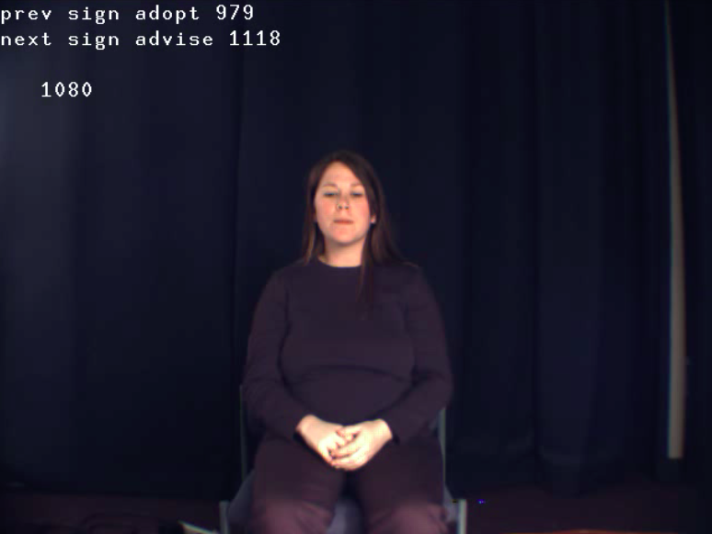
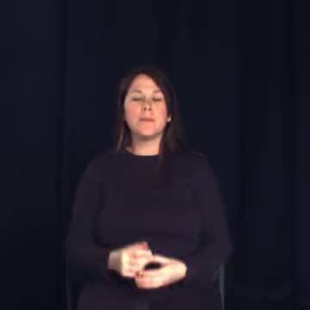
Crop Images
Before:
After:

Slide 13
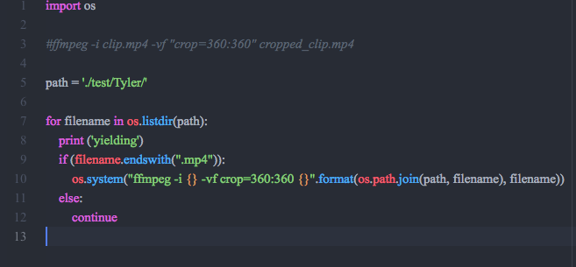

Slide 14
Challenges
Accuracy decreasing
Reducing layers and adding more data
Not enough data
Obtained more data

Slide 15
Training
Epochs: 20
Training accuracy: ---
1.0 after 7th epoch
Validation accuracy:
1.0 after 2nd epoch

Slide 16
Future
Teaching tool
ASL dictionaries
Notes:
For instance, when an ASL user encounters an unknown sign, looking it up in a dictionary is not an option. With existing ASL dictionaries one can easily find what sign corresponds to an English word, but not what English word (or, more generally, what meaning) corresponds to a given sign

Slide 17
References
https://blog.coast.ai/continuous-online-video-classification-with-tensorflow-inception-and-a-raspberry-pi-785c8b1e13e1
Donahue, Jeff, et al. “Long-Term Recurrent Convolutional Networks for Visual Recognition and Description.” 2015 IEEE Conference on Computer Vision and Pattern Recognition (CVPR), 2015, doi:10.1109/cvpr.2015.7298878.
Krizhevsky, A.; Sutskever, I.; Hinton, G. E. (2012). "Imagenet classification with deep convolutional neural networks" (PDF). Advances in Neural Information Processing Systems. 1: 1097–1105.
https://keras.io/layers/
https://github.com/c0decracker/video-splitter
V. Athitsos, C. Neidle, S. Sclaroff, J. Nash, A. Stefan, Q. Yuan and A. Thangali, The ASL Lexicon Video Dataset, CVPR 2008 Workshop on Human Communicative Behaviour Analysis (CVPR4HB'08)

Slide 18
Thank You
Kangning Li
Dr. Patton
Justin
Helen

