Slide 1
World Happiness Index 2021
By: Jason Westfall
Notes:
Hello, I’m Jason Westfall, and my presentation will be in reference to the world happiness index report for 2021

Slide 2
Overview
Audience
Data
Correlations
Hypotheses
Conclusion
Notes:
This presentation will cover the following factors: Audience, or who would be interested in this information; Data, where this data comes from; Correlations comparing the six different factors to the Happiness Index score. Next, I’ll cover both hypotheses based on the correlation graphs. Finally, I’ll wrap up with a conclusion showing which of the two factors were significant.

Slide 3

Audience
Notes:
So, who would be interested in the World Happiness Index? So, similar to myself, I think people that are generally curious about how a country is performing would be interested in this index. Happiness is an important attribute showing how stable a country is. A higher happiness index shows that the citizens of the country support the government in general and their needs are being met. Also, this metric would be of interest to people relocating to a certain country or visiting it.

Slide 4

Data
Dataset Overview: Kaggle.com
Rows / Columns
Wrangling
Country name | Ladder score | GDP per capita | Social support | Healthy life expectancy | Freedom to make life choices | Generosity | Perceptions of corruption
Finland | 7.842 | 47810.47 | 0.954 | 72.000 | 0.949 | -0.098 | 0.186
Denmark | 7.620 | 55994.01 | 0.954 | 72.700 | 0.946 | 0.030 | 0.179
Switzerland | 7.571 | 67305.69 | 0.942 | 74.400 | 0.919 | 0.025 | 0.292
Iceland | 7.554 | 52997.50 | 0.983 | 73.000 | 0.955 | 0.160 | 0.673
Netherlands | 7.464 | 55938.04 | 0.942 | 72.400 | 0.913 | 0.175 | 0.338
Notes:
I downloaded the World Happiness Report from Kaggle.com. The happiness index in based on six different factors: GDP per capita, Healthy life expectancy, Generosity, Social Support, Perceptions of Corruption, and freedom to make life choices. The origin of this data comes from a Gallup World Poll asking citizens in different countries on how they feel on certain factors, the GDP comes from the OECD (Organization for Economic Cooperation and Development) Economic Outlook as well as the World Bank’s Global Economic Prospects from 2020, and the Healthy life expectancy is based on the World Health’s Organization Global Health Observatory data repository from 2020.
The original data contains 149 different countries and 20 different columns. I wrangled the dataset to contain the six factors, ladder score, and country name. Also, I exponentiated the GDP per capita to show actual values as the original dataset contained these values in terms of natural log of these values. The dataset is shown above with the first five rows showing the top five countries with the highest ladder score.

Slide 5

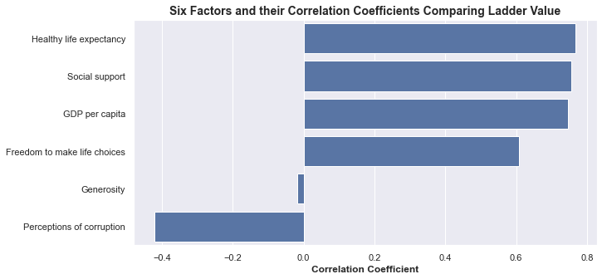
Correlation Coefficient Graph
Notes:
This graph looks at the correlation coefficient between each of the six factors comparing that against ladder score. It shows a strong correlation between healthy life expectancy, social support, GDP per capita, and freedom to make life choices. Generosity has a very weak negative correlation while perceptions of corruption has a fair negative corruption.

Slide 6
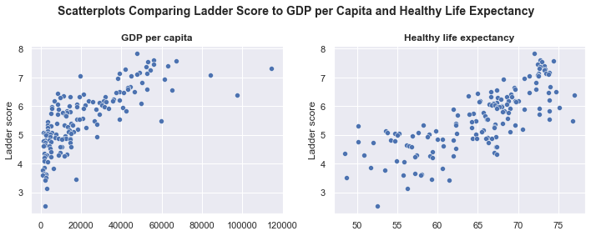
Scatterplots for Hypotheses
Scatterplots for Hypotheses
Notes:
These scatterplots show the two factors that I will cover for my hypotheses in just a bit. Both show strong correlation, however, the question I want to answer is if these factors alone are statistically significant in terms of these factors affecting the ladder score. As a reminder, the ladder score is subjective based on the Gallup World Poll while these two factors were gathered from sources outside this survey.

Slide 7
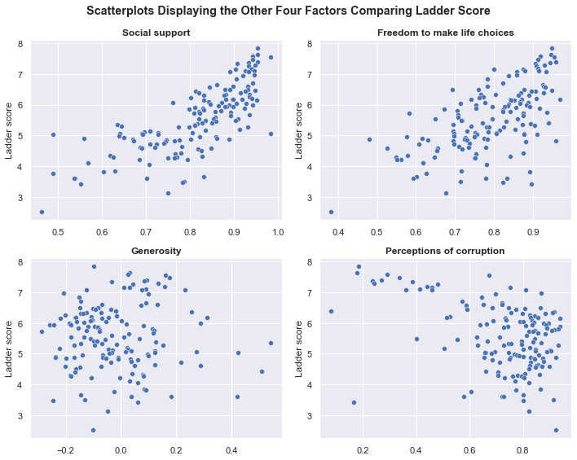
Scatterplots for Other Four Factors
Notes:
And briefly, these are the scatterplots for the other four factors. The scatterplots also show a positive correlation between social support and freedom to make life choices, no correlation in terms of generosity, and a negative correlation for perceptions of corruption.

Slide 8

Hypotheses
$H_{0}$ : $μ1 − μ2 =0$
$H_{a}$ : $μ1 − μ2 ≠0$
GDP per capita is a statistically significant factor influencing ladder score
Healthy life expectancy is a statistically significant factor influencing ladder score
Notes:
So based off the correlations and scatterplots, the two hypotheses I will look at is if GDP per capita and Healthy life expectancy are statistically significant influencing ladder score. The null hypotheses for both is that each of these factors are not statistically significant. A T-test will be conducted comparing the top 30 ladder score values for each category as the treatment group while the remaining 119 countries will be the control group. To reject the null hypothesis, the difference of means cannot be equal to zero according to the equations above, the t-statistic must be above the critical value of 1.96, and the p-value needs to be below 0.05

Slide 9
T-Test Tables for Both Hypotheses
GDP Per Capita
Healthy Life Expectancy
Mean - Control | 5.201689075630252
Variance - Control | 0.7951183318974647
Observations - Control | 119
Mean - Treatment | 6.846399999999999
Variance - Treatment | 0.37527404
Observations - Treatment | 30
T-Stat | 9.486101863988672
P-Value Two-Tail | 6.009885456732183e-17
T-Critical two-tail | 1.96
Sample Size | 149
Difference in Means | 1.6447109243697469
Standard error of difference | 0.138530867756133
Confidence Interval | 0.27152050080202067
Lower Limit | 1.3731904235677261
Upper Limit | 1.9162314251717676
Mean - Control | 5.213109243697479
Variance - Control | 0.8158292401666549
Observations - Control | 119
Mean - Treatment | 6.801100000000002
Variance - Treatment | 0.4395621566666666
Observations - Treatment | 30
T-Stat | 8.974656851457624
P-Value Two-Tail | 1.2340786720044462e-15
T-Critical two-tail | 1.96
Sample Size | 149
Difference in Means | 1.5879907563025224
Standard error of difference | 0.14665530944854677
Confidence Interval | 0.28744440651915165
Lower Limit | 1.3005463497833707
Upper Limit | 1.875435162821674
Notes:
This gives an overview of the statistics used in conducting the T-Test. It shows the mean, variance, and number of observations for the control and treatment groups. It then takes those values and calculates the T-statistic and the p-value. In the case of both factors, both the t-statistic is higher than the critical value of 1.96 (about 9.5 for GDP per capita and around 9 for Healthy life expectancy). Also, the p-value is lower than 0.05 with both values being very close to zero. Next, it shows the sample size, or 149 different countries. Then it shows the difference in means between the two groups. The standard error of difference is calculated based of the variance and number of observations for each group. Finally, the confidence interval is calculated by taking the standard error value and multiplying it by the t-critical value of 1.96. Adding and subtracting this value from the difference in means gives the confidence interval range with 95% confidence. So, in this case, for GDP per capita, the ladder score ranges from 1.37 to 1.92 while the range for healthy life expectancy is from 1.30 to 1.88.

Slide 10
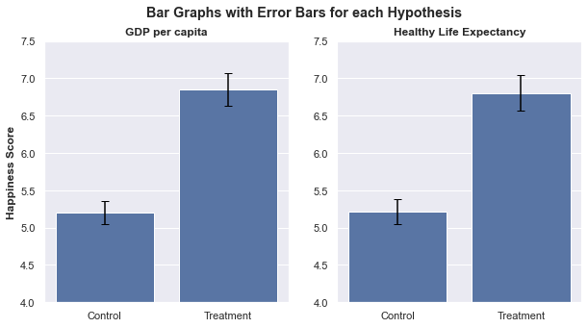
Confidence Interval Graphs for Hypotheses
Notes:
These graphs show the average ladder score for each group and has error bars emphasizing the confidence interval range for each of the two factors. As the error bars illustrate, there is no overlap, which means with 95% confidence the difference in means between each group is not equal to zero.

Slide 11
Conclusion
Both Factors Significant
P-Value / T-Statistic
Confidence Interval
Strong Correlation to Ladder Score
Notes:
Because the p-value on both were around 0, the t-statistic being around 9 for both factors, above the 1.96 critical value, and the difference in means at any point on each confidence interval not equal to zero, we can reject the null hypothesis that GDP per capita and Healthy life expectancy are not statistically significant.
Also, it makes sense that these are statistically significant factors as both have strong correlations to the ladder score. Having more money affords a person more resources to help live fuller lives while having the prospect to live longer also influences one’s opinion that they will be happier, overall.
And happiness score is important to a wide variety of people. From those that are generally curious, want to immigrate or visit that country, as well as government officials making policy to help improve the lives of their citizens. While subjective in nature, it gives an idea on how stable a country really is.

Slide 12

Questions

