Slide 1


Building Farmers in the West
2011 Annual Report
Kynda Curtis, Program Assessment Director and Associate Professor, Utah State University
Dawn Thilmany, Adrian Card, Martha Sullins, Jo Ann Warner, Bart Eleveld, Wilson Grey, Kent Fleming, and Mykel Taylor
Colorado State University, Washington State University, Oregon State University and University of Idaho
Funded by the USDA Beginning Farmers and Ranchers Development Program (grant award number 2009-49400-05877).

Slide 2
Motivation/Background
The growing demand for local, fresh foods has created new market opportunities in the West
  New models of producing, marketing and managing labor intensive produce and livestock operations require training for….
    Beginning farmers who are entering the industry to take advantage of new markets
    Transitioning commercial producers who may seek to learn a different set of skills than those used in their commodity-oriented operations
Building a stronger community and resource-sharing network among this segment of producers, including newcomers

Slide 3
Building Farmers in the West Program
Targets and builds business planning capacity among beginning/ transitioning farmers by extending successes in Colorado pilot programs to:
  Utah, Nevada, Idaho, New Mexico, Washington, and Oregon
Eight week sessions
  Followed by internships and/or additional business planning or production consulting

Slide 4
Evaluation Program
Participant experience & goals shape course content & teaching styles
Determines what participants learned & actions they intend to take
Pre-course evaluation
Post-course evaluation
Aligns mentor & mentee expectations & interests
Pre-mentorship evaluation
Post -mentorship evaluation
Did BFW help participants develop sustainable & profitable businesses, rooted in the community?
9 month follow-up evaluation

Slide 5
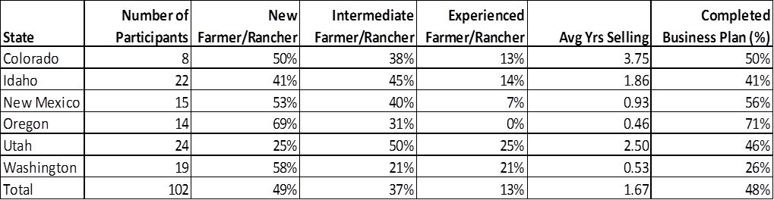
2010-2011 Overview
6 - eight week sessions held
102 participants
48% average completion of business plan

Slide 6
2010-2011 Results Overview
Participants’ knowledge/skills change
  Most improved
    Accessing local resources/technical support
    Developing business plans
    Using effective merchandising at direct markets
  Least improved
    Maintaining financial records & budgeting
      Most cumbersome for participants, need more time
      Length of short courses may be a barrier
      One of the most common “follow up” technical assistance requests
    Managing labor force & assessing seasonal labor requirements

Slide 7
2010-2011 Results Overview
Attitude change
  Greatest increase in agreement with
    I follow a financial plan annually
    I follow a marketing plan annually
    I have a business plan for my operation
Practice change
  Increased interest in producing fruit, herbs, and value-added products
  Increased interest in selling to restaurants and through CSAs

Slide 8
Plan for 2011-2012
Ten new sessions – Fall 2011 and spring 2012
  Nevada – Native American course Sep/Oct 2011
  Colorado – 3 on the Front Range including new Urban Ag Track
Follow-up assessments for 2010-2011 and Fall 2011 courses (9-month)

Slide 9
Thank you! Questions?

