Slide 1

Paint With Sound
Team 330 /
Jingwei Fan (jingweif)
Jing Xu (jxu2)
Sprint 2 presentation

Slide 2
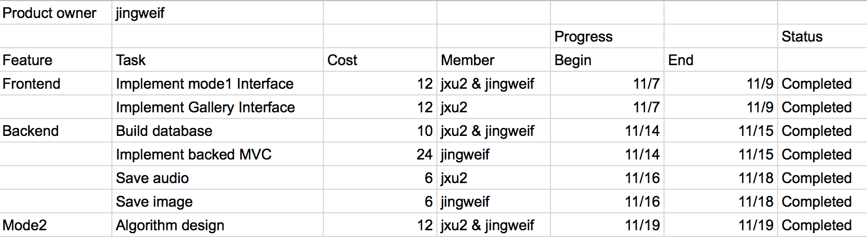
Sprint 2

Slide 3
Application Goal & Design
Transform sound into images.
Light-weighted social function & user interaction (Spring 2)
3 modes
Real-time image generation according to microphone input (Sprint 1 & Sprint2)
More complicated & styled image generated from user-uploaded audio file
Image selection combining simple speech analysis

Slide 4
Work in Sprint 2
User interface & Server-client interaction (main focus)
View gallery
User login & register
Save/download image & audio in mode 1
…
Mode 2 algorithm design

Slide 5
Save image & audio
Library:
FileSaver.js
Canvas-to-Blob.js
Recorder.js
Steps:
1. Get binary data
Covert SVG to Canvas, export canvas to base64 data.
2. Save data as blob, and package into FormData
3. Upload with ajax

Slide 6
Data Model
User
Album
User, name, time
Audio
User, time, audio_file
Painting
User, album, time, audio, image

Slide 7
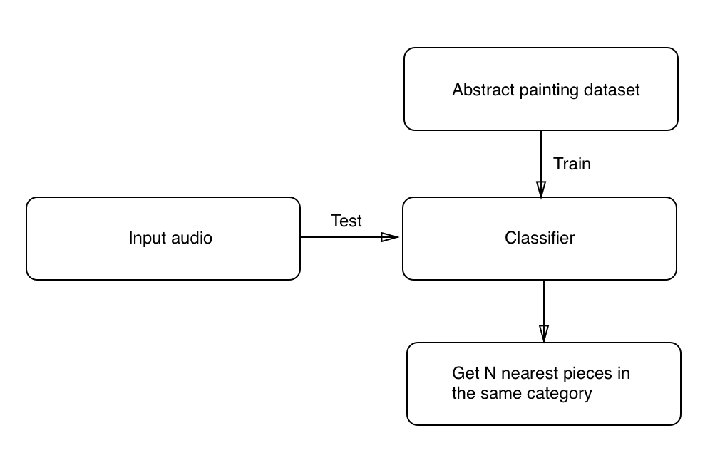
Mode2 algorithm

Slide 8
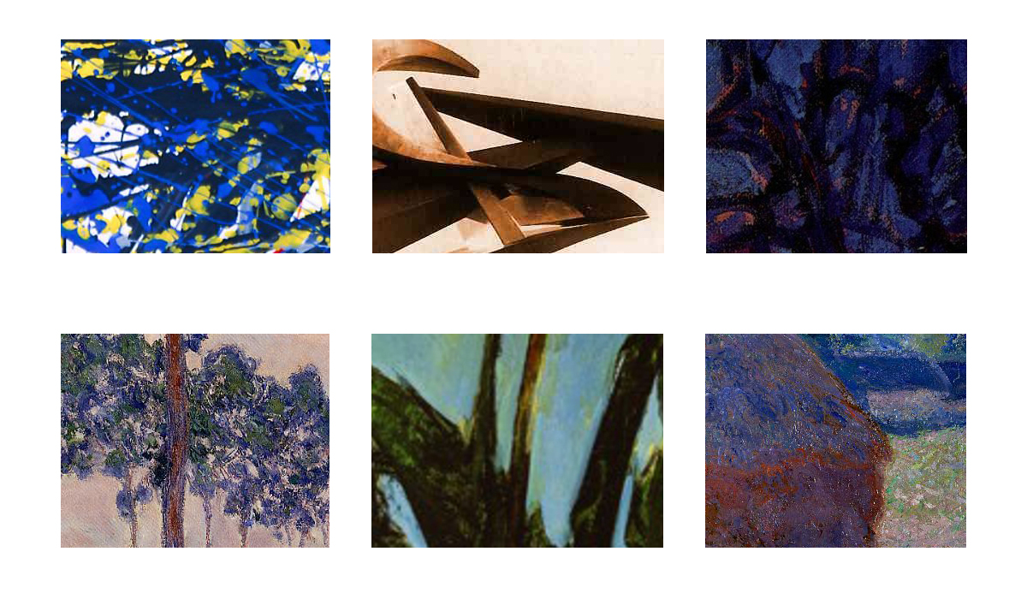
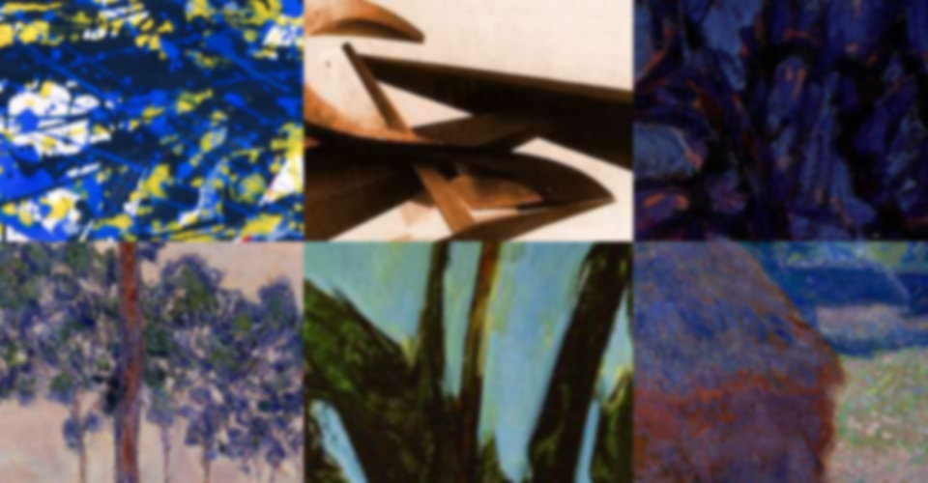
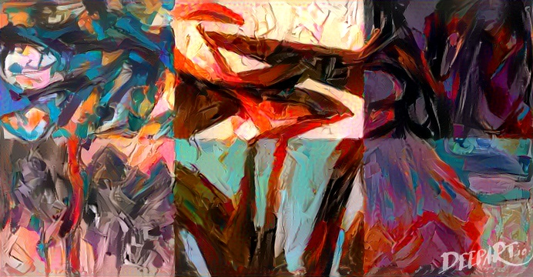
Mode2 algorithm
Cutting species from masterpiece
Splicing species
Applying filters

Slide 9
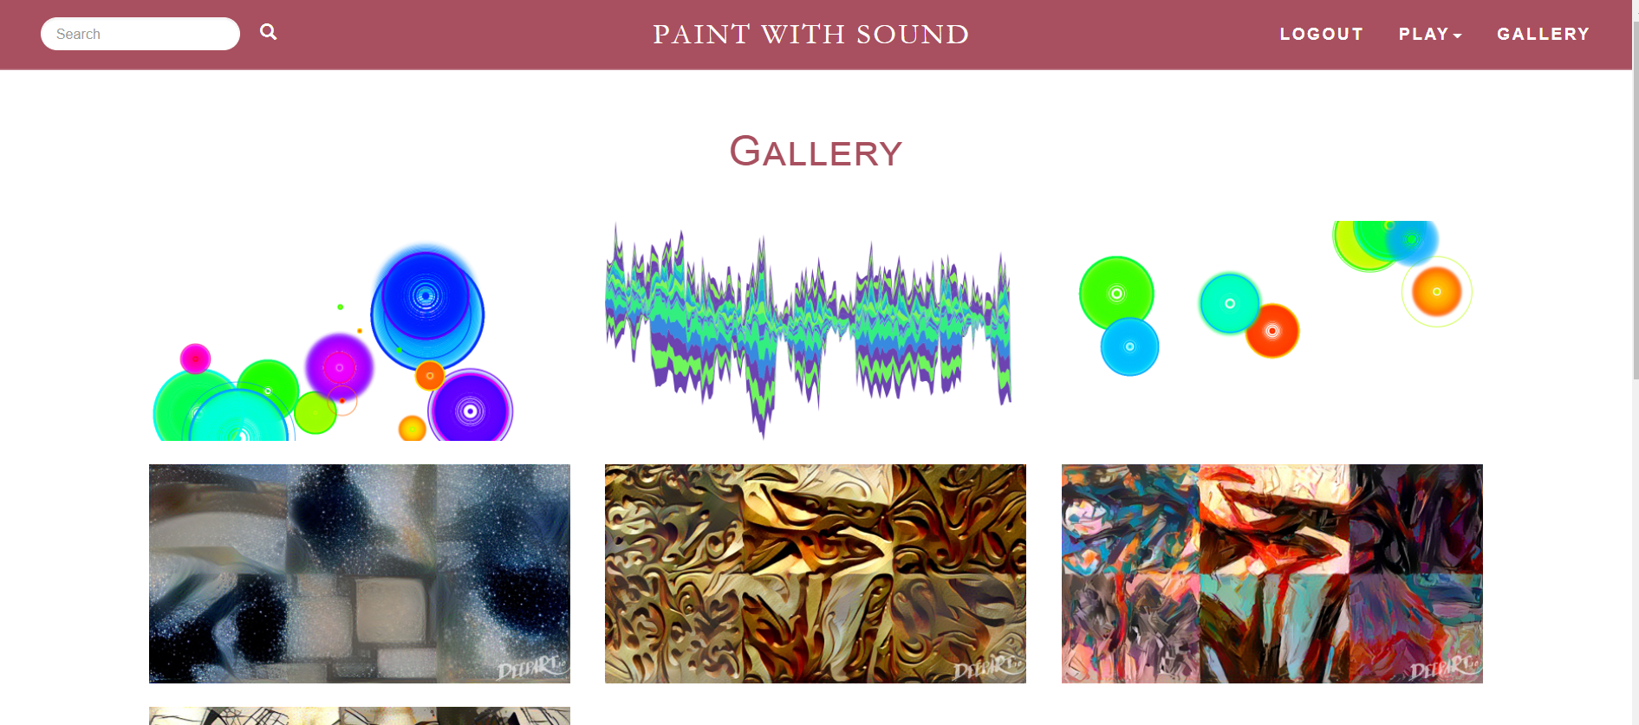
Demo

Slide 10
Problem & Reflection in Sprint 2
For next sprint:
ETL(Extract, Transform and Load) database.
Select features and train classifiers.
Implement mode2 front end interface.
Implement mode 2 back end algorithm.
Implement mode 2 back end MVC.

