Slide 1
Introduction
Weather Data Analytics using python programming, SQL
By John Francis
Data is growing exponentially
This project uses a cloud based system to gather temperature and humidity data, then the data is analyzed using programming and data analytics

Slide 2
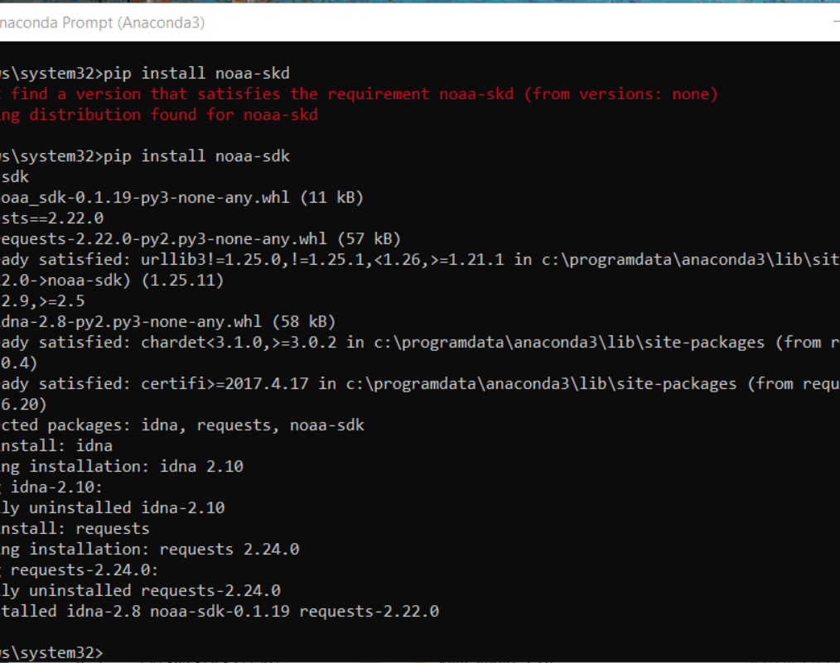
Software Inventory (Screenshots)
Before developing this programming with data project, all sofware must be downloaded and installed
software needed included SQLLite studio, Excel, and a python IDE-anaconda
Included screenshot of NOAA-SDK library installed

Slide 3
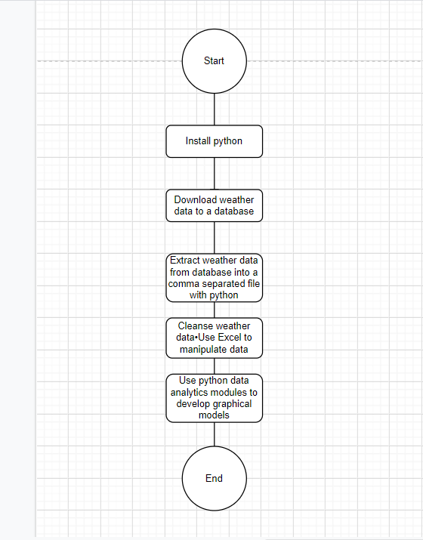
Planning and Design
After performing an inventory of the software needed for this project, a plan was created for the temperature data project
to plan the design of the project, a flowchart was generated
Planning and design of the project are crucial steps to understanding the development process.

Slide 4
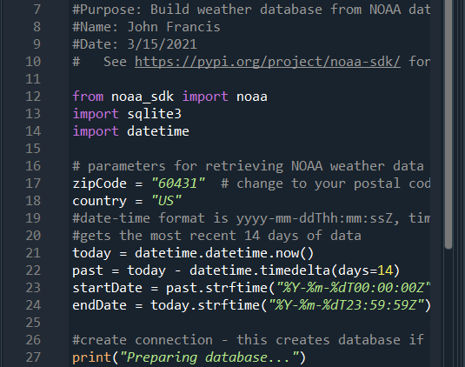
Gathering Temperature and Humididty data
after planning and design, the code was developed to download a set of wether observations.
this data was stored on a local database in a table for later analysis

Slide 5
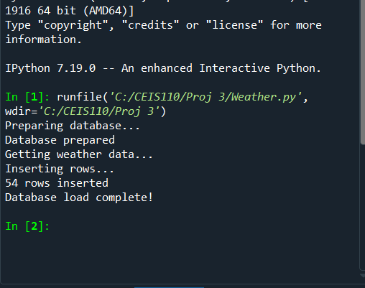
Python Console (Screenshot)
Screenshot of program output in Python console showing program executed successfully

Slide 6

Weather.db File (Screenshot)
Screenshot of Windows Explorer showing database file Weather.db was created

Slide 7
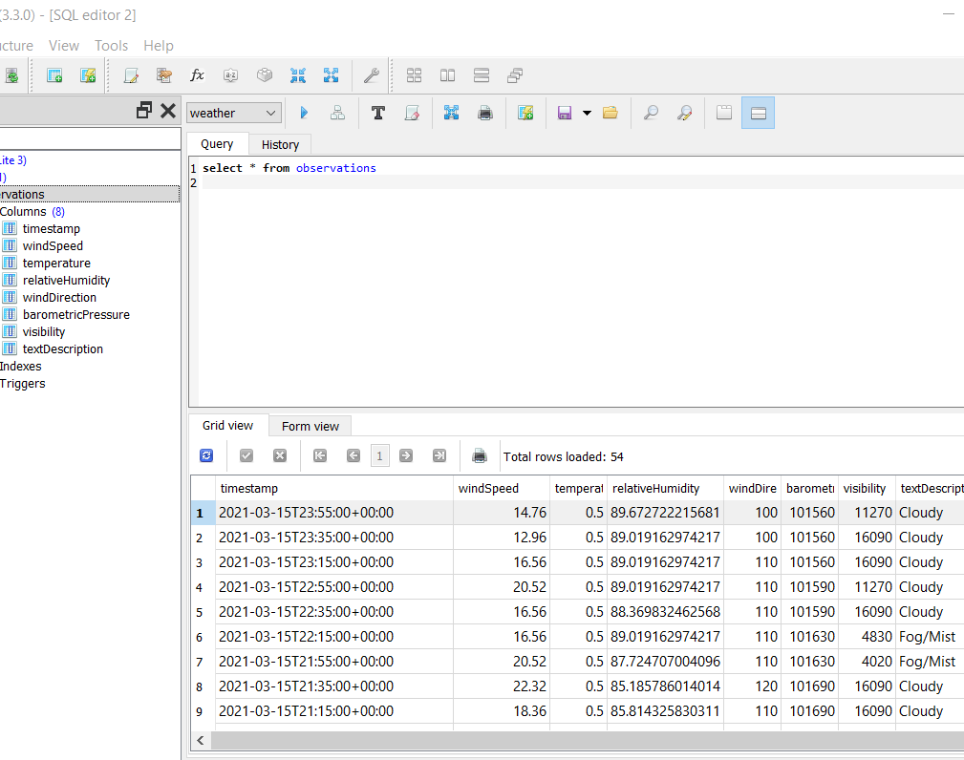
Query to retrieve all columns and all rows (Screenshot)
Querying the database
Structure query language (sql) is a programming language used for working with relational databases.
SQL Lite Studio was used to query the database and view the results
Screenshot of SQL query command and view the results

Slide 8
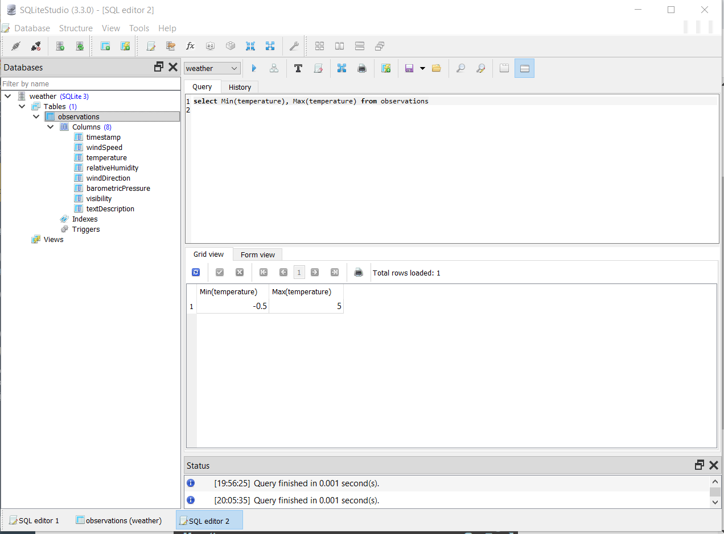
Query to retrieve lowest and highest temperatures (Screenshot)
Screenshot of SQL query command and results

Slide 9
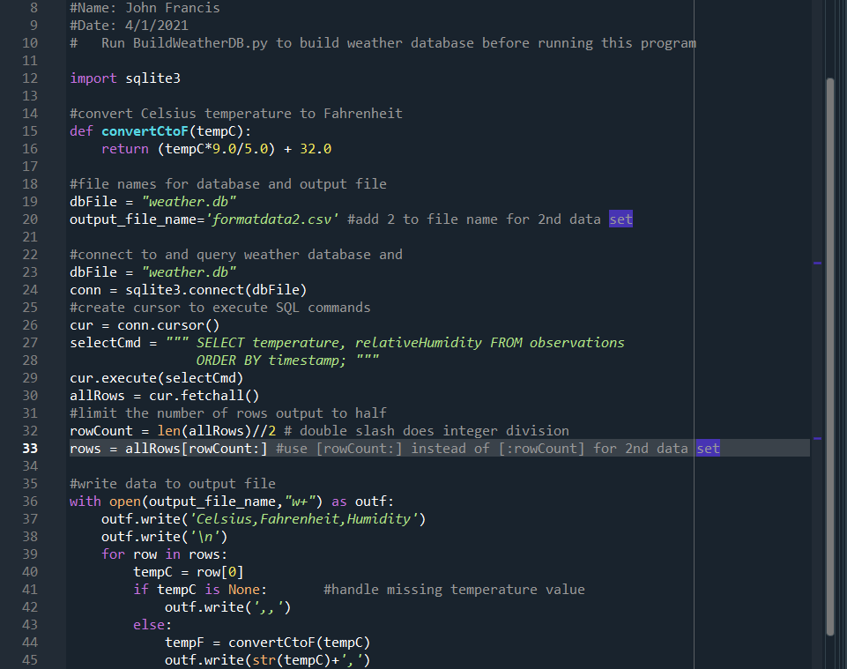
Python code for Data Analytics
Extracting Temp & Humidity Python code

Slide 10
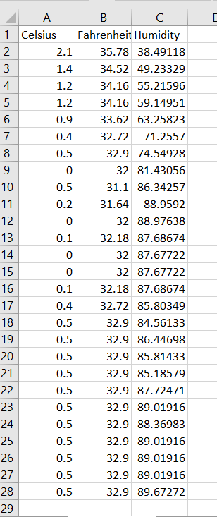
Retrieve and Convert Data to CSV Format
Format data file open in Excel showing 3 columns of data

Slide 11
Data Analytics
Python Data analytics modules allows users to develop charts and graphs depicting data
the data sets can be manipulated as well and saved into tabular format
the data analytics modules are availble as part of anaconda
several plots were generated looking at humidity and temperature
then a prdicion was made about the data.

Slide 12
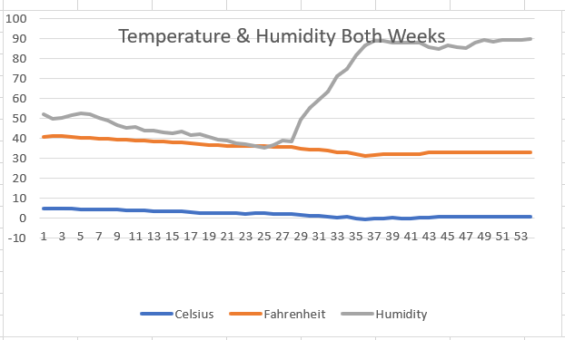
Temperature and Humidity Chart (Graph)
Excel chart based on temperature and humidity data from database

Slide 13
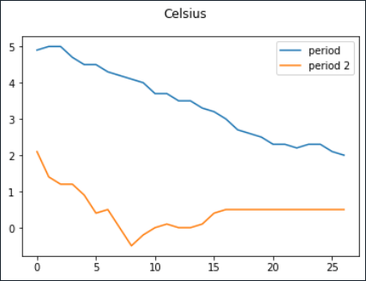
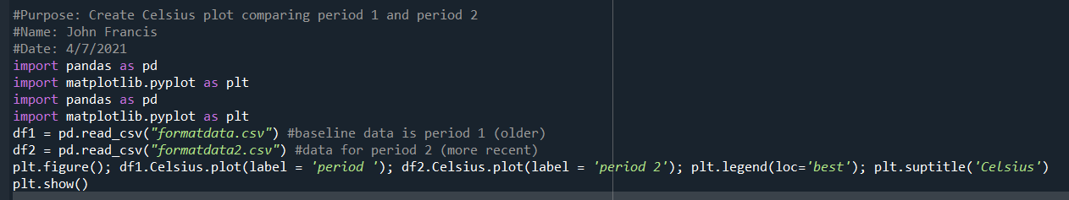
Plot #1
Plot and code used to generate it
Box
Line
Histogram
Scatter
Research your own!

Slide 14
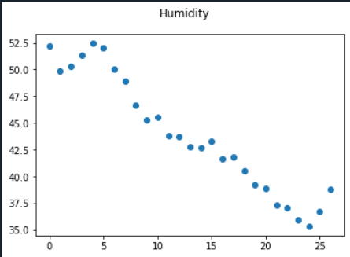
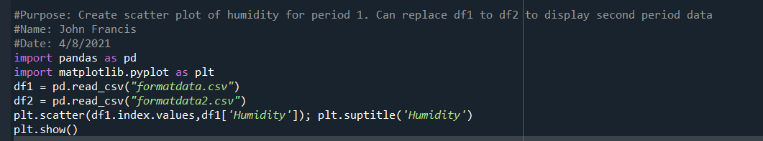
Plot #2 (Screenshots)
Plot and code used to generate it
Box
Line
Histogram
Scatter
Research your own!

Slide 15
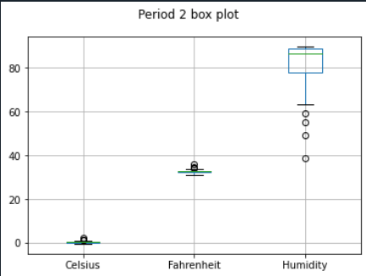
Analysis
Think of your own question and create a chart/graph to answer it
Your own question:
What was the range of humidity readings for the time frame shown?
Answer supported by Chart
65 to 98%

Slide 16
Prediction
If temperature continues to decrease, then the humidity will continue to decrease.
Based on the data, it appears that there was a greater variation in humidity than in temperature. due to this, I predict that on any given day the humidity would change more than temperature.
More trials should be performed - and other factors can be reviewed as well.

Slide 17
Conclusion
this project covered the fundamental topics of programming with data by using data gathered from a cloud service to perform data analytics, operations
Building this project provided a hands-on learning opportunity to put into practice the topics covered in the course.

Slide 18
Challenges
when created the python program, it needed to be in the same directory as weather.db
Misspelling the noaa library install
installing a wrong version of anaconda that needed additional set up to be able to install libraries.

Slide 19
Career Skills Obtained
Several Career skills are gained in this project:
communication-using flowcharts to depict the plan of a project
Database development
programming using python
troubleshooting errors in the code and data cleansing
analysis- reviewing chars and graphs to make predictions on the data

