Slide 1
Ambient Light Sensor Applications
Evaluation Library
Jim Getchell
ALS Applications Engineer
August 31, 2011

Slide 2
Objectives
Enhance Excel based data analysis with ALS evaluation specific functions
Establish a set of “data capture templates” linked with evaluation programs to automate data analysis
Standardize & document measurement techniques

Slide 3
Introduction to Intersil pptx template v2.0
To help you with the process of pptx conversions we strongly suggest you see slide #9 on how best to easily and quickly convert old presentations into the new format
If you have any questions on this template or need help converting a file, please contact Adam Latham, Scott Lewis or Makiko Mossbrooks

Slide 4
Section Subtitles/Dividers

Slide 5
Corporate Template Update
New corporate Power Point template has been updated (file name: “Intersil_Corp_Template_11_15_2010.pptx”) with new features and enhancements as follows:
Added standard bullet slide as new option
Removed one set of template conversion directions which appeared to not function correctly on some systems
Adjusted line spacing on all content slides for improved readability
Included additional legal guidelines for properly applying the use of “Intersil Confidential Information.”
Added Intersil logos page for improved ease-of-use
Added step-by-step flow diagram for selecting the proper slide and viewing all slide options

Slide 6

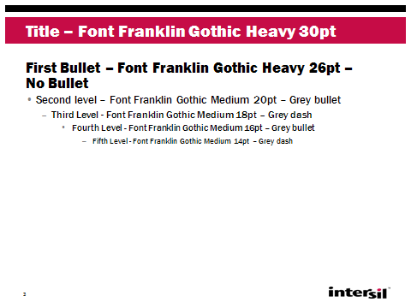


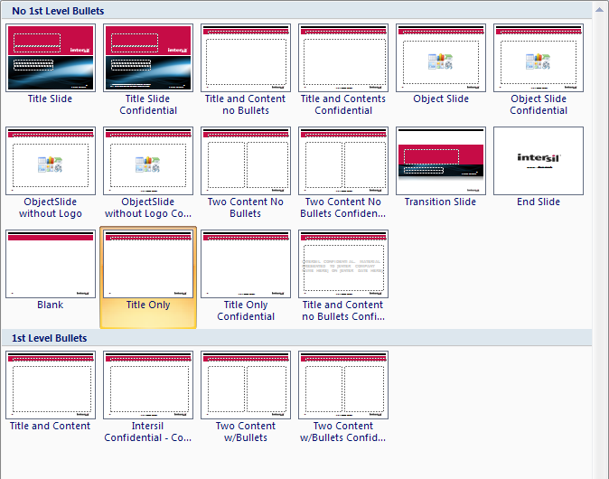
Layout Options and Flow
TITLE SLIDE
CONTENT SLIDE
SECTION DIVIDER
FINAL SLIDE
CONTENT SLIDE OPTIONS
First Level w/o Bullets
Title Slide/Confidential
Title and Content (default layout)/Conf.
Object Slide/Confidential
Object Slide without Logo/Confidential
Two Column/Confidential
Transition
Closing
Blank (no title, no content text box)
Title Only/Confidential
Confidential Watermark (customize in Master)
First Level With Bullets
Title and Content/Confidential
Two Column/Confidential
a
b
c
g
a
b
d
e
f
g
c
d
e
h
i
j
f
g
h
i
k
l
j
k
l

Slide 7
Disclosing Intersil Confidential Information
Instructions for Marking Slides with “Intersil Confidential Information” Label (see Spec PB1-03)
Prior to disclosing Intersil confidential information to another, e.g. other companies, you should ensure that Intersil has executed an NDA with other party that covers your particular information exchange. Please confirm with the Legal/Contracts Dept.
If no appropriate NDA has been executed, please work with the Legal/Contracts Department to have an NDA executed prior to disclosing the Intersil confidential information.
When verbally disclosing Intersil confidential information to others, ensure such information also contemporaneously, visually shown in a slide or handout.
Clearly mark each slide or handout containing Intersil confidential information with the “Intersil Confidential Information” label by choosing the “Intersil Confidential” layout option provided.
If no Intersil confidential information is on a slide, please make sure the slide is not marked with the Confidential Information label.

Slide 8
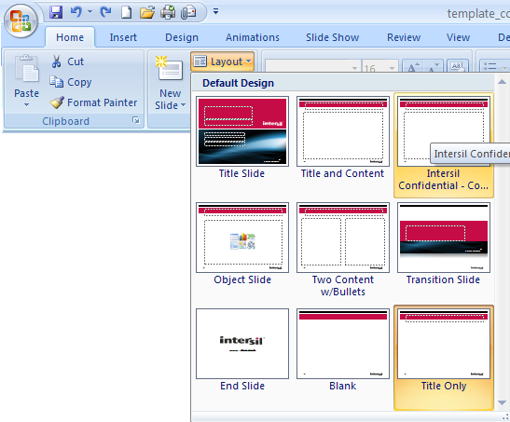
Confidential Slide Format
Select >
< Select the Intersil Confidential – Content layout
Confidential format

Slide 9


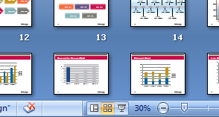
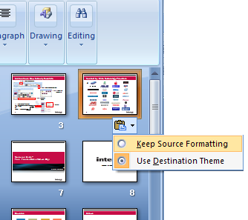
Copy & Paste Old PPTs into New PPT Template
1st – Copy Slide from old presentation/template
Select >
< Select one of these options
2nd – In your new presentation choose the slide sorter icon at the bottom right of the window
5th – To reapply the layout to the template
3rd – Paste the slide in the slide sorter view.
6th – There may be some text that didn’t get applied to the template. You will need to select any unformatted text and change it to the default font > Franklin Gothic Medium or > Franklin Gothic Heavy
4th – Select the clipboard icon that pops up below the slide thumbnail you just pasted. > Choose Keep Source Formatting, this will retain the old format, step 5 will fix the formatting

Slide 10


















Copy and Paste Word Marks and Logos
NOTE: Always hold down Shift key when resizing to maintain correct proportions.
NOTE: The most up-to-date logos can always be downloaded at http://sales.intersil.com/brand/logos.asp

Slide 11








Approved SLOC Licensed Logo Options
2-COLOR POSITIVE
1-COLOR POSITIVE
1-COLOR NEGATIVE

Slide 12
Corporate Color Palette
Intersil Red
D2 Blue
Pale Green
Zilker Orange
198
12
70
R G B
0
101
164
R G B
163
168
107
R G B
242
101
57
R G B
Violet
Mustard
Eucalyptus
Dark Grey
97
77
125
R G B
197
146
23
R G B
131
175
180
R G B
115
117110
R G B
Rich Grey
Med Grey
Light Grey
Black
150
145
145
R G B
192
194
188
230
231
223
R G B
0
0
0
R G B
R G B

Slide 13
Circles
white text
white text
white text
white text
white text
white text
white text
white text

Slide 14
Squares
white text
white text
white text
white text
white text
white text
white text
white text

Slide 15
Arrows
white text
white text
white text
white text
white text
white text
white text
white text

Slide 16
Rectangles
white text
white text
white text
white text
white text
white text
white text
white text

Slide 18
Timeline
Title
Short Description
Title
Short Description
Title
Short Description
Title
Short Description
Title
Short Description
Title
Short Description
Title
Short Description
1990
1995
2000
2005
2010
2015
2020
Title
Short Description
Title
Short Description
Title
Short Description
Title
Short Description
Title
Short Description
Title
Short Description
Title
Short Description

Slide 19

Roadmap
Performance
??nm
40nm
60nm
90nm
Time
2007
2008
2009
2010
2011
2012
2013
2014
2015

Slide 20
Table
Text | Text | Text | Text | Text

Slide 21
Column Chart

Slide 22
Column Chart

Slide 23
Stacked Chart

Slide 24
Line Chart

Slide 25
Two Axes on a Chart — Line and Column

Slide 26
Two Axes on a Chart, Both Appear as Lines

