Slide 1
Intersil Ambient Light Sensor
Evaluation Software
Jim Getchell
ALS Applications
March 26, 2012

Slide 2
Evaluation Software
Swept Measurements:
Wavelength, distance, angle & power

Slide 3
Apps, Libs, Data, Data Analysis
Program: alsSimpleGUI.Angle.WaveLength
Program: alsSimpleGUI.Angle.WaveLength
Lib: ALSusb.ocx
Lib: Plot.ocx
Excel Analysis
CSV
ActiveX components Usable by Microsoft & National Instruments
Lib: Monochromator.ocx
Lib: thorlabsAPT.ocx

Slide 4
Selectable Permutations
Device(s) / Families:
ISL29011
ISL29028
ISL29038
A _{out} (DVM)
Glass (OPM)
29011 | ALS | IR | Prox₀ | Prox₁ | Prox₂ | Prox₃
nm | √ | √
deg | √ | √ | √
mm |  |  | √ | √ | √ | √
nm & deg | √ | √
29028 | ALS | IR | Prox₀ | Prox₁
nm | √ | √
deg | √ | √ | √
mm |  |  | √ | √
nm & deg | √ | √
Profile selects options & performs setup
Sweeps:
Single
nm - wavelength
deg - angular
mm - linear
Combo
nm & deg
nm & comp (x38)
29038 | ALS | IR | Prox₀ | Prox₁ | Prox₂ | Prox₃
nm | √ | √
deg | √ | √ | √
mm |  |  | √ | √ | √ | √
nm & deg | √ | √
nm & comp | √
Add co-package & power sweep
Inputs (up to 4 values):
ALS
IR
Proximity (up to 4 IDRD values)
A _{out} | ALS | IR
nm | √ | √
deg | √ | √
mm
nm & deg | √ | √
Glass | ALS | IR
nm | √ | √
deg | √ | √
mm
nm & deg | √ | √

Slide 5
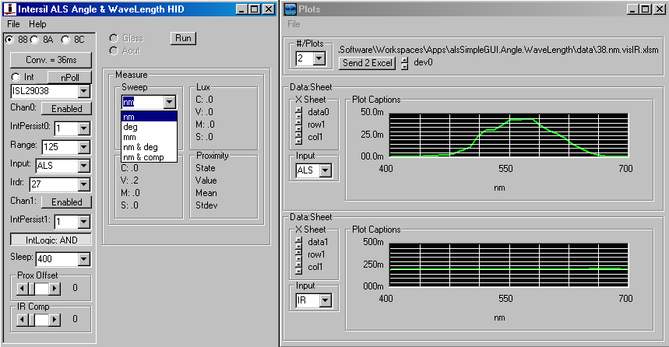
Program Selections
Inputs
Device(s) / Families
Sweeps

Slide 6
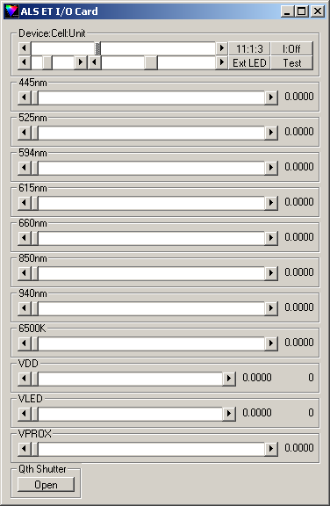


Evaluation Tester Control Panel

Slide 7
Data Dimensions – Excel Organization
Possible Dimensions: up to 4
Sweep – 1 or 2: Row, Column
Device #: Column, Sheet
Input: Sheet, File
Need to make input into JMP as easy as possible...
Use “Sheet Set” instead of file.
Single Dimension Sweep: single file
Two Dimension Sweep: one file/input
File
Input
Data\Device
Data\Device
Data\Device
Data\Device
Data\Device
Data\Device
Device
Data\Device
Data₀\Data₁
Data\Device
Device
Data\Device
Input
Data\Device
Data₀\Data₁

Slide 8
Program Threads: Source, Measure, Record
Source (Sweep):
Setup
start
stop
step
Loop
arm
next
done
pause
abort
Measure:
Lux (100ms)
IR (100ms | Sleep Time)
Prox (Sleep Time)
Record (Measure Done → Loop Next)
Lux
IR
Prox _{0:3}
measureValid_{N}
sweepValid
captureValid

Slide 9
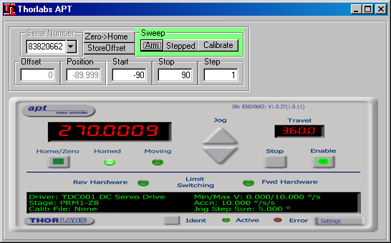
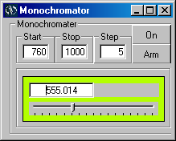
Sweep Driver API’s
Source (Sweep):
Setup
start
stop
step
Loop
arm
next
done
pause
abort

Slide 10
Profile Scripts
< Library | Window >::Selection::value::{index}
Als Address < 88 | 8A | 8C >
Als Part < 29011… >
Als < Enable | Disable > < 0 | 1 >
App Irdr < Cycle | Static >
App38 Prox0 < 0..31 >

Slide 11
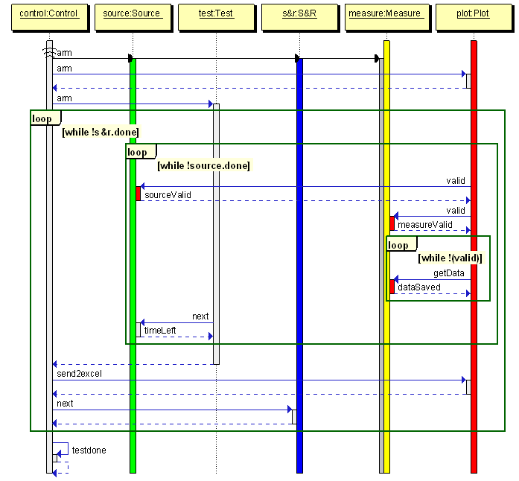
Palette Sequence Diagram

