Slide 1
Response & Radiation
Goals
Provide existing support for new HID evaluation cards
Implement Labview Compatible Driver OCX
Characterize Repeatability
Single Insertion
Multiple Insertion – Single Device
Device Characterization
May 5, 2011

Slide 2
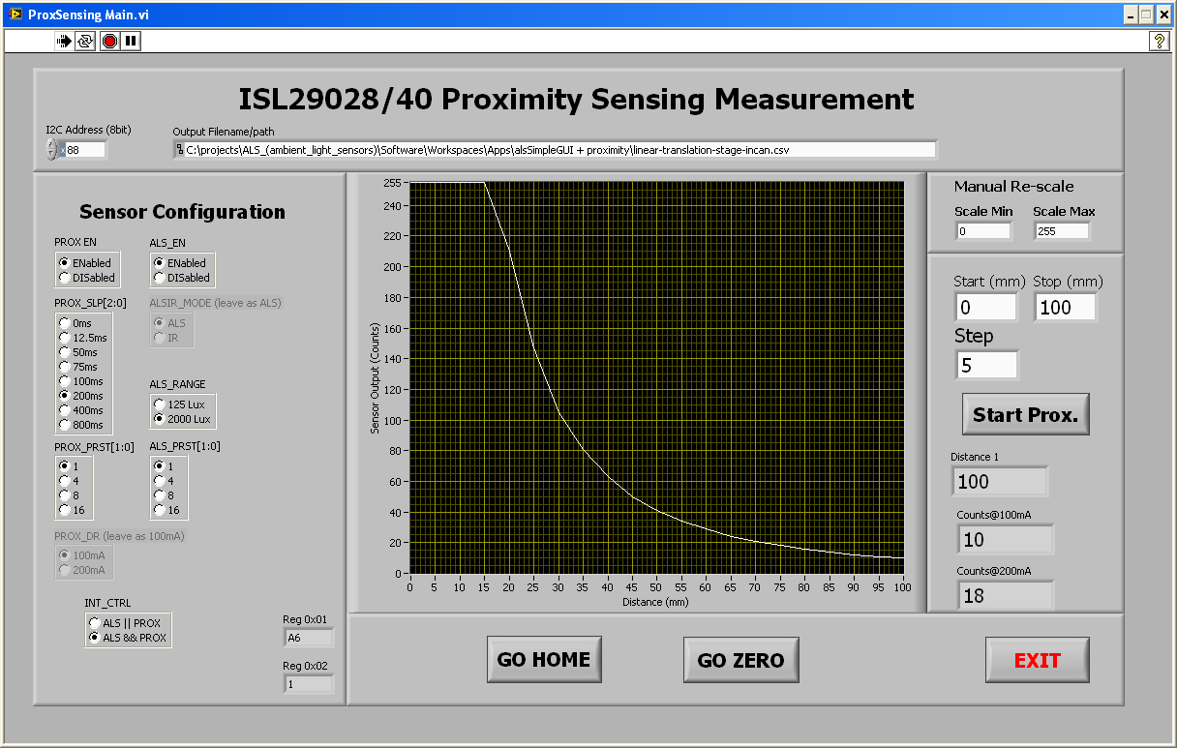
ISL29028 Labview Program

Slide 3
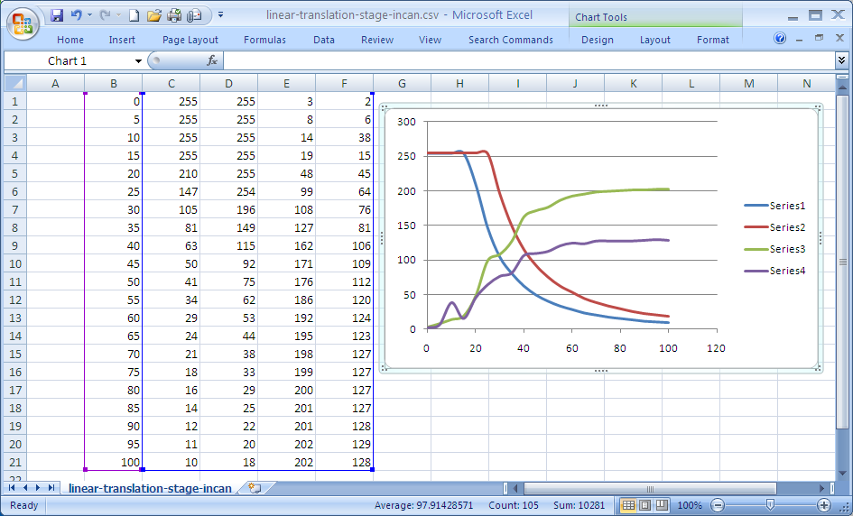
ISL29028 Labview Results

Slide 4
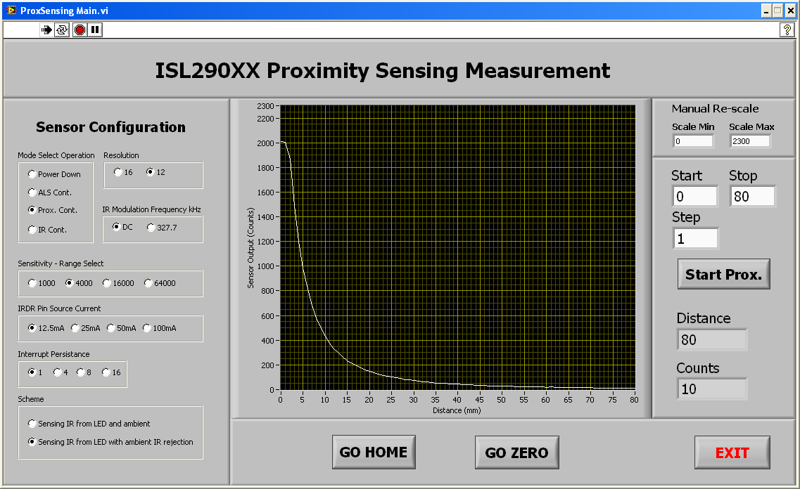
ISL29011 Labview Program

Slide 5
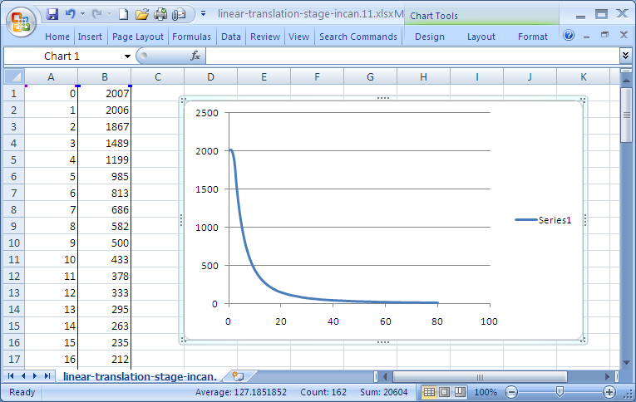
ISL29028 Labview Results

Slide 6
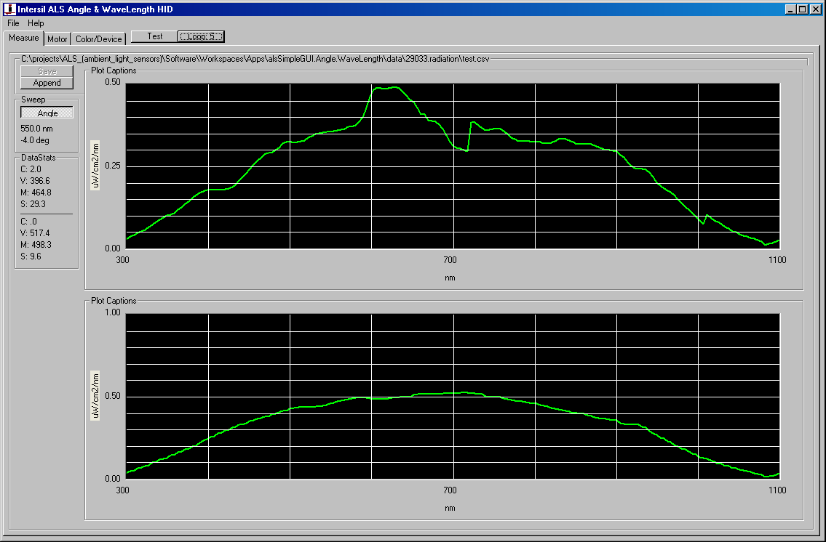
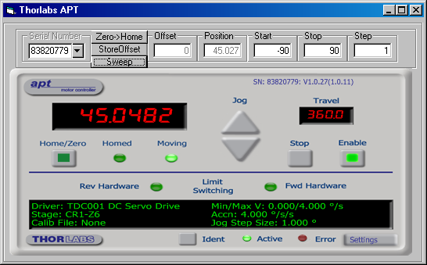
VB Prototype: Radiation Measurement

Slide 7
Repeatability – Single Insertion – White – Low Lux
X28: < 1 lsb -100ma, x11 < 2%
 | Proximity Curve | Standard Deviation
X28 IRDR=110ma
X11 IRDR=100ma/DC
Range Switch

Slide 8
Repeatability – Multi Insertion – White – Low Lux
X28: < ½%, x11 < 2%
 | Proximity Curve | Standard Deviation
X28 IRDR=110ma
X11 IRDR=100ma/DC

Slide 9
Lot distribution – 20 pieces – White – Low Lux
Stddev: x28 < 4% FSR; x11 < 5%
 | Proximity Curve | Standard Deviation
X28 IRDR=110ma
X11 IRDR=100ma/DC

