Slide 1

House Price Prediction: Project Recap
Predicting house prices using the Kaggle House Prices: Advanced Regression Techniques dataset — exploring how linear, nonlinear, and combined modeling approaches affect prediction performance.
Original Scope
Refined Question
Standard comparison of regression models: Ridge, Lasso, and nonlinear methods
When are linear models insufficient, and does combining models improve performance?
Core Hypothesis
Ensemble methods (hybrid & stacking) improve accuracy by combining complementary model strengths

Slide 2
Algorithms & Pipeline
Preprocessing
Models Implemented
Median imputation & categorical handling
One-hot encoding + ordinal mapping for quality features
Log transform: y = log(1 + SalePrice)
Predictions back-converted: ŷ = exp(ŷ) − 1
Ridge Regression
min ||y − Xw||² + λ||w||²
Lasso Regression
min ||y − Xw||² + λ||w||₁
Gradient Boosting
Fₘ(x) = Fₘ₋₁(x) + γₘhₘ(x)
Hybrid & Stacking
ŷ_hybrid = α·ŷ_ridge + (1−α)·ŷ_GB; Stacking via meta-learner f(ŷ_ridge, ŷ_GB)
All models evaluated with 5-fold cross-validation and RMSE.

Slide 3
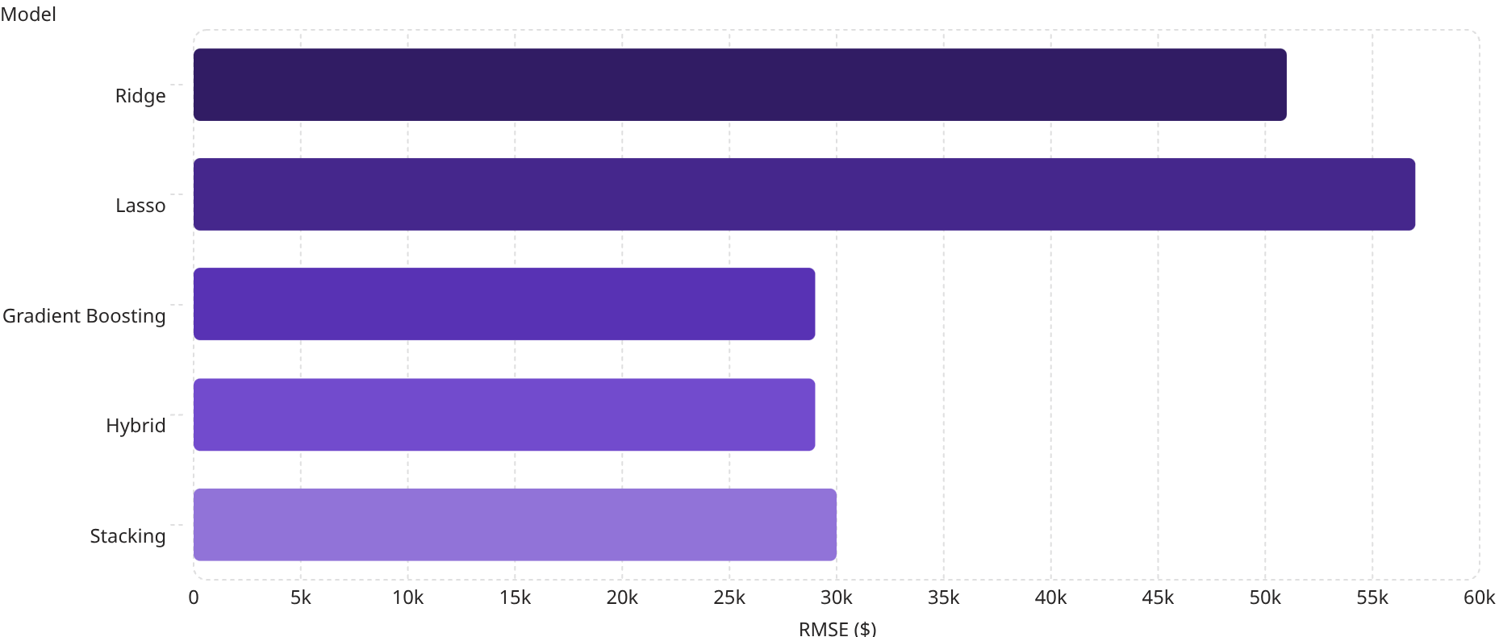

Preliminary Results
~29k
GB RMSE
Best performer — Gradient Boosting
~51k
Ridge RMSE
Linear baseline
~57k
Lasso RMSE
Highest error among all models
Hybrid ≈ GB and Stack ≈ GB — ensemble methods did not improve over Gradient Boosting alone, indicating the base models are not sufficiently complementary.

Slide 4
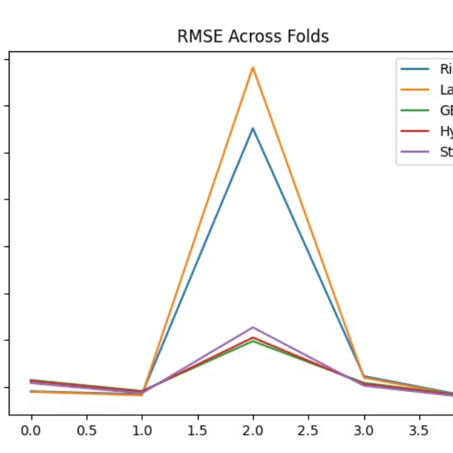
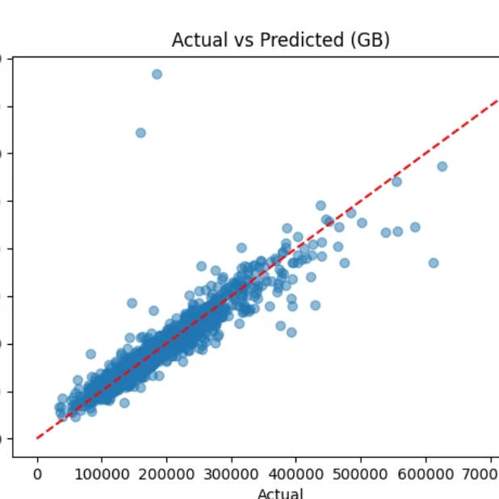
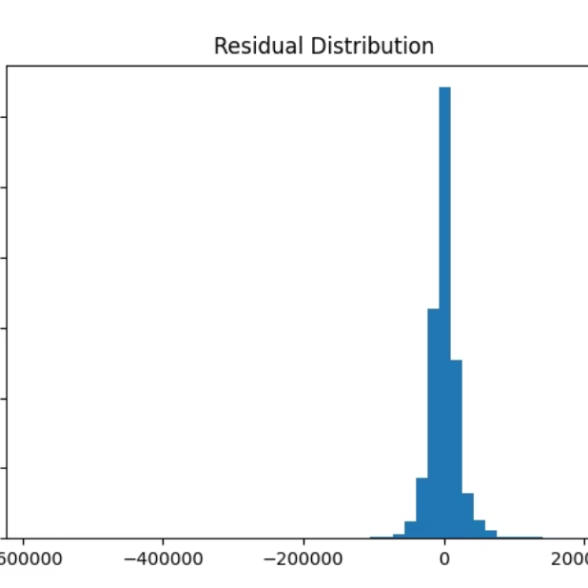
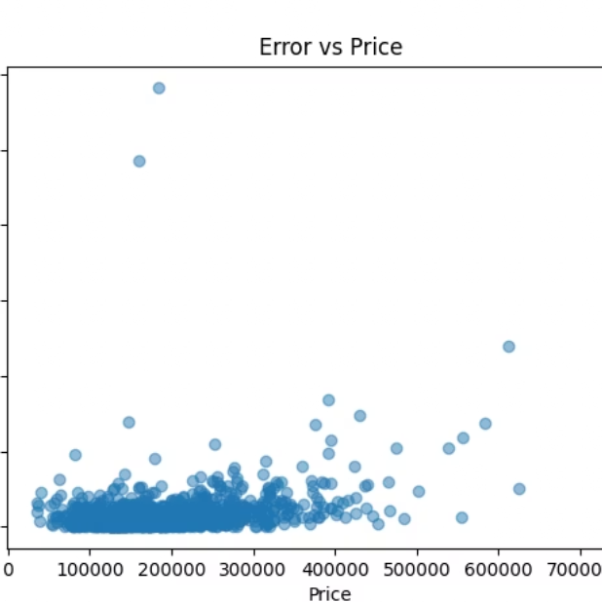
Graph Interpretations
RMSE Across Folds
Actual vs. Predicted (GB)
Residual Distribution
GB is consistently lower across all folds. Ridge & Lasso show large spikes — indicating instability and underfitting.
Points align closely along the diagonal — accurate overall. Slight spread at higher prices reveals larger errors for expensive houses.
Centered around 0 — model is unbiased. Most residuals within ±30k, confirming RMSE ≈ 29k. Some large outliers increase RMSE.
Error vs. Price
Clear pattern: higher price → larger error. Suggests heteroscedasticity — model struggles most with expensive houses.
Top features by importance: OverallQual, GrLivArea, TotalBsmtSF — matching real-world intuition and confirming the model learns meaningful patterns.

Slide 5
Challenges & Solutions
Scope Too Simple
Complex Preprocessing
Initial design was a basic model comparison → expanded to hybrid + stacking to study model complementarity.
Handled via a structured pipeline: imputation, encoding, log transformation, and ordinal mapping.
Linear Models Underperformed
Hybrid Model Failed Initially
Ridge and Lasso showed high, unstable RMSE → introduced Gradient Boosting as the primary nonlinear model.
Residual-based hybrid did not work → switched to weighted hybrid: ŷ = α·ŷ_ridge + (1−α)·ŷ_GB.
Data Leakage Risk
Stacking Did Not Improve
Avoided by not tuning α dynamically on validation data.
Revealed lack of model complementarity — GB already captures both linear and nonlinear relationships.

Slide 6

Final Report Plan & Next Steps
Final Report Will Include
If Time Permits
Finalized comparisons across all models
Improved explanation of hybrid and stacking approaches
Strengthened graph interpretation
Clear connection of results back to hypothesis
Test Kaggle test.csv to verify result
01
Explore LightGBM / XGBoost
More powerful boosting alternatives to test further gains
02
More Diverse Stacking
Improve ensemble with additional base models for true complementarity
03
Feature Engineering
Create new features to improve signal quality
04
Error Analysis by Price Range
Address heteroscedasticity and improve accuracy for expensive houses
Key Takeaway: Gradient Boosting already captures both linear and nonlinear relationships, leaving little room for ensemble gains — a meaningful finding in itself.

