Slide 1
Metro Nashville Education System Budget Analysis
Jonathon Hankins, Nashville Software School

Slide 2
Summary
My hope is to shed light on the complex interconnectivity of different education metrics, opening up new and innovative avenues for budgetary spending effectiveness.
This data should be used as a jumping off point to further explore the uncommon impacts of the budget as a whole.

Slide 3
Disclaimers
A reminder, correlation does not imply causation.

Slide 4
Budget Categories
Measurables
Social Services
Parks
Juvenile Court
Library
Metro Nashville Public Schools
ACT scores
2013 - 2019
Graduation Rates
2016 - 2020
Attendance percentage
2011 - 2017

Slide 5
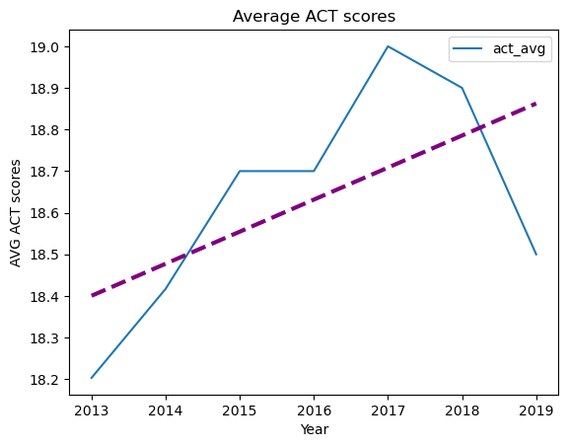
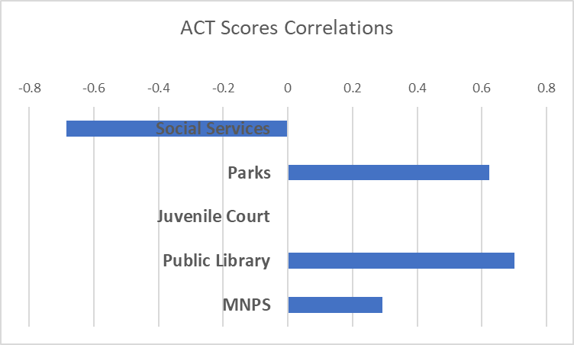
ACT
Composite ACT scores
English, mathematics, reading, science
Scores range from 1 to 36.
Pearson product moment correlation coefficient

Slide 6

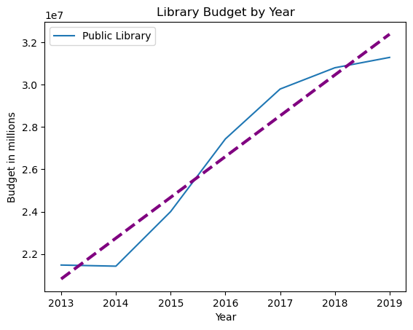
ACT scores vs Library budget spending

Slide 7
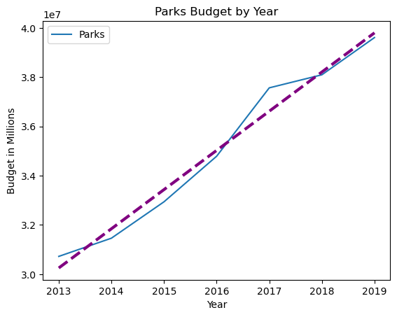
ACT scores vs Parks

Slide 8
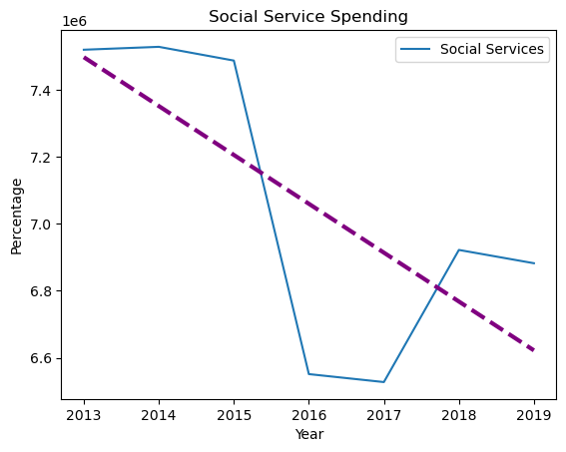
ACT scores vs Social Services

Slide 9
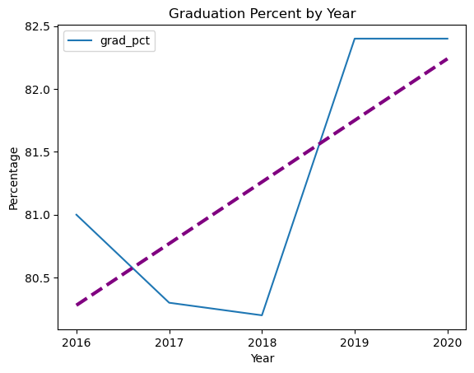
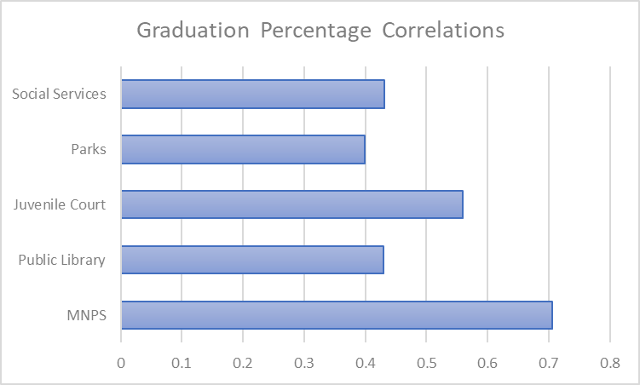
Graduation Rate
Davidson County Graduation Rate
Pearson product moment correlation coefficient

Slide 10
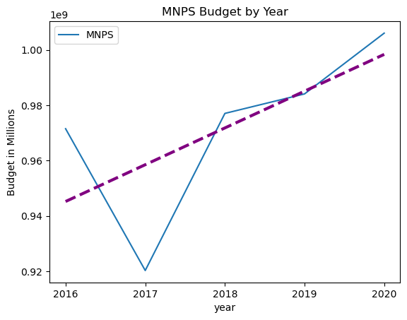
Graduation rate vs MNPS

Slide 11
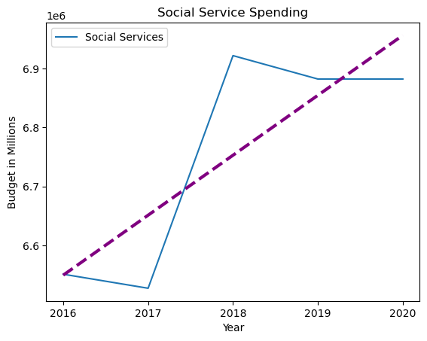
Graduation rate vs Social Services

Slide 12
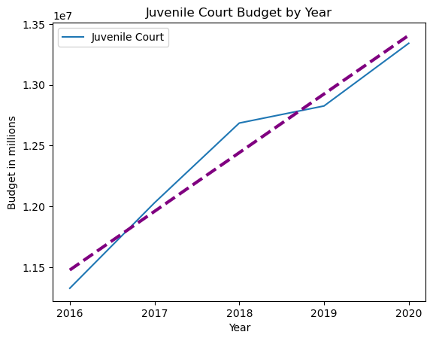
Graduation rate vs Juvenile Court Budget
Juvenile Court

Slide 13
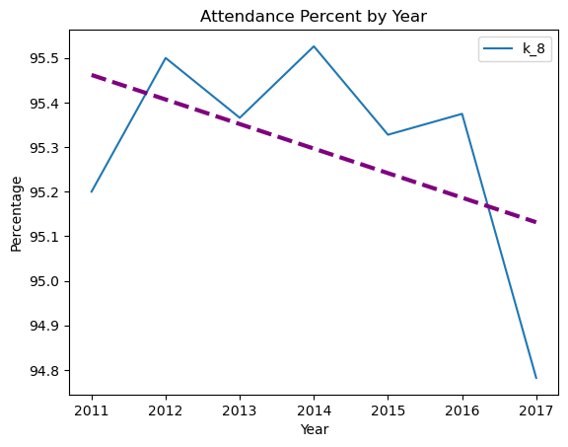
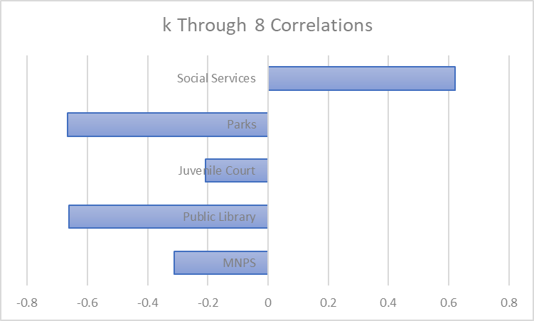
Attendance Kindergarten through 8th
Average percentage of days a student is at school, does not factor in excused absences.
Pearson product moment correlation coefficient

Slide 14
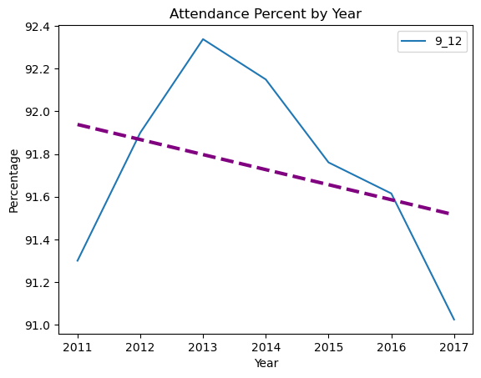
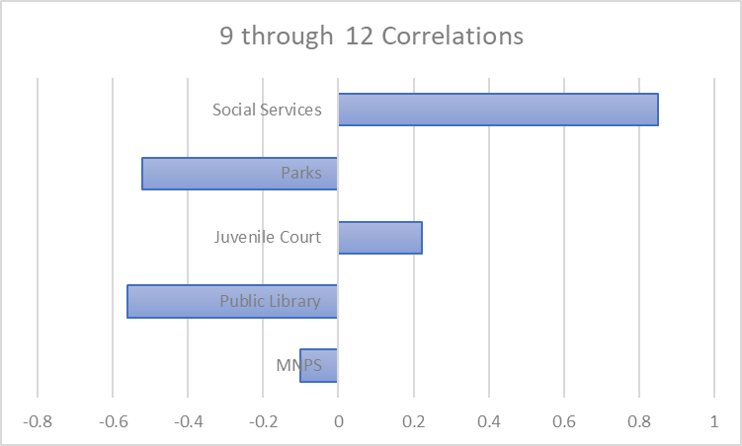
Attendance 9th through 12th
Pearson product moment correlation coefficient

Slide 15
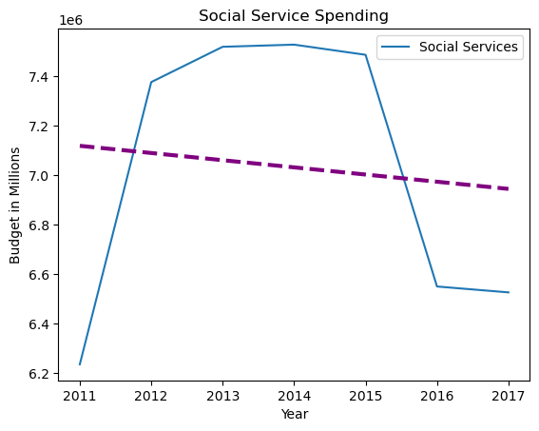
Attendance

Slide 16
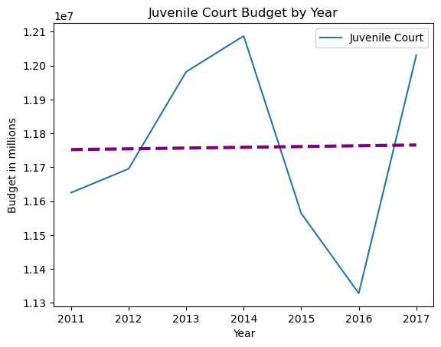
Attendance

Slide 17
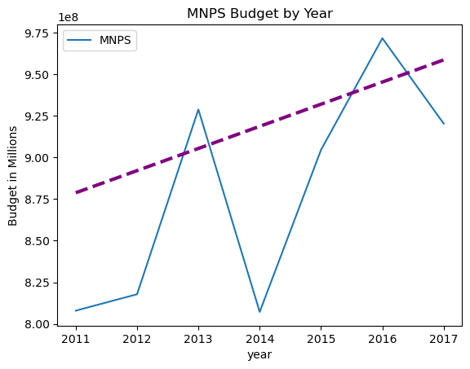
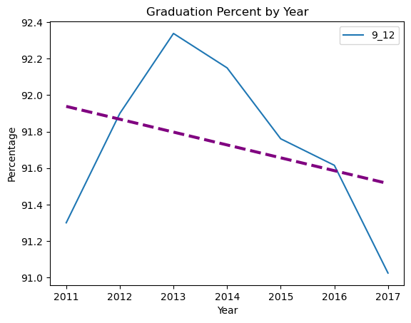

Attendance

Slide 18
Questions?
Thank you for your time!.
Any questions you may think of, please reach out.
Contact Info:
jwhankins177@gmail.com

Slide 19
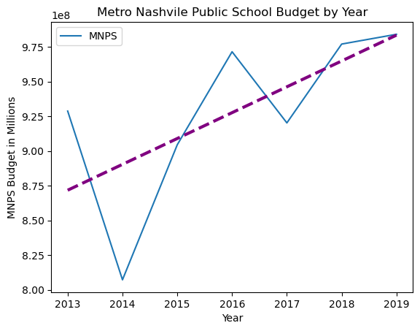
ACT scores vs MNPS

Slide 20
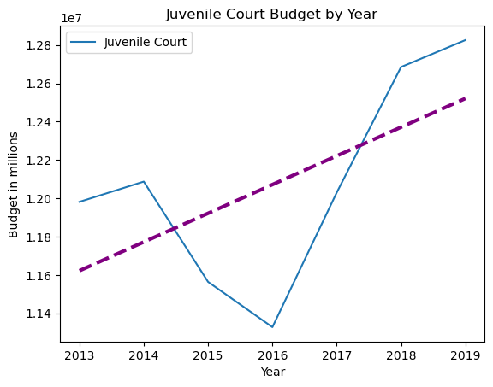
ACT scores vs Juvenile Court

Slide 21
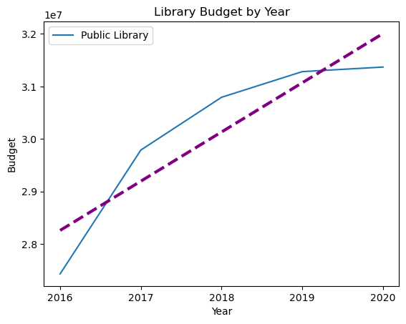
Graduation rate vs Library

Slide 22
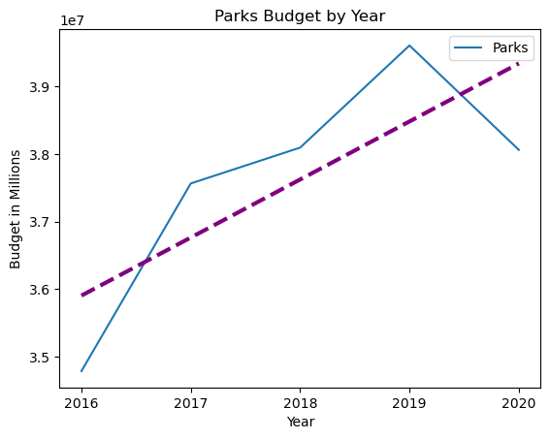
Graduation rate vs Parks Budget

Slide 23
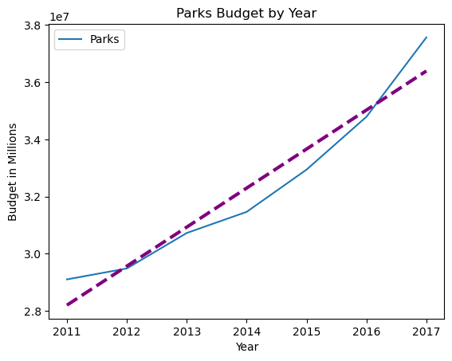
Attendance

Slide 24
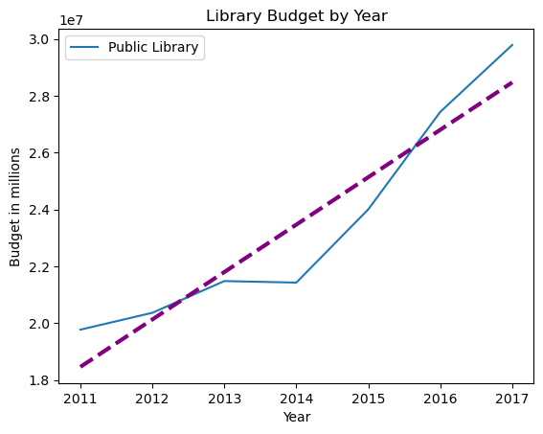
Attendance

