Slide 1
Big Mountain Ticket Price Analysis

Slide 2
PROBLEM STATEMENT:
What opportunities exist for Big Mountain to increase revenue by $1,540,000 increase in expenses this season through cost cutting or increasing ticket prices?
CONTEXT:
Big Mountain Resort has recently installed an additional chair lift that increases operating costs by $1,540,000 this season. Our pricing strategy has been to charge a premium above the average price of resorts in our market segment. There's a suspicion that Big Mountain is not capitalizing on its facilities as much as it could. Basing our pricing on just the market average does not provide the business with a good sense of how important some facilities are compared to others hampering investment strategy. We are looking for guidance on how to select a better value for our ticket price. We are also considering a number of changes that we hope will either cut costs without undermining the ticket price or will support an even higher ticket price.

Slide 3
RECOMMENDATION:
A minimum ticket price increase of $0.88 is required to cover the operating cost ($1.54 million) of the new chair lift while the pricing model suggests that a ticket price of $95.87 could be supported. I recommend a ticket price increase between $1 and $15.
KEY FINDINGS:
The analysis revealed a potential underpricing of tickets at Big Mountain Resort.
Fast Quads, # of runs, snow making coverage, and vertical drop are significant predictors of ticket price.
The random forest model performed the best out of all methods applied in this analysis with a mean CV score of 0.70 and standard deviation of 0.064.
Resorts in Montana share the same weekend and weekday ticket prices.

Slide 4
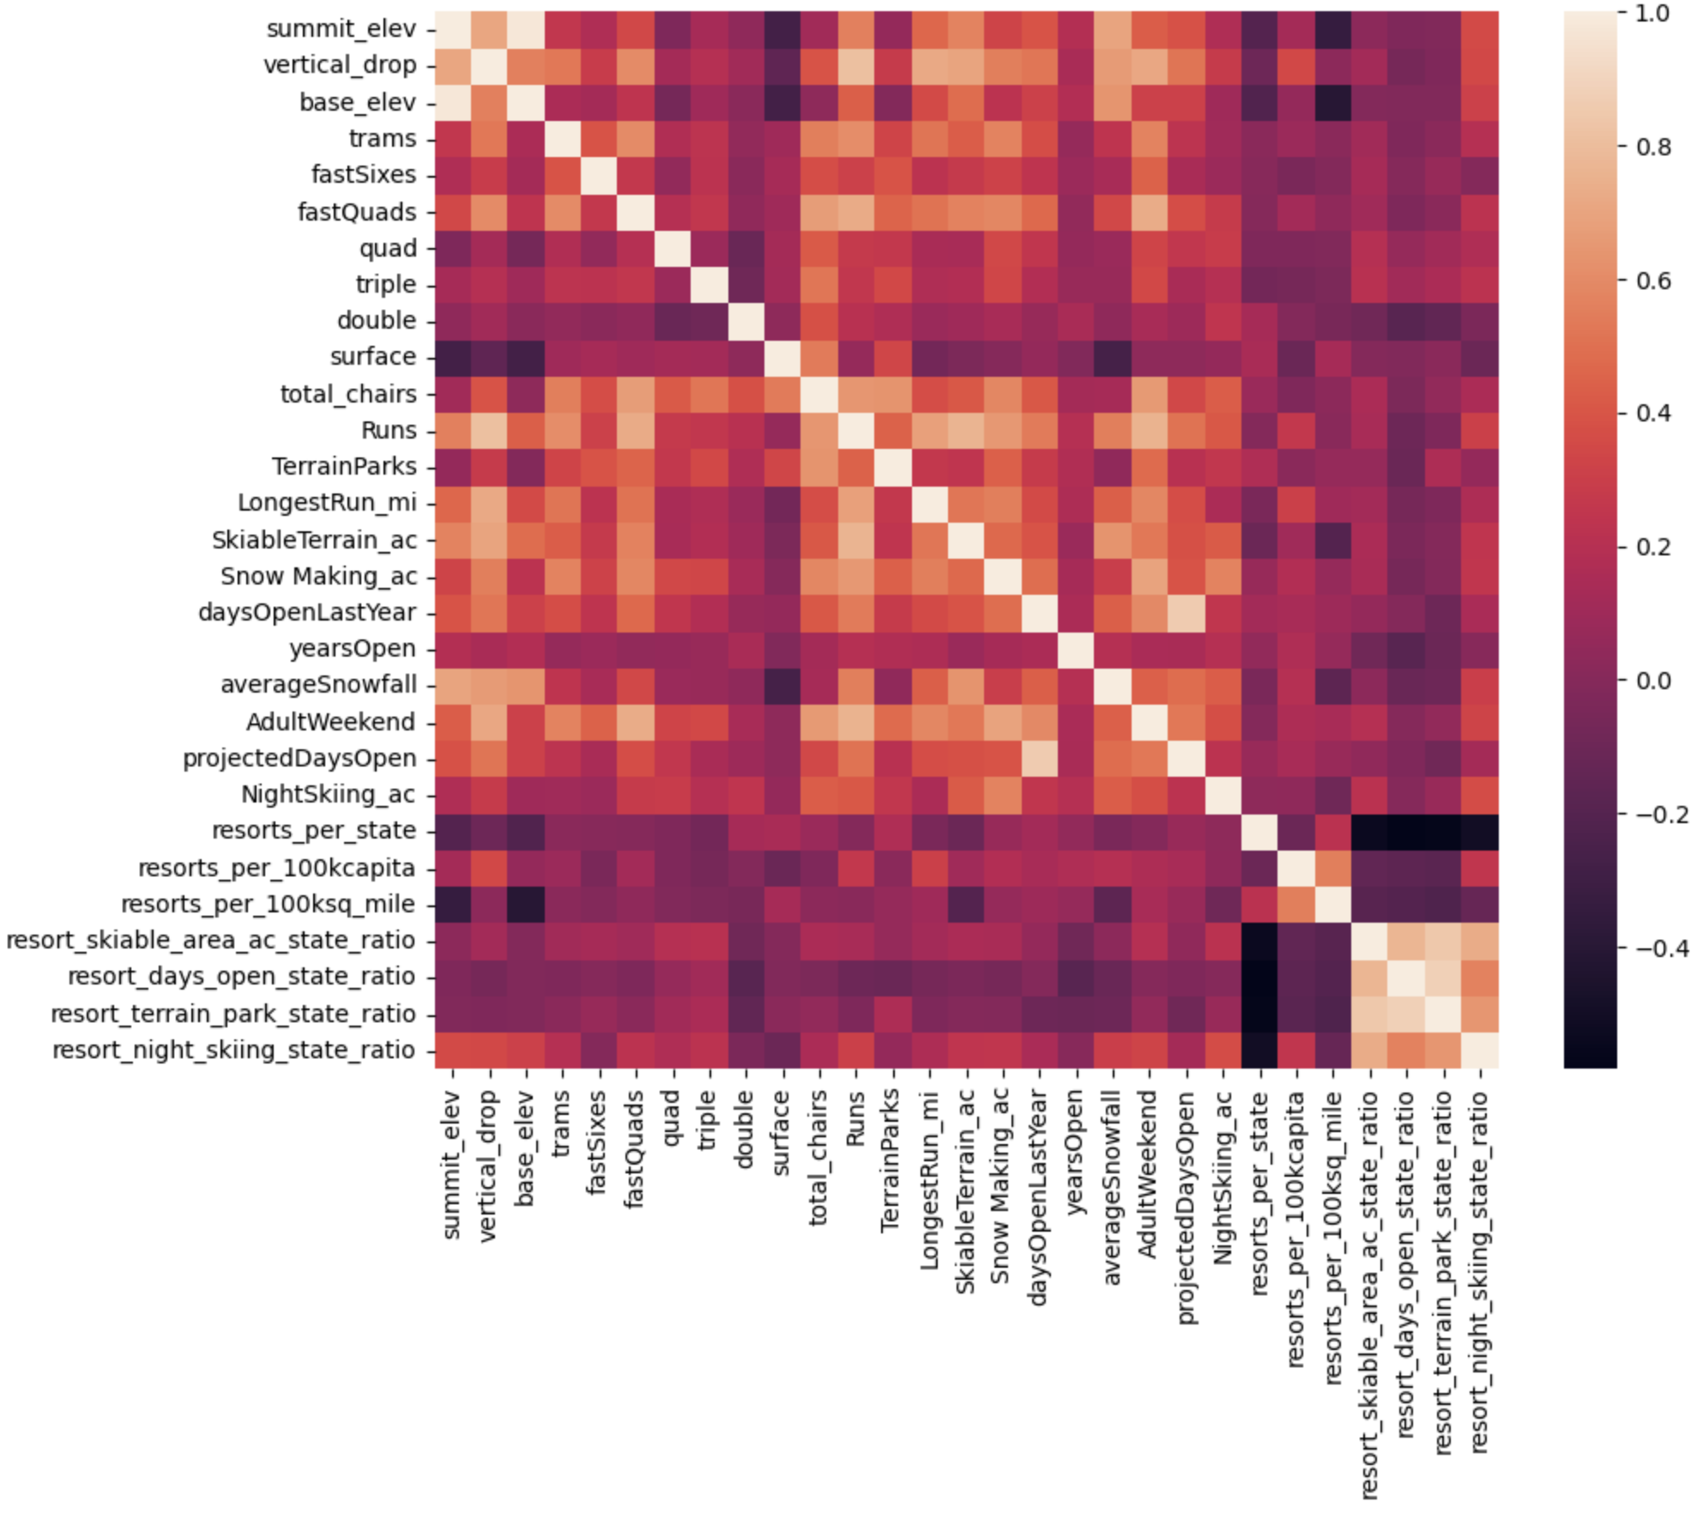
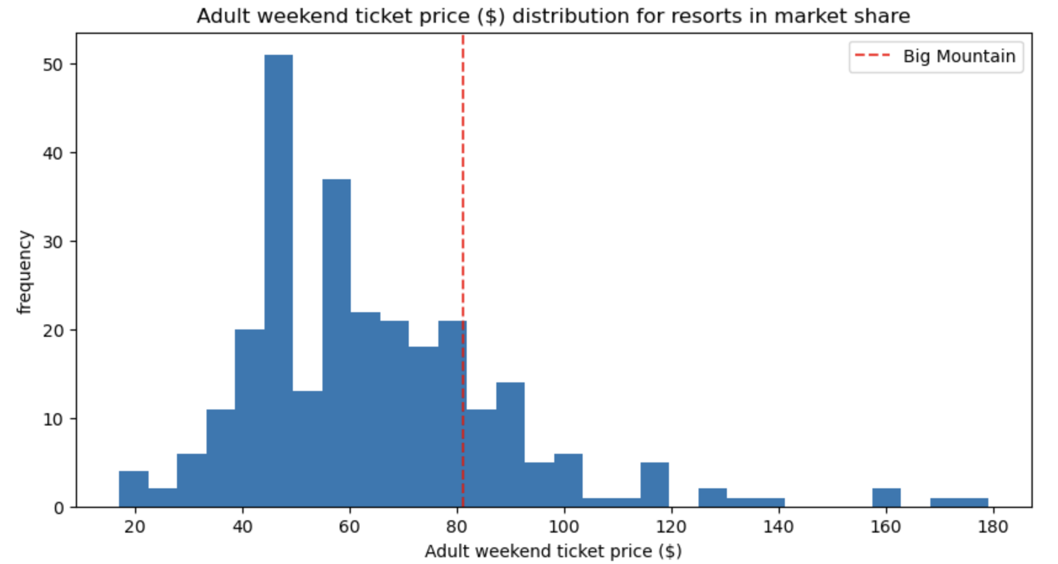
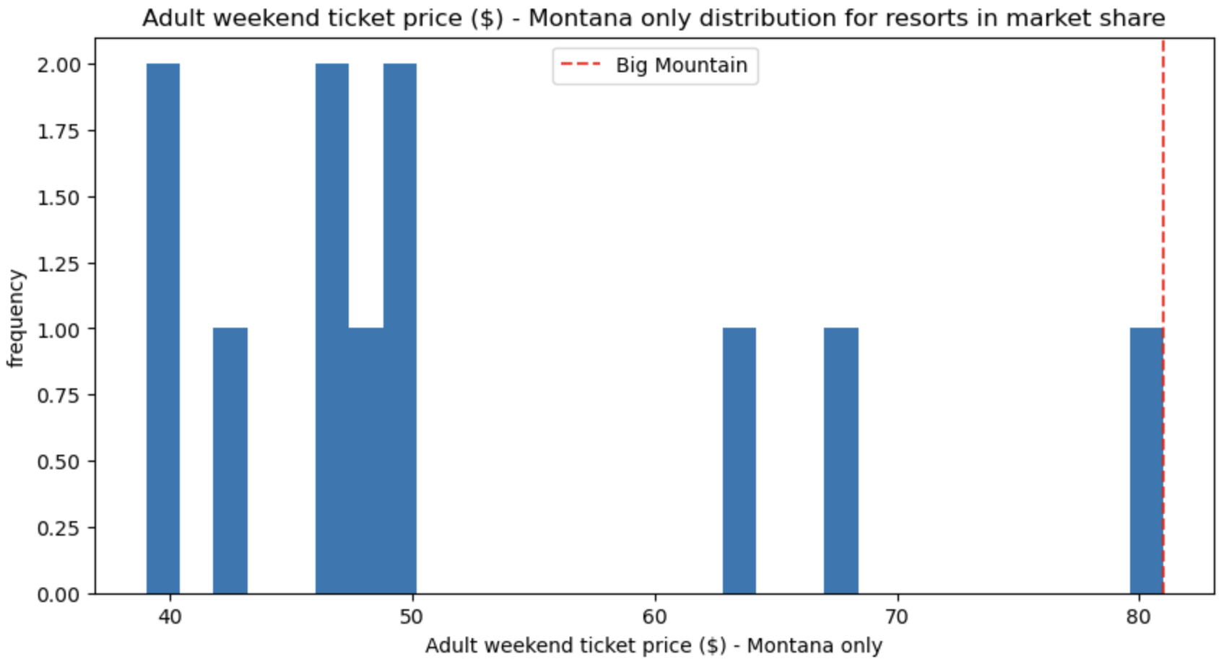
MODELING RESULTS & ANALYSIS

Slide 5
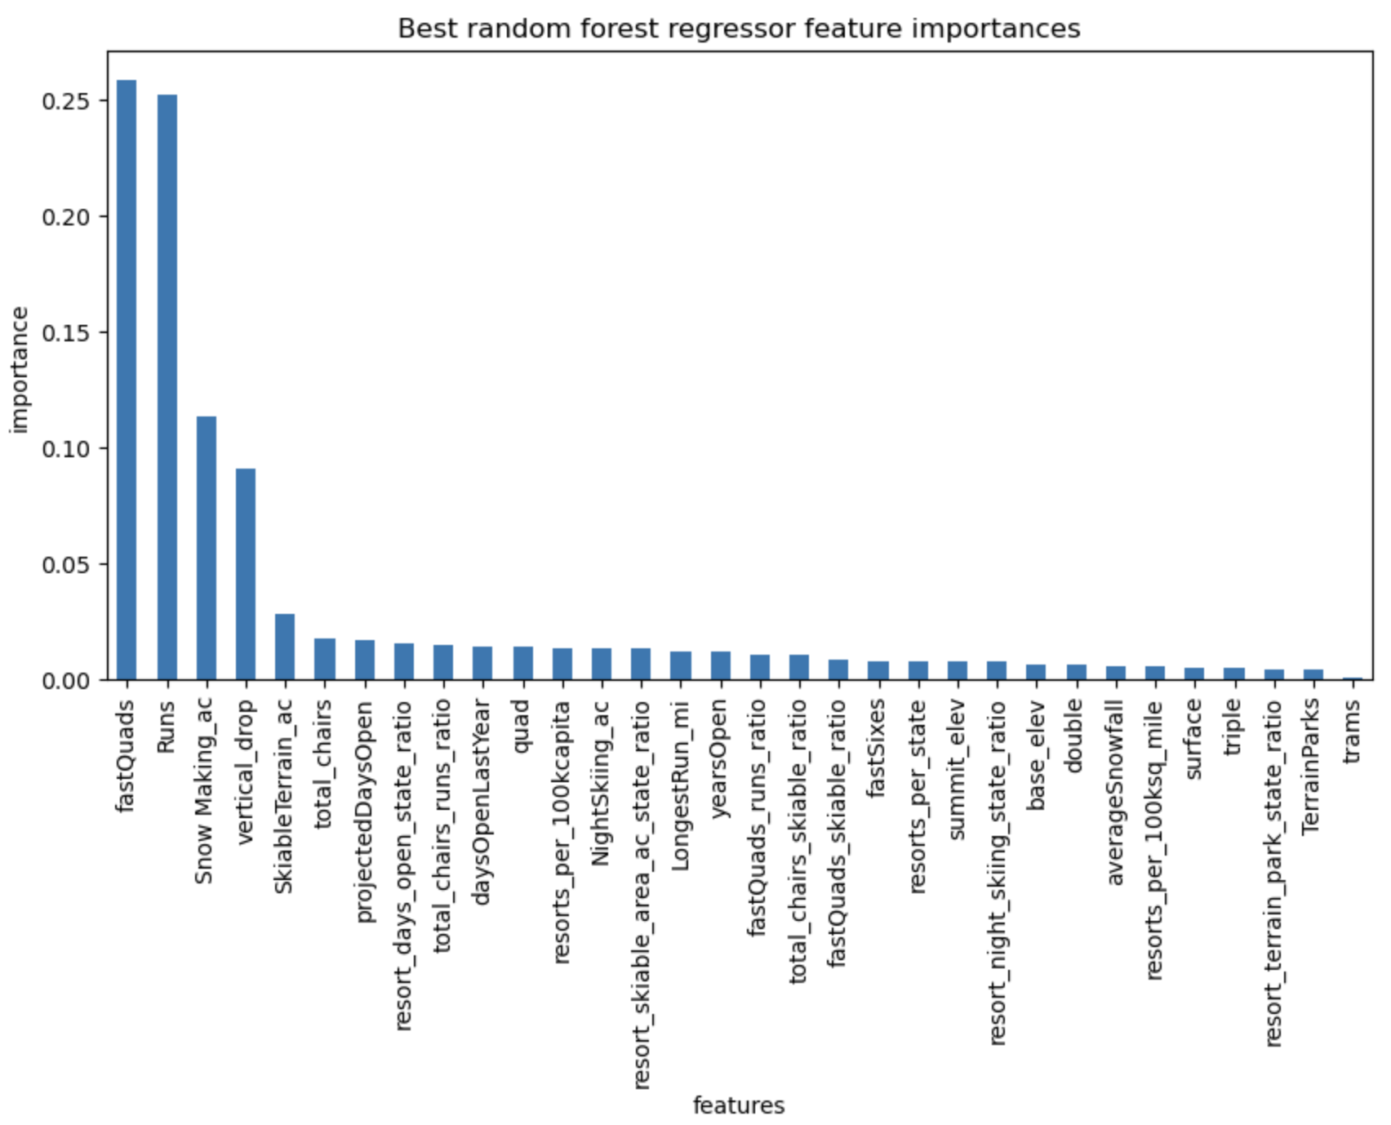
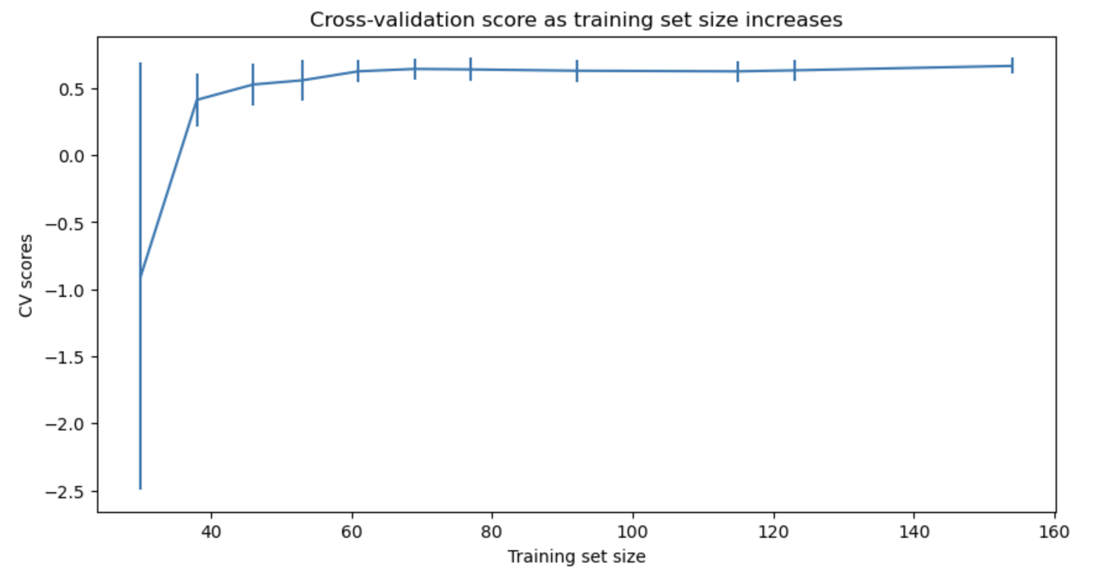
MODELING RESULTS & ANALYSIS
Top Features Determined by Linear Regression:
Vertical drop 10.767857
Snow making area 6.290074
Total chairs 5.794156
Fast quads 5.745626
Runs 5.370555
Longest run 0.181814
Trams -4.142024
Skiable terrain -5.249780
Above: Top features determined by the random forest regression.
Right: CV score showing enough data has been gathered for the analysis as the scores levels out after a sample size of 40-50.

Slide 6
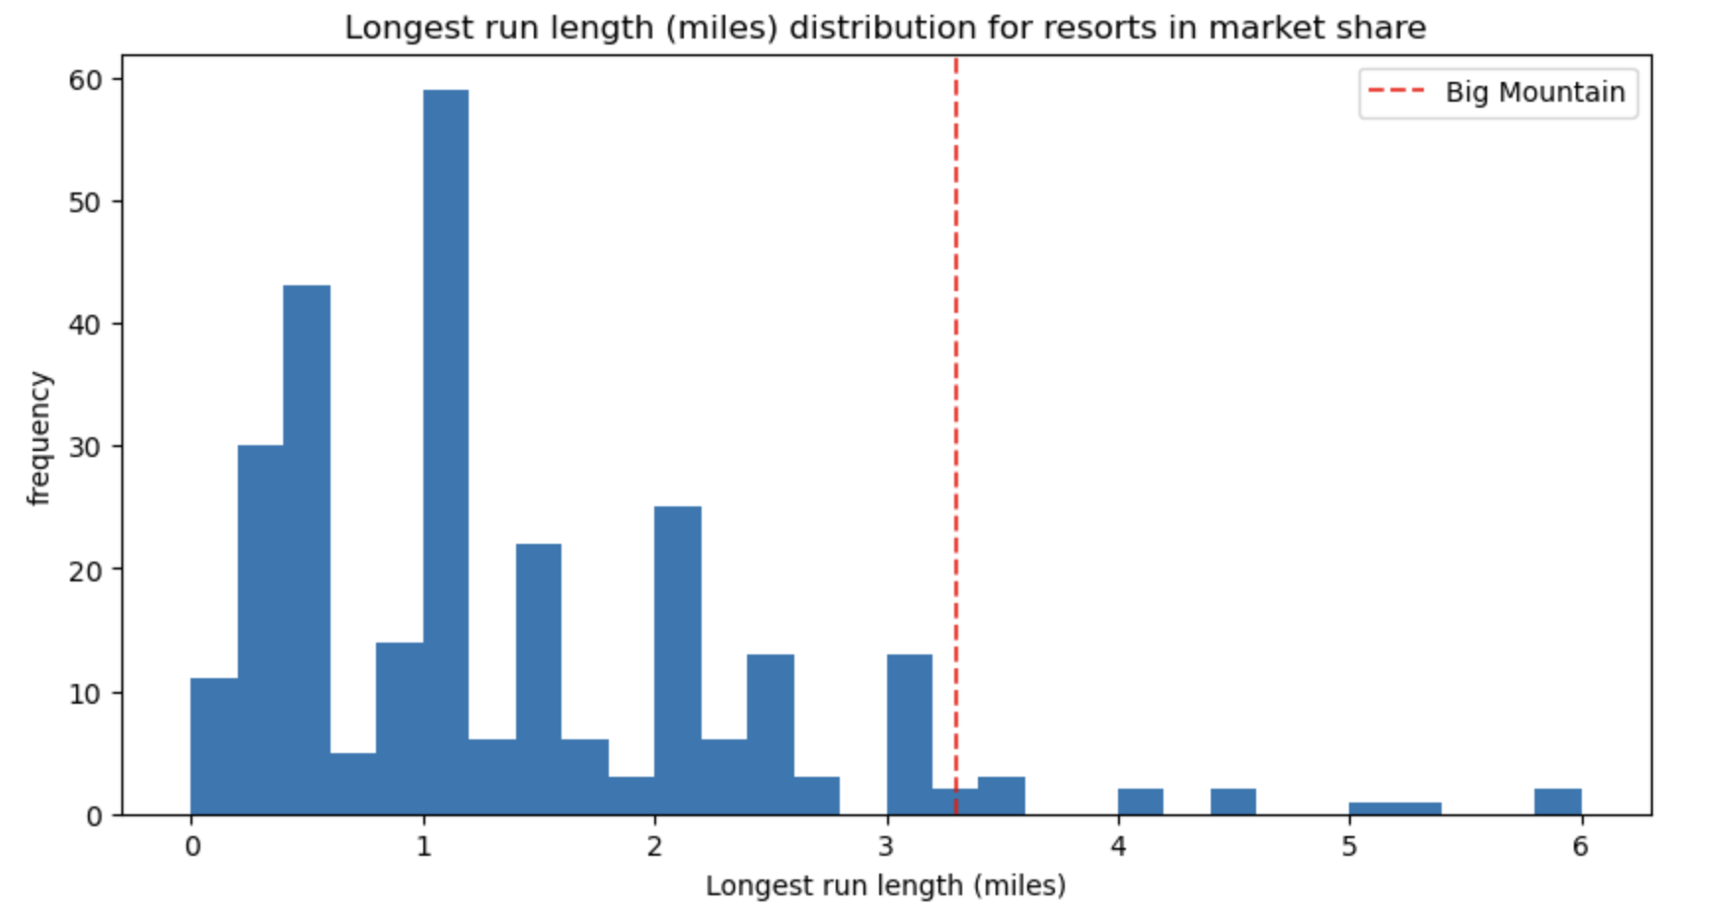
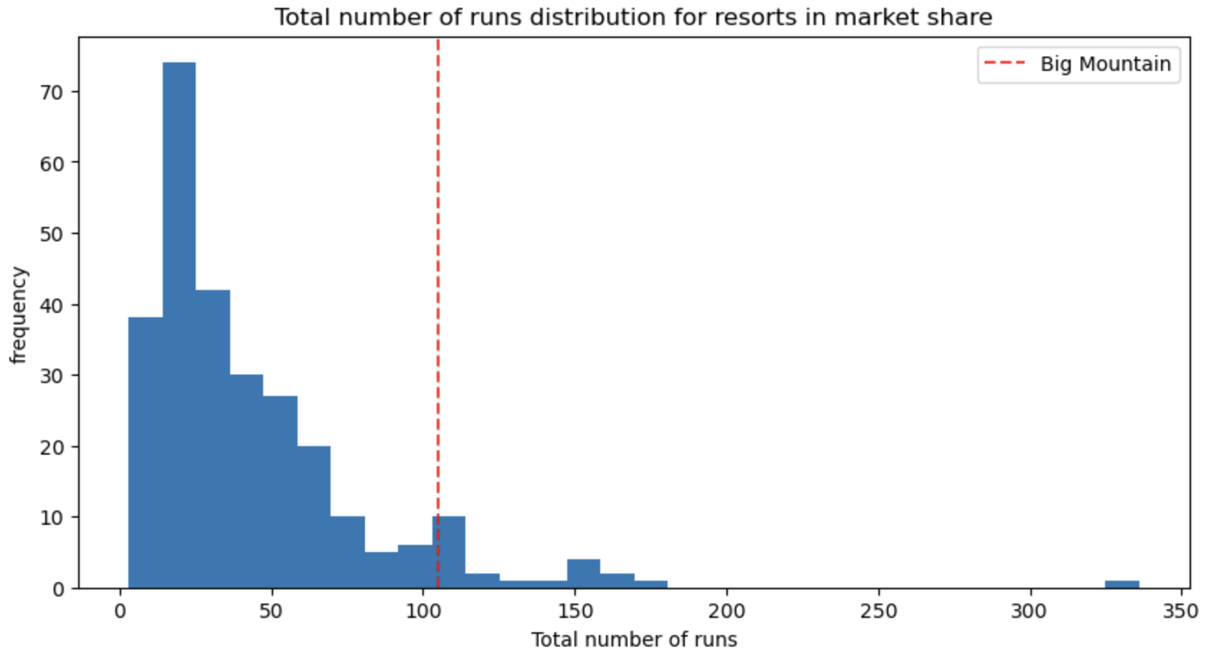
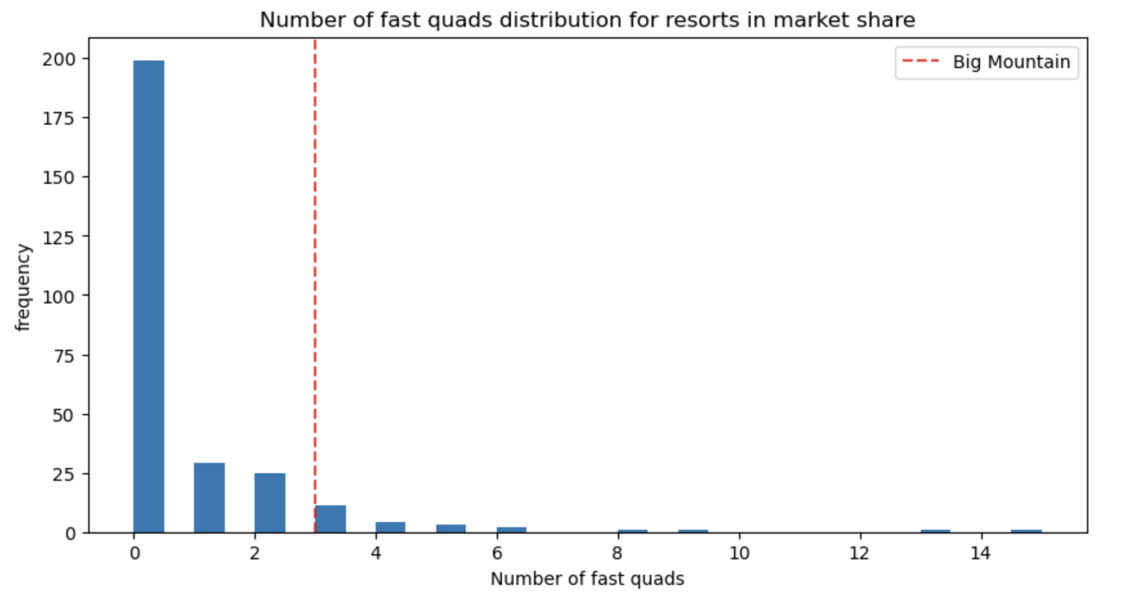
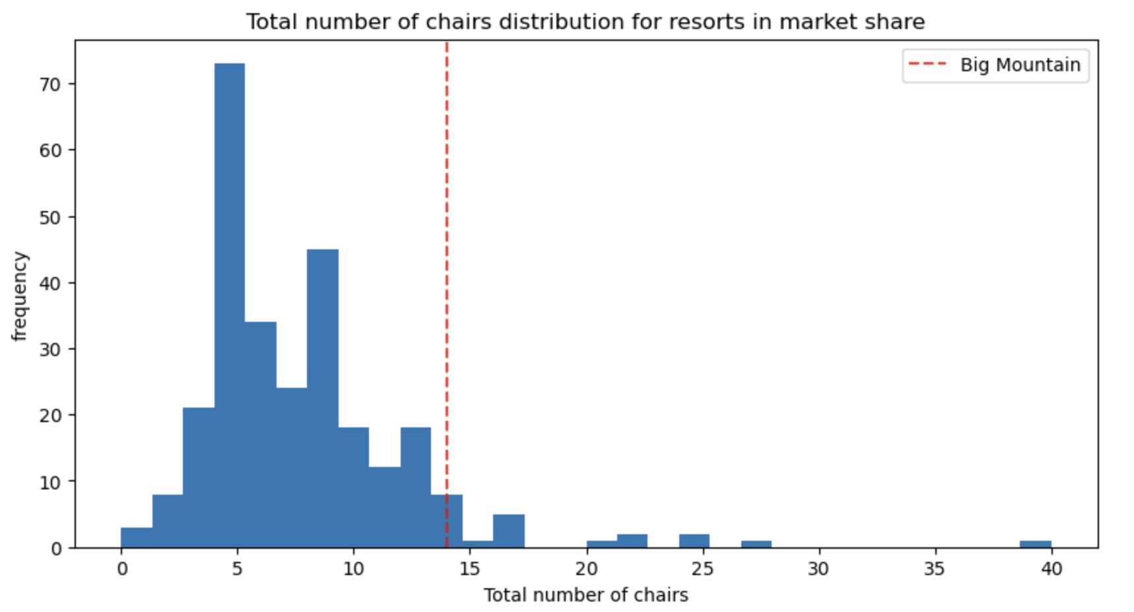
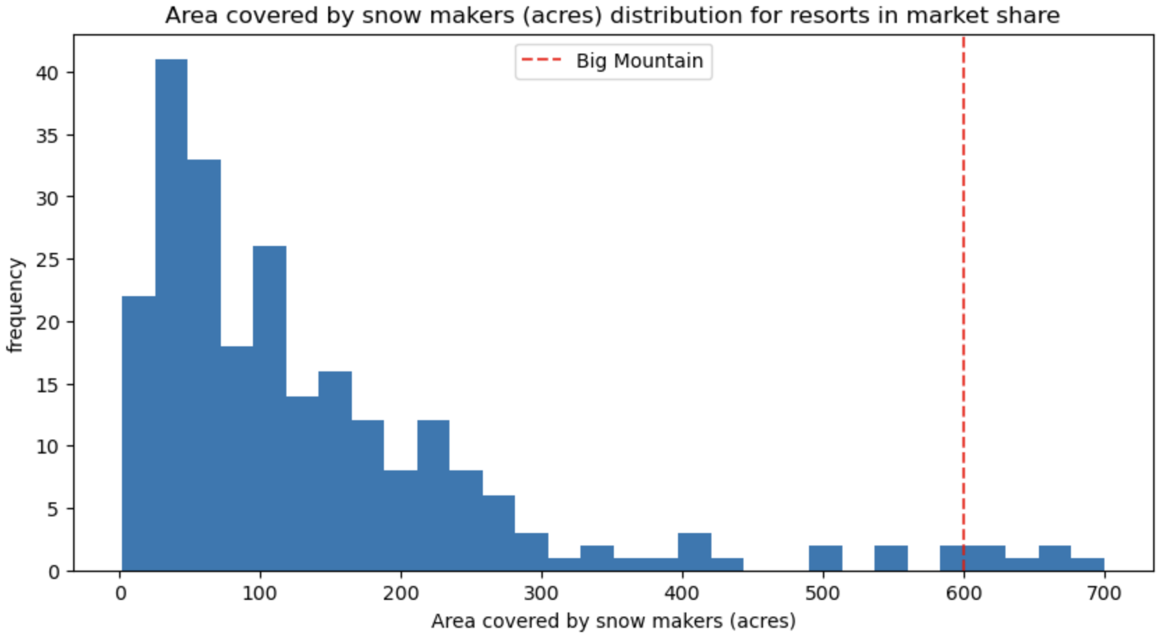
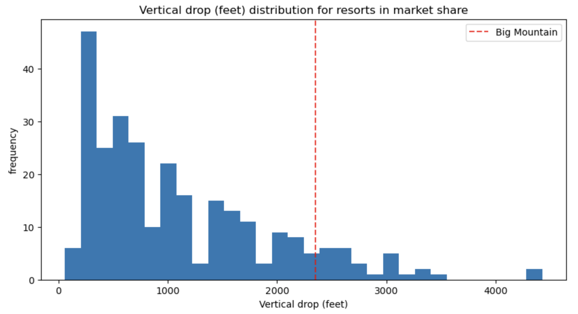
MODELING RESULTS & ANALYSIS

Slide 7
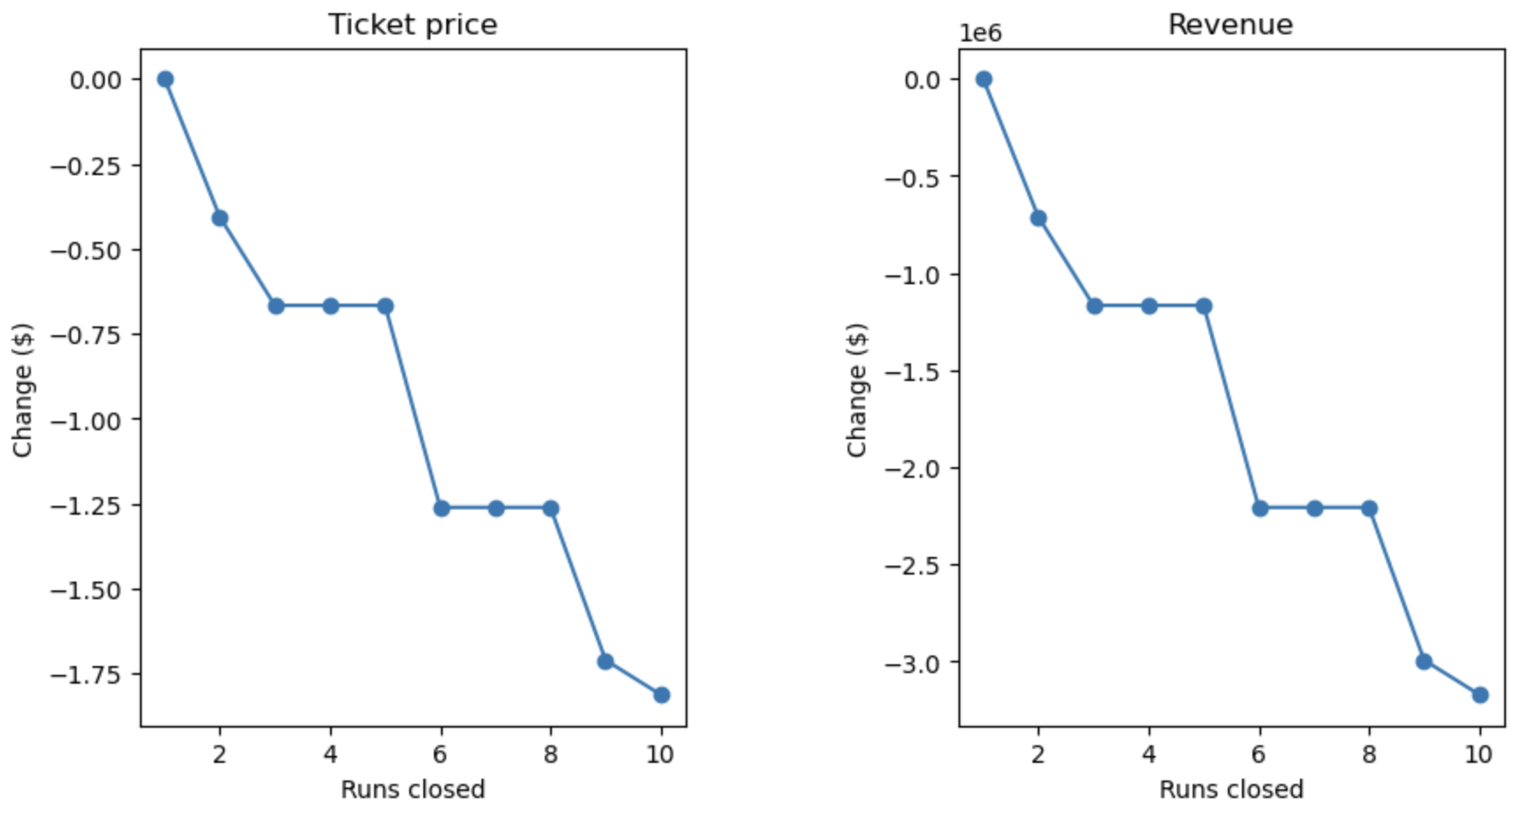
Scenario 1
Permanently closing down up to 10 of the least used runs.
Scenario 2
Big Mountain is adding a run, increasing the vertical drop by 150 feet, and installing an additional chair lift.
RESULT:
This scenario increases support for ticket price by $8.61
Over the season, this could be expected to amount to $15,065,471.
Scenario 3
Big Mountain is adding a run, increasing the vertical drop by 150 feet, installing an additional chair lift, and adding 2 acres of snow making.
RESULT:
This scenario increases support for ticket price by $9.90
Over the season, this could be expected to amount to $17,322,717.
Scenario 4
Increase the longest run by 0.2 mile to boast 3.5 miles length, requiring an additional snow making coverage of 4 acres.
RESULT:
No difference whatsoever. Although the longest run feature was used in the linear model, the random forest model (the one we chose because of its better performance) only has longest run way down in the feature importance list.

Slide 8
Summary & Conclusion
We need to increase ticket price by at least $0.88 to recoup $1.54 million assuming 350,000 skiers this season on average purchasing 5 day passes.
Big Mountain ranks fairly high on many of the league charts of facilities offered. This along with the modeling results suggest a price increase is warranted.
The random forest model is currently the best method for predicting ticket price.
The addition of operating costs and visitor satisfaction scores in future models could help refine the model to be more effective with predictions.

