Slide 1
Introduction to the Hydrologic Cycle
Today’s Agenda:
Syllabus
Class Expectations
Class overview and definitions
Hydrologic Cycle

Slide 2
Professor: Dr. James Heiss
Office: Olney Hall 102C
Email: james_heiss@uml.edu
Class meetings: MWF noon-12:50pm
Office hours: I will be available to answer questions during scheduled office hours:
M 1-2pm, F 9:30-10:30am, or my appointment
Email: james_heiss@uml.edu - start subject with “GEOL3140S19”

Slide 3
Overview
The objective of this course is to provide the fundamentals of the role of groundwater in the water cycle. Students will be provided with real world skills needed to work in the field of groundwater hydrology and enroll in advanced groundwater courses.
Topics:
Surface water hydrology
Water budgets
Principles of groundwater flow
Groundwater mapping
Aquifers
Groundwater wells
Groundwater modeling
Groundwater chemistry
Solute transport
Unsaturated flow
Groundwater-surface water interactions
Coastal hydrogeology

Slide 4
Learning Outcomes
After successful completion of this course you will be able to:
Explain and demonstrate proficiency of major concepts/skills of GIS, spatial data, attribute data, data structures, coordinate systems, data projection, spatial analysis, vector and raster datasets, metadata, and several analytical GIS tools
Navigate within the ArcGIS software environment and perform introductory-level analytical skills such as joining data, creating buffers, digitizing, georeferencing, and conducting geospatial queries, performing raster and terrain analysis
Distinguish between spatial and attribute data
Differentiate vector and raster data and how the data type affects storage, display, and analysis
Collect, process, and analyze geospatial data
Discuss the strengths and weaknesses of GIS for spatial analysis

Slide 5

Textbook
A textbook is not required but will be very helpful when completing problem sets, studying, and having a resource in the future. The two de facto texts are:
Applied Hydrogeology, by C.W. Fetter, Prentice Hall, Inc., Fourth Edition, 2001 (industry standard)
Groundwater, by R.A. Freeze and J.A. Cherry, Prentice Hall, Inc, 1979 (Prior to Fetter, this was the go-to book. It is still super relevant and it is now free! http://hydrogeologistswithoutborders.org/wordpress/1979-english/

Slide 6
Learning outcomes
Understand the distribution and movement of water through components of the hydrological cycle on various scales
Understand the various hydrogeologic properties of aquifers
interpret measurements of hydraulic head and generate water table maps and hydrogeologic cross‑sections
Use the principles of groundwater flow, including Darcy’s Law, to solve groundwater flow problems
Measure aquifer properties through well testing
Measure/acquire and analyze hydrogeological data
Understand the basic chemical processes that control groundwater chemistry and water quality
Understand the strengths and weaknesses associated with groundwater modeling
Identify, formulate, and solve introductory groundwater hydrology problems

Slide 7
Course Requirements
Problem sets
Problem Sets are intended to demonstrate or reinforce concepts or skills learned in class or during field trips. In some cases we will go over the assignments in class on the due date. For this reason completed assignments are due at the beginning of the class period on the due date. In-class assignments fall under the Problem Set category. Any student not present in class who does not turn in a Problem Set on the due date without contacting me beforehand will receive a zero. Problem Sets will not be accepted by email.
Exams
This course includes two exams and one final exam. The final exam will be heavily weighted toward material in the last 1/3 of the semester, but will draw on material from the first 2/3 of the semester. Attendance is mandatory for all exams. Any discussion about missing an exam must occur prior to the exam.
Group Aquifer Project
This 2-3-student group project requires independent literature research on a world aquifer system, a short presentation, and a short paper.

Slide 8
Expectations
All plots and diagrams should have appropriate labels (with units) on all axes and a title or caption clearly describing what is plotted. All values should have units unless the value is unitless. All work should be shown on assignments and exams.
Each student is responsible for completing their own work. You are encouraged to collaborate with and help one another and to use the resources available to you, including lecture material, the textbook, outside sources (internet, academic papers, other texts). Write names of collaborators on the top of each Problem Set. Your work should not be identical to work turned in by others.
Please bring a pencil, pen, ruler, and calculator to each class.

Slide 9
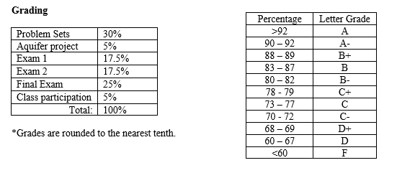
Evaluation

Slide 10
Additional expectations
Familiarity with (be comfortable applying) Math
Dimensional analysis
e.g. I drove @ 72 mph for 15 hours with two one-hour long stops. How many km did I travel?
Scientific notation
300 = 3x10² = 3e2
3.243 * 1.0x10³ =

Slide 11
Additional expectations
Familiarity with (be comfortable using) Excel
Excel
Formulas, fill down, absolute reference ($)
Plots
Type: scatter vs line
Connector: lines vs dots vs curves (never use curves, they imply fake data!)
Labels and titles (label your axes!)
Captions (if you’re including it in a document, caption it!)

Slide 12
 | precip (cm) | mean temp (f)
Jan | 12 | 22
Feb | 13 | 25
Mar | 11 | 34
Apr | 15 | 50
May | 20 | 52
Jun | 25 | 63
Jul | 25 | 72
Aug | 17 | 76
Sep | 23 | X
Oct | 18 | 57
Nov | 17 | 50
Dec | 13 | 38

Slide 13
 | precip (cm) | mean temp (f)
Jan | 12 | 22
Feb | 13 | 25
Mar | 11 | 34
Apr | 15 | 50
May | 20 | 52
Jun | 25 | 63
Jul | 25 | 72
Aug | 17 | 76
Sep | 23 | X
Oct | 18 | 57
Nov | 17 | 50
Dec | 13 | 38

Slide 14
 | precip (cm) | mean temp (f)
Jan | 12 | 22
Feb | 13 | 25
Mar | 11 | 34
Apr | 15 | 50
May | 20 | 52
Jun | 25 | 63
Jul | 25 | 72
Aug | 17 | 76
Sep | 23 | X
Oct | 18 | 57
Nov | 17 | 50
Dec | 13 | 38

Slide 15
 | precip (cm) | mean temp (f)
Jan | 12 | 22
Feb | 13 | 25
Mar | 11 | 34
Apr | 15 | 50
May | 20 | 52
Jun | 25 | 63
Jul | 25 | 72
Aug | 17 | 76
Sep | 23 | X
Oct | 18 | 57
Nov | 17 | 50
Dec | 13 | 38

Slide 16
 | precip (cm) | mean temp (f)
Jan | 12 | 22
Feb | 13 | 25
Mar | 11 | 34
Apr | 15 | 50
May | 20 | 52
Jun | 25 | 63
Jul | 25 | 72
Aug | 17 | 76
Sep | 23 | X
Oct | 18 | 57
Nov | 17 | 50
Dec | 13 | 38

Slide 17
Email

Slide 18
Professionalism when using email:
Emails should include:
A descriptive subject line GEOL3140 S19 – Question on homework due next Weds
A greeting Professor,
Dr. Heiss,
Body of text I am working on the current assignment and have a few questions. Do you have any time to meet on Thursday between 12 and 4 or Friday after 11?
Closing Thank you,
Enthusiastic Hydro Student

Slide 19
Professionalism when using email:
Inappropriate emails:
Hey sorry I wasn’t in class today. Just wanted to check that I didn’t miss anything important??
Hi I need to meet with you tomorrow asap can you let me know when you’re available?
Hello, when is the homework due?

Slide 20
I will make every effort to respect your time and energy.
I respect your right to a timely and helpful email response. I respond to emails Monday through Friday from 9am through 5pm. I make every effort to respond within one day.
I also ask that you check your own email once each week day. Any changes to class will be communicated via email.

Slide 21
Any questions?
(I like feedback)

Slide 22
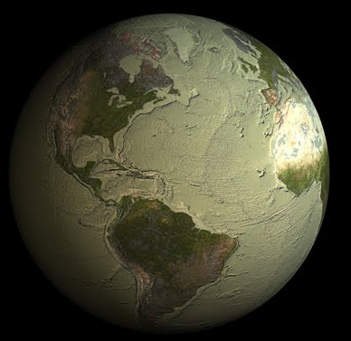

Slide 23
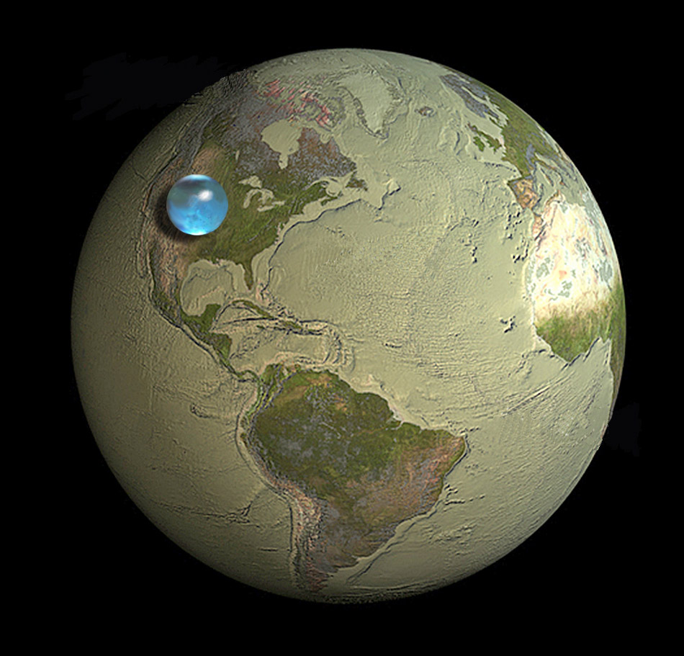
Credit: Howard Perlman, USGS; globe illustration by Jack Cook, Woods Hole Oceanographic Institution (©); Adam Nieman. Data source: Igor Shiklomanov's chapter "World fresh water resources" in Peter H. Gleick (editor), 1993, Water in Crisis: A Guide to the World's Fresh Water Resources (Oxford University Press, New York).

Slide 24
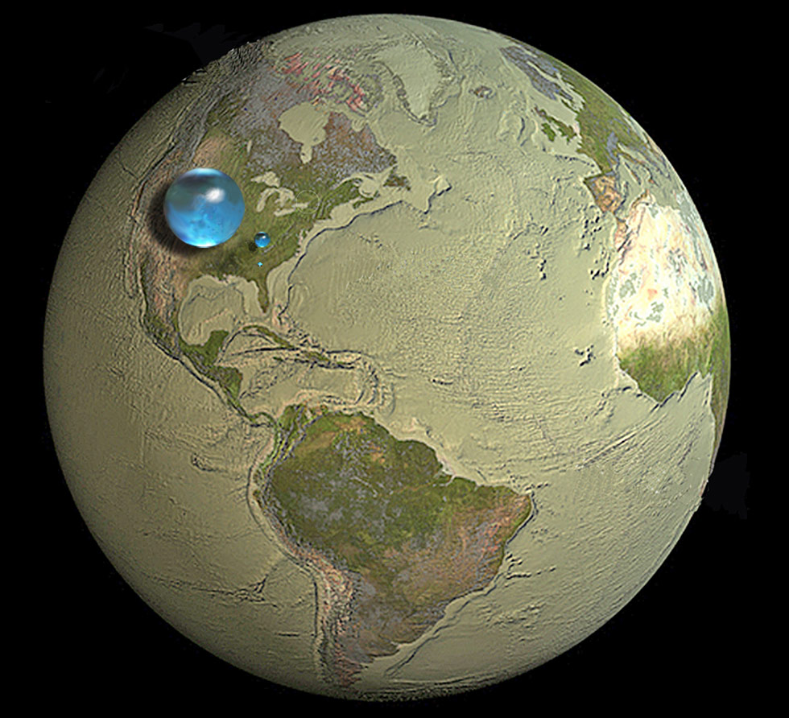
Credit: Howard Perlman, USGS; globe illustration by Jack Cook, Woods Hole Oceanographic Institution (©); Adam Nieman. Data source: Igor Shiklomanov's chapter "World fresh water resources" in Peter H. Gleick (editor), 1993, Water in Crisis: A Guide to the World's Fresh Water Resources (Oxford University Press, New York).

Slide 25
Definitions
Water on Earth
Hydrology →
Hydrogeology →
[Google]

Slide 26
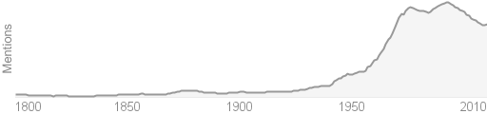
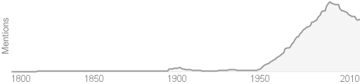
Definitions
Water on Earth
Hydrology → Occurrence, distribution, movement, and chemistry of all waters of earth system
Hydrogeology → Interactions of water with geologic materials
syn: groundwater hydrology, geohydrology
Includes saturated and unsaturated zone
word frequency over time ➔
[Google]

Slide 27
The total usable freshwater supply for ecosystems and people is around 200,000 km³ of water, which is less than one percent of all freshwater resources.
Source: Adapted from Peter H. Gleick. The World's Water 2000-2001. Washington, DC: Island Press, 2000.

Slide 28
Parameter | Equivalent Depth (m)* | Approximate Residence Time
Oceans and seas | 2500 | 4000 years
Lakes and reservoirs | 0.25 | 10 years
Swamps | 0.007 | 1 to 10 years
River channels | 0.003 | 2 weeks
Soil moisture | 0.13 | 2 weeks to 1 year
Groundwater | 120 | 2 weeks to 10 000 years
Ice caps and glaciers | 60 | 10 to 1000 years
Atmospheric water | 0.025 | 10 days
Biospheric water | 0.001 | 1 week
* Computed as though storage were uniformly distributed over the entire surface of the earth. Source: Adapted from R. Allen Freeze and John A. Cherry, Groundwater. Prentice-Hall: Englewood Cliffs, New Jersey, 1979: p.5.

