Slide 1
Things I do
Data access
  WRDS
  Hyak
  Nielsen
  Pitchbook
Statistical programming
  Python
  R
  SAS
  Stata
  SPSS
Research consulting
  Data acquisition
  Data management
  Data purchasing
  Statistical analyses
  Text analytics
  Web scraping
Qualtrics
  Account management
  Survey design

Slide 2
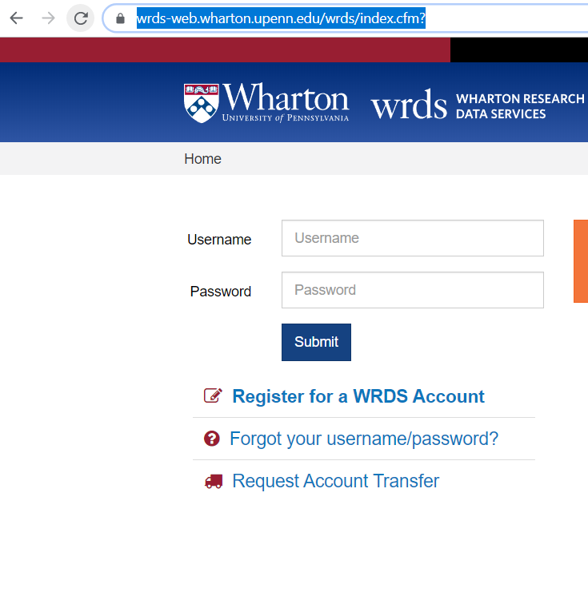
Creating or Transferring WRDS accounts
Access via web/SSH/FTP/SAS/R/Python/Stata
SAS Studio, Rstudio, Jupyter Notebooks
750MB of disk pace on WRDS cloud
Must be renewed every 2 years for PhD, 5 years for faculty

Slide 3
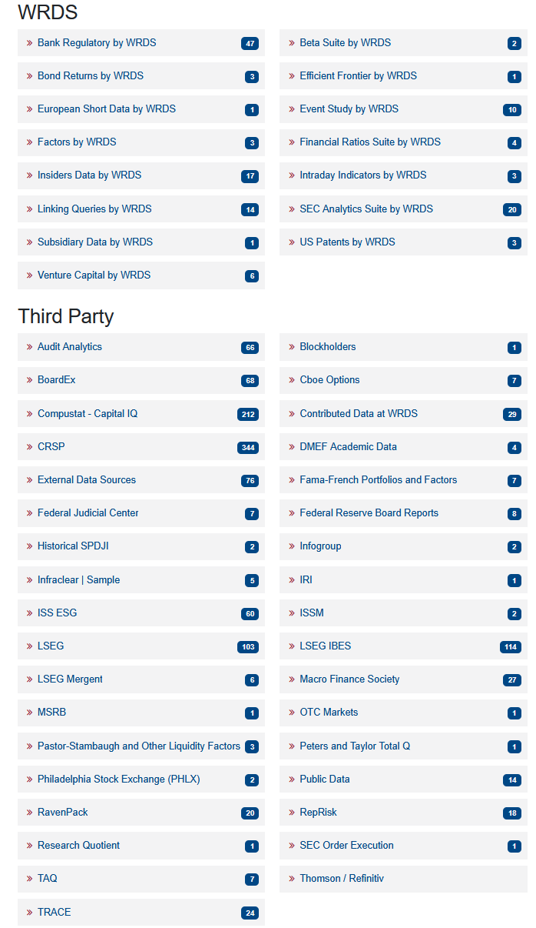
Wharton Research Data Services

Slide 4
Company Financials
Compustat
  Fundamentals Annual/Quarterly
  Bank Financials
  Industry- and Segment-specific data
IBES
  Analyst estimates
  Actuals/Restated actuals

Slide 5
Security Pricing
CRSP
  Daily/Monthly Open/Hi/Lo/Close
  Stock and Index Returns
  Quarterly and Annual updates
Compustat
  Some pricing and volume information, not as comprehensive as CRSP and only quarterly/annually
LSEG Refinitiv Datastream
  Includes international exchanges
TAQ
  Millisecond intraday bid/ask pricing

Slide 6
Executive Compensation and Board membership
Compustat- Execucomp
  C-Suite
  Board membership
BoardEx
  Strong person-level data
ISS/Riskmetrics
  Director compensation
  Shareholder proposals

Slide 7
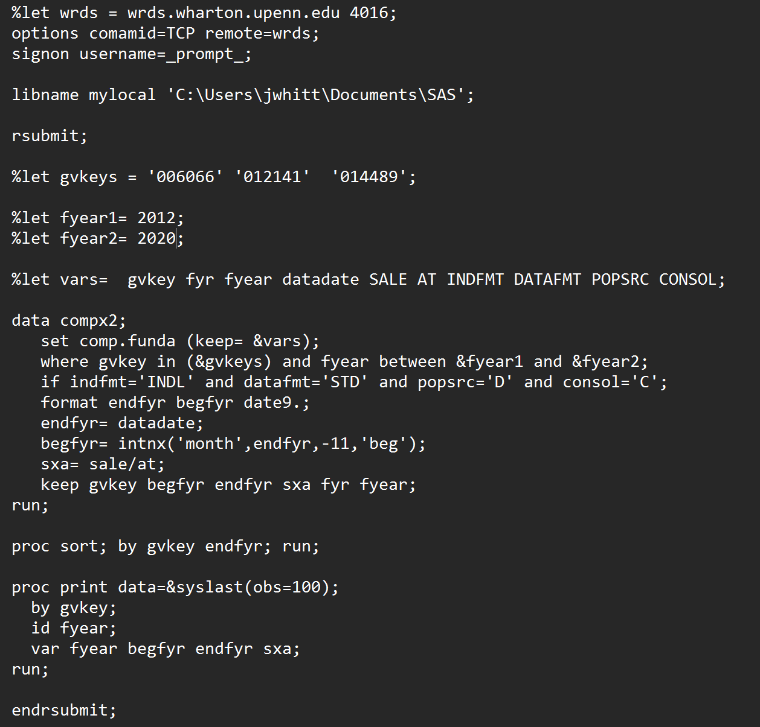
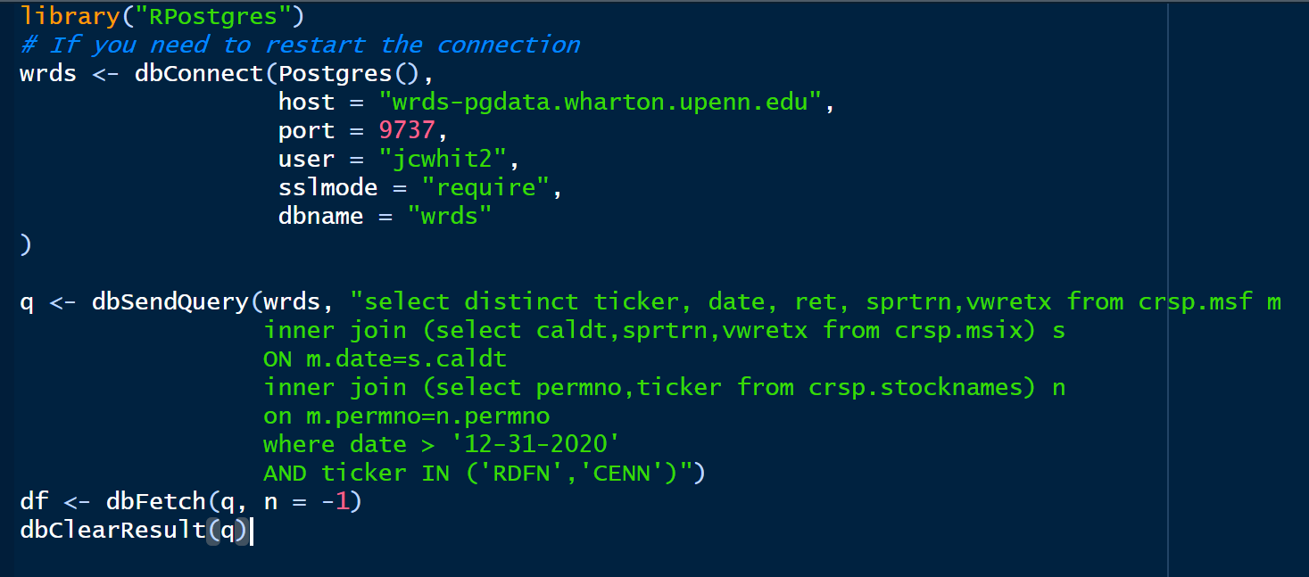
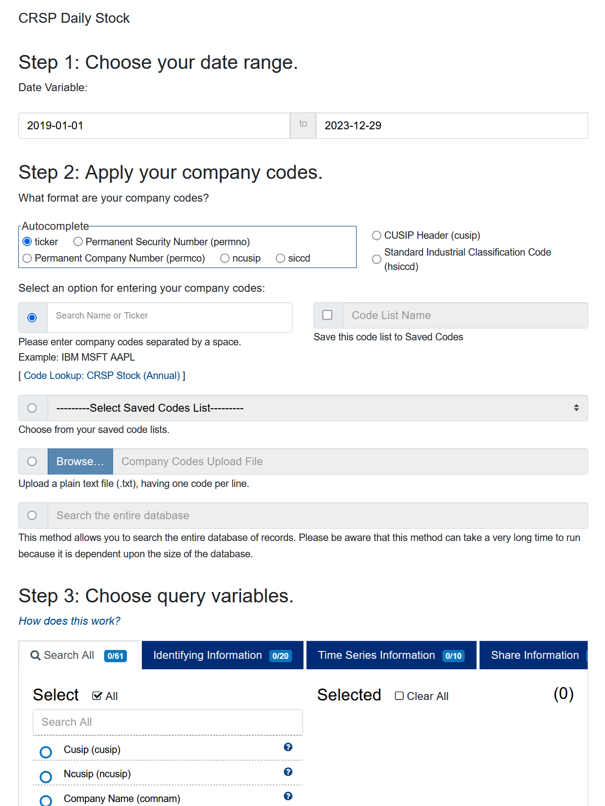
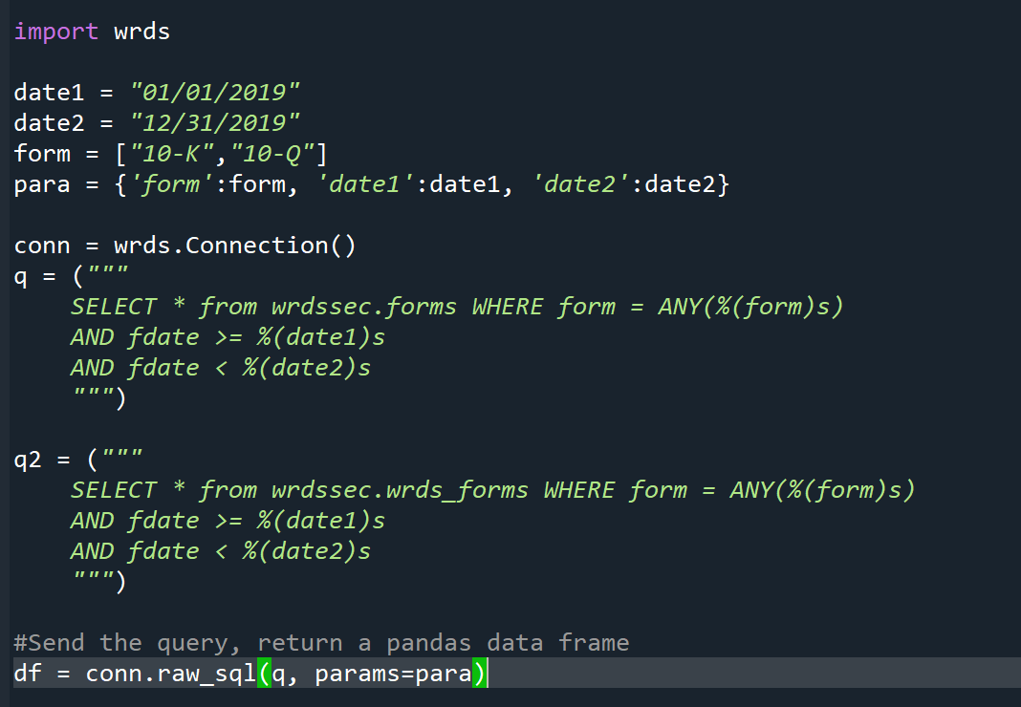
Getting data off WRDS

Slide 8
Other useful datasets
Audit Analytics
  Auditor filings and reports
  Corporate and legal data
RavenPack
  News analytics
WRDS SEC Analytics
  SEC filings
  Text analytics

Slide 9
Pitchbook
Flat CSV files are available via a shared folder
PostgreSQL database also available
Updated weekly

Slide 10
Nielsen
Faculty can request access, PhD students must have a faculty advisor with an account
https://marketingdata.chicagobooth.edu/Anonymous/Welcome
https://www.chicagobooth.edu/research/kilts/research-data/nielseniq/policies
Very stringent data access use policies

Slide 11

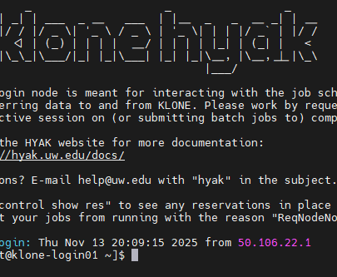
Hyak
UW’s high performance research computing cluster
Foster’s compute node has 2 CPUs with 20 cores each, 175GB RAM
We also have a high memory node with 768GB of RAM and 2 X 20 core CPUs
5TB of NVMe storage
Unlimited scratch space
ckpt & stf nodes

Slide 12
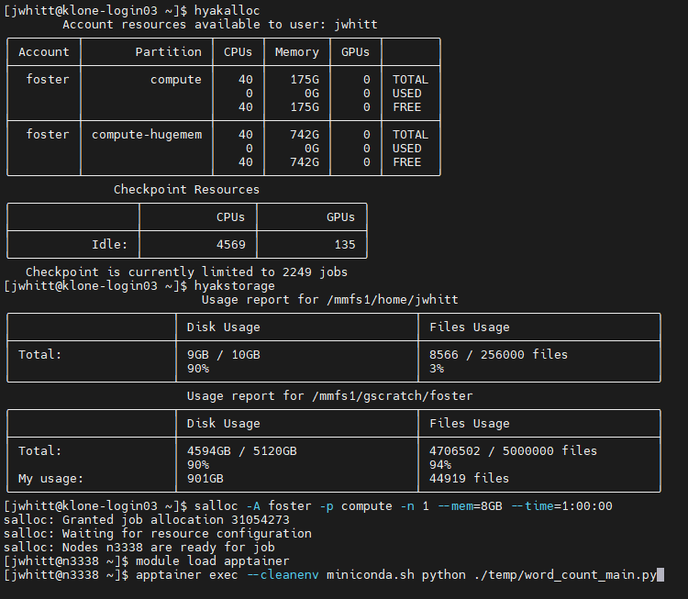
Running Jobs on Hyak
To run code on Hyak:
Login to klone.hyak.uw.edu
Check current usage
Start interactive session (or batch, if you prefer)
Load software modules
Run code
View output

Slide 13
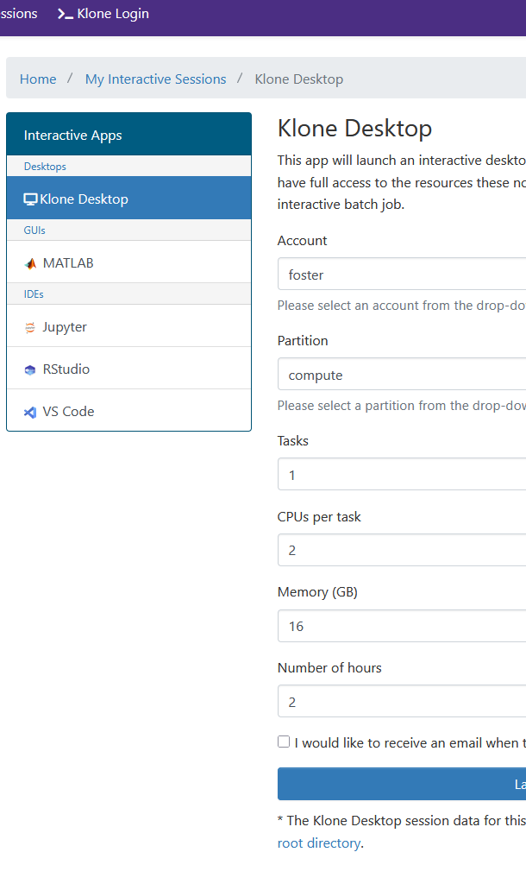
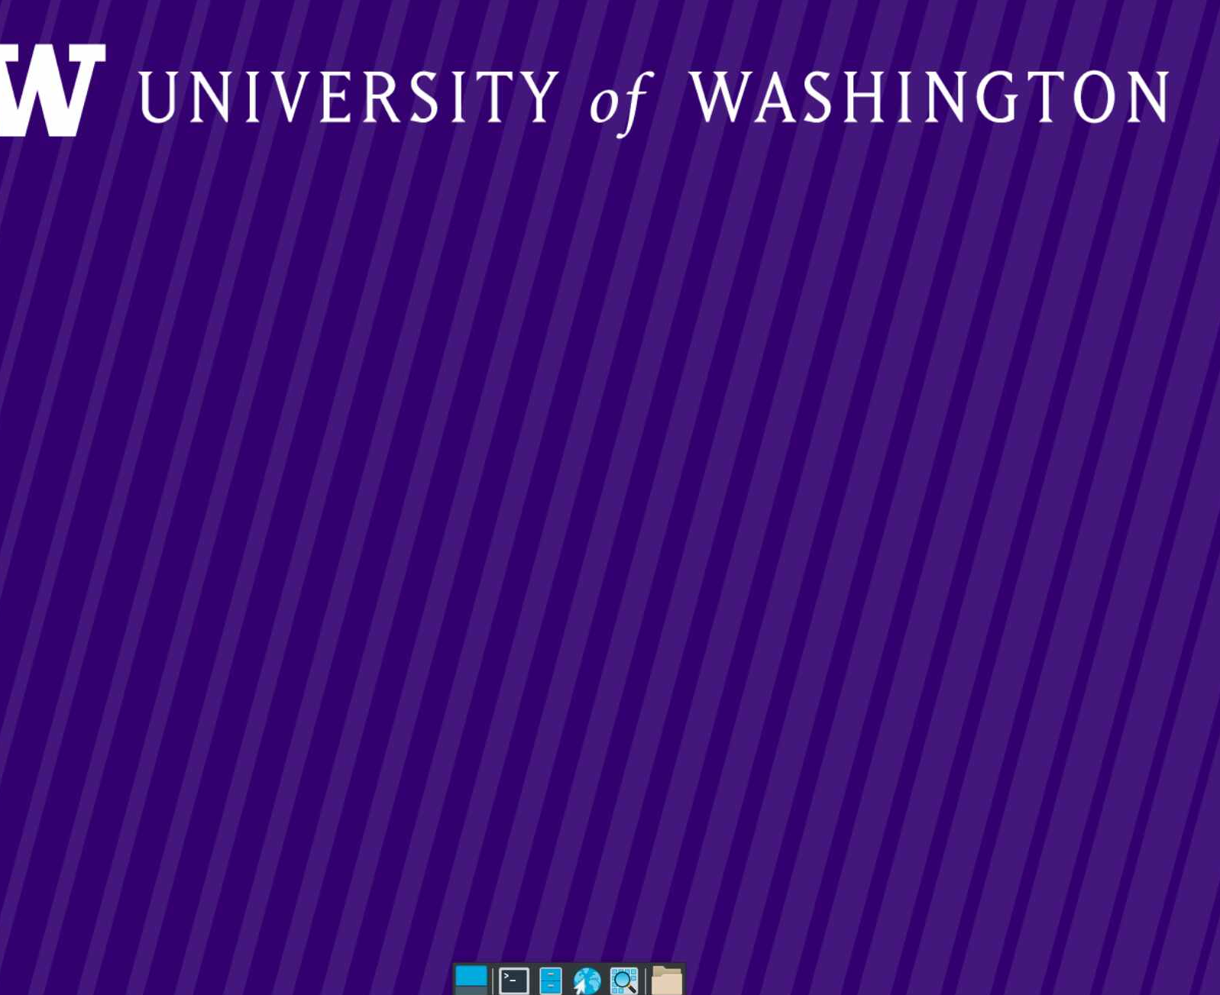
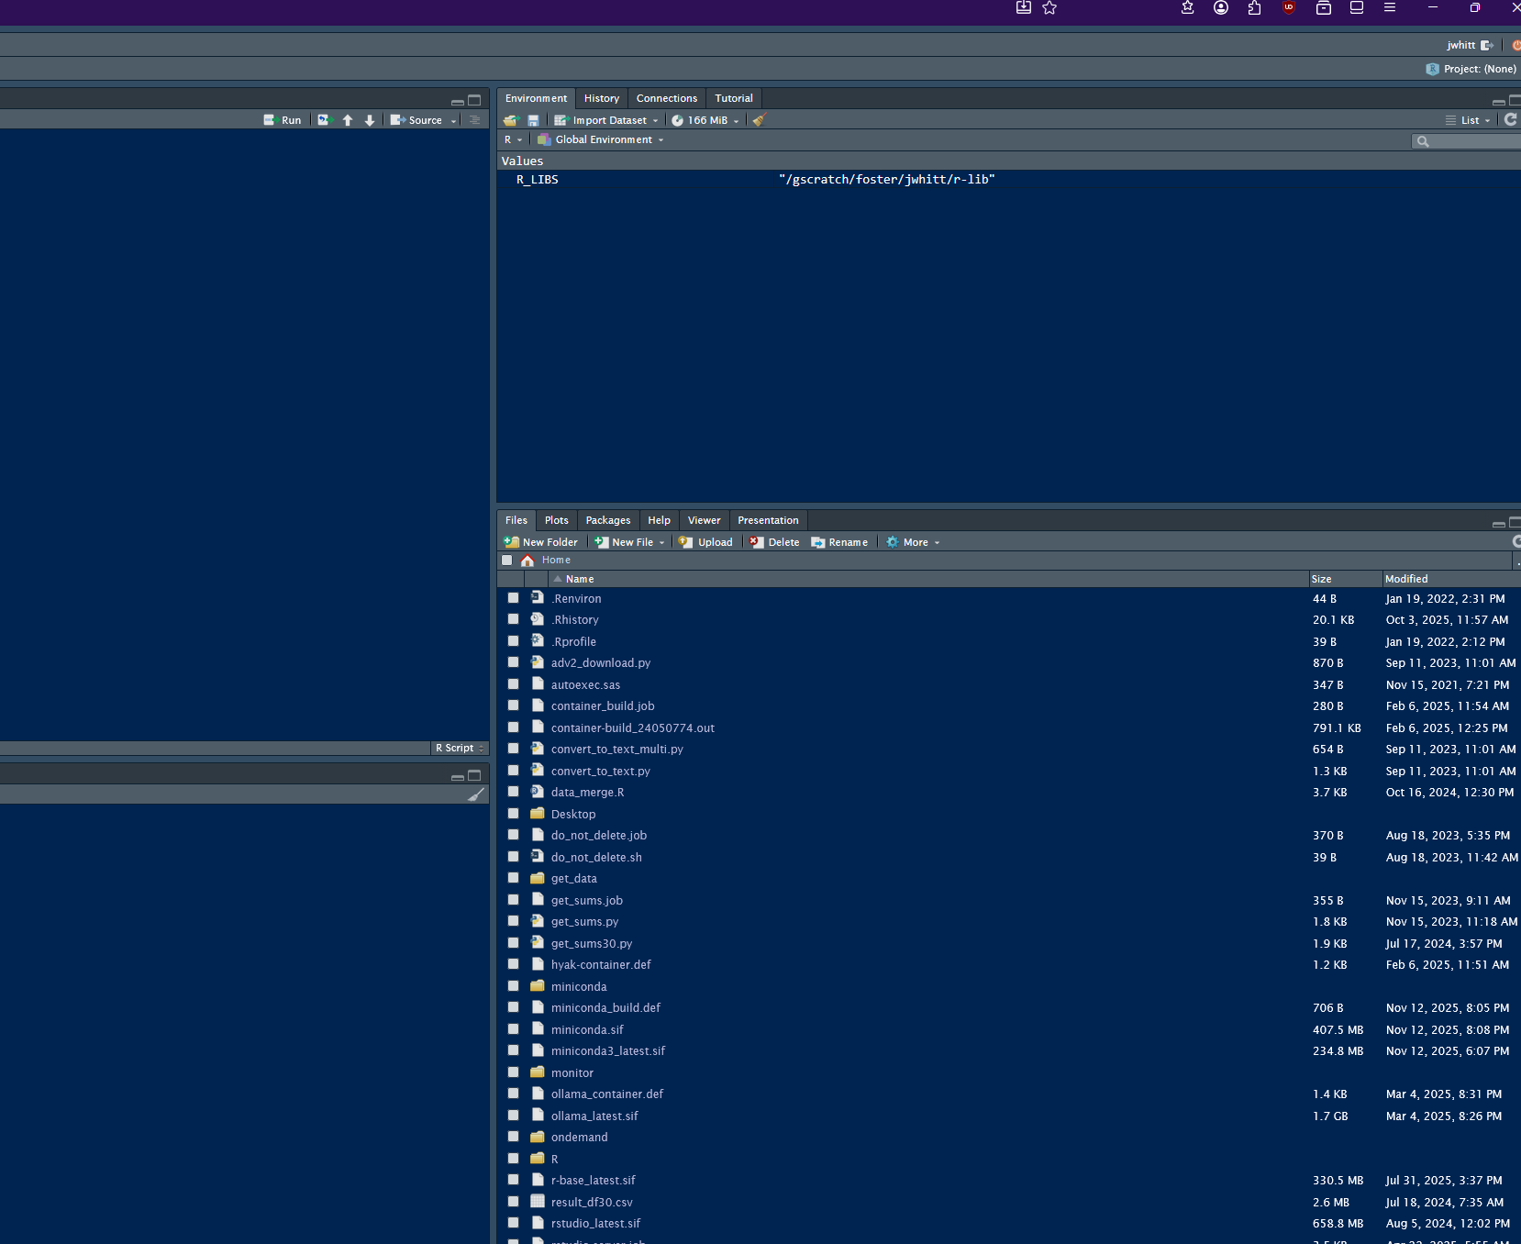
OnDemand
Allows access to Hyak from your web browser
  https://ondemand.hyak.uw.edu
Web GUI for allocating resources
Klone Desktop is a GUI for the Linux OS
Easy to run Rstudio and Jupyter Notebooks

Slide 14
Using resources on Hyak
CPU/RAM shared across all Foster users
Reserve only what is necessary for your job
You can reserve up to 40 cores on a single node
But you shouldn’t
How much should you reserve?
Sample Python job:
  Load in dataset (~2.5GB) containing text of SEC filings
  Load list of words
  Count occurrences of each word from list in each filing
  Assemble dataframe with results

Slide 15
Hyak Job Timings
Request 1, 2, 4 or 8 CPUs, the code completes in 6-8 minutes
  Python by default is 1 core, 1 thread
Reworking to divide the dataset into chunks, then mapping the count function onto each chunk in parallel via concurrent.futures:
  2 CPU : ~ 4 min
  4 CPU : ~ 3 min
  8 CPU : ~ 2 min
Some considerations:
  Is my task easily parallelizable?
  Does it involve reading in large datasets or fitting large models?

Slide 16
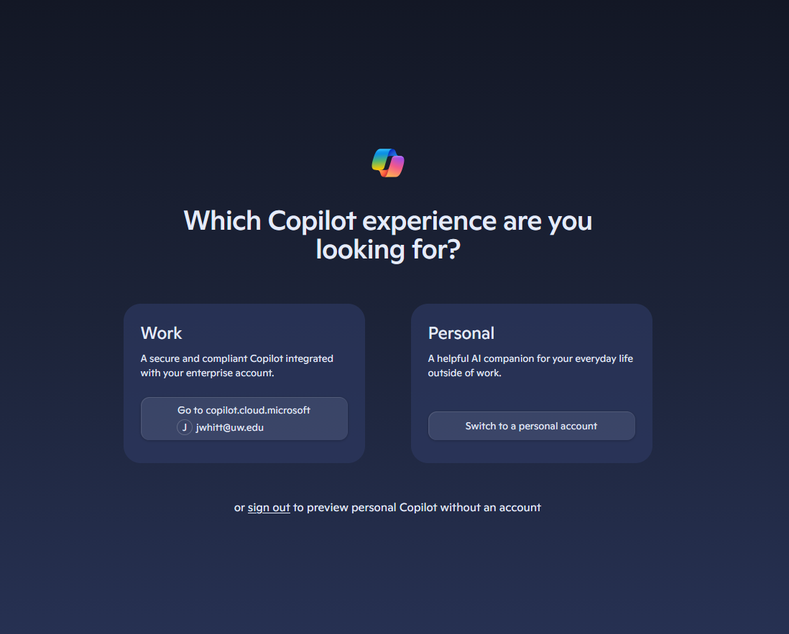
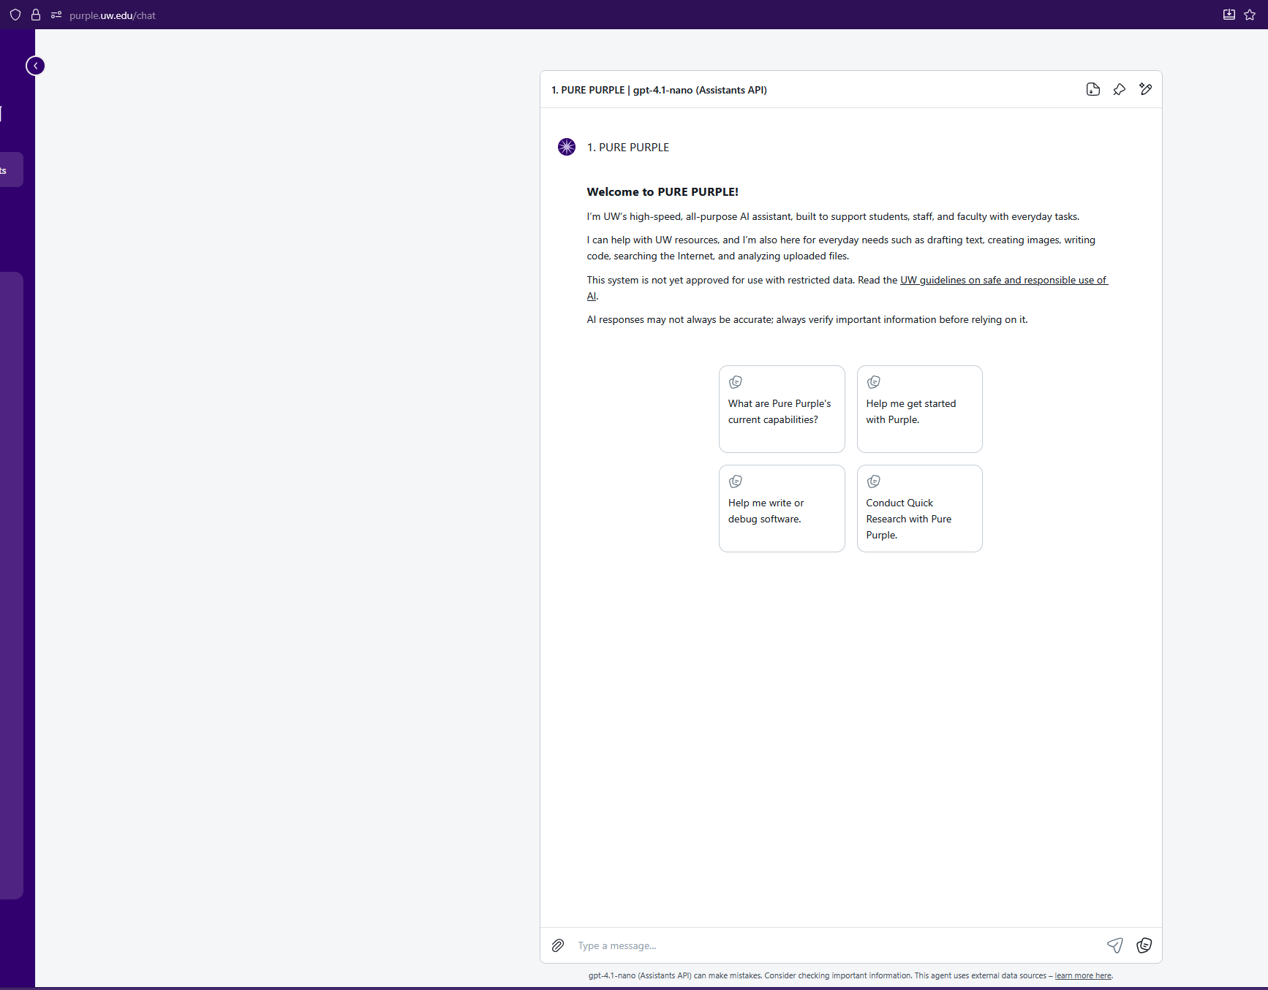
Generative AI
Microsoft CoPilot
  https://copilot.microsoft.com
UW Purple
  https://purple.uw.edu
No current in-house API options
  OpenAI
  Azure
  Anthropic
  Google Cloud
  Amazon Bedrock

Slide 17
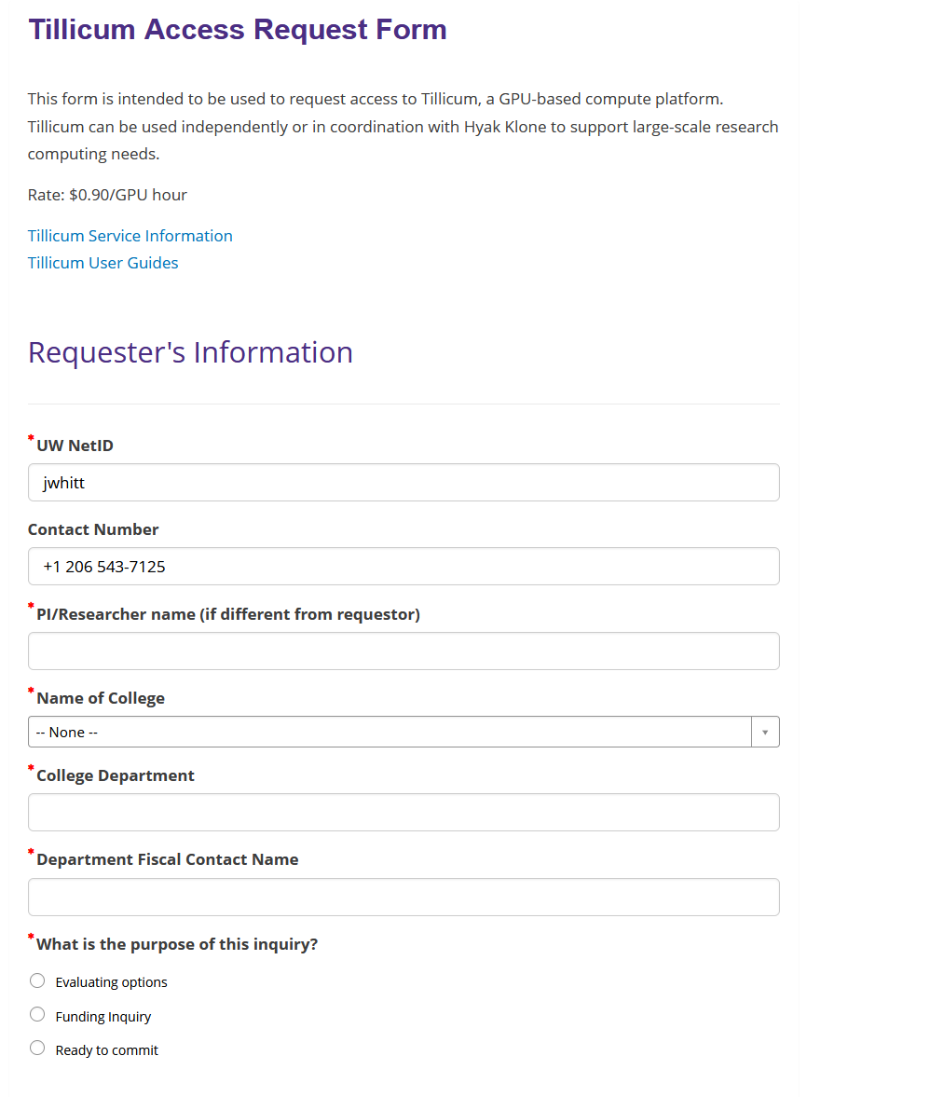
Tillicum
UW’s GPU computing cluster
192 NVIDIA H200 GPUs with 141GB of RAM
1536 Intel CPUs
Rocky 9 Linux (same as Hyak)
Pay-you-go, worktag required
Demo accounts available w/ 100 GPU hours

Slide 18
Qualtrics
https://washington.co1.qualtrics.com
Not to be confused with https://uwashington.qualtrics.com
Authenticates via netID
Unlimited responses
50 active surveys by default, more if you need it

Slide 19
Other resources
UW Software
  https://itconnect.uw.edu/tools-services-support/software-computers/uware/
Center for Studies in Demography and Ecology
  https://csde.washington.edu/computing/accounts/
Hyak
  https://hyak.uw.edu
Bloomberg Terminals
Pitchbook (Library)
  https://guides.lib.uw.edu/pitchbook
Factset
  https://guides.lib.uw.edu/factset
Factiva and TDM Studio
  https://guides.lib.uw.edu/factiva
  https://guides.lib.uw.edu/tdmstudio

Slide 20
Jonathan Whittinghill
206-543-7125
jwhitt@uw.edu

