Slide 1

Running LLMs on your own computer

Slide 2

Why run llms locally?
PROS | CONS
Free Wide selection of open-source models Can be used to test/workshop prompts and code prior to submission to paid services | Limited by local hardware resources Open-source models may lack capabilities of larger, paid models

Slide 3
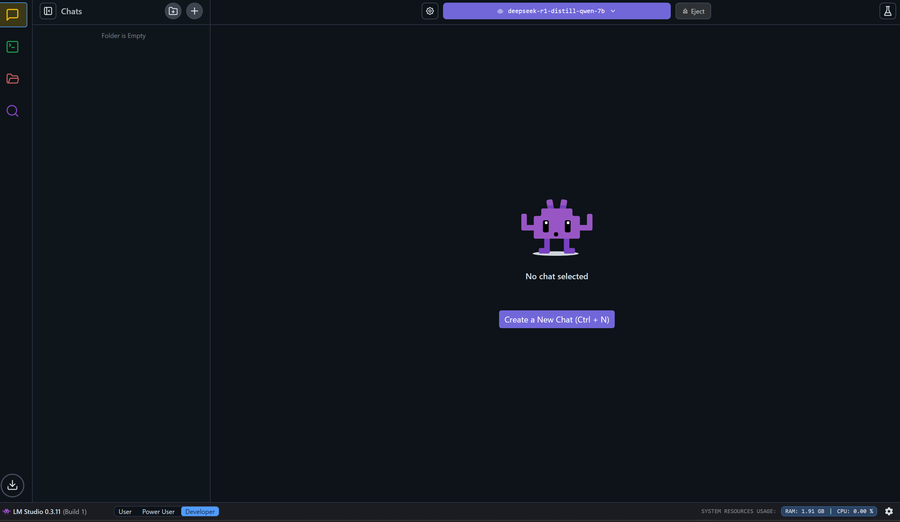
RUNNING AN LLM With LM Studio

Slide 4
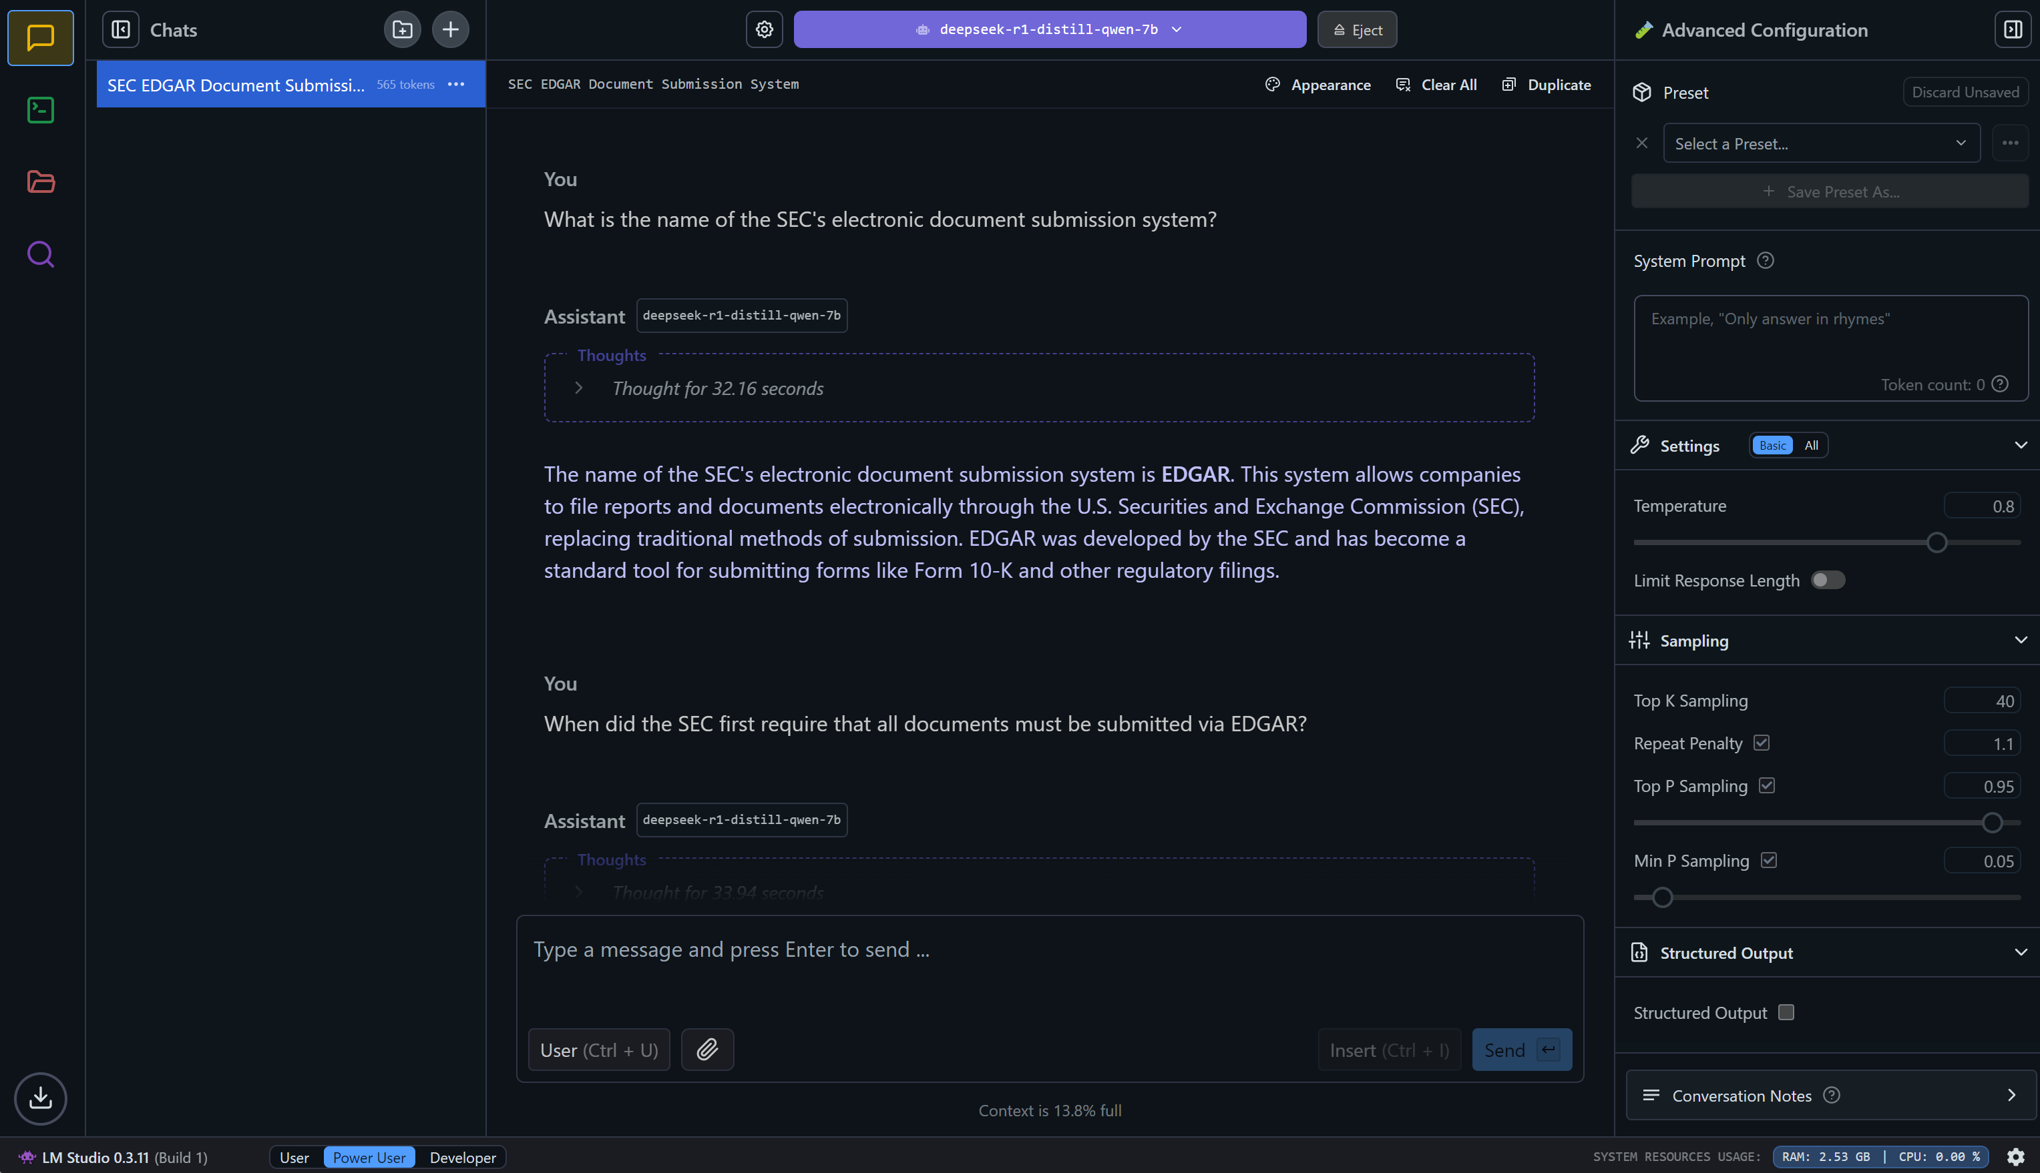
RUNNING AN LLM With LM Studio

Slide 5
System Performance using deepseek-r1-distill-qwen-7b
 | LAPTOP | DESKTOP | WORKSTATION
CPU | AMD Ryzen 6800HS (8 cores) | Intel i5-12600-KF (10 cores) | Intel i9-12900T (16 cores)
RAM | 16GB | 32GB | 32GB
GPU | NVIDIA 3050 4GB | AMD Radeon 6800 16GB | NVIDIA T1000 8GB
Response Time | 30-40 seconds | 3-5 seconds | 10-20 seconds

Slide 6
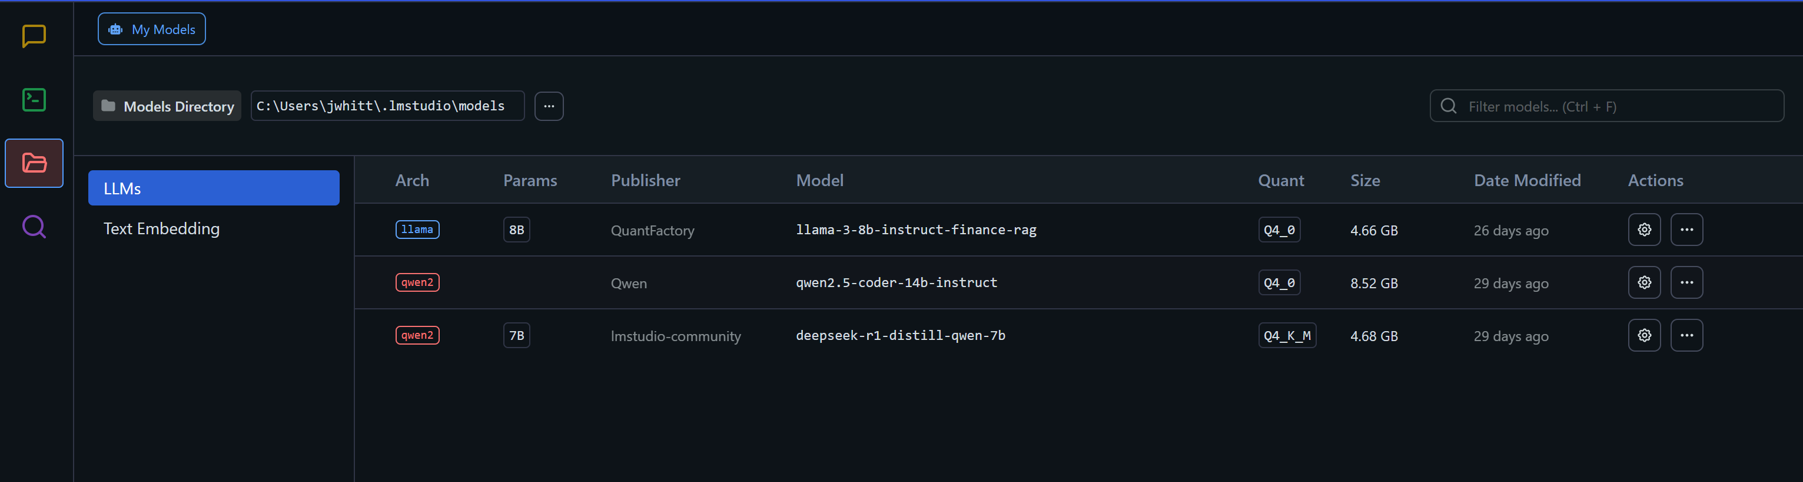
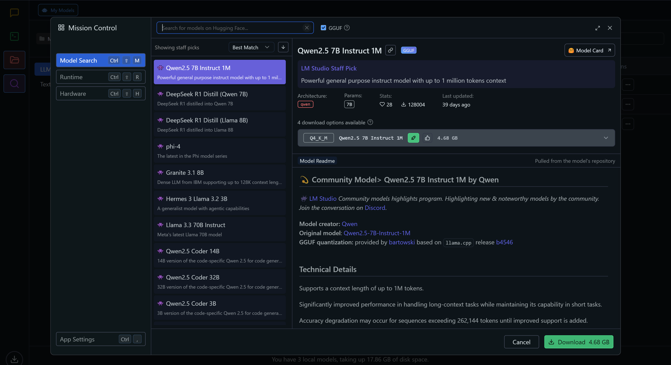
Selecting models

Slide 7
Selecting models
Model size
  Number of parameters
  Distillation and quantization
Dataset content
  Source, size, recency
Purpose
  Chat
  Instruct
  Reasoning
  Code

Slide 8
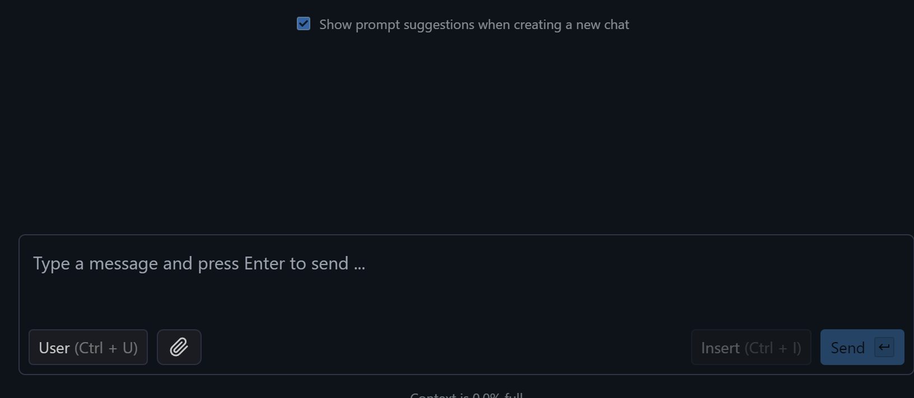
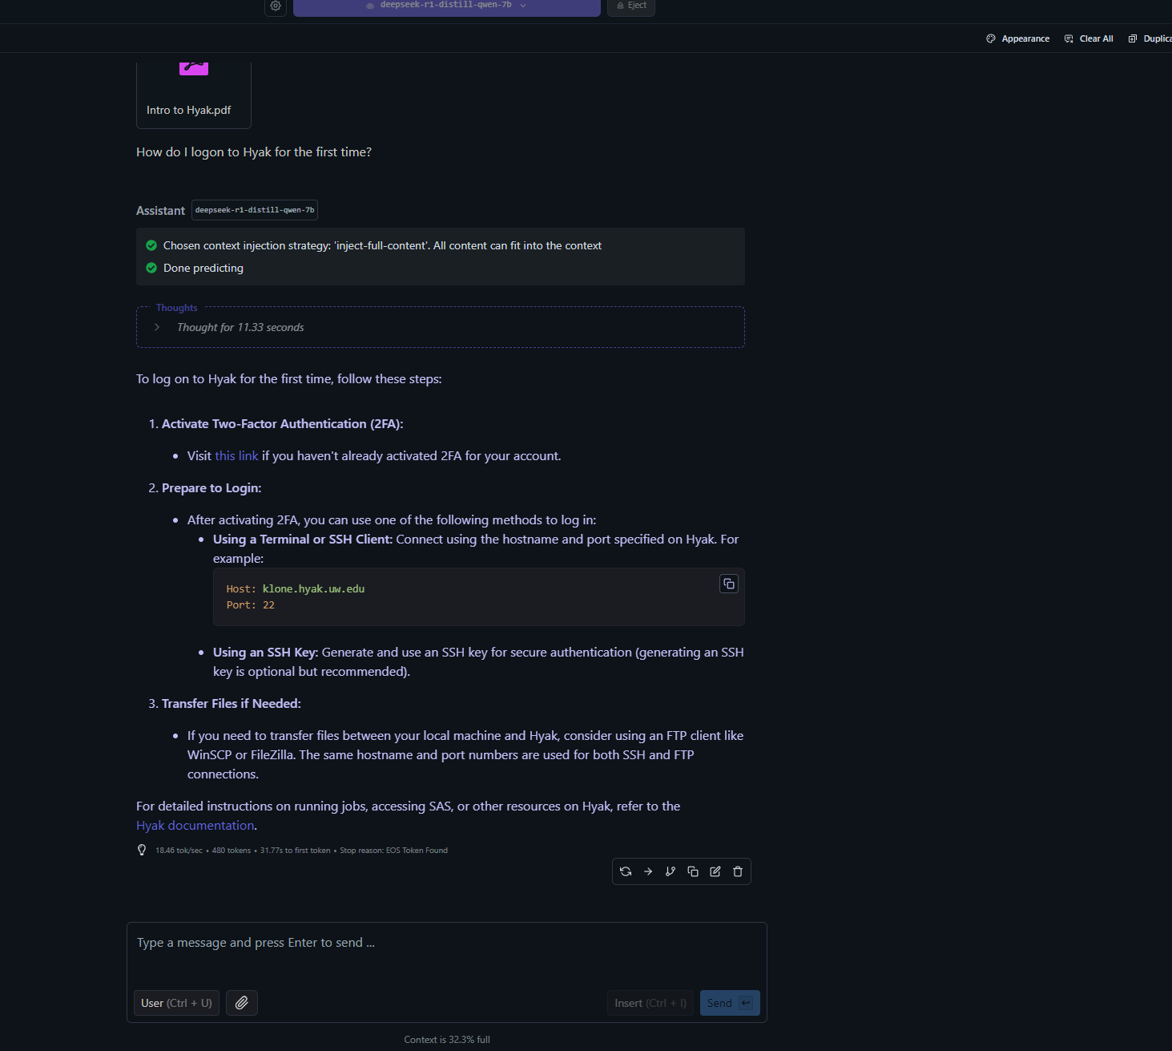
Querying Documents

Slide 9
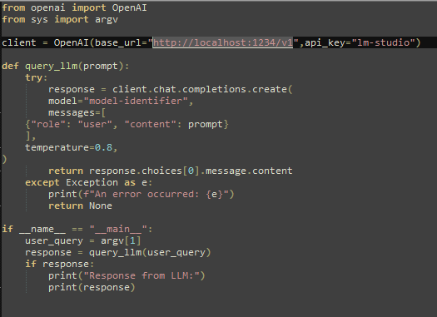
Querying via APi
Full support for OpenAI’s API and associated Python library
Run LM Studio in server mode (http://localhost:1234/v1)

Slide 10
Ollama and Hyak
GPUs on ckpt, in the future Foster’s own GPU slices
Hyak’s GPU cluster (Fall 2025)
Custom containers for running LLMs on CPUs/GPUs
Hyak beat me to it:
  https://hyak.uw.edu/docs/tools/ollama_setup

Slide 11

Thanks!
Jonathan Whittinghill
jwhitt@uw.edu
206-543-7125

