Slide 1


Minun: Evaluating Counterfactual Explanations for Entity Matching
Jin Wang, Yuliang Li
Megagon Labs
06/12/2022

Slide 2
Background: Entity Matching (EM)
Input: Two collections of data entries
Output: all entry pairs that refer to the same entity (products, businesses, ...)
Table A:
Table B:
title | model no. | price
instant immersion spanish deluxe 2.0 | topics entertainment | 49.99
adventure workshop 4th-6th grade 7th edition | encore software | 19.99
sharp printing calculator | sharp el1192bl | 37.63
title | price
instant immers spanish dlux 2 | 36.11
encore inc adventure workshop 4th-6th grade 8th edition | 17.1
new-sharp shr-el1192bl two-color printing calculator 12-digit lcd black red | 56.0
✔
✘
✔

Slide 3
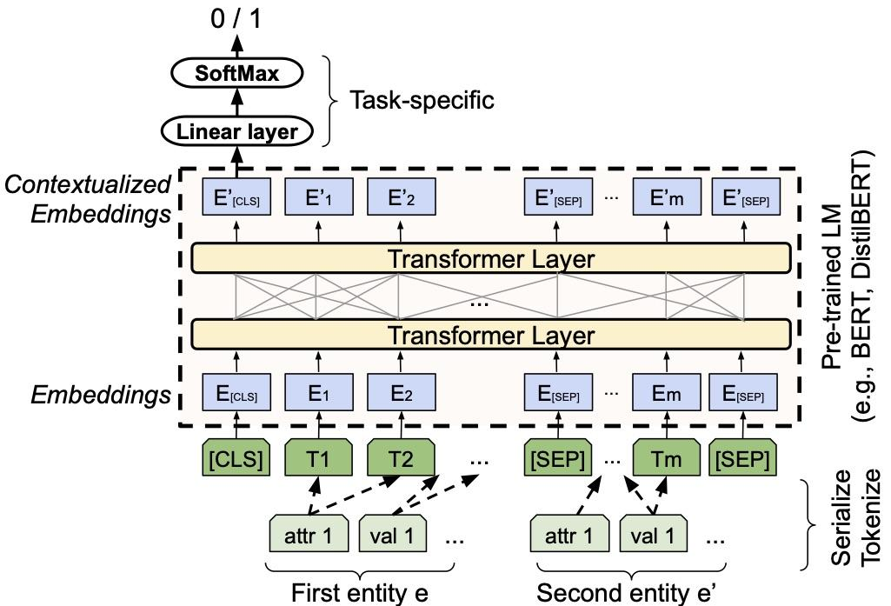
Ditto: EM via Fine-tuning Pre-trained LM
We use RoBERTa for higher quality and DistilBERT for fast training / prediction
Ditto achieves the SOTA performance with pre-trained LMs

Slide 4
Additional Challenge: Explainability
DL models (such as Transformers) are too complex to interpret
In our application of job-resume matching:
Resume
Matching
Model
Match / Non-match
Job Description
Local Explanations
Education, Skills, Benefits, etc. What contributes most to the matching decision?

Slide 5
Existing Techniques
Model-specific
Intrinsic: use models that are interpretable by itself
E.g., the attention mechanism provides some interpretability
Post-hoc: analyze complex black-box models after it is trained
LIME: train an interpretable model from local perturbed samples
SHAP: compute the contribution of each feature using a Game-theoretic method
Model-agnostic
Not working well for textual data (running time + quality)

Slide 6
Counterfactual Explanations
Idea: for a given example x, generate a variant x’ such that M(x) ≠ M(x’)
Provide insights: “If X had not occurred, Y would not have occurred”
Criteria: The CF x’ should be a natural variant close to x
Baseline 1:
Removing spans or named entities
Baseline 2:
Removing (or equalizing) same attributes from both entities
Challenge: These baselines have relatively low coverage. Complex explanations are not covered

Slide 7
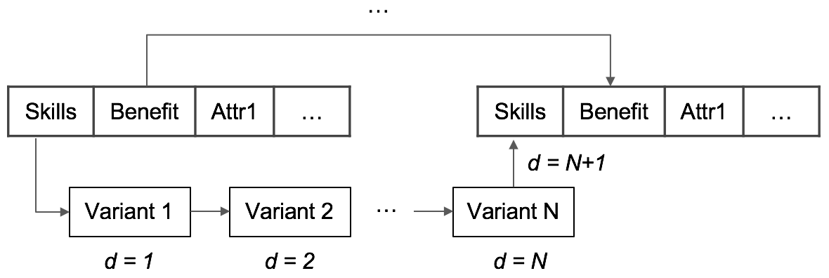
Counterfactual Explanations (cont.)
Can be extended to other distance metrics
(We proposed): search space based on edit distance
Our search algorithm:
Greedy
Binary search
Idea: Find combination of intermediate states that result in a flipped label

Slide 8
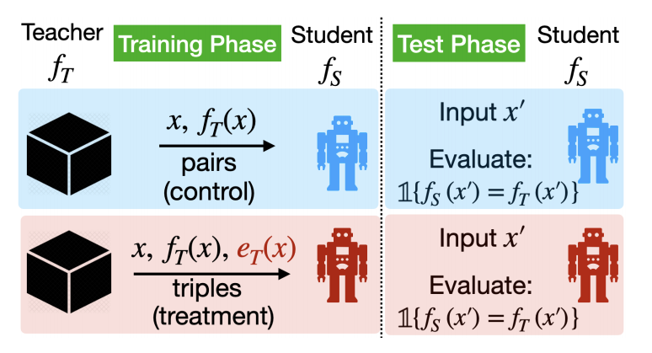
Evaluation framework
How do we compare different types of explanations (e.g., LIME vs. CF)?
A major question not yet fully answered by the XAI community
From [ACL 20] and [TACL ‘21]:
w/o explanations
w. explanations
Idea: Evaluate how much insight a student can learn from the explanations

Slide 9
Evaluation framework (cont.)
Annotate
Dataset
D
Train
Teacher Model
T
Student Model S
F1 score
The Model to be explained
Mimicking a human user
Explain & Augment
Dataset
D’
Train
Student Model S’
F1 score
Explainer
Steps
1. Obtain train/test set for student
2. Make two copies of train set, augment one of them with explanations
3. Use two train set to train two student models
We can measure the “insight” by the delta: F1(S’, Test) - F1(S, Test)

Slide 10
Experiment Setup
Tasks: Explain Ditto (w/ RoBERTa encoder) trained for 5 EM tasks
Student models are DistilBERT
Datasets:
 | T-train | S-train | S-test
Amazon-Google (AG) | 11,460 | 1,146 | 1,147
DBLP-ACM (DA) | 12,363 | 1,236 | 1,237
DBLP-Scholar (DS) | 28,707 | 2,871 | 2,871
Walmart-Amazon (WA) | 10,242 | 1,024 | 1,025
Abt-Buy (AB) | 9,575 | 958 | 958
Original test sets relabeled by the teacher model

Slide 11
Explanation Quality
The higher performance gain is due to the higher percentage of CF examples
Baselines: LIME, Shap (for identifying important tokens/attributes), and a naive span/attribute CF method
 | AVG F1 (w/o exp) | AVG F1 (w. exp) | AVG ΔF1 | %CF examples
Shap | 76.05% | 76.36% | 0.71% | 13.07%
LIME (token+attr) | 76.05% | 76.36% | 0.32% | 14.18%
CF Baseline | 72.65% | 77.62% | 4.97% | 68.52%
Ours (Greedy) | 77.60% | 84.26% | 6.65% | 94.95%
Ours (B. Search) | 77.60% | 86.50% | 8.90% | 94.02%
Our new CF methods delivered the best overall quality (F1 improvement)

Slide 12
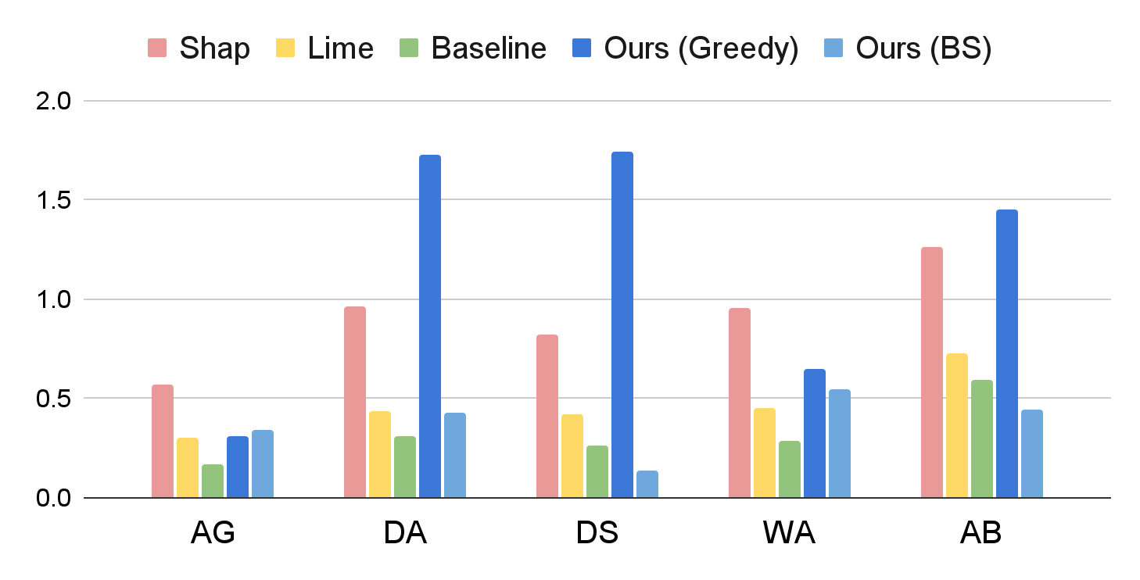
Running time per instance
Time (s)
Our method (w. BS) runs 19% faster than Lime, 58% faster than Shap, comparably to the Baseline

Slide 13
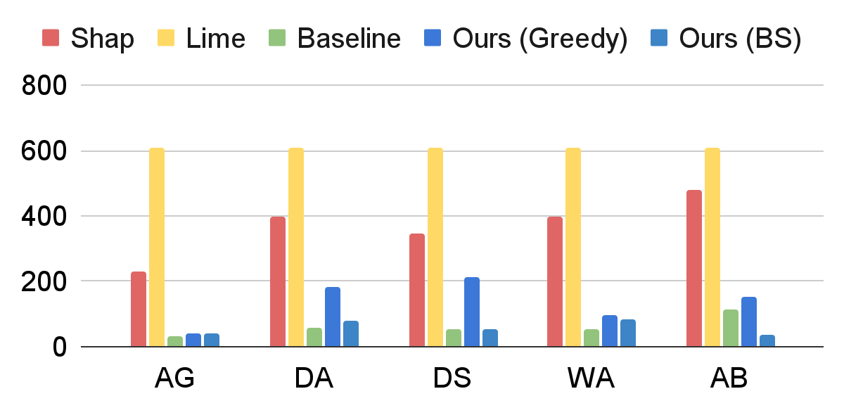
#model calls per instance
# model calls
The accelerated running time is mainly due to savings in calls to the models

Slide 14
Conclusion
An novel method to explain EM applications based on counterfactual explanations
An evaluation framework for comparing different types of explanations
Experimental results show that our method delivers higher quality explanations and high efficiency

Slide 15
Thank You! Q&A
Code available at: https://github.com/megagonlabs/minun

Slide 16
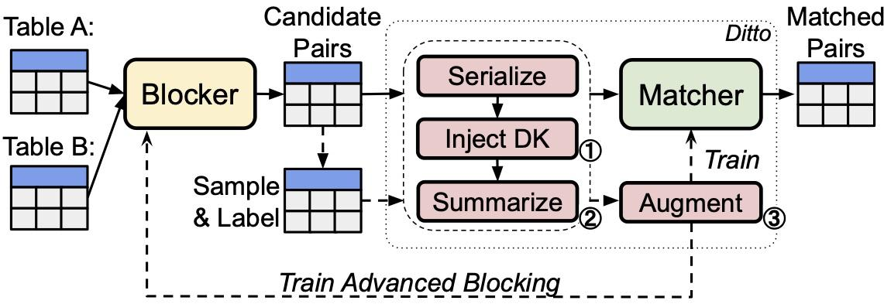
Ditto in complete EM workflow
LM such as BERT, DistilBERT, or RoBERTa
Formulate EM as sequence-pair classification
Ditto achieves the SOTA performance with pre-trained LMs

Slide 17
Explanation Quality (Details)
 | Baseline |  | SHAP |  | LIME (Token+Attr) |  | Ours (Greedy) |  | Ours (B. Search)
 | F1 | ΔF1 | F1 | ΔF1 | F1 | ΔF1 | F1 | ΔF1 | F1 | ΔF1
AG | 74.17% | 2.74% | 71.79% | 1.30% | 71.79% | 3.97% | 69.81% | 6.56% | 70.81% | 7.57%
DA | 97.12% | -1.11% | 97.75% | 1.50% | 97.75% | 1.50% | 97.00% | -1.18% | 97.33% | -0.85%
DS | 94.27% | 0.31% | 93.86% | 0.31% | 93.86% | 0.71% | 95.86% | 1.64% | 96.62% | 2.41%
WA | 58.68% | 3.13% | 54.65% | -2.78% | 54.65% | -3.51% | 78.97% | 18.86% | 84.11% | 24.00%
AB | 56.16% | 3.84% | 63.75% | 1.25% | 63.75% | 0.89% | 79.64% | 7.39% | 83.64% | 11.39%

