Slide 1

Two Birds on One Stone: An Efficient Hierarchical Framework for Top-k and Threshold-based String Similarity Search
Jin Wang, Guoliang Li, Dong Deng,
Yong Zhang, Jianhua Feng
Notes:
Good morning everyone. I am very appreciated to talk to you today. My name is Jin Wang. I am a third year master student from Tsinghua University, Beijing. China. Today I am going to present an efficient hierarchical framework to solve the string similarity search problems.

Slide 2
Outline
Motivation
Problem Formulation
Hierarchical Framework
Support Threshold-based Similarity Search
Support Top-k Similarity Search
Experiment
Conclusion
Notes:
So this is the outline of my presentation. I will first give the motivation.

Slide 3
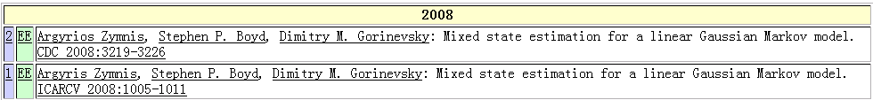
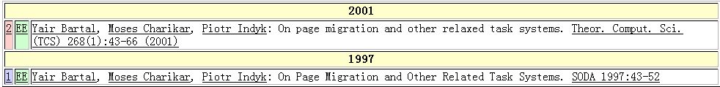
Real-world Data is Rather Dirty！☹
DBLP Complete Search
Typo in “author”
Typo in “title”
Argyrios Zymnis
Argyris Zymnis
relaxed
related
Notes:
As we all know. Data in real world is really dirty. An example is shown here in dblp data. In the upper side we have typos in author name, and on the lower side we have typos in title field.

Slide 4


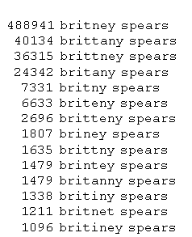
Web Search
Errors in queries
Errors in data
Bring query and meaningful results closer together
Actual queries gathered by Google
Notes:
When we search the google engine, we may not type in the exactly query, that is we may contains error in queries. Also There may be errors in the dataset. So, the similarity search bring query and meaningful results closer together.

Slide 5


Example: a movie database
Iron man
The man
Find movies starred Samuel Jackson
Star | Title | Year | Genre
Keanu Reeves | The Matrix | 1999 | Sci-Fi
Samuel Jackson | Iron man | 2008 | Sci-Fi
Schwarzenegger | The Terminator | 1984 | Sci-Fi
Samuel Jackson | The man | 2006 | Crime
Notes:
Here is an example. We have a traditional movie dataset here. If we want to find movie starred by Samuel Jackson. It is very easy to achieve and we get the two blue records as results.

Slide 6


Query: Schwarzenegger?
The user doesn’t know the exact spelling!
Star | Title | Year | Genre
Keanu Reeves | The Matrix | 1999 | Sci-Fi
Samuel Jackson | Iron man | 2008 | Sci-Fi
Schwarzenegger | The Terminator | 1984 | Sci-Fi
Samuel Jackson | The man | 2006 | Crime
Notes:
But what if we want to query schwarzenegger? Which some user doesn’t know the exact spelling ?

Slide 7
Relaxing Conditions
Find movies with a star “similar to” Schwarrzenger.
Star | Title | Year | Genre
Keanu Reeves | The Matrix | 1999 | Sci-Fi
Samuel Jackson | Iron man | 2008 | Sci-Fi
Schwarzenegger | The Terminator | 1984 | Sci-Fi
Samuel Jackson | The man | 2006 | Crime
Notes:
Here we need to use a similarity search which find a star similar to the query string, then we can find the result we want even there are spelling errors in the input query

Slide 8
String Similarity Search
String Similarity Search finds all entries from the string collection that approximately match the query.
Applications:
Biology, Bioinformatics
Information Retrieve
Data Quality, Data Cleaning
….
Notes:
Therefore we propose the problem of string similarity search which finds all entries from a string collection that approximately match the query. This problem has plenty of applications such as bioinformatics, information retrieve and data cleaning and data quality.

Slide 9
Outline
Motivation
Problem Formulation
Hierarchical Framework
Support Threshold-based Similarity Search
Support Top-k Similarity Search
Experiment
Conclusion
Notes:
Then we turn to the problem formulation

Slide 10
Edit Distance
ED(r, s): The minimum number of single-character edit operations(insertion/deletion/substitution) to transform r to s.
ED(brother, breathes) = 3
Notes:
To quantify the similarity, here we use a famous similarity function --edit distance, The edit distance is the minimum number of edit operation needed to transform one string to another. For example, the edit distance between “brother“ and “breathes” is 3, as we can transform “brother” to “breathes” by substituting ‘o’ with ‘e’, inserting ‘a’ and substituting ‘r’ with ‘s’.

Slide 11
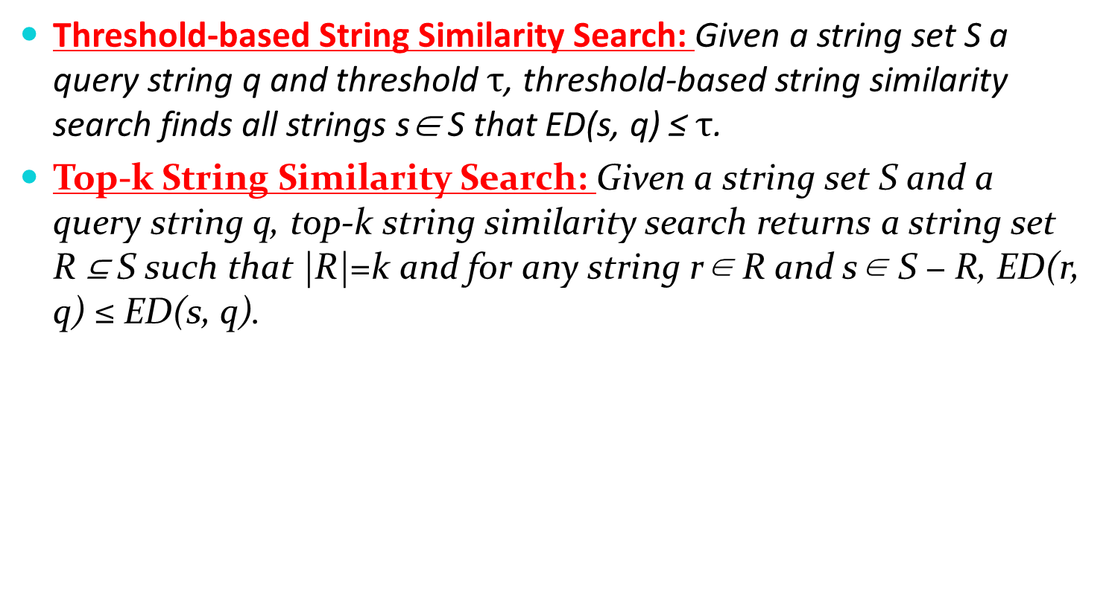
Problem Formulation
Threshold-based String Similarity Search: Given a string set S a query string q and threshold $τ$, threshold-based string similarity search finds all strings s∈ S that ED(s, q) ≤ $τ$.
Top-k String Similarity Search: Given a string set S and a query string q, top-k string similarity search returns a string set R ⊆ S such that |R|=k and for any string r∈ R and s∈ S − R, ED(r, q) ≤ ED(s, q).
ID | string | Length
s1 | brother | 7
s2 | brothel | 7
s3 | broathe | 7
s4 | breathes | 8
s5 | swingable | 9
s6 | deduction | 9
q = “brothor”
τ=1
k=2
Notes:
So here we give the definition of the two string similarity search problems. The threshold-based string similarity search operation finds all strings in the dataset, whose edit distance to the query is no larger than the given threshold tau. And topk string similar search problem outputs k most similar strings to the query. Unlike threshold-based, it can’t identify a threshold in advance. Here is the example suppose tau = 1 and k = 2. The threshold-based search return the result s1 as the ed between q and other strings are larger than 1. top-k search return s1 and s2 as the ed between q and other strings are larger than those of s1 and s2

Slide 12
Outline
Motivation
Problem Formulation
Hierarchical Framework
Support Threshold-based Similarity Search
Support Top-k Similarity Search
Experiment
Conclusion
Notes:
To solve these two problems, we proposed a hierarchical index structure – hstree. First we will look at the related work pass-join

Slide 13
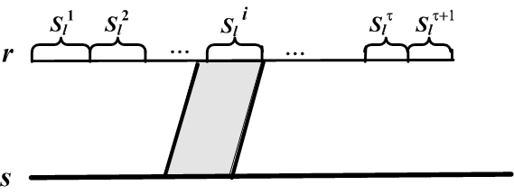
Previous work: Pass-Join
Segment filter
Need a threshold before index construction
Can’t support top-k search
Split r to τ +1 disjoint segments
Notes:
The pass-join method in VLDB 2012 implement a segment filter to solve the problem of similarity join. For a given threshold tau, it split strings in the dataset into tau+1 segments. A string is a candidate only if it has a matched segment with the query string. But for similarity search problems, it has two limitations: first, second. To solve this problem, we proposed the hierarchical segment index. We will talk about how to construct such an index.

Slide 14
Hierarchical Framework
Group strings by length
ID | string | Length
s1 | brother | 7
s2 | brothel
s3 | broathe
s4 | breathes | 8
s5 | swingable | 9
s6 | deduction
Notes:
First, we need to group the strings in the data set by length, and build a hstree index for each group

Slide 15
Hierarchical Framework
Iteratively partition strings into segments
b
bro
ro
brother
ther
th
er
Notes:
Then for each group, we will iteratively partition strings in this group into 2 disjoint segments until we reach a level that has segments of length 1. in other words, the group with length l has log l levels. Here is an example, for group 7 in level 1 we partition string brother into two segments “bro” and “ther”, then iteratively, in level 2 we partition “bro” into “b” and “ro” , “ther” into “th” and “er”. As level 2 has a segment “b” with length 1, we stop here.

Slide 16
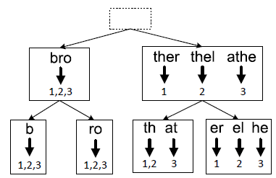
Hierarchical Framework
Build the inverted indexes
Partition into segments,
add into index
brothel
broathe
group 7
Notes:
Similarly, we partition strings and add them into index. Then we get the hstree index for group 7. in level i there are 2 to the power of i nodes. For
each tree node, we build an inverted index, where entries are segments with the corresponding segment id. each segment is associated with an inverted list which is a list of strings that contain the segment

Slide 17
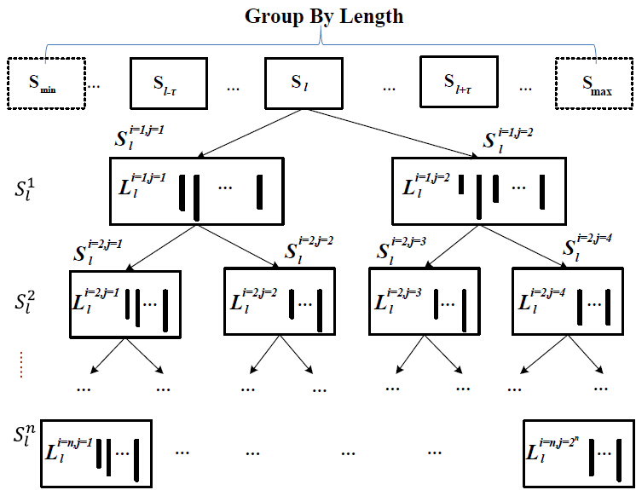
Hierarchical Framework
Repeat previous procures for each group
Notes:
We repeat the above procedure for each group and finally build the index for the whole data set

Slide 18
Outline
Motivation
Problem Formulation
Hierarchical Framework
Support Threshold-based Similarity Search
Support Top-k Similarity Search
Experiment
Conclusion
Notes:
Next we will talk about the hsearch algorithm to support threshold-based similarity search using the hierarchical index.

Slide 19

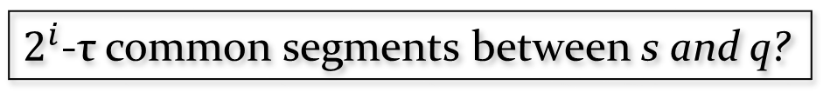

Threshold-based Similarity Search
Extend Segment Filter
Threshold τ
Query q
Data s
Locate level $i=$
Level i has $2^{i}$ segments
$2^{i}$-τ common segments between s and q?
Yes
No
s is a candidate
s is pruned
Notes:
In order to use the hstree index to perform search, we extend the segment filter: Based on the pigeon hole theory, if string q is similar to string s, in level i string q must have 2 to the power of I minus tau substring matching segments of s.

Slide 20

Threshold-based Similarity Search
Filter and Verification method
level = 2
τ = 2
$$2^{2}−2=2$$
candidates:
s1,s2
List merge
verify
q=brether
s1
Notes:
And then we can devise a filter-and-verification method. The steps are as follows: first we select substrings in the query to match the segments in the index, then we identify the level i and find corresponding inverted lists. After that we perform list merge of such lists, count the number of matched segments and get the candidates according to the extended segment filter. Finally we verify each candidate and get the real results. Here is a running example of such steps:

Slide 21

Improving Filter Step
Reduce the number of substrings
Length of substrings
Position the start point of substrings
Look from both left and right side [Li et al. VLDB 2012]
Notes:
In order to improve the performance of the algorithm, we need to improve both filter and verify step. For the filter step, one improvement we can make is to reduce the number of substrings. To reach this goal, we can consider length, position and use the technique in vldb 2012 paper to look, finally we only need to check the substrs with the start position in this range, while i is the level, j is the id of segment, pj is the start point of the jth segment, delta is the length difference between two strings

Slide 22

Improving Filter Step
Remove Invalid Matching—dynamic programming
ac
are_accommodate_to
com
were_acomofortable
match
mo
get maximum valid matching
Notes:
Another improvement is to remove invalid matching. Matched segments in the previous step may conflict with each other. Because segments are disjoint, but substrs are not. Simply count the matched segments may lead to false positive. For example,. To avoid redundant computation we propose a dp algorithm. use this recursion, we can finally get the maximum valid matching.

Slide 23
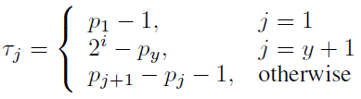
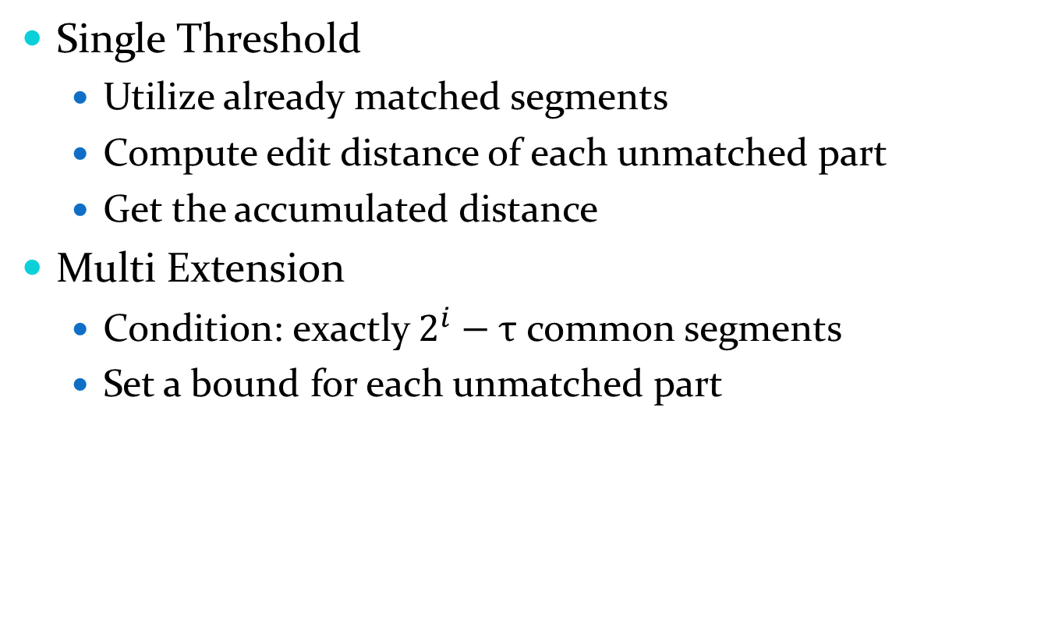
Improving Verification Step
Single Threshold
Utilize already matched segments
Compute edit distance of each unmatched part
Get the accumulated distance
Multi Extension
Condition: exactly $2^{i}−τ$ common segments
Set a bound for each unmatched part
Notes:
We also make some improvements in verification. we can utilize the set of matched segments to avoid unnecessary computations. We align q and s based on
these matched segments and partition them into 2 y + 1 parts including y matched segments and y + 1 unmatched segments. We denote the total edit
distance as TED, we only need to verify whether TED < tau in this alignment. When there are exactly 2 to the power of i minus tau ,we can further improve the performance by assigning ED between each unmatched part with a tighter threshold bound. The bound is shown in the following equation based on pigeon hole theory

Slide 24
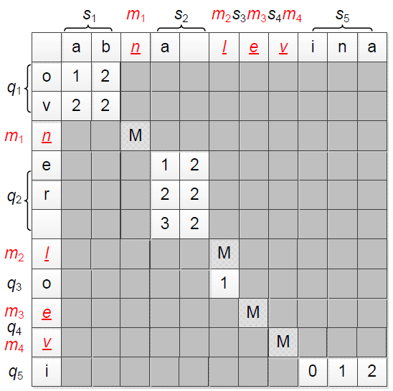
Improving Verification Step
τ = 6
Threshold for each part:
2,1,0,2
2 > 1, pruned!
no need to compute
Notes:
An example of the two verification algorithms is shown here. Suppose s and q already has match, tau = 6. for single threshold, we compute the real ed between each unmatched part and add them, finally we have TED = 7 larger than 6, so we pruned s . And for multi-ex, we can give each part a threshold use the given equation and after computing the ed of the second unmatched part, we can terminate, the ed of the remaining parts are no longer needed

Slide 25
Outline
Motivation
Problem Formulation
Hierarchical Framework
Support Threshold-based Similarity Search
Support Top-k Similarity Search
Experiment
Conclusion
Notes:
Then we will look at the topk problem

Slide 26
Top-k Similarity Search
Challenges
Redundant computation from enumerating thresholds
Consecutive errors in one segment
Notes:
A naïve way to perform topk is to incrementally enumerate the threshold and perform hsearch algorithm for each threshold until we get k results. However, this method is rather expensive because it executes multiple (unnecessary) search operations for each threshold and involves many duplicated computations. So we need some techniques to solve such problems.

Slide 27
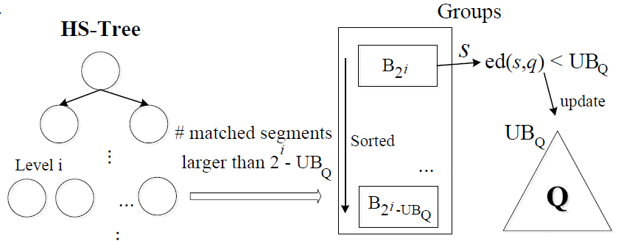
Top-k Similarity Search
Batched Pruning
Notes:
We proposed a batch-pruning method to perform topk search. We maintain a priority queue Q to keep the current k promising results. Let UBQ denote the largest edit distance between the strings in Q to the query. Obviously UBQ is an upper bound of the edit distances of top-k results to the query. Given a query q, we still access the HS-Tree in a top-down manner. We group the strings in the inverted lists based on the number of substrings they contain. there are 2 to the power i minus x mismatch segments for strings in Bx. If 2 to the power i minus x is larger than UBQ, we can prune all strings in buckets that is smaller than x. then we perform verification for candidates, if the ed is smaller than UBQ, we will put the result into Q and update the value of UBQ. For level i, if 2^i is no smaller than UBQ +1, we can terminate because we have found all top-k answers within threshold UBQ

Slide 28
Top-k Similarity Search
Verify ED = 3
s1
s2,s3
3 <= 4-1, pruned!
Add s1,
update UB = 3
breahers
top-1 heap
Notes:
Here is a running example for batched pruning method. Suppose query is here and k = 1; we first search the 1st level and find no matched segments. Then we come to the 2nd level and find two matched segments “b” and “er”, then we perform list merge and find s1 has 2 matched segs while s2 and s3 has 1. so we put s1 into 1st bucket, s2 and s3 into 2nd. First we perform verification on s1 and ed = 3, we add s1 into the top-1 heap and update UB = 3. As … we can safely terminate the algorithm and pruned s2 and s3.

Slide 29
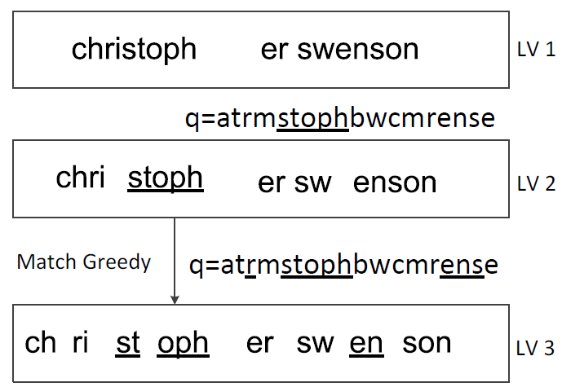
Top-k Similarity Search
Greedy Matching
Deal with consecutive errors within a segment
Estimate a tighter bound in next level
christopher swenson
atrmstophbwcmrense
UBQ = 3
Notes:
Moreover, if one mismatch segment involves more than one consecutive errors, the estimation of segment filter is not accurate. We propose a greedy-matching method to solve this problem. The core idea is that even if there are 2^i – UBQ matched segs in level i, we don’t perform verification at once. Instead, we continue to try to find 2^i+1 – UBQ segments in level i+1, if we fail to reach this goal, we can prune it. Otherwise if we reach the lowest level, we verify the ed. Here is an example of this method… we continue to try to find 8-3 =5 matched segments in level 3. as we only find 3 matched , we can filter the candidate and don’t need to verify.

Slide 30
Outline
Motivation
Problem Formulation
Hierarchical Framework
Support Threshold-based Similarity Search
Support Top-k Similarity Search
Experiment
Conclusion
Notes:
Next I will show the experimental results of our techniques.

Slide 31
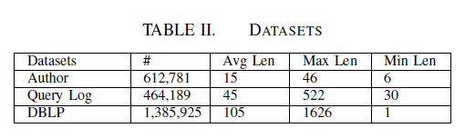
Experiment Setup
Three real Data sets
Environment
C++, GCC 4.8.2, -O3 flag
Ubuntu Server, 32GB memory
Notes:
We conducted an extensive set of experimental studies on three real datasets. The first one is the Author dataset which is a set of author names and extracted from the DBL. The second one is the query log dataset from aol query log. The third one is a set of dblp title. We randomly selected 100 queries from the datasets and compared the average elapsed time. The environment is

Slide 32
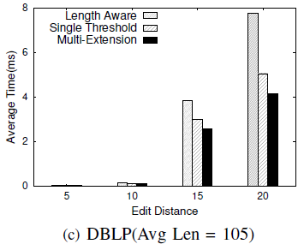
Threshold-based: Verification Algorithms
Notes:
SingleThreshold involves less verification time than Length-aware because it can avoid duplicated computations on already matched segments For each part,
MultiExtension has a different threshold and will terminate as soon as the edit distance of one part is larger than the given threshold of that part

Slide 33
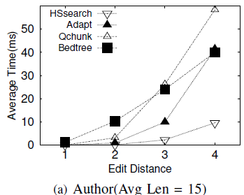
Threshold-based: Comparison with State-of-the-art Methods
Existing algorithms
Adapt(SIGMOD 2012)
QChunk(SIGMOD 2011)
B^{ed}-Tree (SIGMOD 2010)
Notes:
We obtain the code adapt,bed-tree: from author, quchunk: implement by ourselves.
Q-gram: weaker filter power because overlaps between grams, can’t take advantage of verification, need parameter tuning

Slide 34
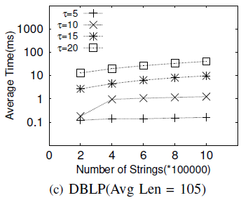
Threshold-based: Scalability
for τ=20, our method took
20 ms for 400,000 strings,
27 ms for 600,000 strings
33 ms for 800,000 strings.
Notes:
Near linear

Slide 35
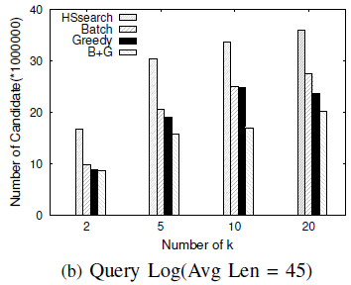
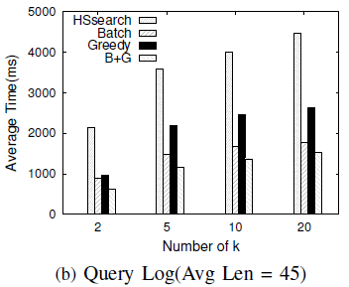
Top-k: Evaluate Filter Techniques
Number of candidates
Average Query Time
Notes:
Then evaluate topk. Number of candidates and avg query time. It is clear Batch can prune dissimilar strings in batch and thus reduce the number of candidates. As Greedy can find consecutive errors within a long segment, the number of candidates can also be reduced. We had significant filtering power by combining these two filters together.

Slide 36
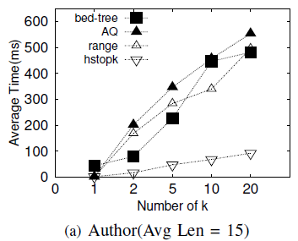
Top-k: Comparison with State-of-the-art Methods
Existing algorithms
AQ(AAAI 2010)
B^{ed}-Tree (SIGMOD 2010)
Trie-based(ICDE 2013)
Notes:
Bedtree: enumerate thresholds
Aq: multiple index, gram
Range: not efficient for long string,

Slide 37
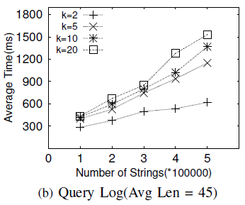
Top-k: Scalability
for k=20, our method took
436 ms for 100,000 strings,
672 ms for 200,000 strings
1279 ms for 300,000 strings.
Notes:
linear

Slide 38
Outline
Motivation
Problem Formulation
Hierarchical Framework
Support Threshold-based Similarity Search
Support Top-k Similarity Search
Experiment
Conclusion
Notes:
Finally we reach the conclusion

Slide 39
Conclusion
String Similarity Search
A hierarchical framework to support both threshold-based and top-k similarity search.
An efficient algorithm to support threshold-based string similarity search
Efficient algorithms and filters for top-k similarity search
Experimental results show that our methods significantly outperforms existing methods

Slide 40

Thanks!
Q&A
http://dbgroup.cs.tsinghua.edu.cn/

Slide 41
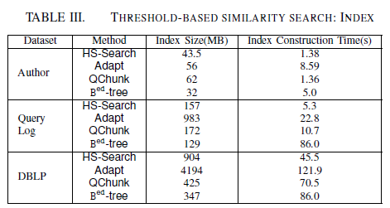
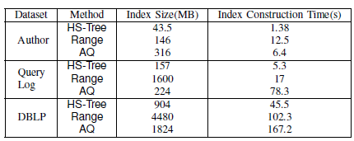
Index time and size

Slide 42



complexity
Space:
Time:
Filter:
Verify:

Slide 43
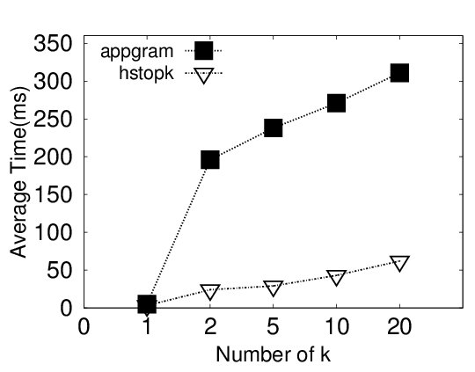
Compare with appgram
Author(Avg Len = 15)

